Slide 1
Fossil Fuels (part 1)
Lecture 19
Fundamentals of Earth Resources
L. M. Cathles
2017

Slide 2
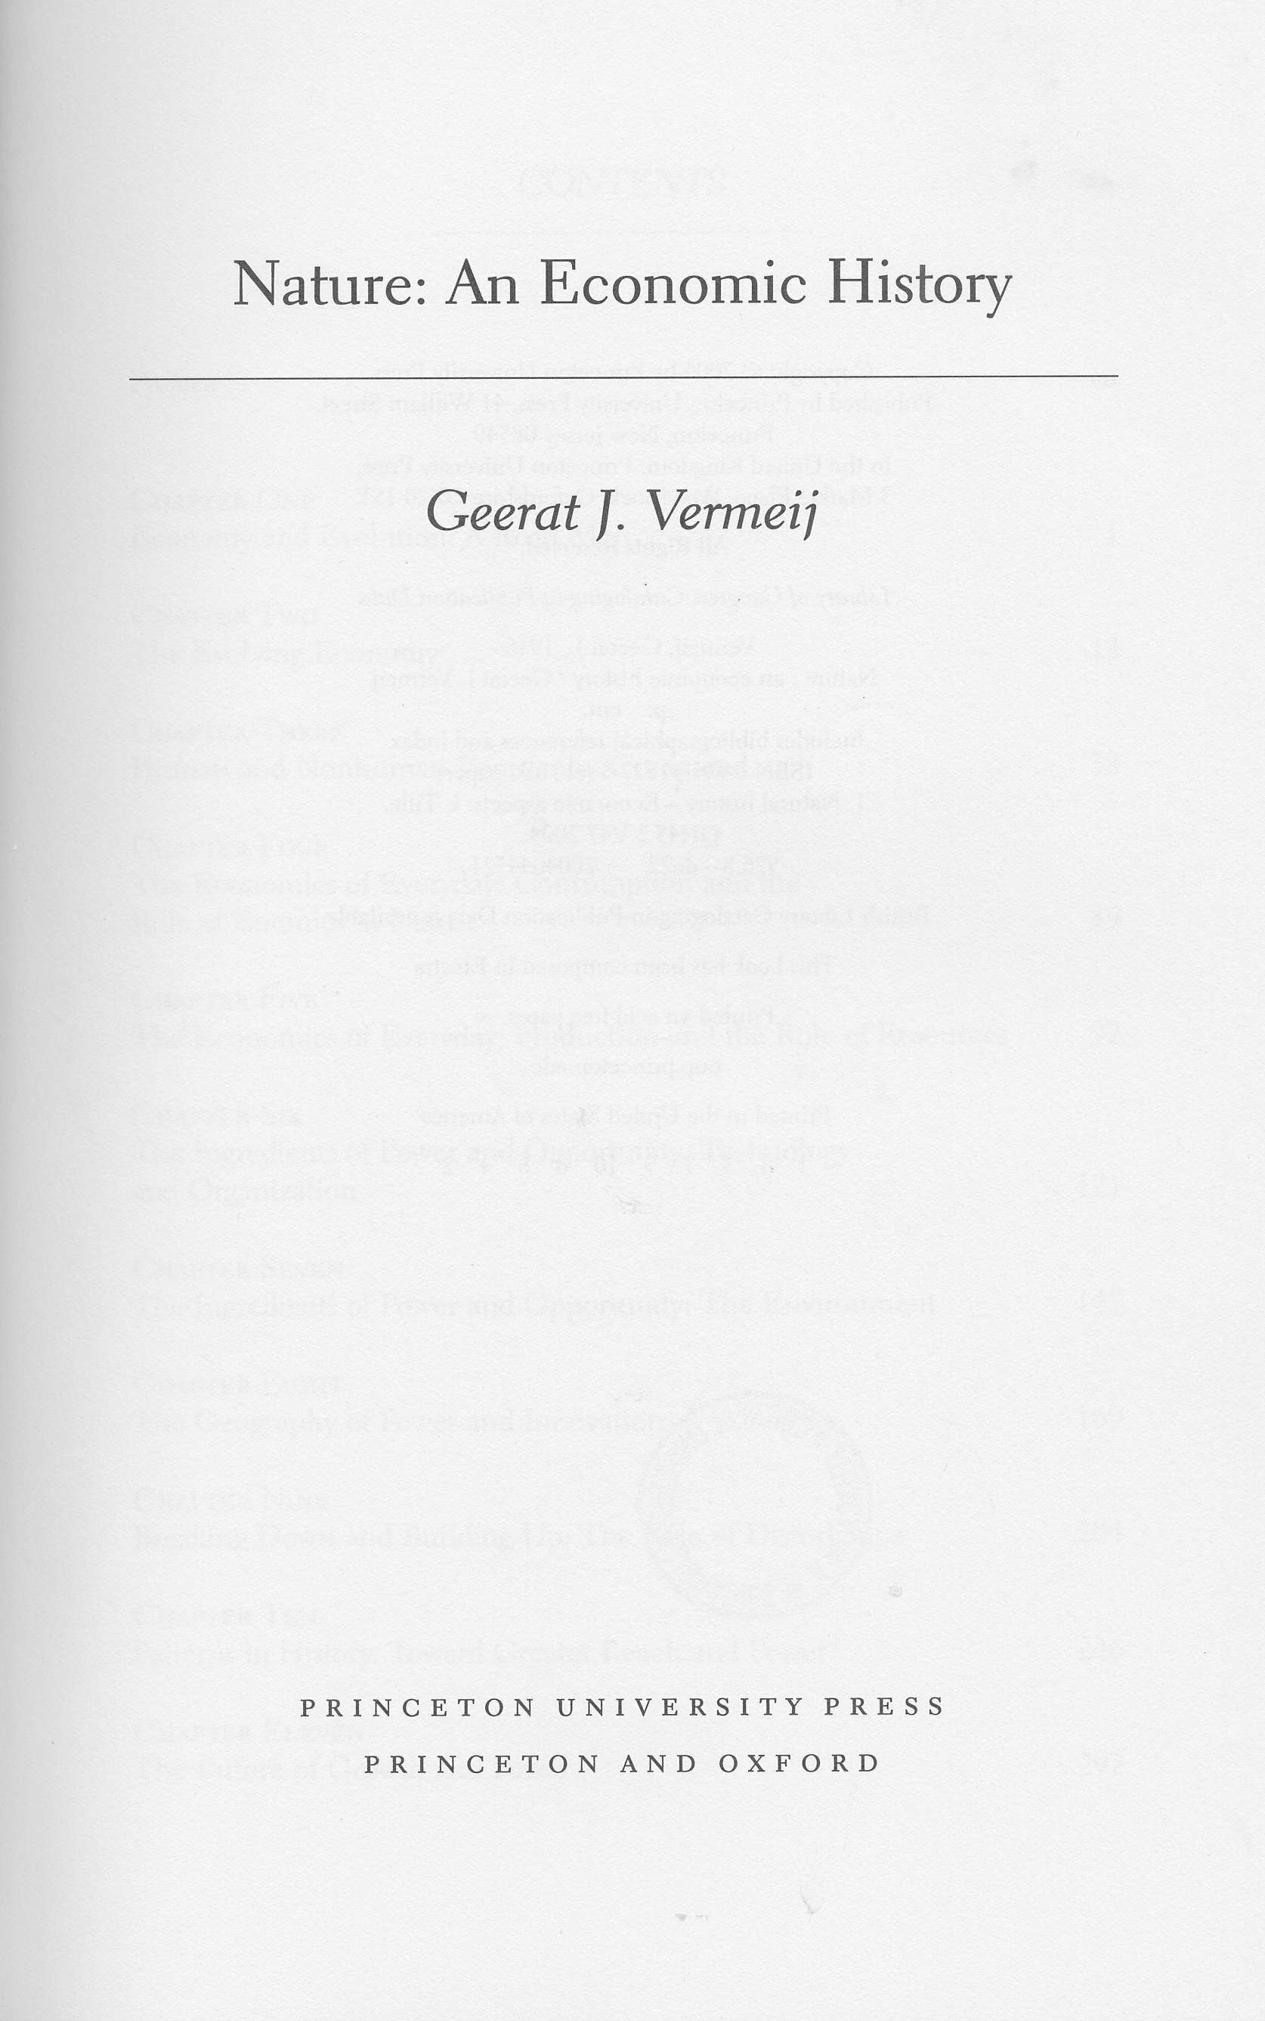
History of Oil
Outline
History
Usage
Geology
The future
Oil is best illustration yet…ever increasing scale and size of collaborating units
Fascinating illustration of the discovery process.
Oil is 20th century history

Slide 3
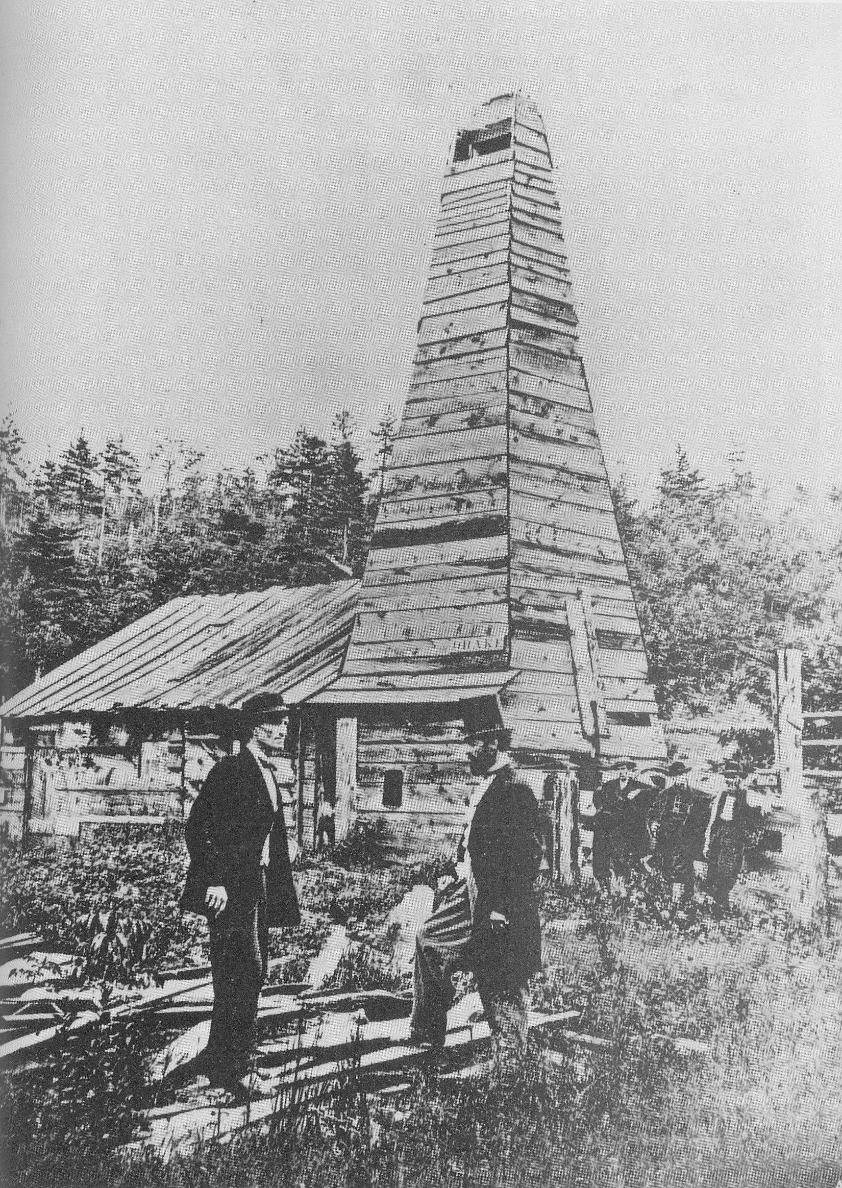
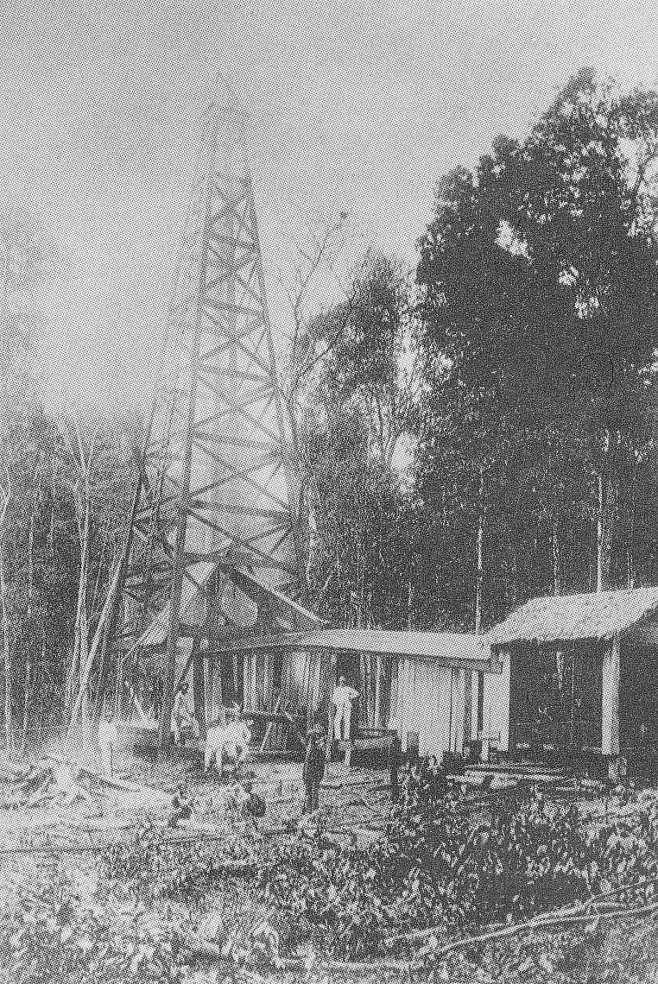
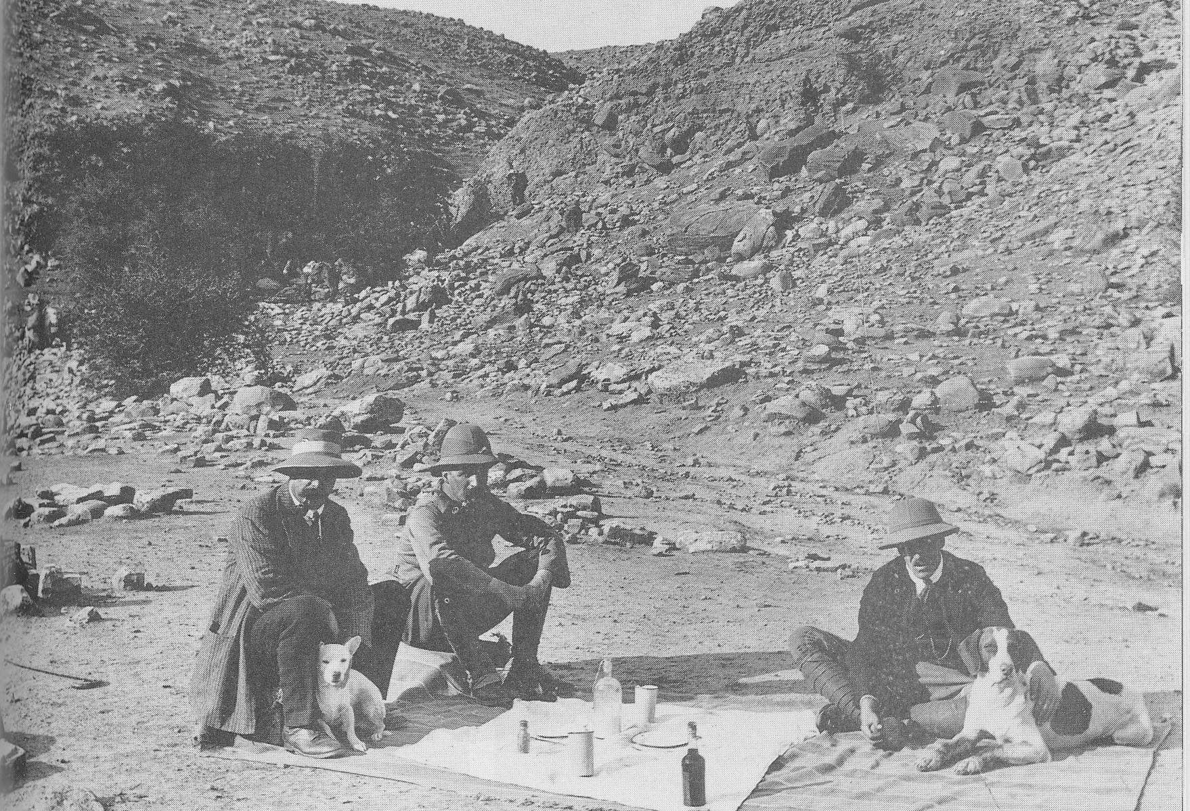
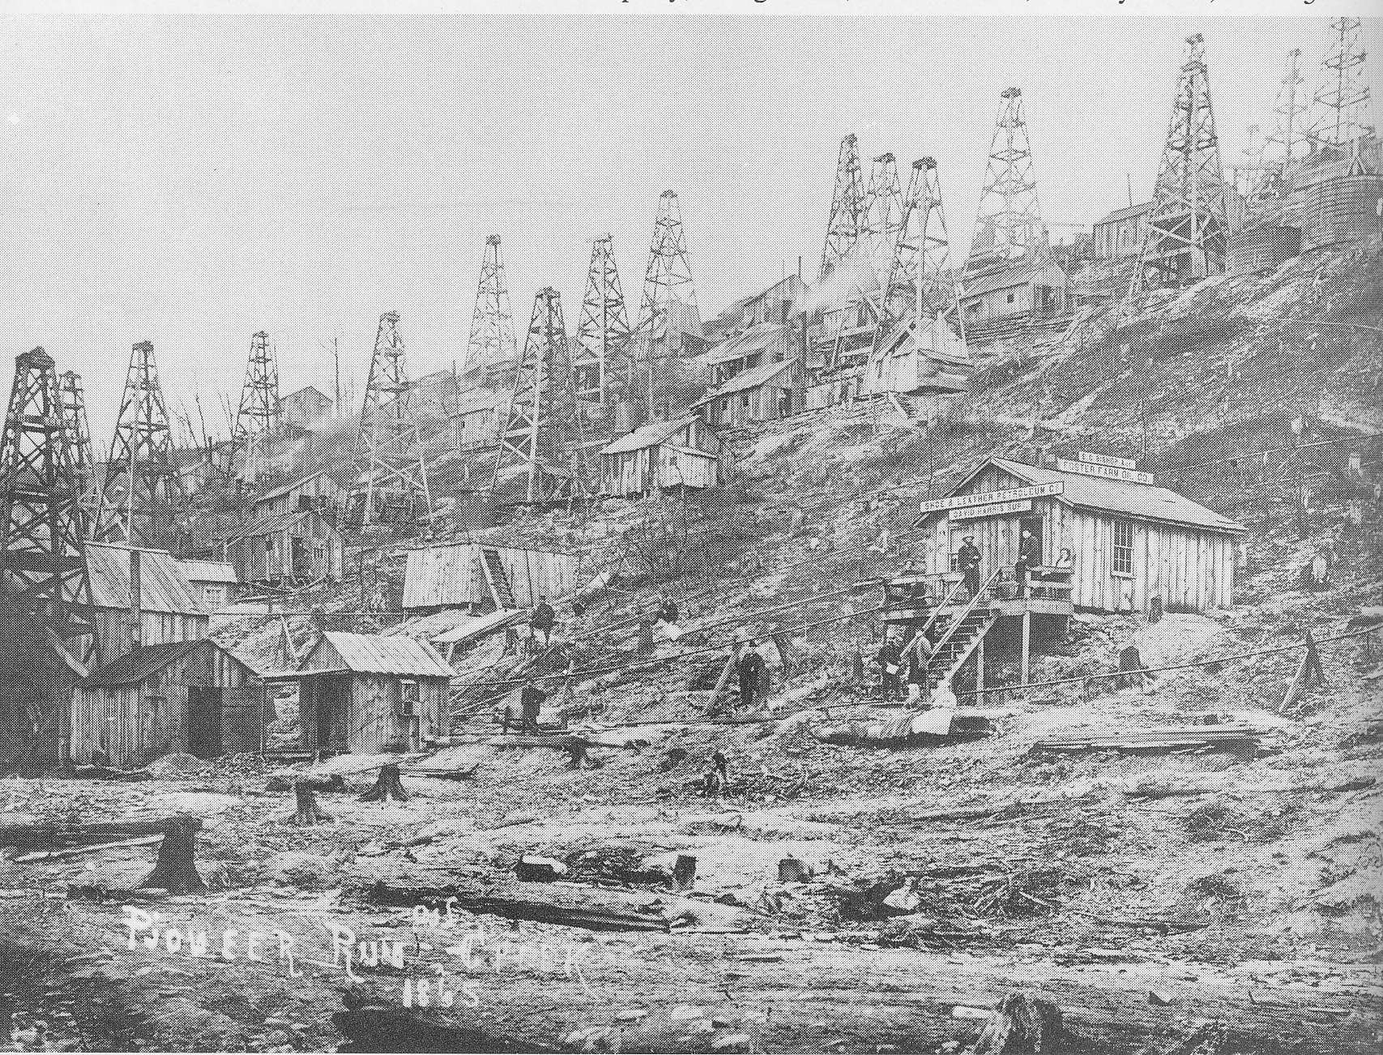
Discoveries hang by hair…
8/27/1859 Drake hits oil in Pennsylvania after being told to “close up”
1885 oil developed in Summatra after 10 year struggle (Royal Dutch)
1/10/1901 Patillo Higgins (1-armed, self educated mechanic), dream labeled “nonsense”, hits oil at Spindletop, Tx
3/25/1908 failed in “plain of Oil”, endured water with dung, hits oil in Iran with letter from Burma Oil to “wind down” on the way
9/15/1927 Baba Gurgan in Iraq
8/3/1930 Dad Joiner (70 yr old wildcatter, and ladies man), told by Doc Lloyd (former patent medicine roadman and “trendolgist”) exactly where to drill, with offer by Texaco geologist to “drink every barrel of oil you get out of that hole”, hits “Black Giant” 45x10 miles (140,000 acres) reservoir– largest ever found in U.S. in sandy and disserted East Texas.
2/3/1938 Frank Holmes hits oil in Kuwait
3/1938 Socal hits oil in Saudi Arabia after mgmt instructs “no new projects to be initiated without submission of detailed proposal”
1969 Phillips discovers Ekofisk, Norway… last well by last company
“Oil is found in the minds of men”
Wallace Pratt

Slide 4
Retrospectively, discoveries largely obvious
Tar pit of Trinidad (extraction of Kerosene)
Baku- eternal flames
“Flamable springs” in Ohio- Lima field
Sumatra seepages used by natives
California tar pits and seepages La Brea
Higgens (spindletop) Sunday school outing gas springs
Oils seeps in Persia- Maidan-i-Naftan (“plain of oil”)
Baba Gurgan in Iraq, burning furnaces of Nebuchandnessar
Abu Naft (father of oil) Frank Holmes “smelled it”

Slide 5
Boom and Bust
Pithole Pa
“Worthless farm” sold for $1.3x10⁶ in July 1865, $2x10⁶ in September, sold at auction January 1878 for $4.37
West Texas Black Giant crashes prices
1926 $1.85/bbl → 1930 1$/bbl → May 1931 15¢/bbl
Tx RR commission could stop physical waste but not economic waste (established 1891 to assert populist control over RR, had charter to stop physical waste but not to control production to manage price swings; courts enforced)
Oklahoma Gvnr “Alfalfa Bill” Murray proclaimed martial law and took control of oil fields
Texas Gvnr Ross Sterling declared E. Texas in “state of insurrection” and “open rebellion”, sent in Guard and shut down production
Rockefeller- bringing order out of chaos

Slide 6
Managing the resource…
Discovery requires markets
Markets developed by marketing and technology
medicine→lighting→fuel
Connecting fields and markets requires transportation
Oil (Energy) is truly global
Regulation needed (Texas RR Commission)
Companies got big (Standard busted in US but today is recombining)
Competition between companies always fierce
Compulsion to develop, reduce price, sell, and grow

Slide 7
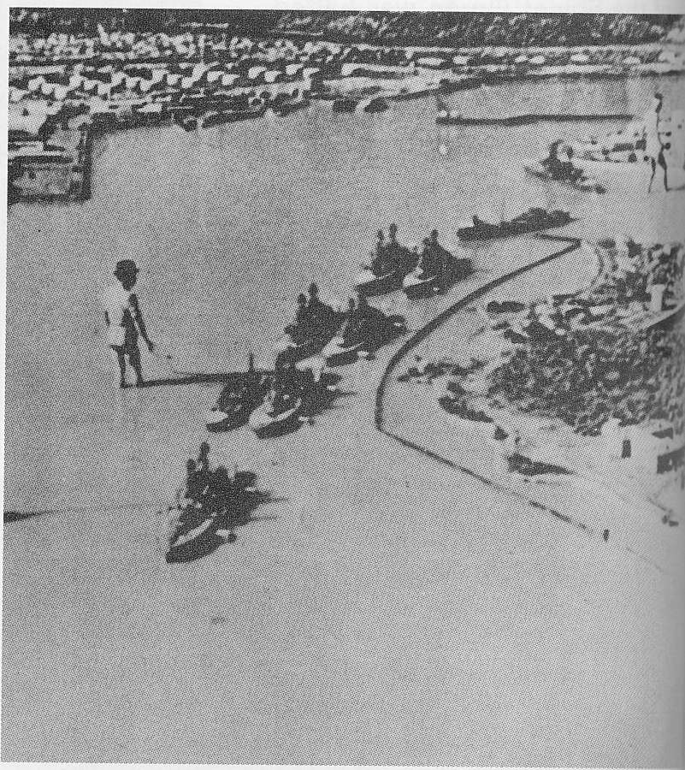
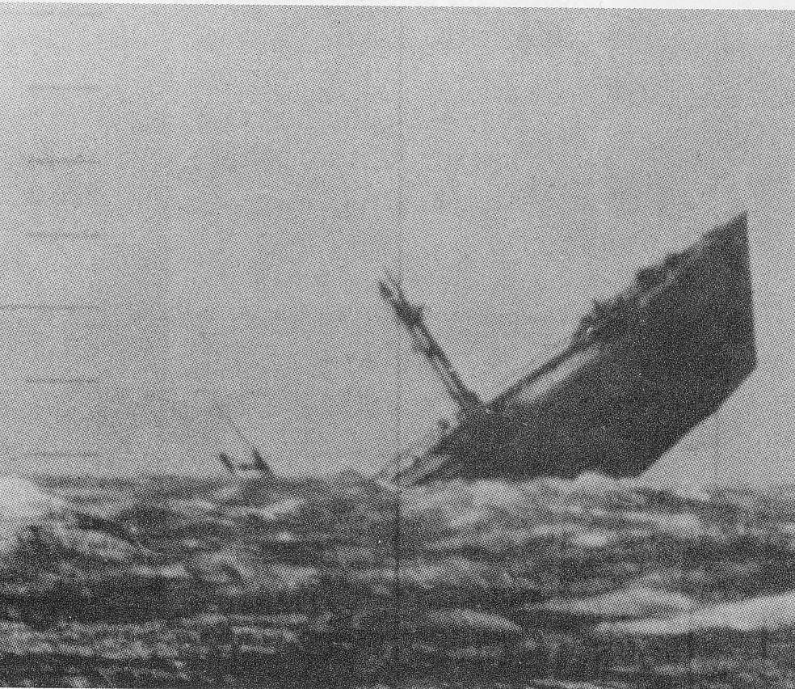
Oil (Energy) = Power
WW I
1914 British Expeditionary force 817 motored vehicles, 15 motor cycles
Paris taxies commissioned to carry troops to front
Last months of war 56,000 tanks, 23,000 motor cars, 34,000 motor cycles, 55,000 airplanes
WW II victory on the back of controlling oil
Japan Greater East Asia Co-Prosperity Sphere → great depression → Japanese bombing in China → American embargo on oil shipments to Japan → Pearl Harbor
Almost a year of preparation- model of Pearl Harbor
Pacific turkey shoot of oil tankers

Slide 8
Fossil Fuels
The context
(until recently)

Slide 9
Human rate of Energy Consumption 15 TW
= 1.5 ×10¹³ W
= 4.71×10²⁰ J/yr
= 77×10⁹ bbls oil equiv/yr
= 29 Gbbls/yr = 5.7 TW
86% from fossil fuel
wikipedia

Slide 10
US Energy supply has been shifting
Craig et al. (2001)

Slide 11
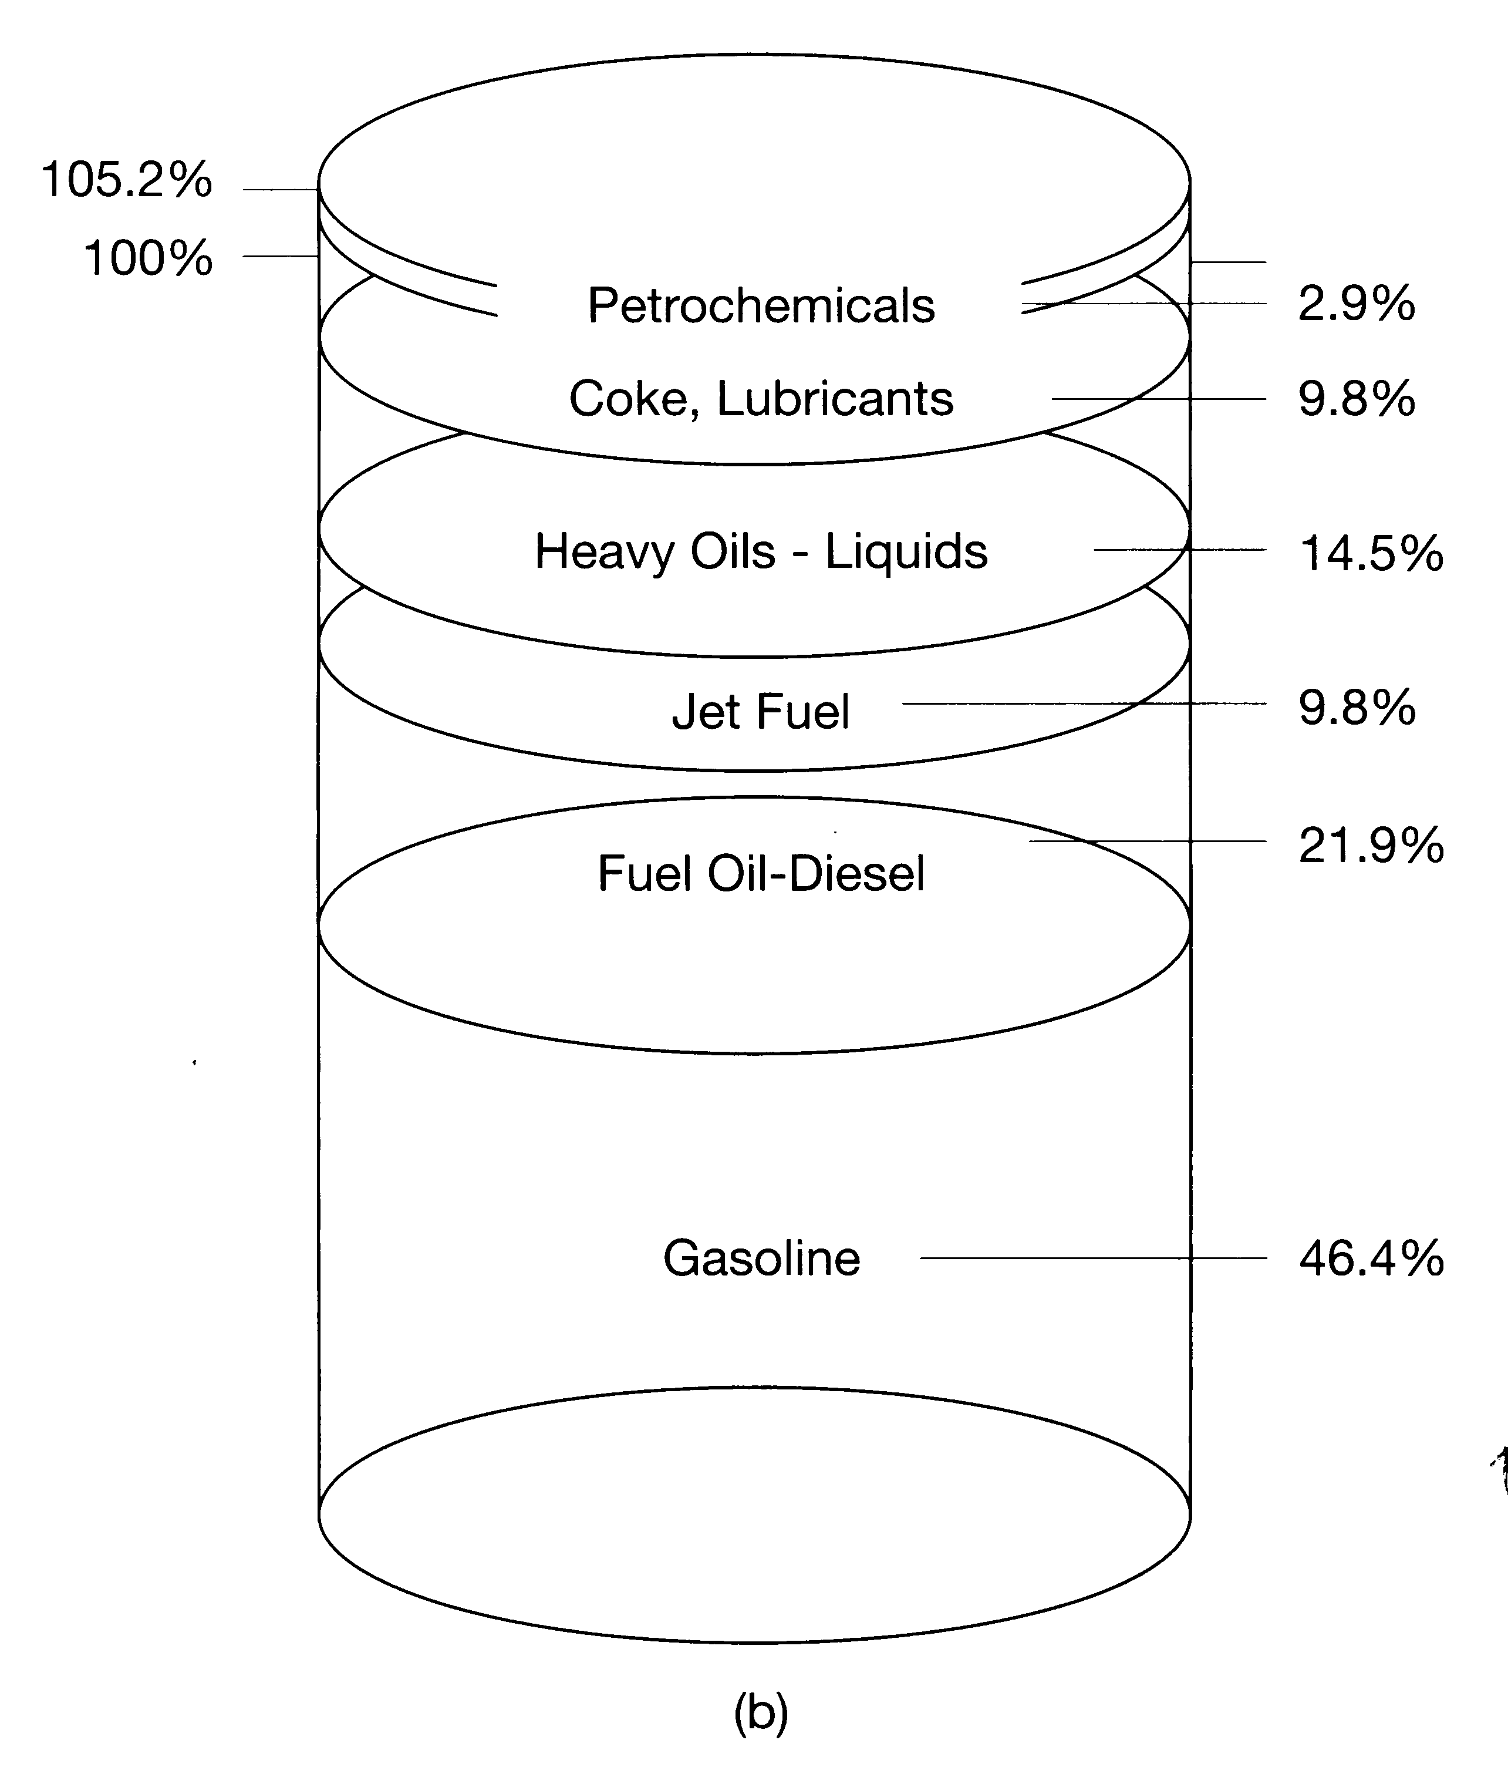
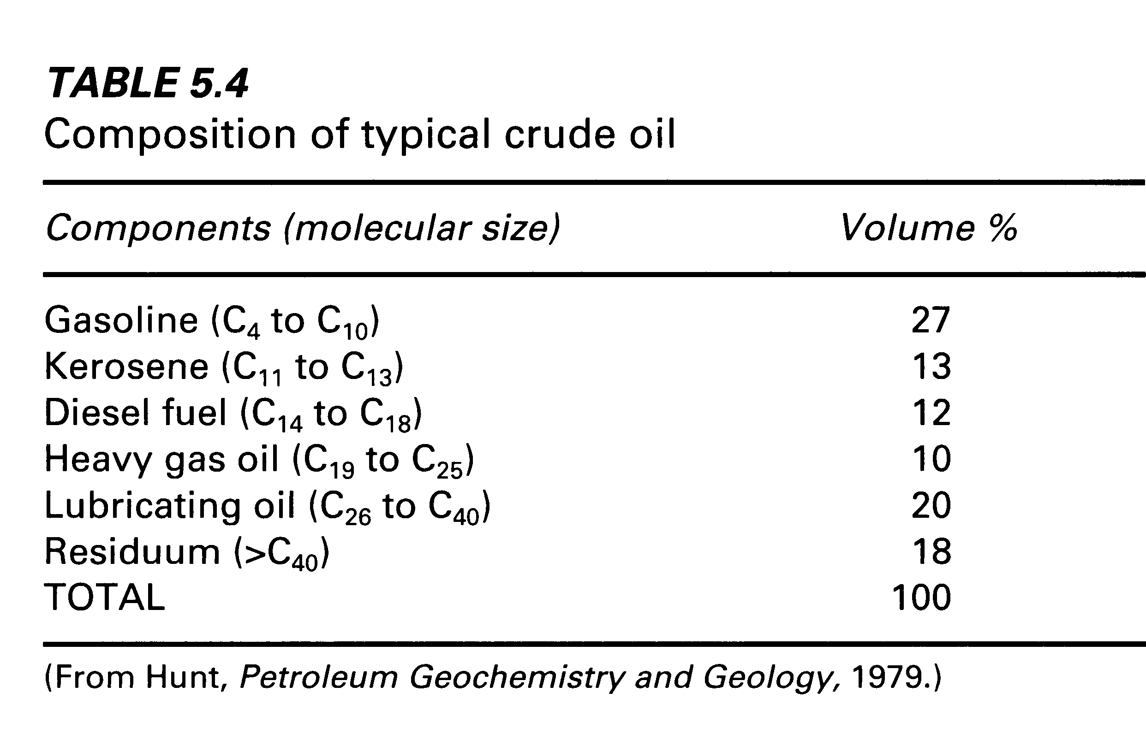
Composition of crude oil
Craig et al. (2001)

Slide 12
US Energy Flow (in quadrillion 10¹⁵ btu/y)
or 10¹⁸ J
1 btu = 1.055x10³ J
~1/3
23% (~0.9 Bt/y)
0.68 TW
~1/3
36%
~1/3
24%
(~23 TCF/y)
0.72 TW
~1/3
3.14 TW
38%
(6.3x10⁹ bbl/y)
28%
~1/3
1.15 TW
0.21 TW
7%
~1/3
0.23 TW
8%
26%
Total input
99x10¹⁸J yr⁻¹
= 3.14 TW*
* Why is this true? How do you convert J to W?
Craig et al. (2001)

Slide 13
Yearly US Electricity Flow
56.5%
65.6%
32.6x10¹⁸ J yr⁻¹= 1.04 TW
11.5x10¹⁸J
9.3%
2.6%
20.5%
34.4%
10.7%
0.4%
0.36 TW
Craig et al. (2001)

Slide 14
Oil Imports…a huge (former) concern
How things looked just a few years ago…
18.5 million bbls/d = 6.7 Gbo per year
a widening gap
3.65x10⁹ bbl/y
Oil, thousands of barrels per day
imports
Craig et al. (2001)

Slide 15
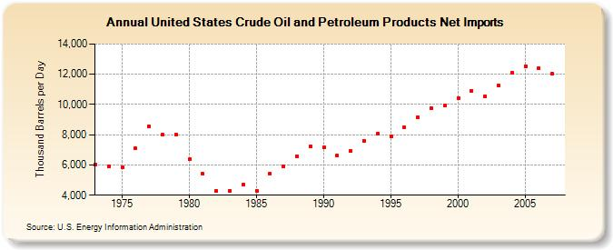
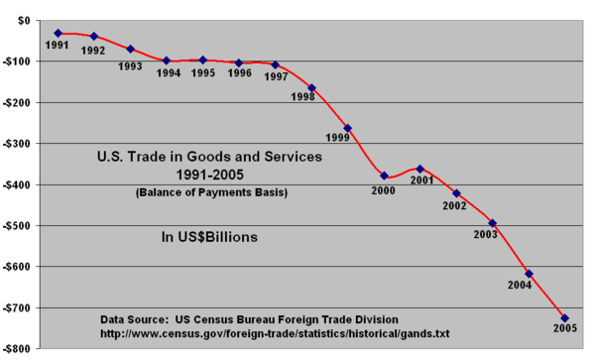
Import Impact on Budget Balance
12,000 x 10³ bbl/d = 4.4 Gbo/y
Oil Imports
http://tonto.eia.doe.gov/dnav/pet/hist/mttntus2a.htmhttp://tonto.eia.doe.gov/dnav/pet/hist/mttntus2a.htm
Slide 11
Balance of Payments
12,036 kbbl/d = 4.4 x 10⁹ bbl/yr
@ $100/bbl = $440 x 10⁹ /yr
Balance of payments = -$730
Oil import is ~60% of imbalance
falling off cliff
$-730 billion /yr
www.transamericanalliance.org/resources/4_US+...
2005

Slide 16
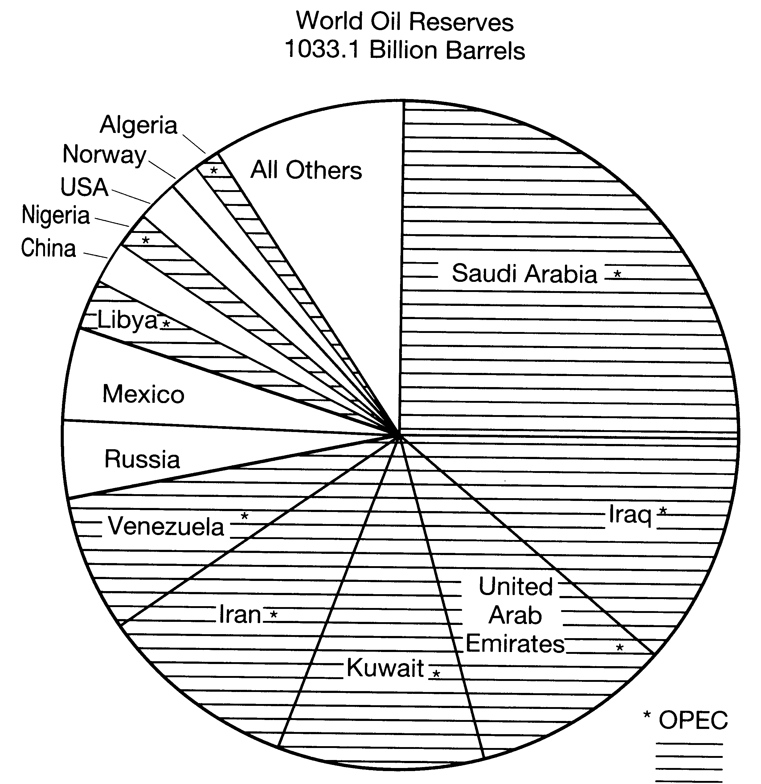
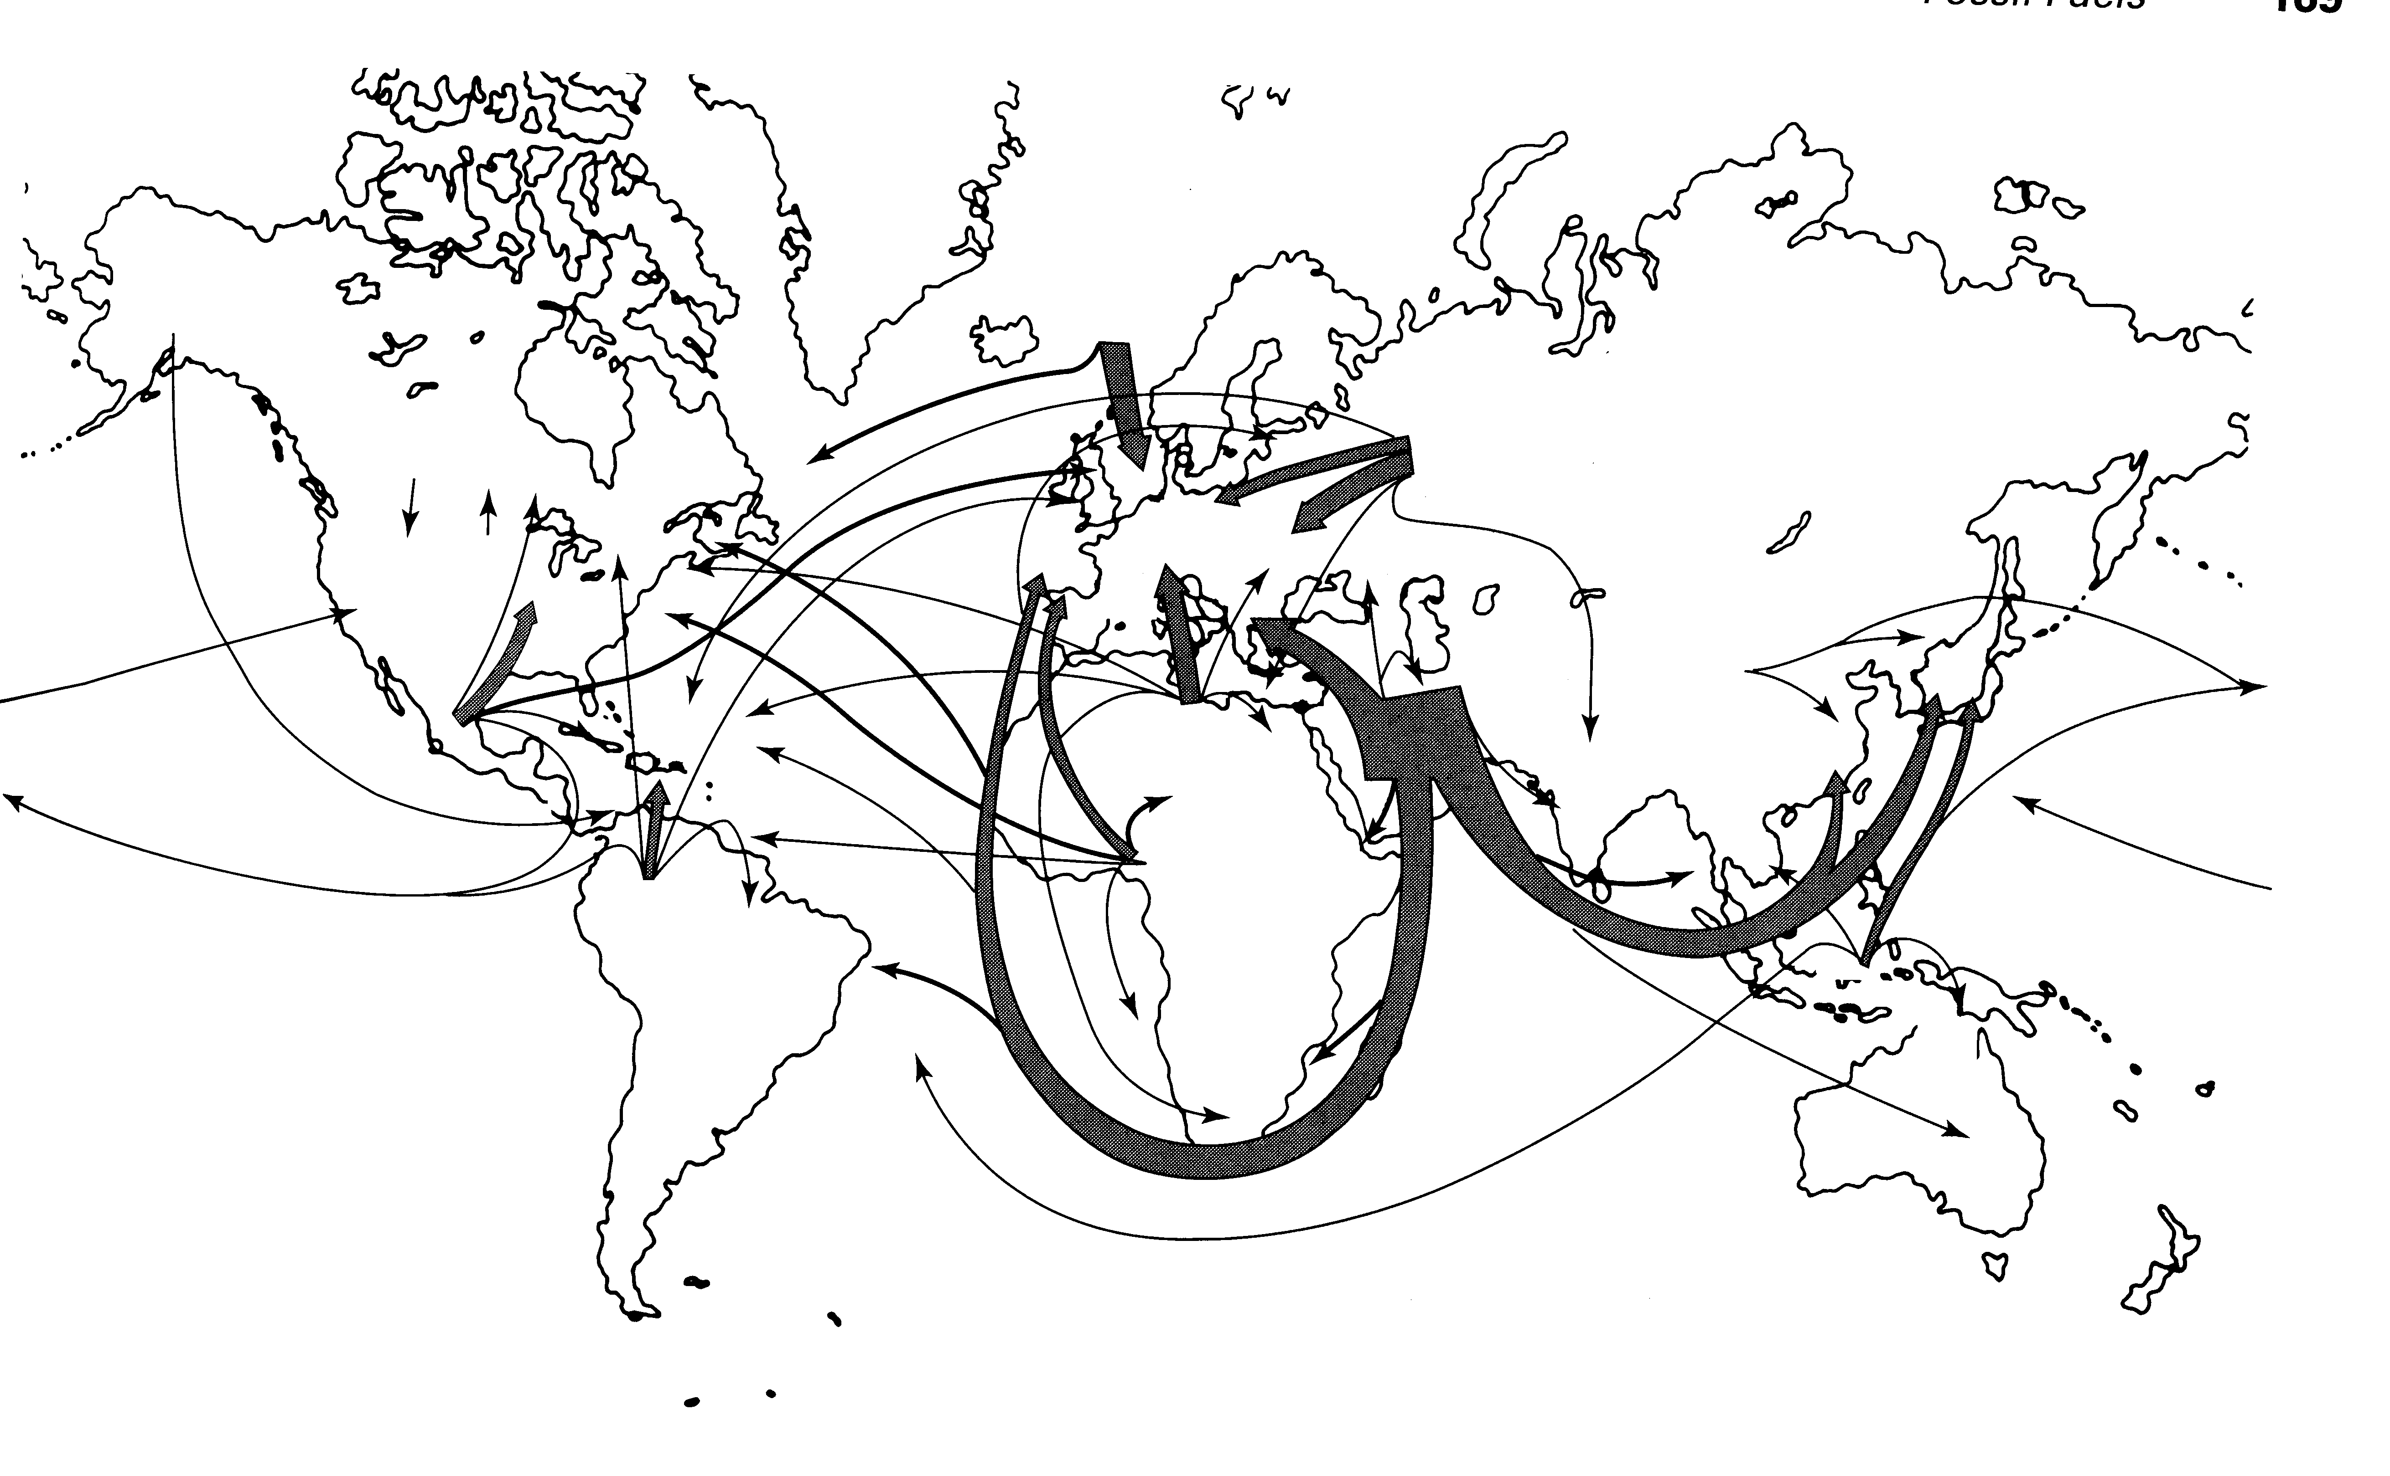
Dependence on OPEC
At constant production rates
 | OPEC | Non-OPEC
2000 | 768 | 252
2010 | 670 | 108
2020 | 571 | 0
~50% of oil transported by large tankers
Craig et al. (2001)

Slide 17
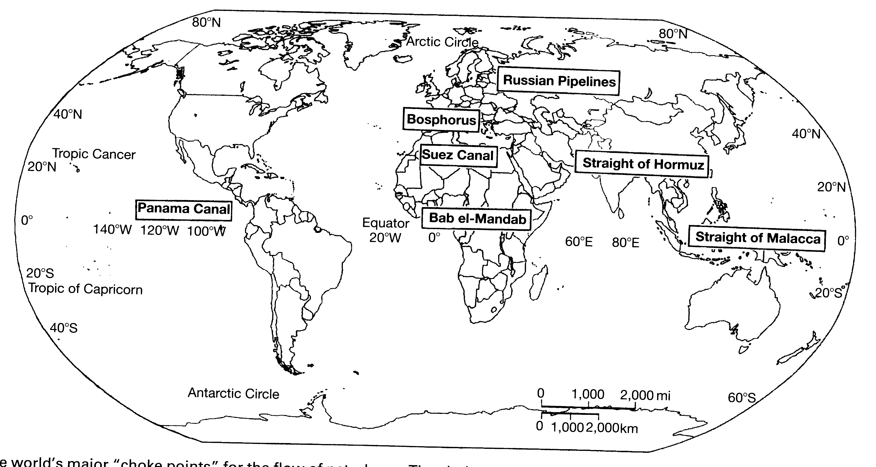
Choke points….
Craig et al. (2001)

Slide 18
Running out? Estimate from Historical Production

Slide 19
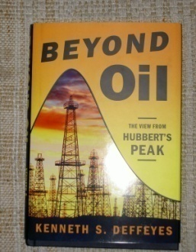
Production Related to Cumulative Production
Hubbert’s Peak Method
when Q=Q_{t}, P=0
US Production / Cumulative Production
extrapolate to
ultimate cumulative
production
Straight line
Deffeyes, 2005

Slide 20
Hubbert Predicted US Production History
peak when ½ oil produced
max P
data
prediction
time of
Prediction
(1956)
Time
Deffeyes, 2005

Slide 21
Hubbert’s Method Predicts World is at Peak, and
1 Trillion barrels of oil (tbo) Remains to be Produced
World P/Q
peak when ½ produced
ultimate production
1 tbo produced
1 tbo remaining
Cumulative Production, Q
Deffeyes, 2005
Lecture 11 to here

Slide 22
billion bbls oil equivalent
USGS 2000

Slide 23
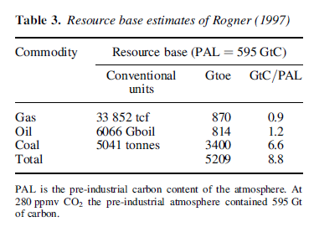
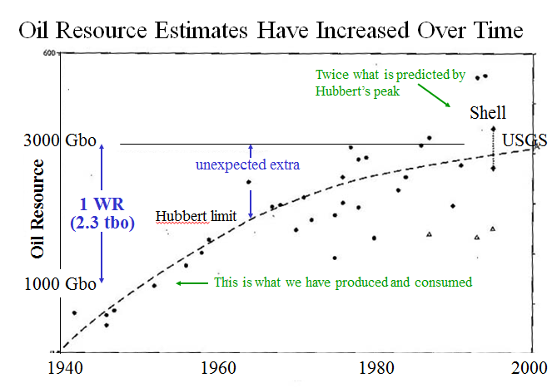
Rogner’s Resource base = 6066 Gbo
=814 Gto @ 0.134 t/bo
Cathles (2013) Future Rx
Resource Base
6 Tbo
Remaining
50% Rogner’s resource base
2.3 Tbo
1 Tbo
1 Tbo
Consumed so far

Slide 24
Hubbert Prediction US Production History
peak when ½ oil produced
data
prediction
time of
Prediction
(1956)
Great until 2006…
Time
Deffeyes, 2005

Slide 25
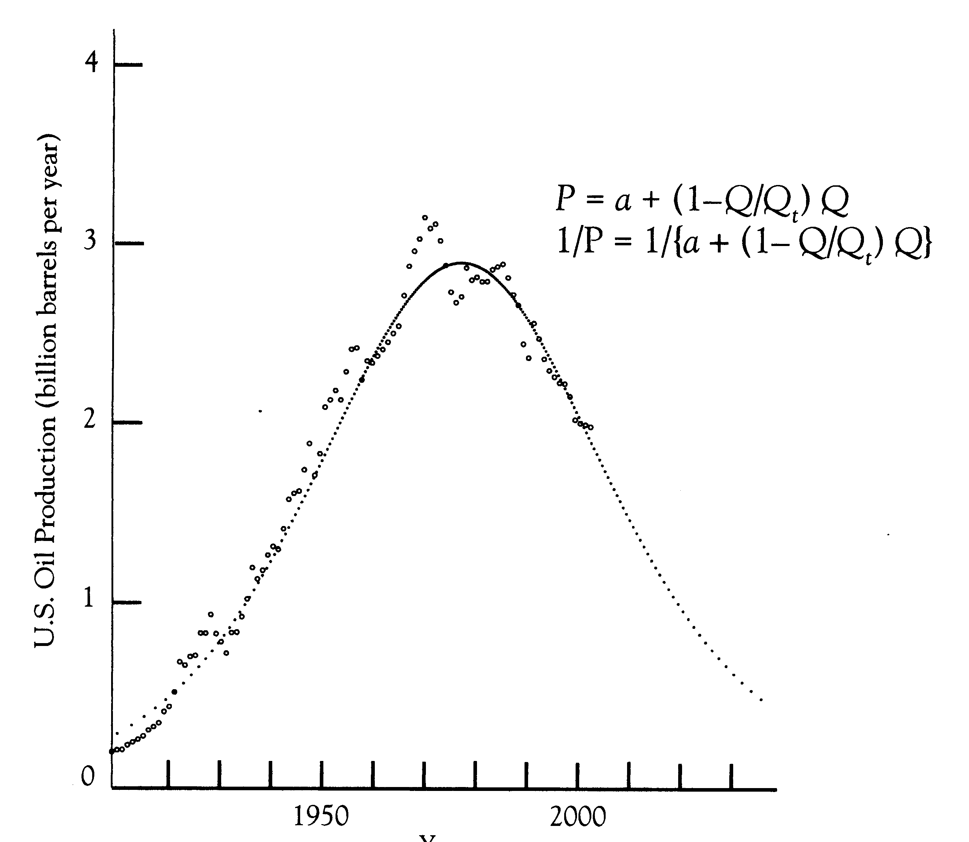
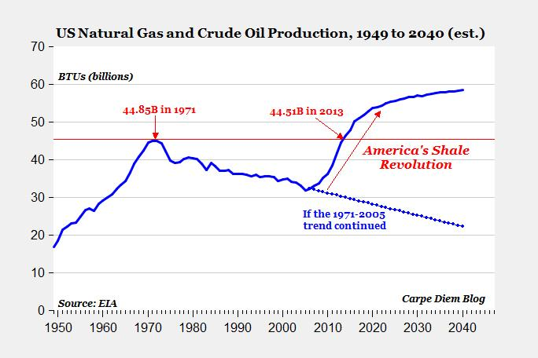
…and then!
Hubberts prediction great until ~2006
1973
…things changed
American Enterprise Institute

Slide 26
Summary
Vermeij (biological perspective)
Predators (producers and traders) drive change; performance more important than efficiency
Size is an advantage
Growth enables adaption
Successful survive
Technology can change everything (shale oil)

Slide 27
References
Deffeyes, K.S., 2005, Beyond Oil, The view form Hubberts Peak, Hill and Wang, New York, 2002p.
Yergin, Daniel, 1991, The Prize, the epic quest for oil, money, and power, Free Press, Chicago, 885p.

Slide 28
A Word on Price
For $130/bbl oil
1 bbl = 42 gallons
thus raw petroleum = $3.10/gallon
$0.25 Federal tax
$0.184 Federal excise tax
$0.19875 Michigan excise and environmental tax
$0.24 Michigan sales tax
$0.33 ExxonMobil profit
Tax $0.87
Delivery + Profit $0.33
$4.30 per gallon sales price
Cost of crude quadrupled in $ but doubled in euros
In 2000 euro =$0.82, euro in 2008 =$1.60
In 1988 $0.91/gallon
adjusted for true* inflation $₁₉₈₈0.91=$₂₀₀₈ $4.11
Car and Driver Aug 2008 p13
Price of gas not risen as much as it seems
Ruoff, The Energy Future, Chap 7
* Taking into account energy and food costs (google: John Williams, Shadow Statistics)

