Slide 1
Resource needs and supply
Lecture 3: Fundamentals of Energy and Mineral Resources
L. M. Cathles
2017

Slide 2
Demand is real and large
Difficult to grasp the magnitude of changes taking place… and this is just the start of the 2.3 kW p⁻¹ to 7 kW p⁻¹ transition.
Some illustrations….

Slide 3
Visualizing change
2010
iCRAG

Slide 4
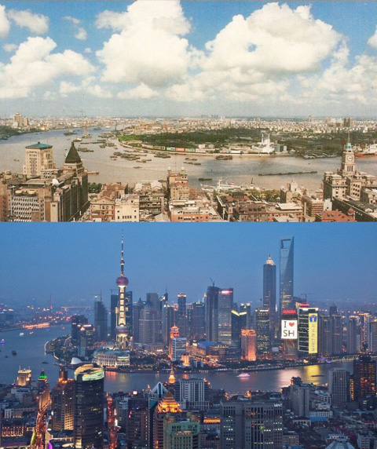
Resource demand
Urbanization: Shanghai – 20 years of growth
1990
2010
China: >200 cities >1 million people within 5-10 years

Slide 5
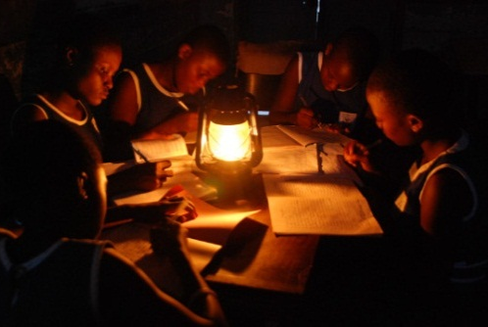
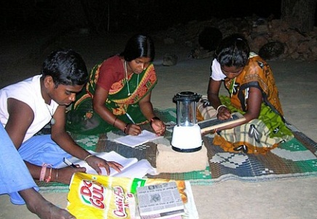
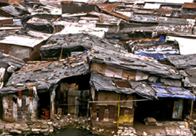
Basic human needs unfilled
1 to 3 billion people
no access to electricity – hinders education
use wood, charcoal, coal and dung for heat
no toilets and many also lack clean water
suffer malnutrition – e.g., zinc deficiency
Primary solutions: funding and organization…
and natural resources

Slide 6
“If you can’t grow it, you have to mine it” – or otherwise extract it from the earth, oceans and recycled materials (if available)

Slide 7
Renewables have large resource needs
Consider wind energy

Slide 8
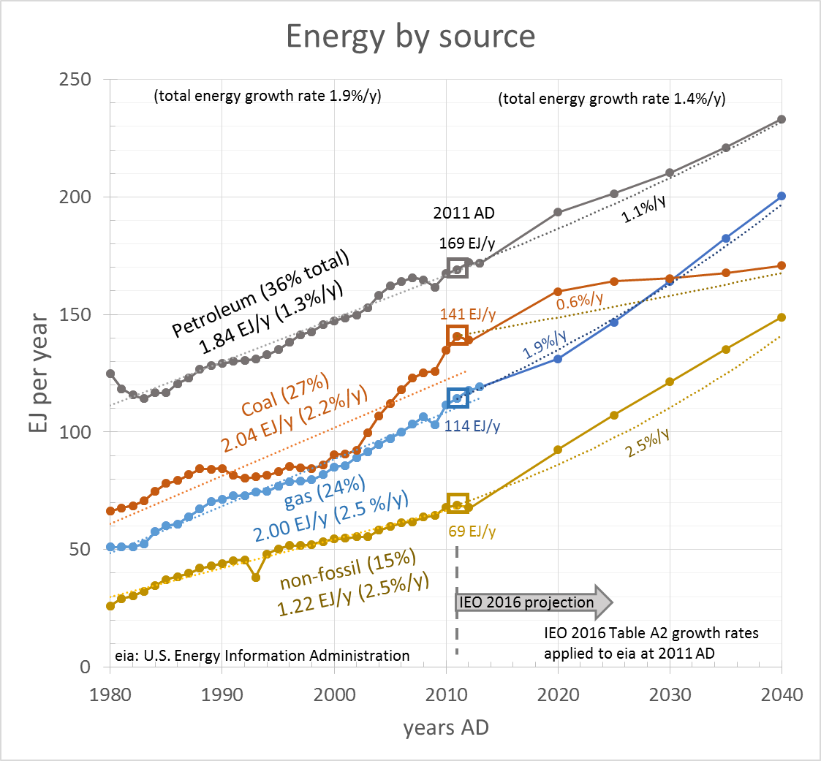
Grow renewables faster so displace FF
Non-FF grow at 2.5%/y from 69 Ej_{h}y⁻¹ in 2011
Non FF h→e = 38%
69 EJ_{h}y⁻¹ = 26.2 EJ_{e}y⁻¹ = 832 GW_{e} (1 EJ = 10¹⁸ J)
Growth*₂₀₁₁ = 21 GW_{e}y⁻¹
Goal 2300 J_{h} y⁻¹ = 75 TW_{h} = 28 TW_{e}
Reach in 142 y:
(1.025^142)69 EJ_{h}y⁻¹ =2300 EJ_{h}y⁻¹
(1.025^142)832 GW_{e} =28 TW_{e}
Growth*₂₁₅₃ = 693 GW_{e}y⁻¹
*2.5% growth/yr
convention
Resource needs?
year | Build rate
2011 AD | 21 GW y⁻¹
2153 AD | 693 GW y⁻¹

Slide 9
Colorado Wind Farm (Pacca and Horvath, 2002)
4480, 600 kW turbines
489 km², 10 turbines/km²
5.55 TWh = 629 MW
140 kW/turbine
Rated capacity = 2.7 GW
Capacity factor = 23%
64 t/turbine
0.35 t/turbine
year | Build rate | Mt steel y⁻¹ | Mt Cu y⁻¹
2011 AD | 21 GW y⁻¹ | 10.5 | .05
2153 AD | 693 GW y⁻¹ | 347 | 1.7
~0.5 t steel/kW
2.5 kg Cu/kW

Slide 10
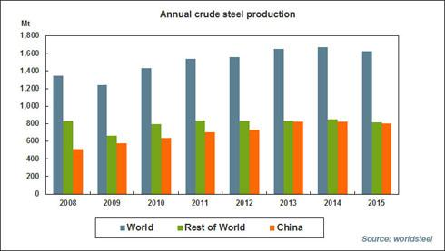
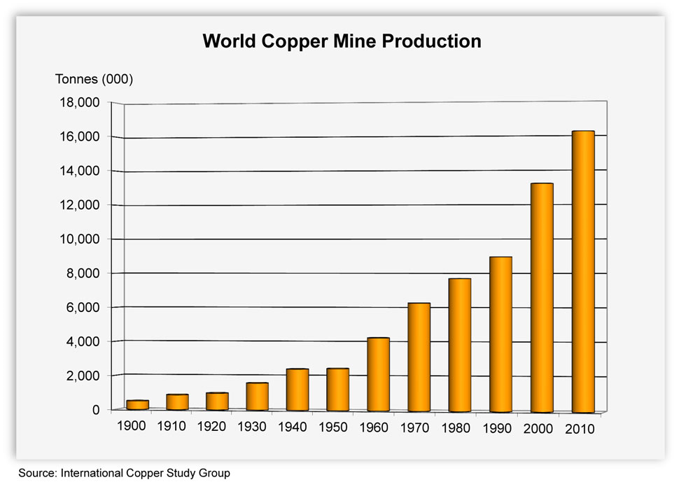
Percent of current steel and Cu production
Steel production Cu production
1623 Mt/y
18.3 Mt/y
2013
year | Build rate | Mt steel y⁻¹ | Mt Cu y⁻¹
2011 AD | 21 GW y⁻¹ | 10.5 (0.6% of 2015 production) | .05 (0.3%)
2153 AD | 693 GW y⁻¹ | 347 (21% of 2013 production) | 1.7 (9.2%)
Not all demand can be met by wind (buildings, bridges, factories, etc… also)
Not all energy will come from wind… also solar, nuclear, hydro etc. with
smaller/different resource needs
But resource needs will be challenging

Slide 11
Can we reduce Resource Demand?
What do we spend our energy on?
What do we need?
How much can we cut back?
“Every big counts”
All material from MacKay, D. J.C., 2009, Sustainable Energy without hot air, UIT Cambridge Ltd., Cambridge, 366p. (available free online at www.withouthotair.com)

Slide 12
Measuring Power in [kWh/d]
1 kWh = 3.6x10⁶ J
kWh = usual unit on electric bill
= 41.7Wd ~ one 40W light bulb for 1 day
kWh costs 10p (16¢)in UK
8.5¢ (LA, ND, TN) to 17.7¢ (NYS)
= 1 food calorie
1 kWh ~ 1000 food calories

Slide 13
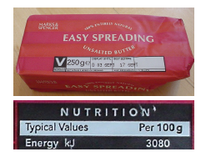
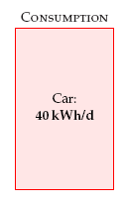
Car Consumption
drive 30 mi/d/person
Energy content of gas
car mileage
27 mi/US gallon
33 mi/imperial gallon (= 1.2 US gallons)
= 1.66 kWp⁻¹
Energy content of all hydrocarbons are similar:
3000 kJ/100g = 3x10⁷J/kg
density ~ 0.8 kg/l
E_{butter} ~ 2.4x10⁷J/l
1 kWh = 3.6x10⁶ J
E_{butter}~ 6.7 kWh/l
Gas = 10 kWh/l
Diesel = 11 kWh/l
personal
1.66 kW
Delivery efficiency of gas is 0.71 (1 l gas requires ~1.4 l oil to make and deliver)
Forty 40 W
light bulbs

Slide 14
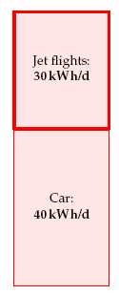
Plane Travel
Boeing 747-400 carries 240,000 l fuel and can travel 8,800 miles with 416 passengers
round trip
= 1.37 kWp⁻¹
1 intercontinental trip per person per year
1.37 kW
1.66 kW

Slide 15
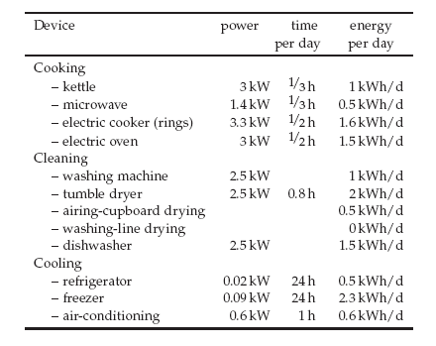
Heating and Cooling
Hot Water ~ 13 kWh/d/p
+ cooling
1.54 kW
1.37 kW
Sum = 13 kWh/d
use more than need
Heating: Electric heater 24 kWh/d x 0.5 yr x 2 = 24 kWh/d/p
1.66 kW

Slide 16
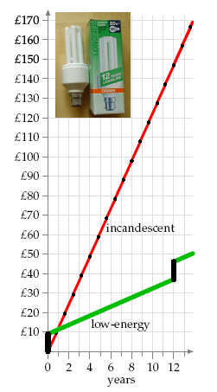
Light
0.16
1.54 kW
=
Home 2.75 kWh/d/p
Work 1.3 kWh/d/p
makes economic sense to buy fluorescent bulbs
1.37 kW
Buy new every 12 yrs
1.66 kW
Cost 100W bulb 3hr/d

Slide 17
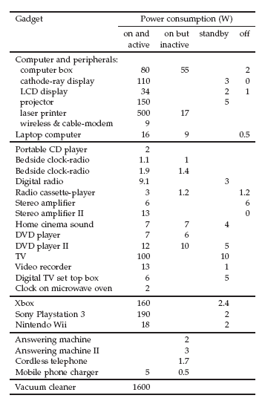
Gadgets
0.20
0.16
1.54 kW
Computer server 0.4 kWh/d/p
(1% US elect. consumption)
Vacuum cleaner 0.4 kWh/d/p
Mowing Lawn 0.6 kWh/d/p
1.37 kW
~ 5 kWh/d/p
1.66 kW
1W = 1 £/yr
DVD II costs 20£
In 2 yrs idling energy = purchase cost
sum=114.8 W

Slide 18
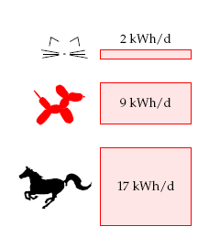
Food and Farming
Veggies
1 kcal = 1 calorie (food)
Energy to feed and animal
Human kcal/d x 1.1x10⁻³ kWh/kcal
65 kg 2600 3 kWh x 0.5 = 1.5 kWh/d/p
diet half veggies
0.046 kWh/kg_{animal}
pets are extra
meat & dairy
½ liter milk per day
50 g cheese/d (½ l milk to make)
Cow gives 16 l/d
0.63
0.20
0.16
dairy
Weight
of cow
110 g chicken food @ (2850 kcal/kg = 3.3kWh/kg)
0.36 kWh/chicken
chicken lays ¾ egg/d
2 eggs/d needs: (2.66 chickens)x0.36 = 1 kWh/d eggs
1.54 kW
2 eggs/d/p
food
1.37 kW
227 g meat/d chicken pork beef
75 75 75 grams eaten
50 400 1000 days to slaughter
3.75 30 75 ∑=110 kg standing crop animal
meat
yield
1.66 kW
Fertilizer 2 kWh/d/p
Farm Energy 0.9 kWh/d/p
e.g., eating 0.075 kg chicken per day means supporting 0.075x50=3.75 kg of chicken waiting to be eaten
∑=1.5 +1.5 + 1 + 8 +2 +.9 = 14.9 kWh/d/p

Slide 19
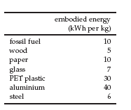
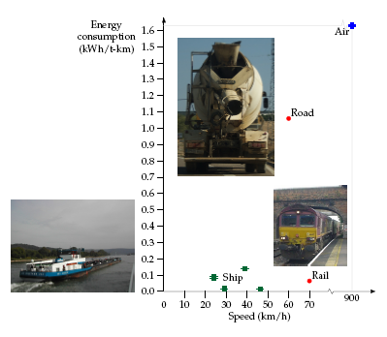
Stuff and its transport
0.17
Embodied energy = E of digging, modifying, transporting raw materials
+ E of producing product (factory light and heat, transport)
0.5
mainly food packaging
400 g packaging/p/y x 10 = 4 kWh/d/p
200 g paper/p/d x 10 = 2 kWh/d/p
2 kW
48
0.63
Stuff
0.20
Britain's C-footprint doubled by imports
Manufact energy kWh/kg
= 2 kWh/d/p
0.16
1.3 t/yr/p nonfuel manufactured imports x (1000/365) x 10 = 40 kWh/d/p
= 7 kWh/d/p
= 4 kWh/d/p
Transport
Shipping
Energy for supermarkets = 0.5 kWh/d/p
Water delivery and removal = 0.4 kWh/d/p
1.54 kW
12
tnspt
1.37 kW
PC (2yr) 2.5kWh/d/p
House (100 yr) 1 kWh/d/p
Car (15 yr) 14 kwh/d/p
5/d = 3kWh/d
1.66 kW
Desalination
8 kWh/m³
195 kWh/p/d = 8.1 kW p⁻¹
or plastic bottles

Slide 20
195 kWh/p/d
8.1 kW p⁻¹
0.17
0.5
2 kW
What can we save?
0.63
0.20
0.16
Heat pumps
1.54 kW
1.37 kW
Better transport
1.66 kW

Slide 21
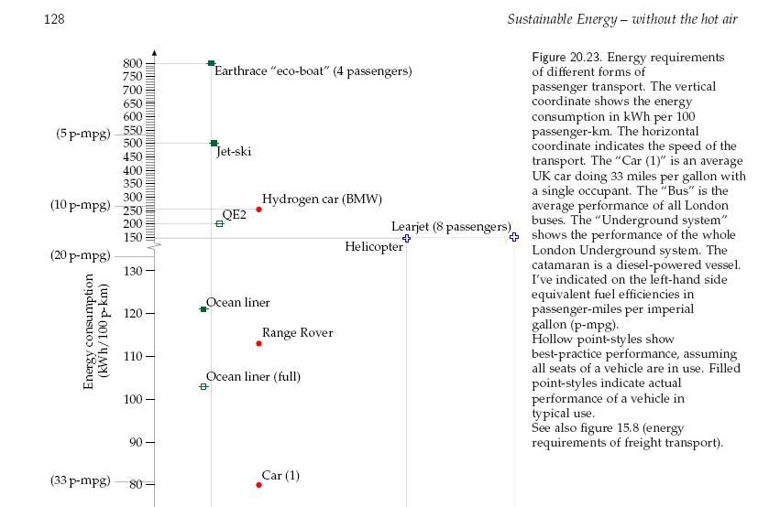
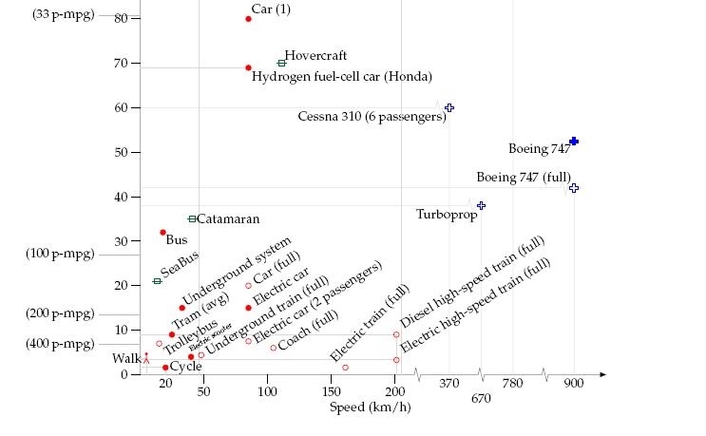
Better Transport
Substantial savings possible
boats
40 kWh/p/d → ~10 kWh/d/p
Save 30 kWh/d/p
Car @ 80 kWh/100 km
33 mpg with single occupant
Boats will not replace planes
kWh/100 p-km
planes
Electric car at 15 kWh/100 km
Public transportation at 10 “
speed

Slide 22
Heating with heat pumps
8.1 kW p⁻¹
195 kWh/p/d
Insulate ↓0.72
Thermostat shenanigans ↓0.75
5.6 kW p⁻¹
135 kwh/p/d
0.9 gas → 1.95 for heat pump (factor of 2.16)
37 kWh/d/p → 9.25 kWh/d/p
Savings = 27.7 kwh/d/p
Heat 9.2
E_{Heat} = E_{ele} + 3xE_{ele}
Get 4 units of heat for one unit of electric power
Jet 30
reverse refigerator
Car 10
195 kWh/p/d

Slide 23
Heating with heat pumps
8.1 kW p⁻¹
195 kWh/p/d
5.6 kW p⁻¹
135 kwh/p/d
More?
Heat 9.2
Jet 30
Car 10

Slide 24
8.1 kW p⁻¹
195 kWh/p/d
5.6 kW p⁻¹
135 kwh/p/d
Can renewables provide 5.6 kW p⁻¹ ?
Heat 9.2
Jet 30
Car 10

Slide 25
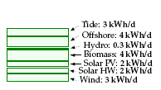
8.1 kW p⁻¹
195 kWh/p/d
5.6 kW p⁻¹
135 kwh/p/d
Can renewables provide 5.6 kW p⁻¹ ?
Feasible
MacKay’s Answer – no
Heat 9.2
0.75 kW p⁻¹
Jet 30
Car 10

Slide 26
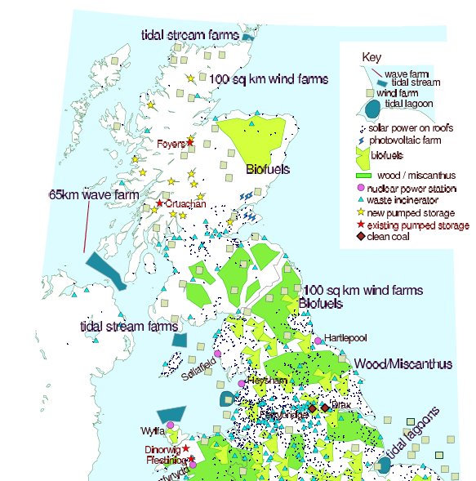
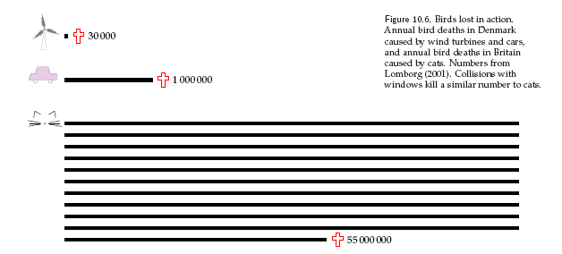
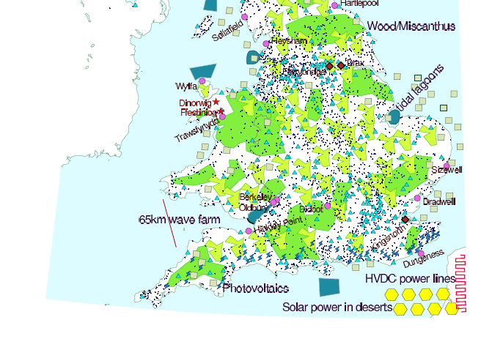
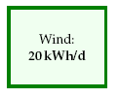
OnshoreWind
Whitelee near Glasgow
140 turbines
322 MW peak (6 W/m²)
55 km² area
Load factor = avg/peak ~ 30%
100 sq km wind farms
10% total land/p yield conversion
6 m/s wind
13 mph
½ car
UK: 59.5x10⁶p, 244,000 km², 4110 m²/p
50x Denmark today
7x Germany
2x World
Denmark
/yr
x 50 = 1.5 million
Britain today
0.8 kW
= (20 kWh/d)(0.0417 kW/kWh/d
Agricultural land area of UK = 166,000 km2 (70% total)

Slide 27
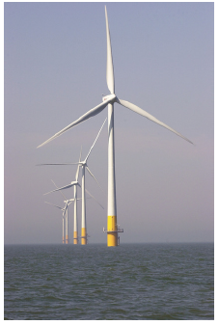
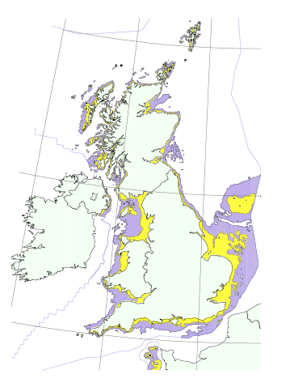
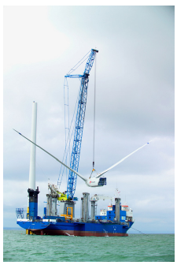
Offshore Wind
*
0-25m
Wales
25-50m
2/3 for shipping
Deep Offshore = 32 kWh/d/p
0 to 25 m: 40,000 km² = 666 m²/p
25 to 50 m: 80,000 km²
Area UK : 244,000 km²
2/3 Wales
* Requires 44,000 3MW turbines
15/km coastline if lined the coast
corrosion is problem (1/3 turbines replaced every 18 mo)
48 kWh/d/p would require 60x10⁶ t steel and concrete
~1 t/p, world steel production ~0.2 t/p/yr (see slide 10)
WWII Liberty ship production 0.1 t steel/American/yr
7000 km N Sea pipelines 8x10⁶ t steel and concrete
10,000 turbines in 10 yrs requires 50 jackup barges
3MW offshore wind turbine weighs 500 t
Weight-to-power ratio = 170 kg/kW
resource issue
1.33 kW
0.66 kW
0.8 kW

Slide 28
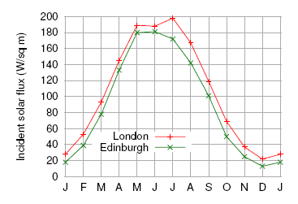
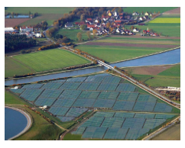
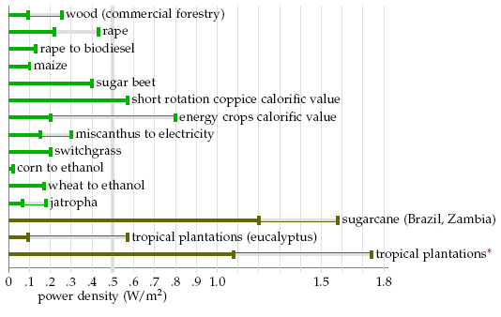
Solar
110 W/m²
~ 1000x0.32x0.34
W/m² incident
Incident avg/inc clds
1
fx land
capture
Personal (110 W/m² avg in UK)
Hot Water | 10 m²/p | 50% capture | 55 W/m² | 13 kWh/d/p
PV | 10 m²/p | 20% | 20 | 5 kWh/d/p
Farms (% of UK 244,000 km²)
PV | 5% | 10% capture | 10 W/m² | 50* kWh/d/p
plants | 75% | 100% | 0.5 W/m² | 36 kWh/d/p
Muhlhausen, Bavaria
5 W/m² avg power
choose
Expensive ones, S facing
4110 m²/p
2.1 kW
200 m² p⁻¹
* 100x all panels in entire world today
0.21
3000 m² p⁻¹
33% losses -> 24
Miscanthus Grass
0.75 W/m²
1.5 ->1 kW/p
(using all farmland!)
0.54
1.33 kW
0.5 W m⁻²
0.66 kW
0.8 kW

Slide 29
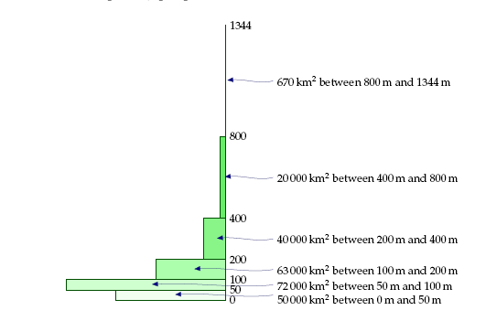
Hydroelectric
0.06
1
solar
lowlands
2.1 kW
much more efficient
Upper bound
no evap, every drop rain
Land Elevation
0.21
highlands
0.54
20% x 7kWh/d/p = 1.5 kWh/d/p
1.33 kW
guess at practical
Wind
0.2 kWh/d/p today
0.66 kW
highland
lowland
0.8 kW

Slide 30
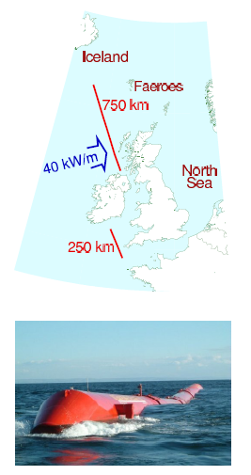
Wave
0.16
Measured power of Atlantic waves per m of coast
0.06 Hydro
1
Total capture
Onshore = millpond
= 16 kWh/p/d*
= 4 kWh/p/d at 50% extraction and 50% coverage
solar
2.1 kW
0.21
Pelamis wave energy collector
0.54
300 kW 4-section snake
350 t steel
350 t ballast
750 kW maximum
500 kg steel/kW
1.33 kW
Wind
(3x wind)
0.66 kW
3x wind turbine’s 170 kg/kW
0.8 kW
* =666/(40 W / kWh/d)

Slide 31
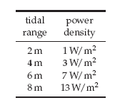
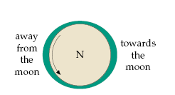
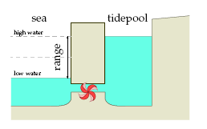
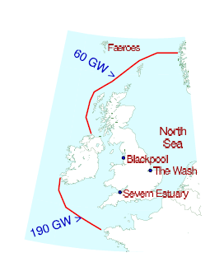
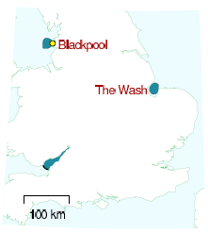
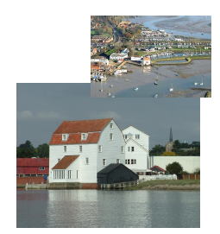
Tide
0.46
Lagoons 1.5 kWh/d/p
Farms 9
Barrages 0.8
spring and neap tides
align or not align with sun
0.16
0.06
1
Tide stream farms = 6W/m²
(underwater wind turbines)
~9 kWh/d/p around UK
Tidepool
Upper bound estimate
solar
2.1 kW
Cardiff Barrage
0.8 kWh/d/p
1.5 kWh/p/d
0.21
0.54
Raw power incoming lunar tide
predictable
day and night year round
can store energy
low cost hardware
storms not issue
invisable (under the sea)
1.33 kW
absolute upper bound
Wind
0.66 kW
If extract 10% and 50% conv/transm eff
= 5 kWh/d/p
0.8 kW

Slide 32
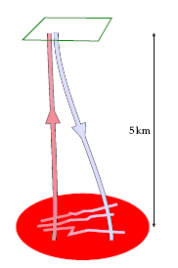
Geothermal
Geothermal
0.04
0.46
0.16
0.06
1
50 mW/m² geothermal heat flow
17 mW/m² extractable forever
43 p/km² land (23,260 m²/p) world population density
0.41 kW/p
solar
If all land used
In UK 4000 m² p⁻¹
= 2 kWh/p/d
2.1 kW
0.21
not at all feasible
0.54
Hot dry rock
<130,000 TWh in UK according to consultants
1.1 kWh/d/p for 800 yrs
1.33 kW
0.05 kW/p
Wind
0.66 kW
0.8 kW
TOTAL non-fossil supply = 176.5 kWh/d/p = 7.3 kW/p

Slide 33
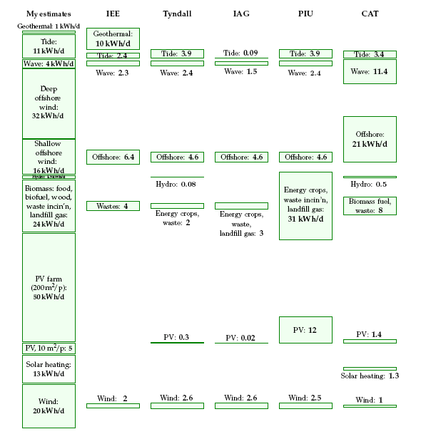
But MacKay Estimates VERY Generous
27.1
15.9
11.8
56.4
48 kWh/d/p
176.5

Slide 34
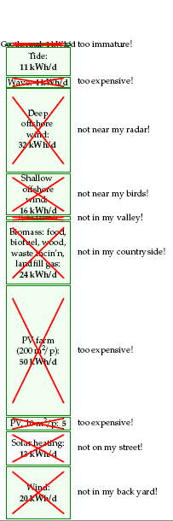
8.1 kW p⁻¹
195 kWh/p/d
Getting realistic
7.4 kW p⁻¹
176.5 kWh/d/p
58 kWh/p/d
Savings
5.6 kW p⁻¹
135 kwh/p/d
hydro
Energy Gap
117 kWh p⁻¹ d⁻¹
Heat 9.2
0.75 kW p⁻¹
18 kWh/d/p
Jet 30
Car 10

Slide 35
Summary
8.1 kW p⁻¹
195 kWh/p/d
7.4 kW p⁻¹
176.5 kWh/d/p
Can’t give up enough to close gap
Still need:
Food
Light
Defense
Transport
Gadgets
Some stuff
Jet travel
58 kWh/p/d
Savings
5.6 kW p⁻¹
135 kwh/p/d
hydro
Possible solutions:
Use less energy
Find more renewables
Use other people’s “
Nuclear
Have less people
Energy Gap
117 kWh p⁻¹ d⁻¹
Heat 9.2
(Some academics are discussing a sustainable population of ~2 billion =1/3 of today. This is hinted at by height of green stack compared to red. This is not an appealing vision. )
0.75 kW p⁻¹
18 kWh/d/p
Jet 30
Car 10

Slide 36
UK plan M
Land growing
Renewables place High demand on land
2x realistic
0.75 kW p⁻¹
100 km² wind farms
biofuels
pumped storage
(r= existing)
waste incinerators
Middle Plan
wood and grass
65 km wave farms
clean coal power stations
tidal lagoons
tidal farms
solar farms
20 km² each
35.1 kWh/p/d renewables
1.46 kW p⁻¹
60x10⁶ p in UK

Slide 37
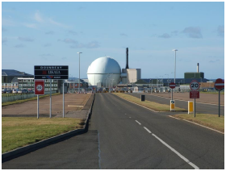
195 (8.1)
MacKay’s conclusion
176.5 kwh/p/d
(7.3 kW/p)
Every Big Counts
Gap | 60 x 10⁶ p UK | 1 x 10⁹ p EU
For 4.8 kW p⁻¹ | 288 GW | 4.8 TW
@ 15W m⁻², 85% trans | 150x150 km | 600x600 km
135 (5.6)
Other
People’s
back yard
England
Supply Europe
Gap
117 (4.8)
Nuclear or concentrating
Solar in deserts
The “bigs”
Fast breeder test facility
Dounreay, England
Heat 9.2
18 (0.75)
Nuclear
288 1 GW reactors
Jet 30
Car 10
consumption
cut
Max
green
reasonable
solution

Slide 38
Conclusions
Renewables must be supplemented by some combination of desert solar or nuclear
Renewables compete with agriculture for land surface
~30% reduction in demand possible
10.5 billion people can have ~135 kWh/p/d of sustainable energy and a European standard of living
Choices required
Resource supply is challenging no matter what choices

