Slide 1
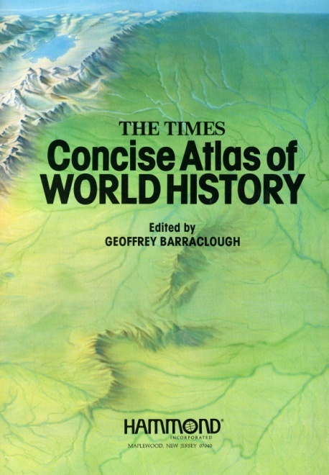
A Brief History of Humanity (constant change, increasing organization and specialization)
Lecture 10: Fundamentals of Energy and Mineral Resources
L. Cathles
2017
Most figures from:

Slide 2
History is a tale of accelerating:
Trade
Technology
Human dynamics
Size of collaborating groups
Knowledge
Resources, technology, and history intertwined
History is context for discussion of resources and future

Slide 3
Humans, products of the Pleistocene (ice ages), developed in the Holocene (current interglacial)
Homo sapiens very recent (50-100ka)
10 ka
history
50 ka behavior
250 ka modern humans
1.5 fire
2.8 Ma
0.4-0.25 Ma
Modern humans
40 ka
2.8 Ma Homo Habilis
(stone tools)
1.8-1.3 Ma Homo ergaster
(fire, complex tools)
1st out of Africa
Australpithecus sediba 1.977Ma
1.5 Ma
fire
stone
behavioral
modernity
glacial
LGP
2.5 Ma
0.5 ma
Post-glacial period
3200 BP
1200 BC
5150 BP
3150 BC
Mesolithic
Neolithic
Bronze Age
Iron Age
Cu
10 ka
8
bow, cutting tools
6
farming
4
2
0
Notes:
Man in Asia 2nd interglacial 400,000-200,000 BC
Peking man, Java man ~350,000
Dominant view is that anatomically modern humans migrated “Out of Africa” 10k to 100kBP. Now ~1.5 Ma; 6% Neanderthal
Alternative view is that Homo erectus migrated “Out of Africa” ~2.5 MyrBP and Homo sapiens evolved in separate interbreding populations. [last 2 lines Wikipedia, 2010]
Homo Sapiens Java 40,000, China 30,000 >>>beginnings of agriculture soon thereafter
Copper and bronze in SE Asia ~3000BC, China 1600BC coinciding with first Historical Dynasty (Shang); SE Asia Dong Song bronze drums distrib widely; bronze basis of great Indus civilization. But iron was required for empires that were not just loose feudal overlordships which moved capitals frequently
5000 BP (3000 BC) advanced civilization in Egypt
New Guineans reached Fijii ~1300 BC, Marquesas 300 AD, Hawaii ~800 AD, New Zealand 850-1100 AD.
Sahara and rise in SL cut off Africans and australian aborigiones who remained hunter gathers. Camel and trade impacted Africans

Slide 4
120m lower sea level allowed human dispersion
Dispersion was very rapid
12,000 BP
LGM
ICE
4p 100 km⁻²
Land bridge
12ka
11.3ka
FAVORABLE
in DRY periods
LAND
BRIDGES
11.25ka
Ice@12 ka
11.15ka
11 ka
FAVORABLE
in MOIST periods
10.5ka
Rising Holocene sealevels isolated different groups
Human population increased 16x from 10,000 to 6,000 BP
20,000 BP
(agriculture)

Slide 5
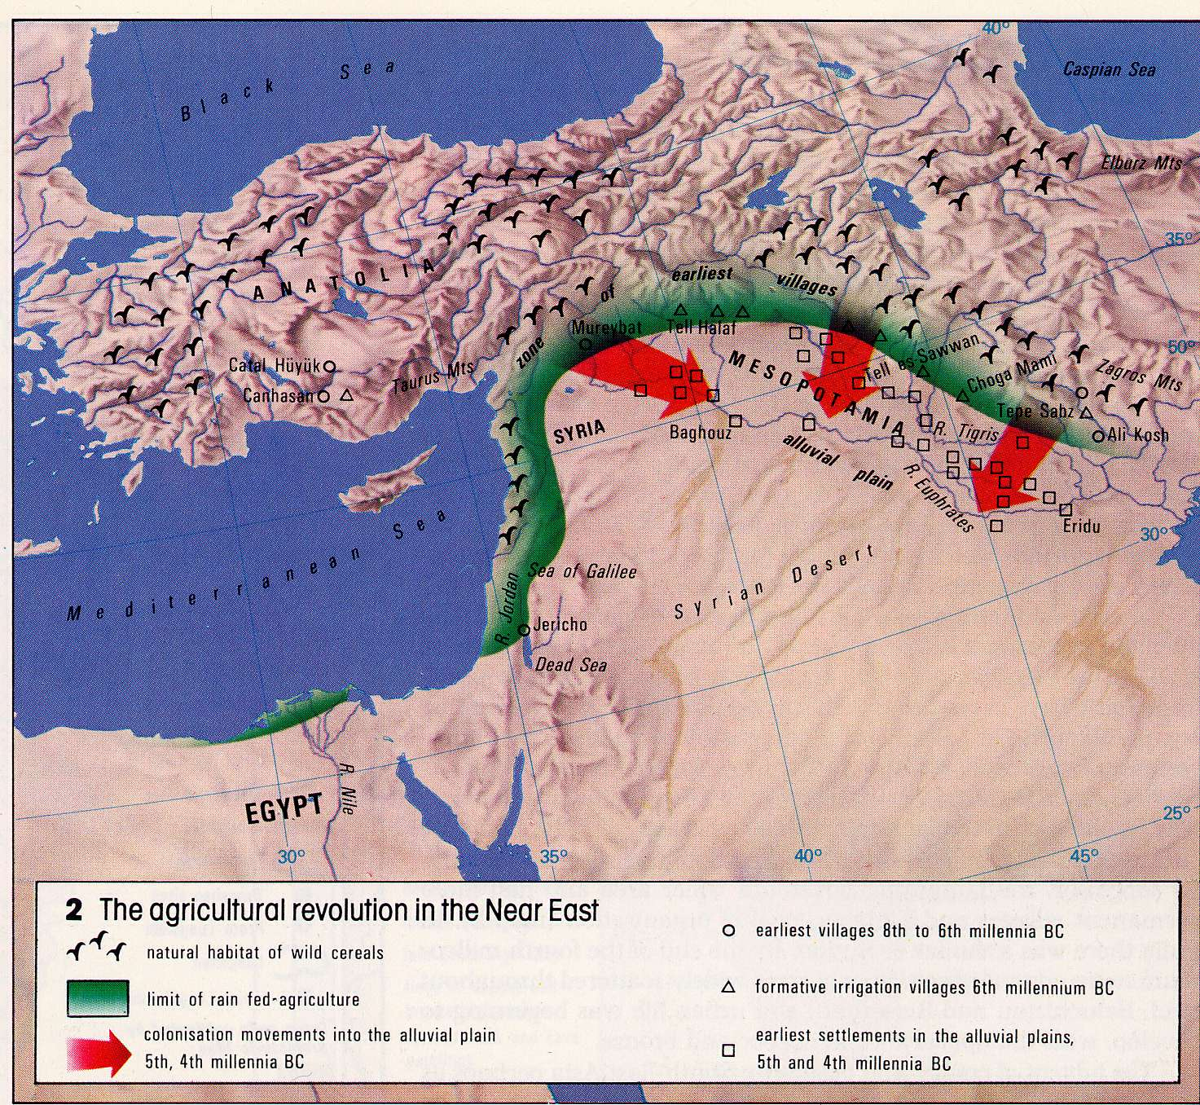
~8000 BP select, breed, domesticate plants & animals Jerico traded for stone tools from Anatolia
Slow (spotty) start of neolithic (agricultural) revolution…
Wild cereals (uplands, 12” y⁻¹)
earliest villages
formative irrigation
Anatolia
Cities developed later.
Jericho ~30 acre proto-city
colonization into
the alluvial plain
Trade
600 km
Irrigation ~7000 BP
Jerico
(cooperation)
~8000 BP

Slide 6
Exchange of seed, animals was important
camel
wheat
maise
millet and rice
potato
irrigation
The secrets of animal husbandry and farming were shared
Sharing/collaborating possibly as important as intelligence
Notes:
Maise in Mexico
Millet and tice in China -> near east ->Mediterranean Europe
Cereal cultivation Near East -> Asia 3000 bp
Wheat and barly in remote mt uplands (rainfall limit of 12”/yr
Irrigation 7000-6000 bp
Asia yam and bananna -> Asia 3000 bp
Central Asia Camel -> Africa 100 BC w/ rapid expansion
N America potato -> europe (1500 AD) enabled feeding of incr pop europe (Napolean and swiss)

Slide 7
Dispersion continued till quite recently
… up to 900 BP
800 AD
Hawaii
300 AD
Marquesas
Fiji 1300 BC
850-1100 AD
New Zealand

Slide 8
Schools of Cu Technology 6500-3500 BP
4,500-1500 BC
Exhaustion ended Bronze Age
Cu workings starting 10 kabp
Cu
Oman
6500 BP

Slide 9
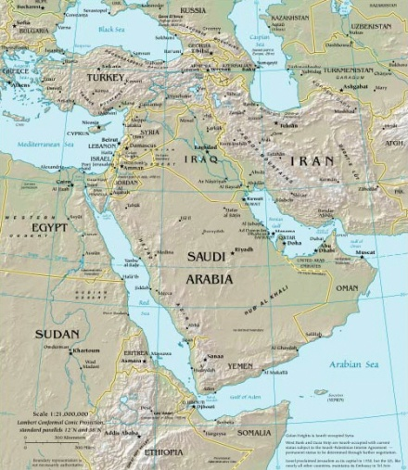
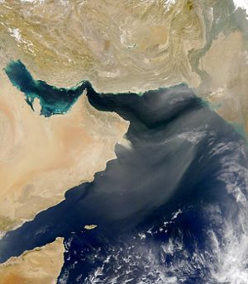
Archeology
Muslim
grave site
Oman
Slag (6000 yrs BP)
4000 BC
Oman
80% of Cu for copper age came from Oman
Ground and smelted
multiple times

Slide 10
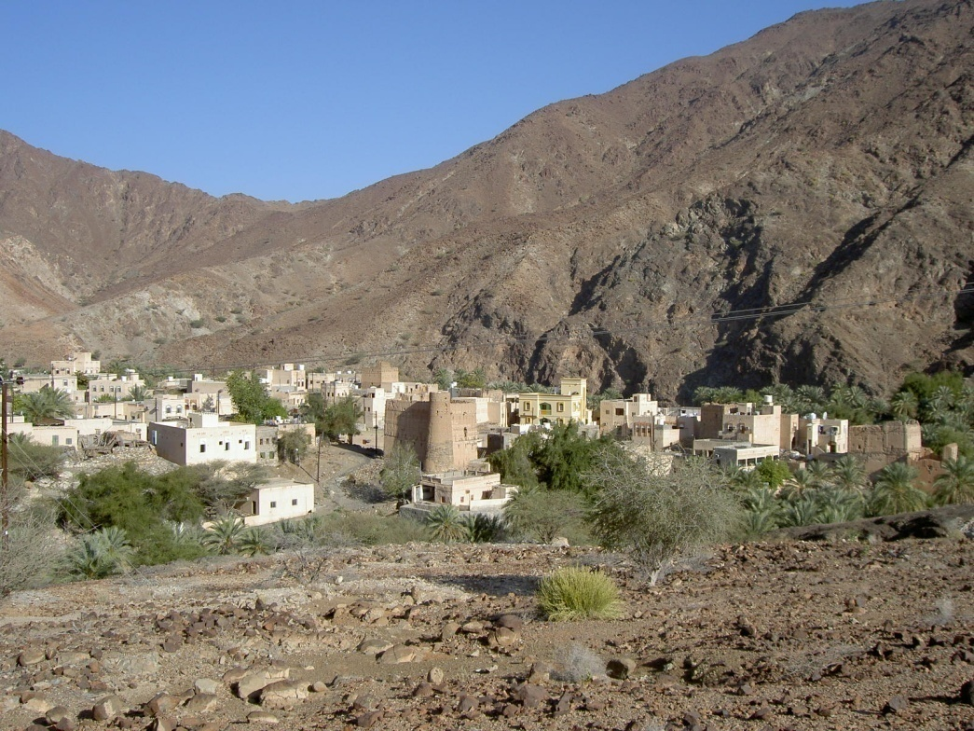
Towns at moho
Oasis guard towers
…up to 1950
Hajir (“the one who goes to Mecca”)
1800
Madrass (school)
falange

Slide 11
Growth of civilization: (1) Egypt 3500 BC (2) Mesopotamia (Hammurabi 1782-1750 BC)
Organization and control
~3750 BP
(Riverine societies developed agriculture, irrigation, cities and city-states)
Troy
Babylon
Memphsis
Breadbasket
of Romans

Slide 12
The Greeks and Crete
…to convert to BC subtract 2000
3500-1200 BC
4500-3200 BP
Invasion ? 1900 BC
Invasion 2300-2200 BC
Colonization 2500-1450 BC
Transport by sea– coastline and ports were THE advantage

Slide 13
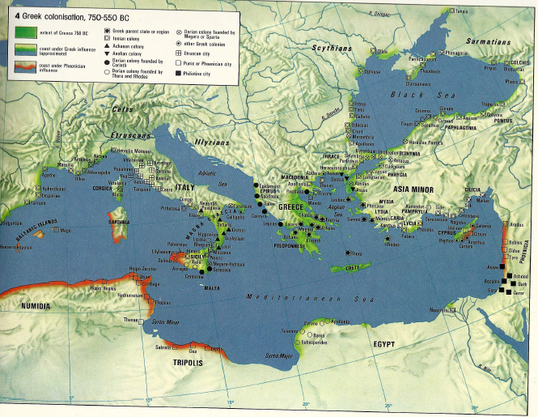
750-550 BC
Greek Colonization
80% Bronze age Cu from Cyprus, exhaustion of Cornwall Sn

Slide 14
George Constantino, Director Cyprus Geological Survey
3,500 years production of Cu (2780BC to 600 AD when water table stopped)
Cu more valuable (military) than Au, Ag
King Alleysia wrote King of Egypt: sending 3 tons Cu, please send back ebony bed inlaid with Au and Ag, and chariot of Au and Ag)
4x10⁶ tons slag tell history of metallurgy
Charcoal fuel requires 16 re-forestations of Cyprus
Aphrodite rose from sea from east as did Cyprus
husband Festus was god of metallurgy
son Adonis, created by thunderstorm from branch of pine

Slide 15
New World Civilizations radiated from Central America
1500-600 BC
(~Greek Era)
600 BC
Mexico &
Mayans
maise
mining (obsidian)
pottery
Au, Ag, Cu
1500 BC
1200 BC
Aztecs

Slide 16
The Greek World
Pericles, Socrates, Sophocles, Euripides, Parthenon
(transport and trade was by sea)
497-185 BC
2500-2200 BP
Prefab temples

Slide 17
To east lay Persian Empire
Persians (w/ Ionians) miraculously defeated at Marathon (490 BC) and Salamis (480 BC)
Peloponnesian wars between Athens and Sparta weakened Greeks
Defeated by Phillip of Macedon (Persia)– father of Alexander the Great- in 338 BC
550-331 BC
2600-2300 BP
Marathon
Salamis
338 BC
Phillip of Macedon beats Greeks

Slide 18
Under “Alexander the Great” Macedonia became world power (Adriatic to India). Extended Greek influence and prepared way for Roman Empire
323 BC
2323 BP
Empire Boundary
Routes of
Alexander
Alexander the Great died at 32 and empire fill apart
but he founded over 70 cities as cultural centers…
Pupil of Aristotle

Slide 19
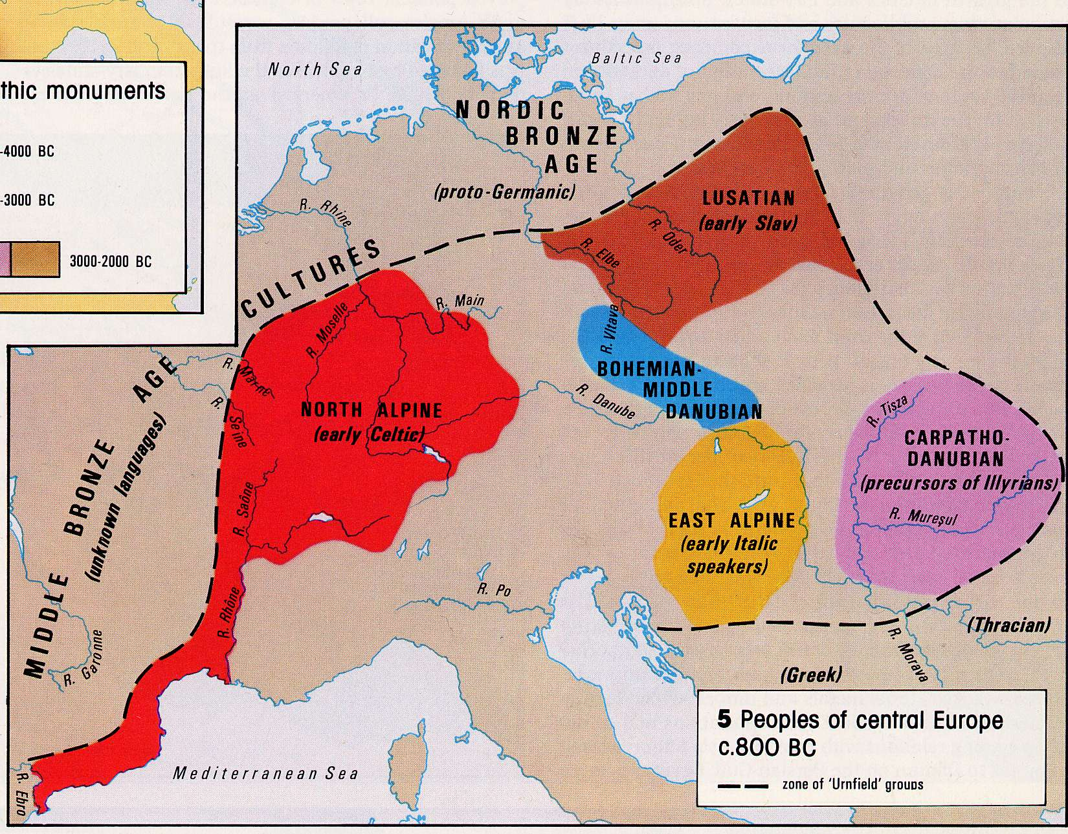
Wheeled vehicles and plough allowed cultivation of heavier soils, human population increased greatly. Urnfield culture complex benefited from introduction of iron 1000-800 BC
Urnfield Groups

Slide 20
The Celtic Empire (ironworkers/arms)
200 BC
Celts
raids
Contact with Mediterranean stimulated Celts, but prepared way for Caesars campaigns

Slide 21
The Roman Empire (264 BC -565 AD)
800 years
2300-1400 BP
…longevity required constant defense, raising of armies, etc.
Byzantium
Division
Roman
Under barbarian pressure Diocletian divided Empire. Western fell to barbarians, but Byzantium survived another 1000 years.

Slide 22
Trade Routes at 200 AD
1800 BP
Kushan
Chinese
Persian
Indian
Greeks

Slide 23
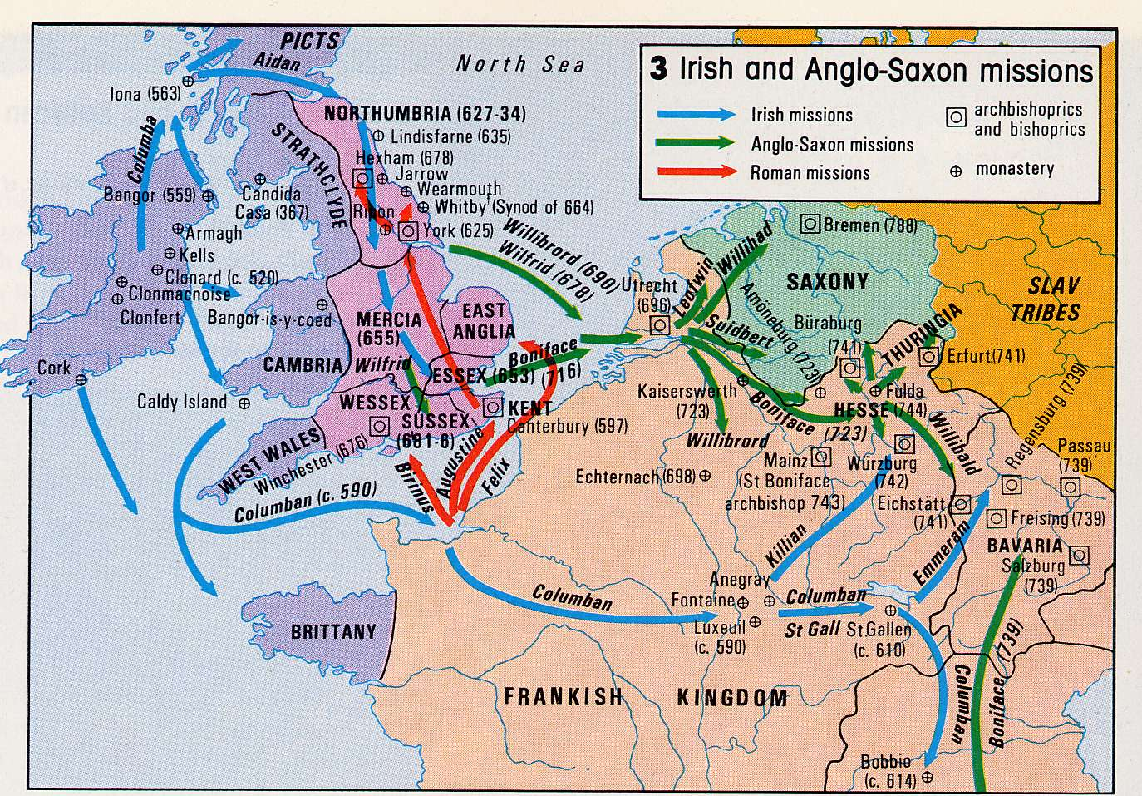
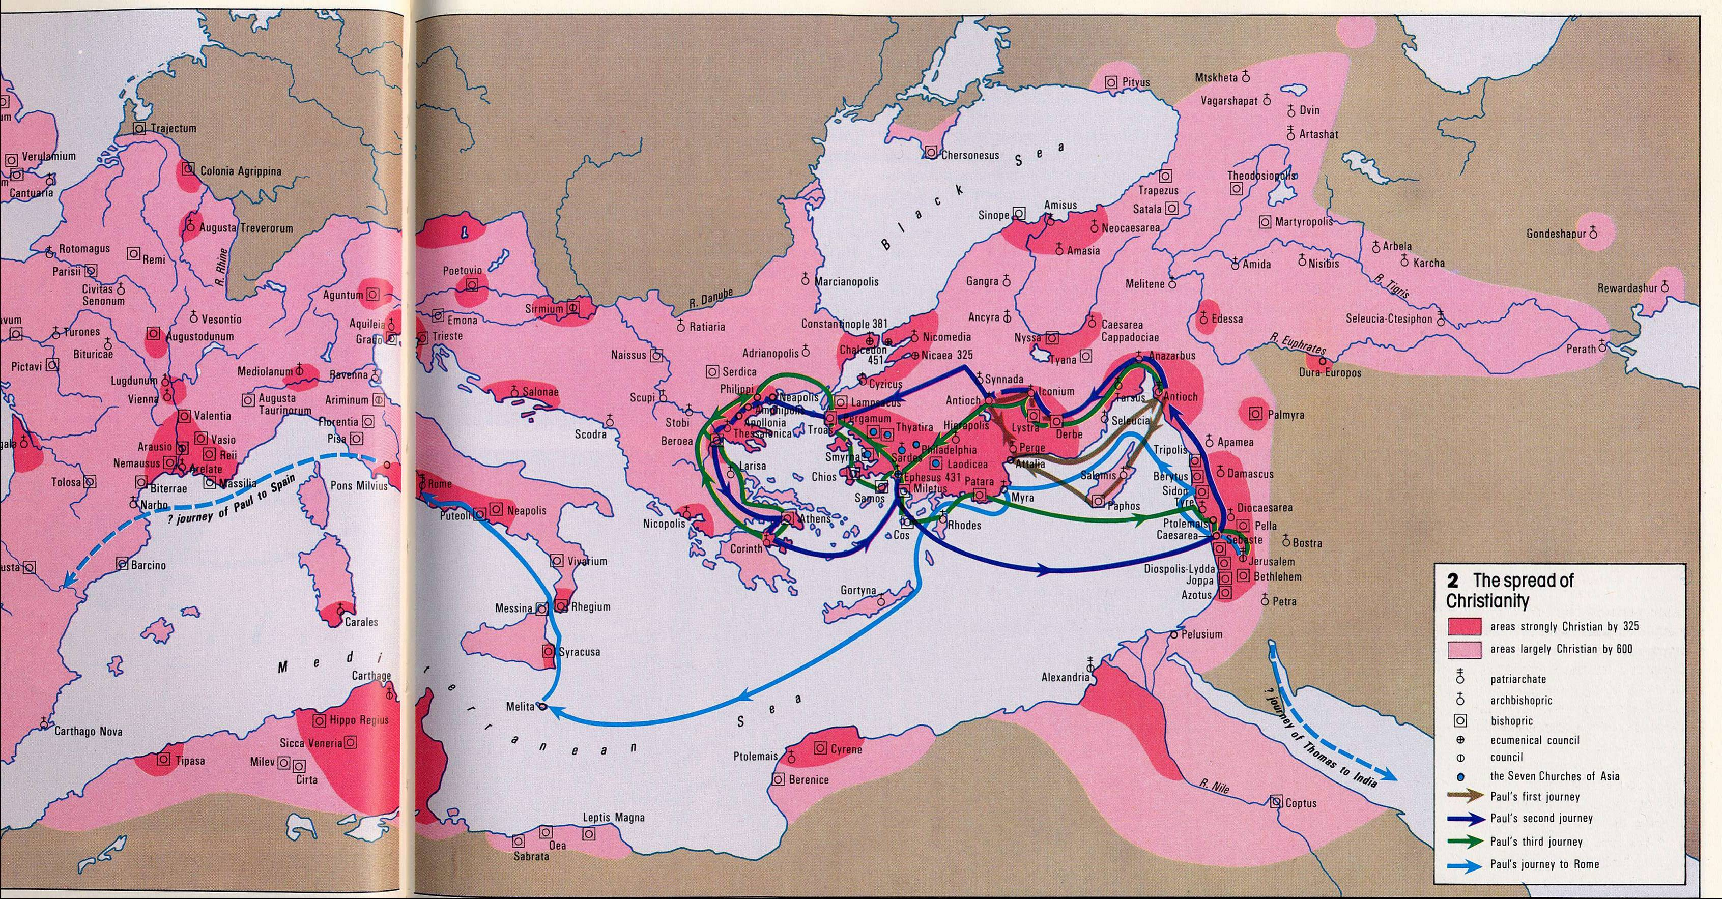
Spread of Christianity
Confucius
500 BC - 500 AD
Major Religions founded
St Patrick
b. 390 AD
Christian by325 AD
600 AD
Journeys of Paul
45-67 AD
(imprisoned in Judea and Rome)
Paul
Religion

Slide 24
Missionary drives by Coptic Christians (Egypt), and Nestorians exiled from Persia
~451 to 650 AD
1500-1350 BP
Nestorian
Coptic
Jacobite/Nestorian

Slide 25
Plagues 430 BC to 542 AD
2400-1500 BP
Trade and missions spread plague…

Slide 26
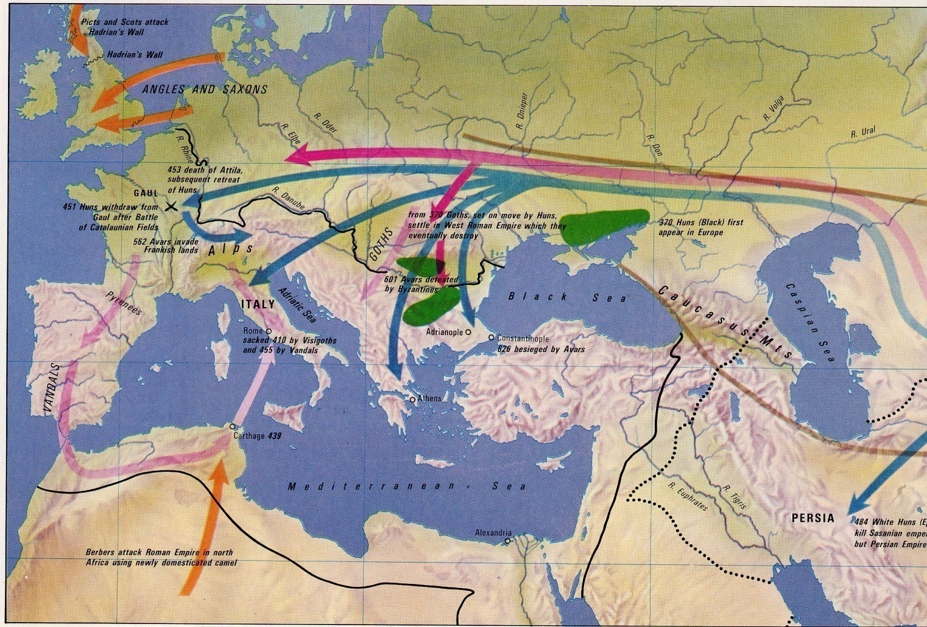
Barbarian invasions and the fall of Rome…
1590 BP
Huns induce germanic migration. Vandals and Visigoth sack Rome in 410 AD.
Picts and Scotts breach Hadrians wall. Angles and Saxons invade England.
Goths settle in Western Roman Empire.
Avars induce Slaves to move into Greece and Balkans
Angles and Saxons
Avars
Goths
Huns
Vandals
453 AD Attila dies and Huns retreat (Battle of Catalaunian Fields)

Slide 27
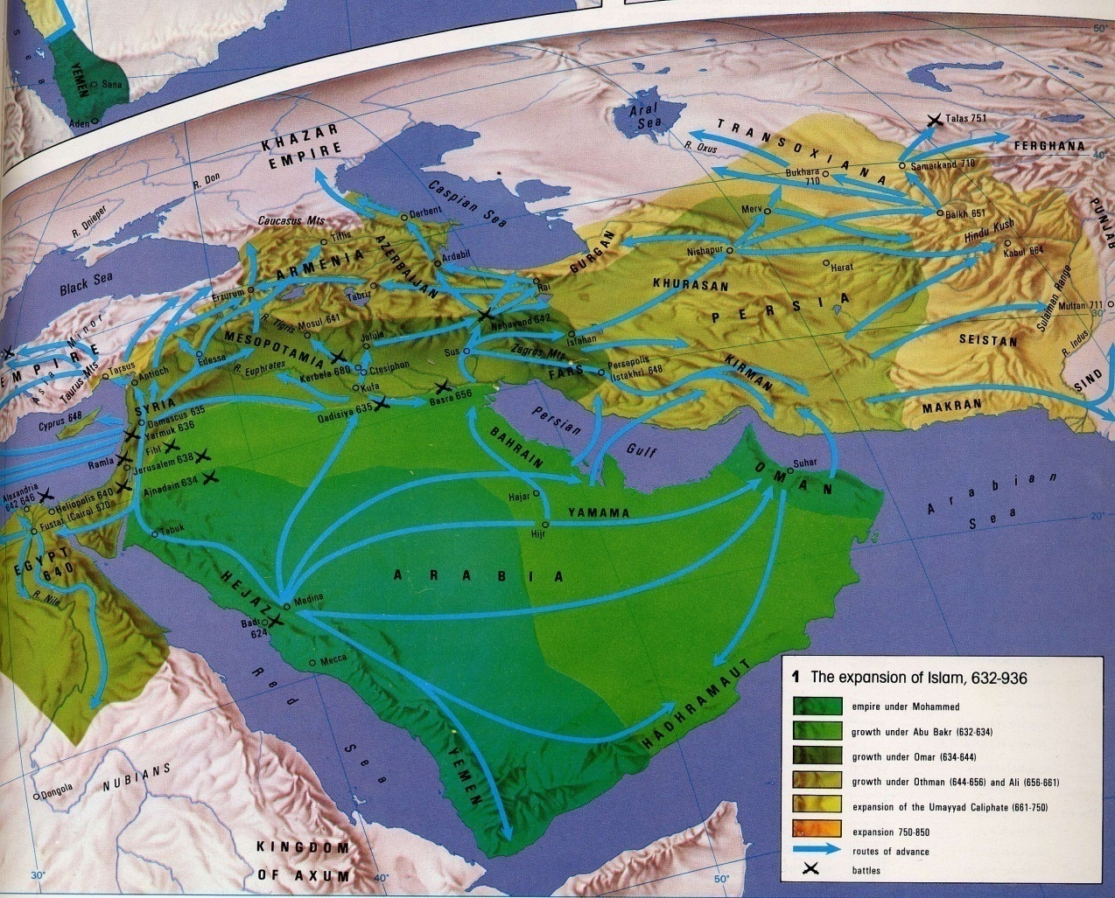
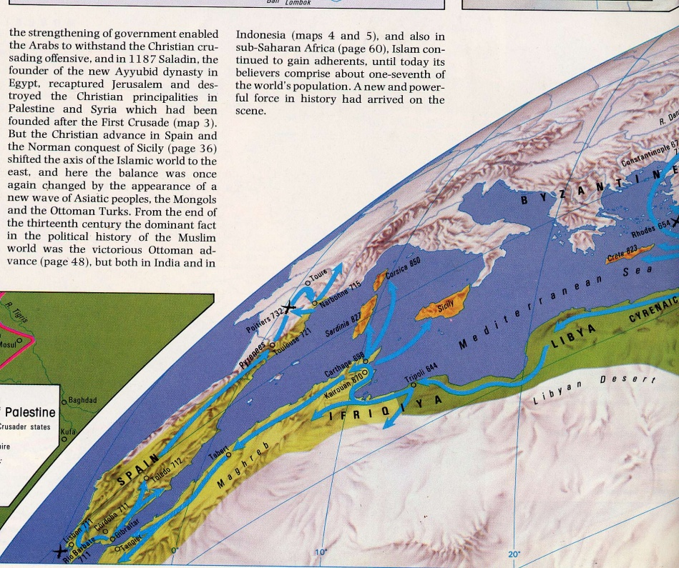
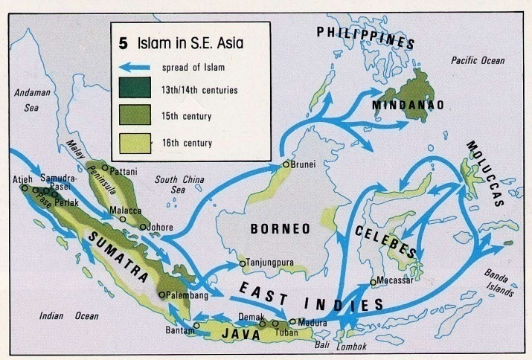
The Islamic World 632-1517
(885 years)
1400-500 BP
“Most important event between
fall Rome and European Exploration”
Constantinople
Routes of advance
637 AD Byzantines defeated in Palestine
643 Persia is overrun
751 Defeat Tangs
673,717 failed to take Constantinople
750 less aggressive Abbazid dynasty
945 shorn of political power→ decline
13th-16th C

Slide 28
France expands (Charlemagne)
…brief stability
714-814AD
1286-1186 BP

Slide 29
Invasion by Vikings and Muslims
600-950 AD
Y= Christian borders
Magyars from east (r)
Took Hungarian Plain
Attack N Italy, Gm
Sarcens from south (b)
Pillaged Rome 846
Deep into Gaul
Vikings from north (p)
Orkney and Shetland
Ireland (841 Dublin)
911 France gave Normandy
950AD: Mediterranean Muslim Lake
but then Arab unity dissolved
Viking Invasions/raids
Christian
Magyar Invasion
Muslim-Christian Divide
200 yrs Arab rule
Saracens sack Rome in 846

Slide 30
Byzantium (E. Roman Empire) calls for help…
Constantinople
Mazikert 1071 AD
929 BP
Lure of Egypt and Asia, and losses to German tribes
628 Persian threat met at Nineveh
Constantinople held 674, 717 using peasant militia “themes”
976 drove Arabs back to Jurusalem
1071 Seljuk turks beat Byzantines at Manzikert
Byzantium calls on west for help… big mistake

Slide 31
Reconquest by Italian fleets of Genoa and Pisa
Genoa attacked N. Africa
Venice cleared Adriatic
First Crusade 1096-1099
Started re-conquest of Spain, halted, continued in 1200s
Royal authority decreased…feudalism bloomed
Norman Conquest of England (1066) – spread democracy
950-1149 AD
1050-851 BP

Slide 32
Christianization of Europe
~1000 to 1200 AD
1000-800 BP
Brown = routes of missionaries

Slide 33
Expulsion of Jews
Askenazi→Poland and Lithuania (the Pale)
migrations
1290
Sephardic
1497
1492
expulsions
Crusades induced intolerance. 3rd and 4th Lateran Councils (1179, 1215) passed discriminatory legislation… expulsions.
821,785 BP

Slide 34
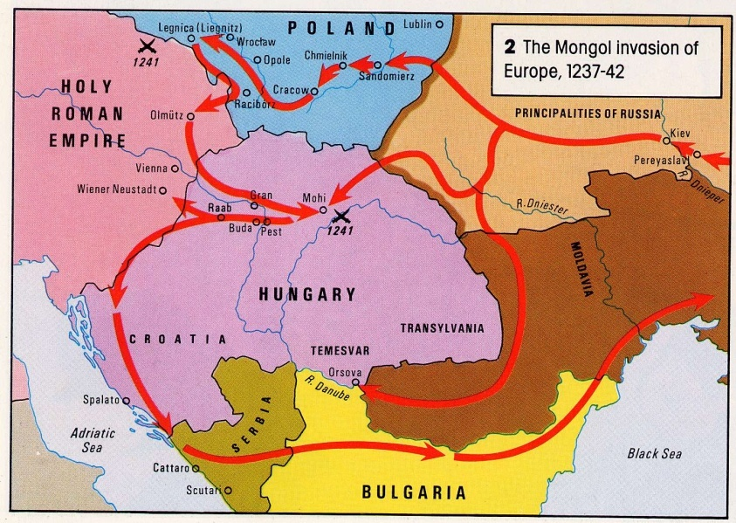
Mongol Invasion of Genghis Kahn and Sons..
1211-1234 overran Ch’in empire N China
1280-1376 defeat Sung army, attack Java and Japan
1220 defeat Muslims at Khwarizm
Genghis died 1227, divided empire and sons carried on.
1237-8 overran Russia, 1240 sacked Kiev
1241 destroyed German-Polish army at Legnica
1258 sacked Baghdad (Abbasid capital)
1260 Muslim victory at Ain Jalut stopped Mongols
789-740 BP
Russia Mongol tributary
for 200 yrs
Tamerlane (1336-1405) last great Mongol conqueror died attacking China
1696 Mongolia under China
304 BP
Sacking of Kiev moved Russian capital to Moscow. Russia is spiritual descendent of Byzantine Empire
595 BP
Marco Polo (left Venice at 15 yrs), 10 years in court of Kublai Khan, learned Mongolian; Khan empire made travel safe.

Slide 35
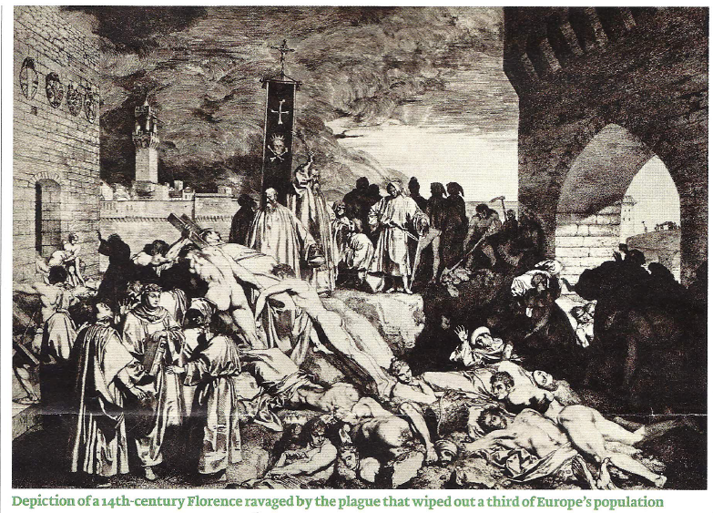
The Black Death
1346-1353 AD
647-654 BP

Slide 36
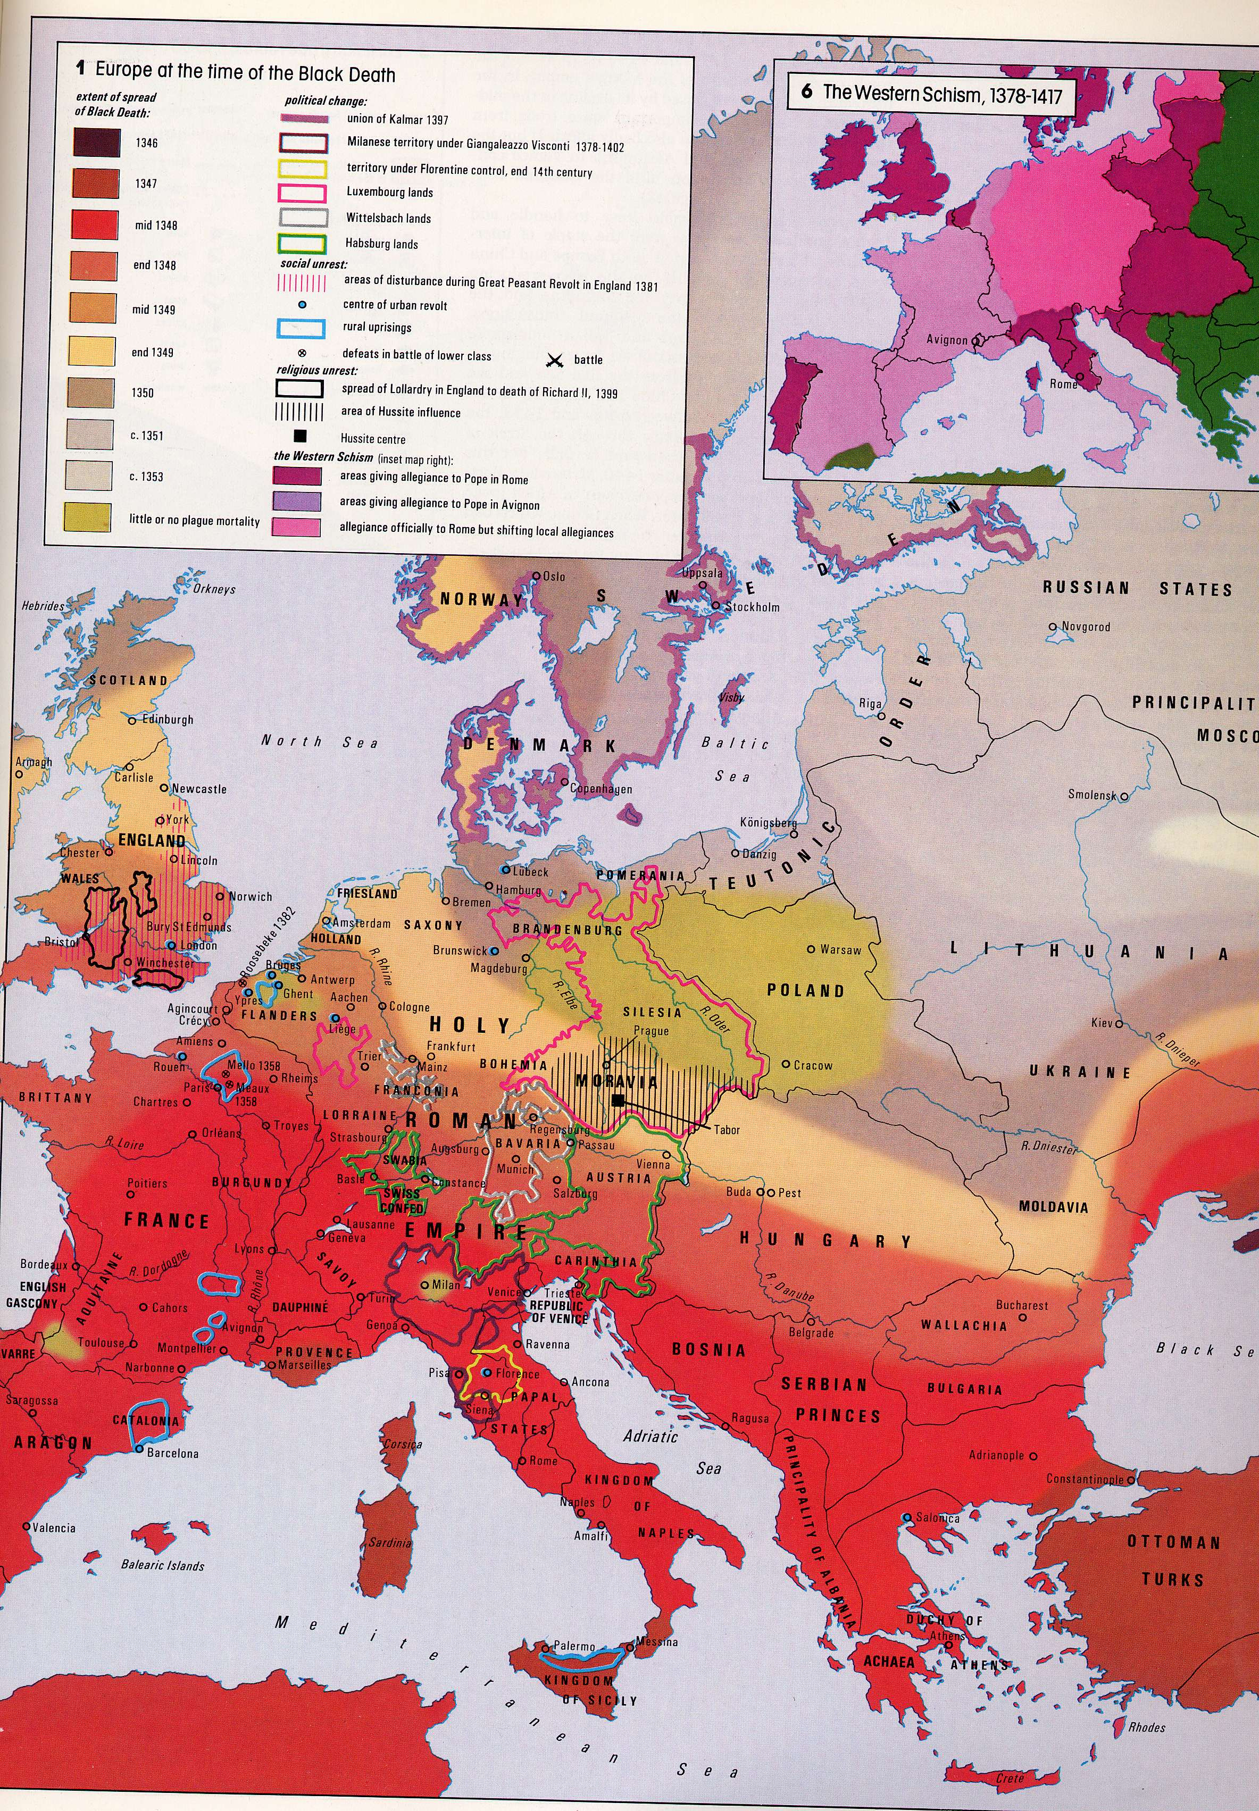
Black Death 1346-1353
Peasant
revolt
Urban
revolt
shifting
Rome
1353
none
Avignon
Two Popes
1350
1349
1348
647-654 BP
Little ice age
Great famine 1315-1317
weakened
Rural uprisings
1347
30% of Europe died
1348

Slide 37
Muslim Expansion…but landlocked
revitalized by Sulfi Mysticism and infusion of central Asian Turks
from 1354 (646 BP) Christian west was on defense
1453 Constantinople fell and Black Sea became Ottoman lake
Three Muslim Powers: Ottoman (Sunni), Persia (Shia- Ismail Savafi), Mughal Empires
Ottomans defeat Ismail in Tabriz 1516, overrun Hungary 1526, besiege Vienna 1529
Persian
Ottoman
Mughal

Slide 38
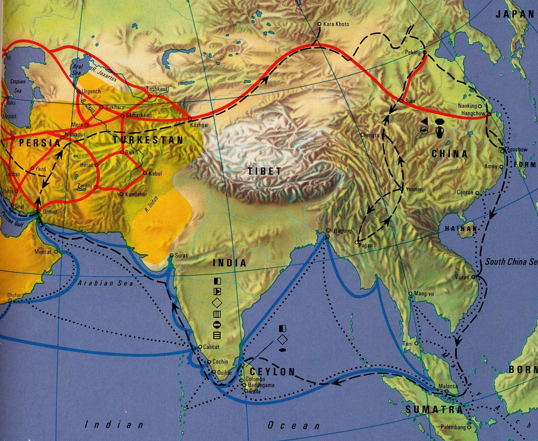
Medieval trade routes blocked
… big mistake
~1000-1500 AD

Slide 39
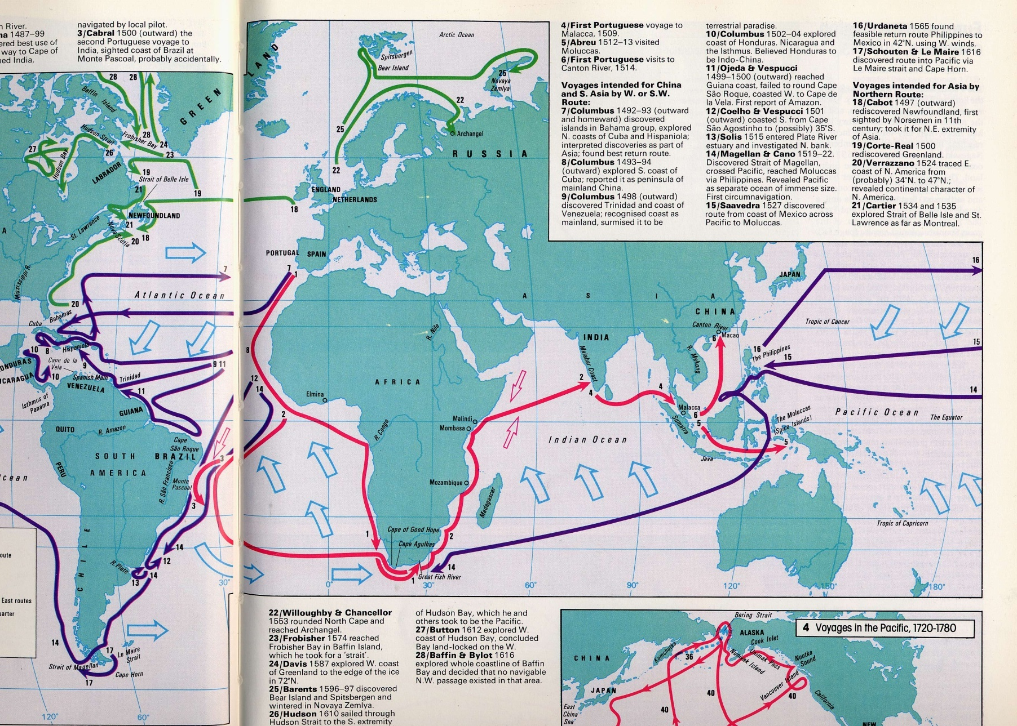
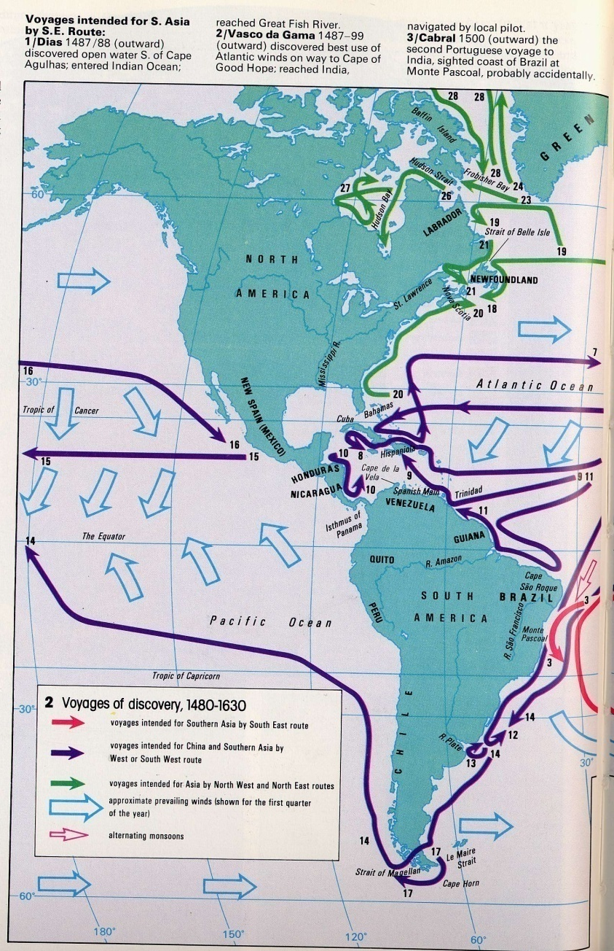
Europeans Explore for Safer Routes…
1497
1492
1527
1487-99
1519-22
1519-22

Slide 40
Chinese Exploration
…but Chinese were first
579 bp
Explored and mapped the entire world
…but then became isolationist under mandarin control

Slide 41
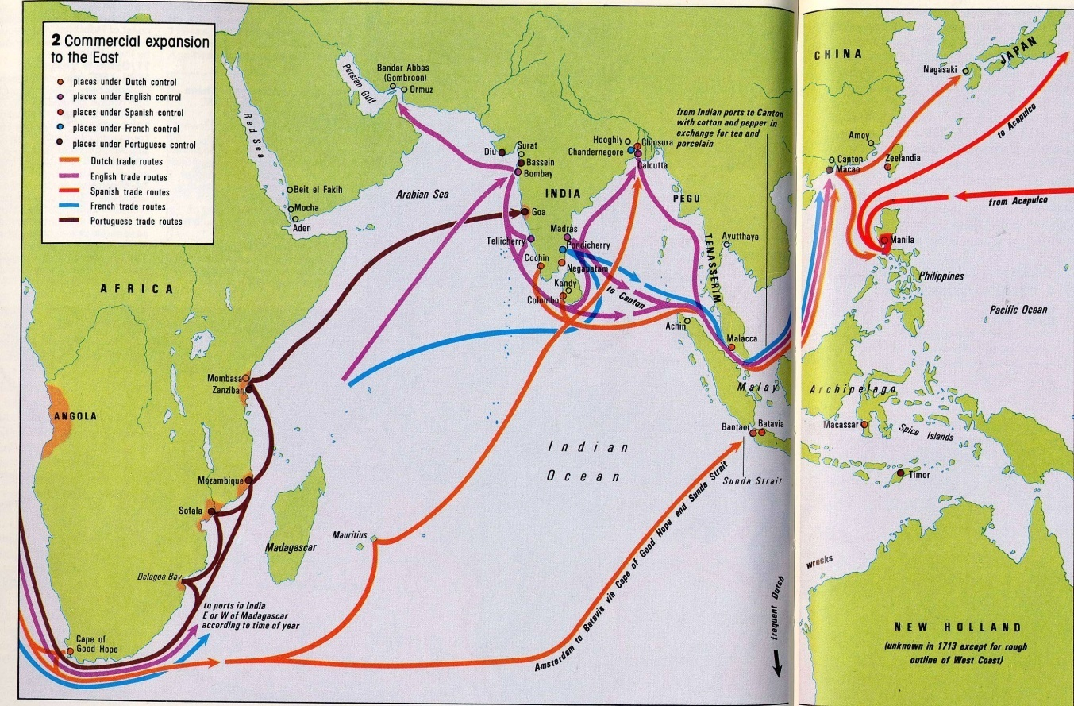
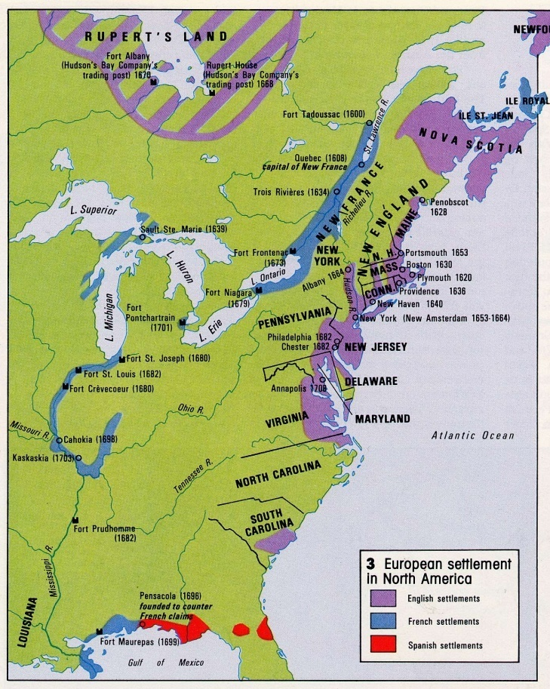
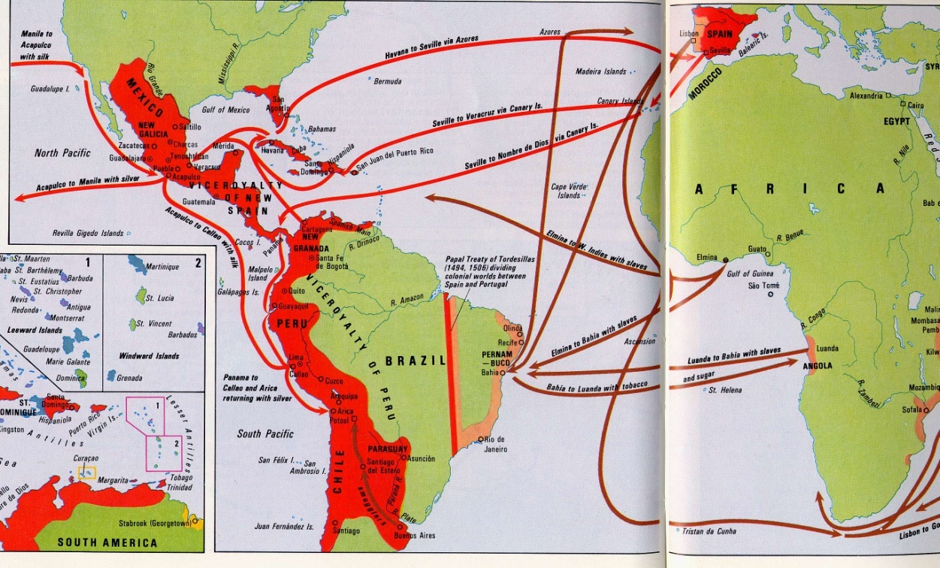
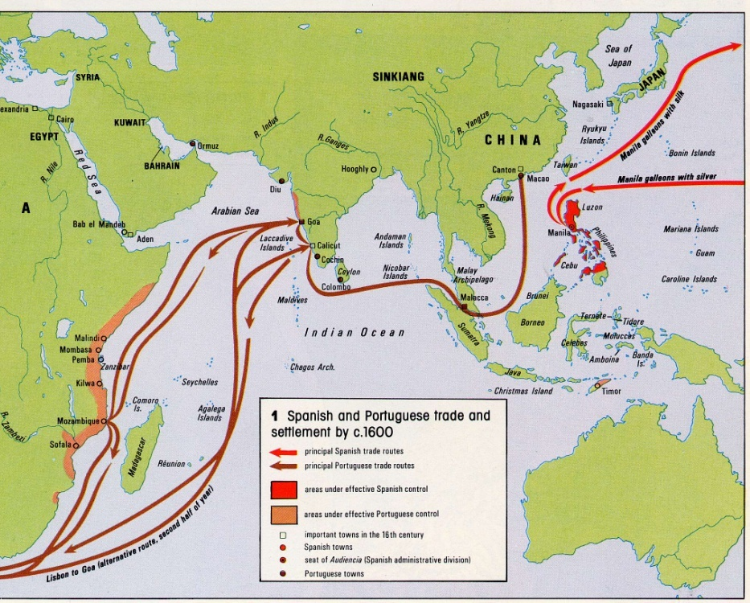
Trade
Colonies
Gold

Slide 42
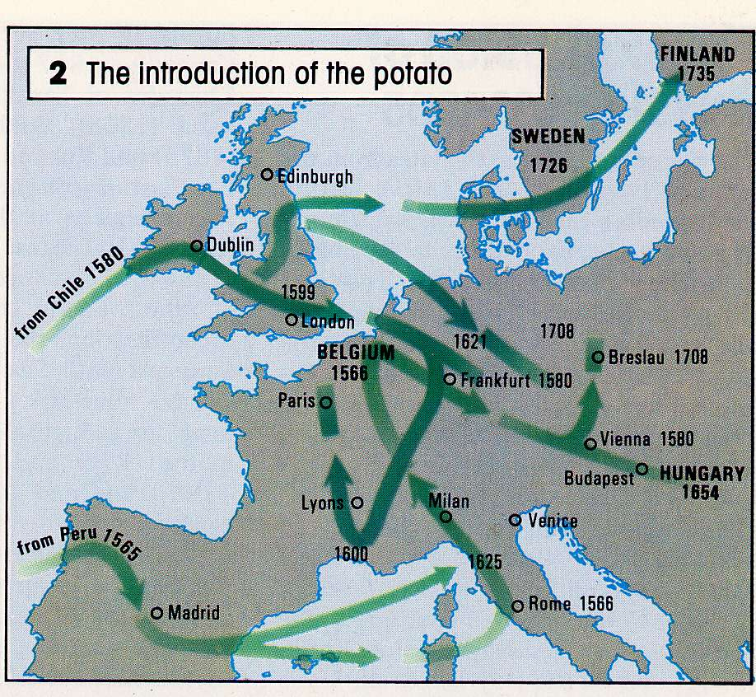
Exchange
Potato fed Europe’s growing population

Slide 43
Serious global trade begins…
1775 AD
225 bp

Slide 44
Oil
Drake well 1859
145 bp
The ultimate example (so far)
Scale, importance
Energy is food for civilizations
Will discuss in Lecture 16

Slide 45
Yrs Before 2000 AD
8000
7000
6000
5000
4000
3000
2000
1000
0
The accelerating sweep of history
Oman
Cu
Egypt
Mesopotamia
Crete
Fe
Persia
Greece
Alexander the Great
Celts
Plagues
Trade
Romans
Barbarian Invasions
Charlemagne
Vikings
Islam
Crusades
Bizantium calls for help
Christianity
Black Death
Mongols
Muslim
Expansn.
Explor./coloniz.
Oil

Slide 46
Generalizations
Increasing size of collaborating units
Family clusters→tribes→proto-cities→city-states→empires (Egypt, Macedonia) →religious groups
Trade, increasingly long-distance
Competition/conflict (between ever-larger groups)
Accelerating Technological change
Agriculture, animal husbandry, metals, tools, ships, knowledge
Most dynamic most successful

Slide 47
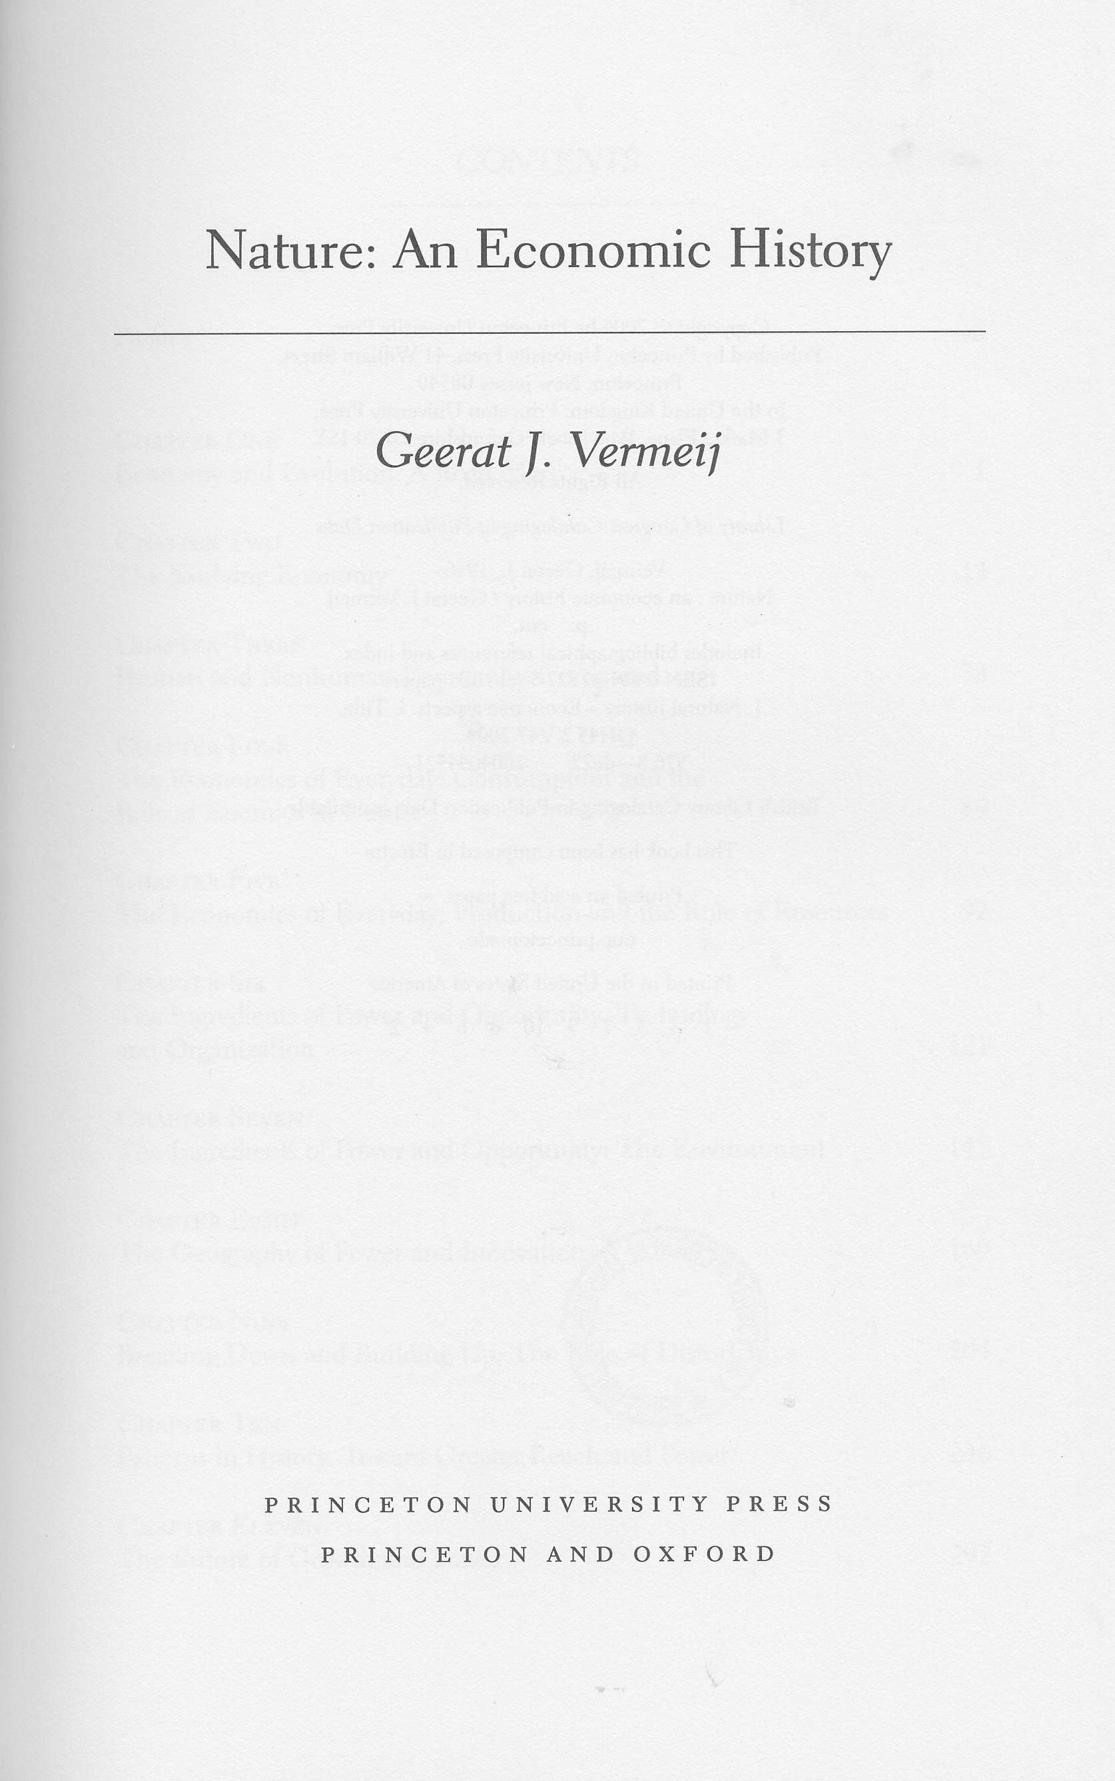
Biological Perspective
Trends
↑ power (metabolism, communality, rate of energy consumption)
↑ dominants
↑ productivity
↑ complexity
Predators (producers and traders) drive change
Performance more important than efficiency (mammals vs reptiles; brain=25% energy)
Size an advantage
Continental species out-compete island species
Groups of individuals beat individuals (packs, ants)
Tribes → nationalities → religious groups
Storage an advantage
banking, world trade in food
Growth enables adaptation
Increases range of choices
Avoids zero-sum-game dilemma
Successful survive and control future
Success determines what works
What works is show by biological (and economic) trends

Slide 48
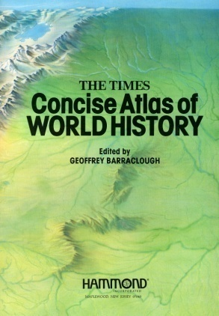
References
Barraclough, Geoffrey, 1982, The times concise history of world history, ed. Hammond, Inc., Maplewood, New Jersey,184p.
Vermeij, Geerat, 2004, Nature: an Economic History, Princeton Univ. Press, Princeton and Oxford, 445 p.
Yergin, Daniel, 1991, The Prize, Free Press, New York, 881 p.
Menzies, Gavin, 2002, 1421 The Year China Discovered America, William Morrow, New York, 552 p.
Tim Harford, 2011, Why success always starts with failure: Adapt, Farrar, Straus and Giroux, New York, 309p.

