Slide 1
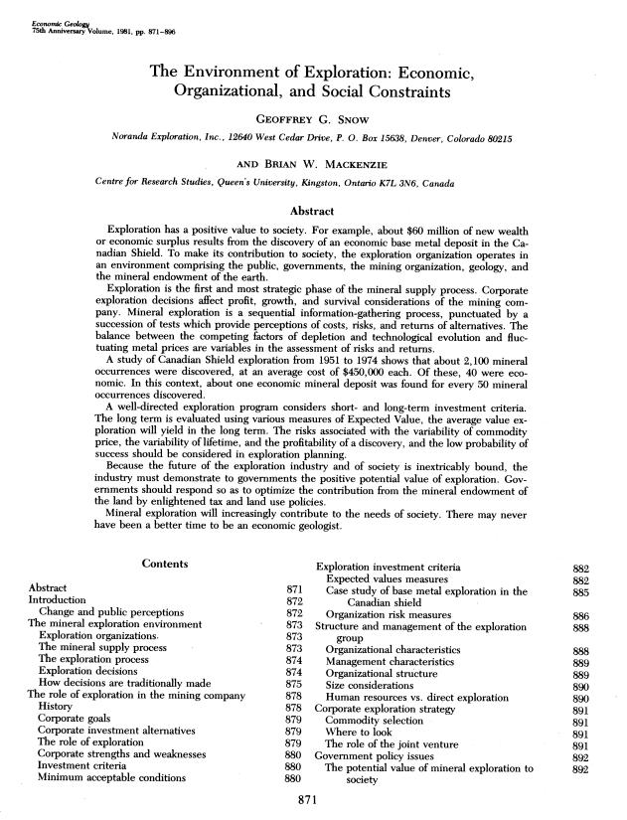
Economic Analysis
Lecture 7: Fundamentals of Energy and Mineral Resources
L. Cathles
2017
Snow and Mackenzie (1981)

Slide 2
Economic Terms
Return on Investment (ROI) = net return / total cost
Example: sell asset for $1.5 million
total cost $1 million
net return = $1.5-$1.0 = $0.5 million
ROI = $0.5 / $1.0 = 50%
Future Value (FV) = expected value of asset some time in future
Present Value (PV) = what you would pay today for an asset of
some stated future value at some discount rate
Discount Rate = rate at which you can borrow money
Present Value Interest Factor (PVIF) = fractional value today of
future asset
Net Present Value (NPV) = present value of one or more cash flows
less any initial investment cost
Internal Rate of Return (IRR) = discount rate at which NPV is zero
Levelized Cost = discount rate at which NPV=0 for specified
discount rate, plant life, no tax, no subsidies

Slide 3
Future Value
Simple Calculations in “NPV- simple and mine examples” on BB
Year | Start Value | Interest | End Value
1 | 100,000 | 10000 | 110,000
2 | 110,000 | 11000 | 121,000
3 | 121,000 | 12100 | 133,100
4 | 133,100 | 13310 | 146,410
5 | 146,410 | 14641 | 161,051
 | Discount rate = |  | 0.1
Present Value
=100,000×(1+i)
=100,000×(1+i)²
=100,000×(1+i)⁴
Future value
Change this to 0.08. Future value changes to $146,933
Present Value of $161,051 at 10% discount rate = $100,000
Present Value Interest Factor = 100,000/161,051 = 0.621
PV of $161,056 in 5 years at DR=10% = $161,056 × 0.621 = $100,000
PVIF = 1/(1+i)^{n}
See anonymous (2006)

Slide 4
Cash Flow Example
Change this to 0.08. NPV increases to 39.74.
Simple Calculations in “NPV- simple and mine examples” on BB
 |  | discount rate |  | 0.1
period | cash flow | PVIF | NPV
0 | -100 |  | -100
1 | 35 | 0.909 | -68.18
2 | 35 | 0.826 | -39.26
3 | 35 | 0.751 | -12.96
4 | 35 | 0.683 | 10.95
5 | 35 | 0.621 | 32.68
Initial investment
Net Present value after 5 yrs
Expenditure and
revenue stream
=1/(1+i)^{n}
See anonymous (2006)

Slide 5
Present Value Interest Table
Simple Calculations in “NPV- simple and mine examples” on BB
column
A
discount rate
Period | 0.02 | 0.04 | 0.06 | 0.08 | 0.1 | 0.12
1 | 0.980 | 0.962 | 0.943 | 0.926 | 0.909 | 0.893
2 | 0.961 | 0.925 | 0.890 | 0.857 | 0.826 | 0.797
3 | 0.942 | 0.889 | 0.840 | 0.794 | 0.751 | 0.712
4 | 0.924 | 0.855 | 0.792 | 0.735 | 0.683 | 0.636
5 | 0.906 | 0.822 | 0.747 | 0.681 | 0.621 | 0.567
6 | 0.888 | 0.790 | 0.705 | 0.630 | 0.564 | 0.507
7 | 0.871 | 0.760 | 0.665 | 0.583 | 0.513 | 0.452
8 | 0.853 | 0.731 | 0.627 | 0.540 | 0.467 | 0.404
9 | 0.837 | 0.703 | 0.592 | 0.500 | 0.424 | 0.361
10 | 0.820 | 0.676 | 0.558 | 0.463 | 0.386 | 0.322
row
17
=1/(1+$B$16)^A17
discount rate
years in future
or period
Example:
Present value of $161,051 five years from now for 10% discount rate
PV= $161,051 x 0.621 = $100,000
See anonymous (2006)

Slide 6
Present Value Interest Table
Period | 0.02 | 0.04 | 0.06 | 0.08 | 0.1 | 0.12
1 | 0.980 | 0.962 | 0.943 | 0.926 | 0.909 | 0.893
2 | 0.961 | 0.925 | 0.890 | 0.857 | 0.826 | 0.797
3 | 0.942 | 0.889 | 0.840 | 0.794 | 0.751 | 0.712
4 | 0.924 | 0.855 | 0.792 | 0.735 | 0.683 | 0.636
5 | 0.906 | 0.822 | 0.747 | 0.681 | 0.621 | 0.567
6 | 0.888 | 0.790 | 0.705 | 0.630 | 0.564 | 0.507
7 | 0.871 | 0.760 | 0.665 | 0.583 | 0.513 | 0.452
8 | 0.853 | 0.731 | 0.627 | 0.540 | 0.467 | 0.404
9 | 0.837 | 0.703 | 0.592 | 0.500 | 0.424 | 0.361
10 | 0.820 | 0.676 | 0.558 | 0.463 | 0.386 | 0.322
15 | 0.743 | 0.555 | 0.417 | 0.315 | 0.239 | 0.183
20 | 0.673 | 0.456 | 0.312 | 0.215 | 0.149 | 0.104
Finding mines more than ~10 yrs in advance of mining is not economic

Slide 7
Internal Rate or Return
Simple Calculations in “NPV- simple and mine examples” on BB
Change discount rate to 0.221. PV 5 years out will be ~0. Thus the internal rate of return is 22.1%.
discount rate when NPV = 0*: 0.221
period | cash flow | PVIF | NPV
0 | -100 |  | -100
1 | 35 | 0.819 | -71.33
2 | 35 | 0.671 | -47.86
3 | 35 | 0.549 | -28.63
4 | 35 | 0.450 | -12.88
5 | 35 | 0.368 | 0.01
* IRR = discount rate at which NPV=0
See anonymous (2006)

Slide 8
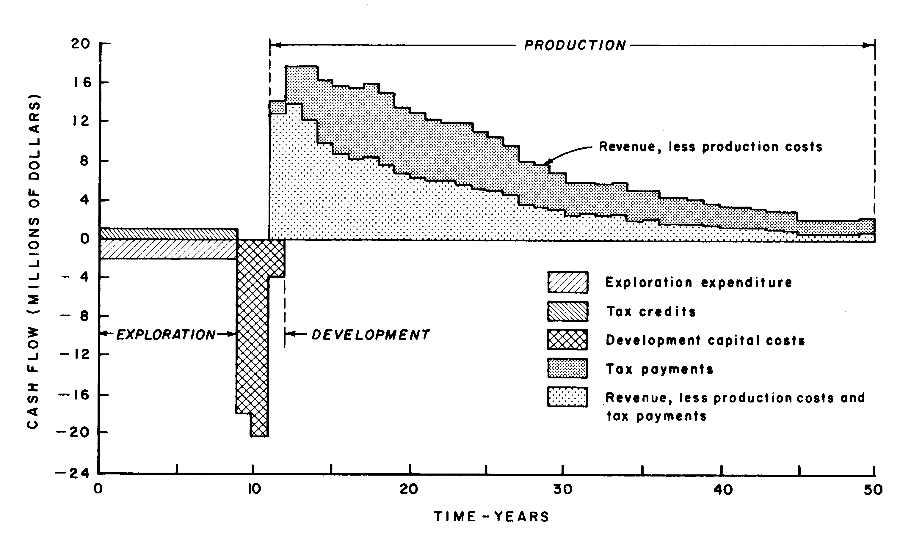
Cash Flow for a Typical Discovery
Tax
Exploration
tax credit
Snow and MacKenzie (1981)

Slide 9
Mining Base Case
Mining Base Case in “NPV- simple and mine examples” on BB
 |  | $ millions | $ millions |  |  | $ millions
 | year | exp/inc | tax | PVIF | NPV Tax | NPV
 | 1 | -2 | 1 | 0.926 | 0.926 | -0.926 |  | disc = | 0.08
 | 2 | -2 | 1 | 0.857 | 1.783 | -1.783 |  | tax incentive mul = |  | 1
 | 3 | -2 | 1 | 0.794 | 2.577 | -2.577 |  | tax mul |  | 1
 | 4 | -2 | 1 | 0.735 | 3.312 | -3.312
 | 5 | -2 | 1 | 0.681 | 3.993 | -3.993 |  | total income |  | 267.6
 | 6 | -2 | 1 | 0.630 | 4.623 | -4.623 |  | Net Income |  | 121.1
 | 7 | -2 | 1 | 0.583 | 5.206 | -5.206 |  | Tax |  | -146.5
 | 8 | -2 | 1 | 0.540 | 5.747 | -5.747
 | 9 | -18 | 0 | 0.500 | 5.747 | -14.751 |  | NPV |  | 13.834
 | 10 | -21 | 0 | 0.463 | 5.747 | -24.478 |  | NPV Tax |  | -22.009
 | 11 | 10 | -1.2 | 0.429 | 5.232 | -20.704
 | 12 | 18 | -4 | 0.397 | 3.644 | -15.144 |  | IRR=14.034%
 | 13 | 18 | -5.8 | 0.368 | 1.511 | -10.659 | no tax and no tax incentIve IRR = 16.9
 | 14 | 16.5 | -6.3 | 0.340 | -0.634 | -7.186 |  | no tax incentive IRR= 10.8%
 | 15 | 15.8 | -7 | 0.315 | -2.841 | -4.412
 | 16 | 15.5 | -7.3 | 0.292 | -4.972 | -2.018
 | 17 | 16 | -7.7 | 0.270 | -7.053 | 0.225
=0
exploration
Post-Expl
Delay
Post-Devel
Delay
development
61% to Gvmt
production
exploration cost ~ $8 million
NPV – expl cost = $22 million
146.5

Slide 10
Plotting NPV(t) for typical mine on Canadian Shield
See Parametric Variations Base Case tab on NPV-simple and mine examples spreadsheet on BB
NPV falls as discount rate increases
Concavity shows earlier expenditures and revenues dominate (because of time value of money)
There is NPV for Co and Government
2/3rd to Government, 1/3rd to Co (~60% tax)
More Co profits means more for Govmt
20
Co.
NPV
Tax
NPV
$22.0
$14.1
$8.9
IRR = 14%
15
Discount = 8%
$13.8
B
a
s
e
C
a
s
t
(
8
%
d
i
s
c
o
u
n
t
)
10
10%
$7.1
5
1
0
%
d
i
s
c
o
u
n
t
12%
$2.8
0
1
2
%
D
i
s
c
o
u
n
t
exploration
production
0
10
20
30
40
50
60
NPV ($ millions)
1
3
%
D
i
s
c
o
u
n
t
-5
Time [yrs]
-10
-15
development
-20
-25
-30

Slide 11
Tax Policy Important: vary exploration tax credit…
See Parametric variations of base case tab in excel NPV- simple and mine examples spreadsheet
20
8% Discount Rate
NPV (IRR)
15
Base case
$13.8 (14%)
Exploration
tax credit
Tax
10
80% base
$12.6 (13.2%)
no credit
$8.1 (10.8%)
5
0
-5
0
10
20
30
40
50
60
Exploration tax credit encourages mining
Taxation has strong influence
NPV ($ millions)
Time [yrs]
-10
-15
 | Base | 80% | 0%
NPV Co | $13.8 | $12.7 | $8.1
NPV Gvmt | $22.0 | $23.2 | $27.8
IRR Co | 14% | 13.2% | 10.8%
Gvmt NPV @ NPV_{co} = 0 | $5.2 | $7.6 | $16.9
-20
Base Case
NPV company $13.8
NPV tax $22.0
-25
-30
-35

Slide 12
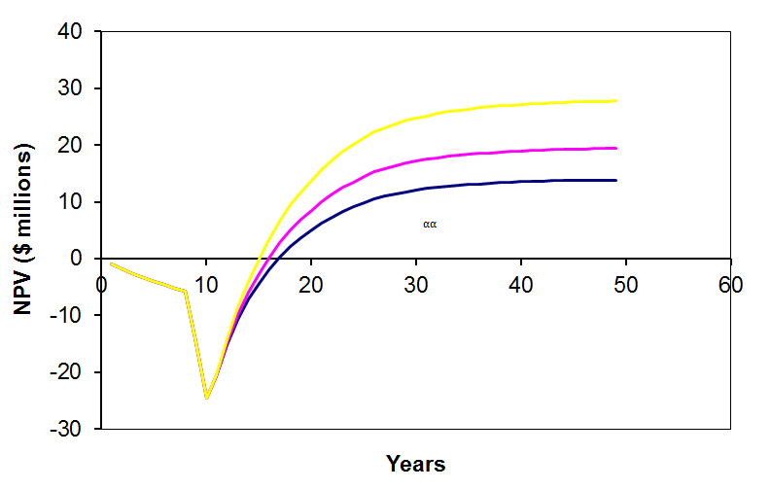
Taxes have big impact…
NPV (IRR)
Exploration
tax credit
Tax
50% base tax
$27.7 (18%)
80% base
$19.4 (15.8%)
$13.8 (14%)
Base case
 | Base | 80% | 50%
NPV Co | $13.8 | $19.4 | $27.7
NPV Gvmt | $22.0 | $16.4 | $8.1
IRR Co | 14% | 15.8% | 18%
Gvmt NPV @ NPV_{co} = 0 | $5.4 | $1.7 | ($1.3)
There is a sweet spot where government gets most income:
Greatest nbr companies doing well

Slide 13
Power Plants
Concept of levelized cost useful
Levelized cost = product value with no subsidies or taxes
Set: discount rate, life of plant, costs of construction, cost of fuel, operating costs
Set: taxes, subsidies, to zero
escalate real costs (fuel, O&M)
Levelized cost: sales price at which NPV = 0
Recipe

Slide 14
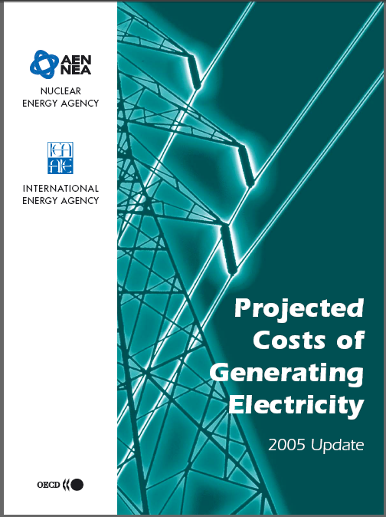
Levelized Costs
A discount rate of 10% is suitable for “liberalized” energy markets
Data is from 2005 OECD report:
Organization for economic cooperation and development
One tricky issue:
Overnight construction costs are given in $/kW_{e}
350MW plant with construction costs of $1161/kW_{e} will cost $406 millon to construct
For NPV calculations, the costs are typically specified in ¢/kWh. In this regard, 1 kW_{e} should be considered 1 kW_{e}-yr, since the plant will produce electricity all year
1 kW_{e}-yr = 1 kW_{e} (yr=24 h/d x 365 d) = 8760 kW_{e}h
$1161/kW_{e}-yr = $0.132/kWh =13.2 ¢/kWh
Similarly: an NPV of 21.9 ¢/kWh = 1.92 $/W_{e}-yr
21.9 ¢/kWh = 0.219 $/kWh
(24x365 h/yr)(0.219 $/kWh ) =1918 $/kW_{e}-yr
=1.92 $/W_{e}-yr
Report is on blackboard
2005 OECD …
These numbers apply to coal calculation

Slide 15
The OECD report describes its method as calculating the NPV of the yearly costs and incomes. The first coal spreadsheet in Electrical costs unitized NEW.xls uses this method. The subsequent spreadsheets consider construction costs as up front costs as was done in the mine development example.
The yearly costs, revenues, and tax can be read from the spreadsheet.
1. Selecting cell O20 shows a formula =-$O$3/$O$4
= overnight constr [₵/kWh] divided by the number of years of construction
2. Selecting cell O24 shows =-$B$9*((($P$8+$P$7)*(1+$B$5)^A24))=
3. Selecting cell P24 indicates =$D$11*$O$11 which indicates the revenue is the capacity factor times the sales price of 1 kW_{e}.
cost multiplier
Fuel cost
O&M cost
Cost growth
You can easily read the spreadsheet in this fashion and see how it works
You can manipulate the calculation using M_{C} and G_{i}

Slide 16
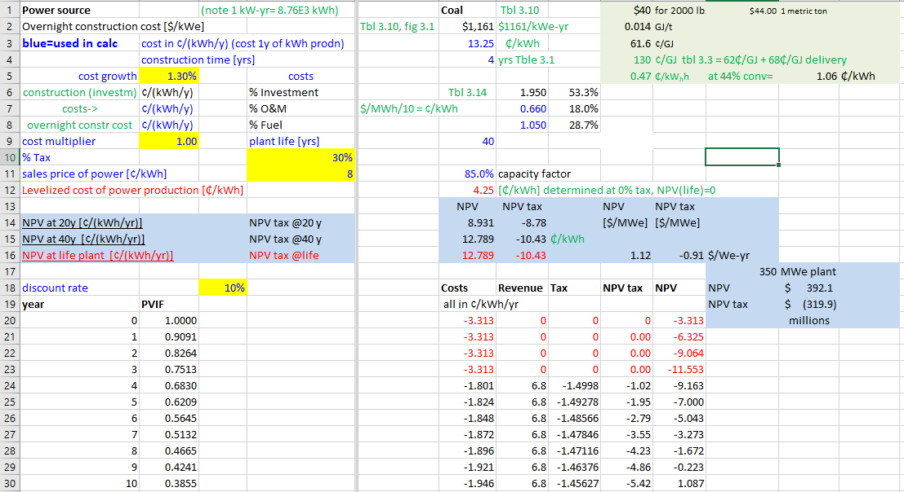
Blue: controls
Red: results
Green: units and comments
Levelized Analysis of Coal
References for costs
Levelize cost of electricity
(method next slide)
taxes
sales price
discount 10%
NPV 350 MW_{e} plant is $392 million, $406 million to construct

Slide 17
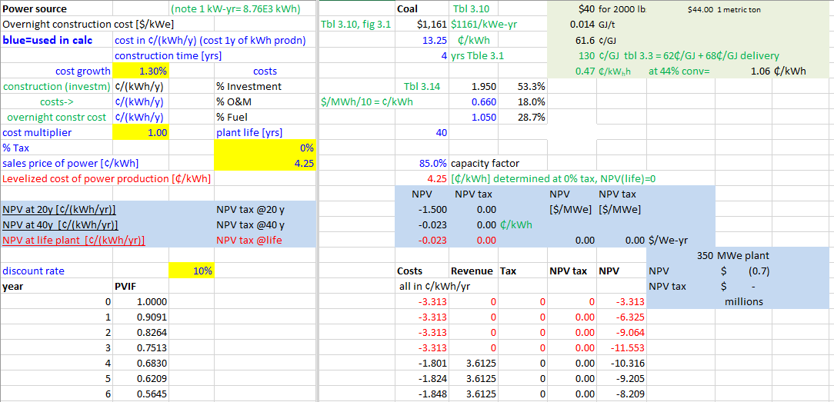
Blue: controls
Red: results
Green: units and comments
Levelized Analysis of Coal
METHOD: Set % Tax and vary sales price till NPV = 0.
Set taxes =0
Determine sales price where NPV = 0
… can repeat for all electricity generation types in “Electrical Costs unitized.xls”

Slide 18
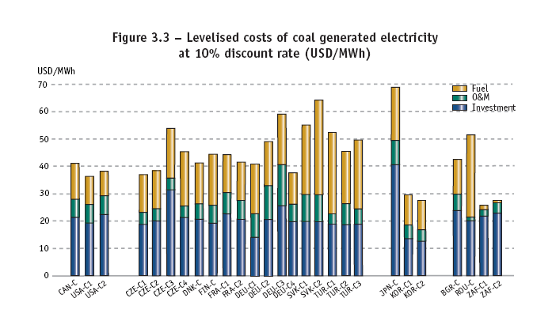
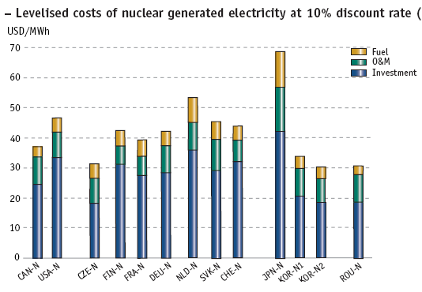
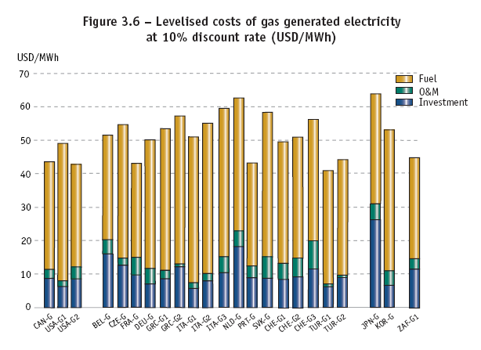
Results
levelized price in ¢/kWh
4.25
(Levelized costs calculated in “Electrical Costs unitized” are displayed for calculations of plants in various countries
5.01
5.52
Arrows ( ) indicate levelized costs computed in excel “Electrical Costs unitized” spreadsheet

Slide 19
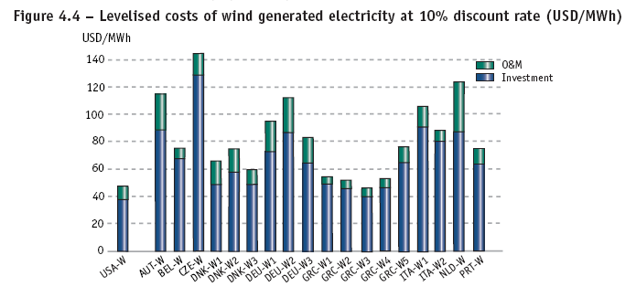
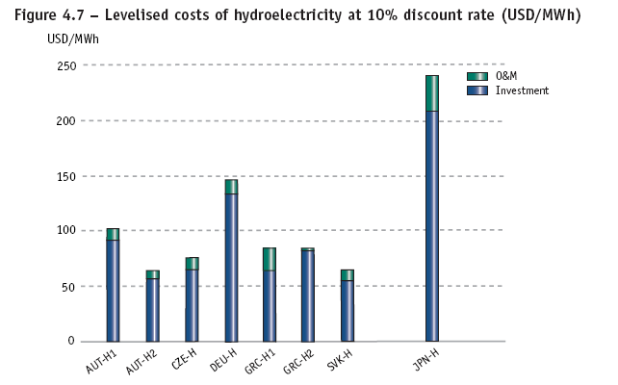
4.6
6.15
Arrows ( ) indicate levelized costs computed in excel “Electrical Costs unitized” spreadsheet
Solar
Thermal
PV
33.7
2.8

Slide 20
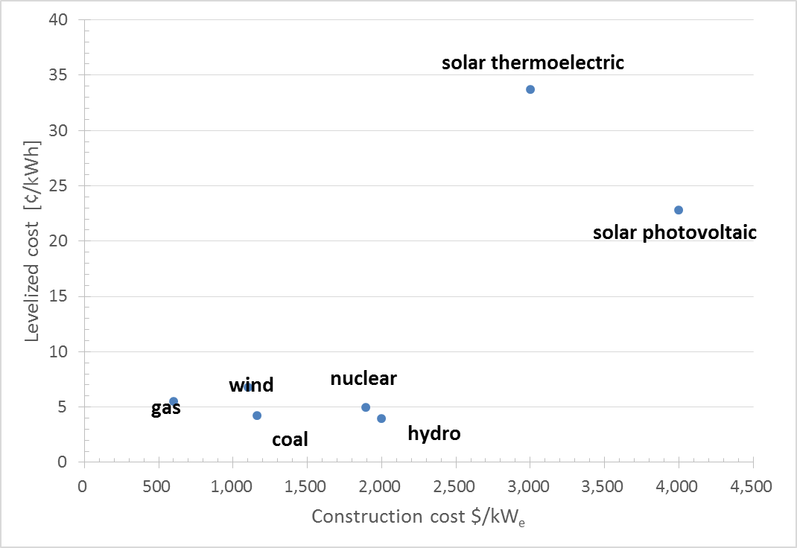
Viability of power generation options

Slide 21
Levelized cost summary
 | $/kW_{e} | ¢/kWh | ¢/kWh |  | ¢/kWh
Plant type | Construction cost | Construction cost | Levelized Cost | Capacity factor | O&M
gas | 600 | 6.8 | 5.52 | 85% | 0.35
Coal | 1,161 | 13.3 | 4.25 | 85% | 0.66
Wind | 1,100 | 12.6 | 6.81 | 35% | 0.96
Hydro | 2,000 | 22.8 | 4 | 50% | 0.98
Nuclear | 1,894 | 21.6 | 5.01 | 85% | 0.85
PV | 4,000 | 45.7 | 22.8 | 24% | 0.48
Thml Solar | 3,000 | 34.2 | 33.7 | 24% | 3.8
What are the reasons for the high levelized cost of solar?
Why is solar PV cheaper than Thermal Solar?

Slide 22
Levelized Cost Summary
¢/kWh | coal | gas | nuclear | wind | hydro | Thml Solar | PV Solar
Construction | 13.25 | 6.85 | 21.62 | 12.56 | 22.83 | 34.25 | 45.66
Investment | 1.95 | 0.87 | 3.34 | 3.8 | 9.1 | 23.1 | 20.4
O&M | 0.66 | 0.35 | 0.85 | 0.96 | 0.98 | 3.8 | 0.48
Fuel | 1.05 | 3.06 | 0.47 | 0 | 0 | 0 | 0
Capacity Factor | 85% | 85% | 85% | 35% | 50% | 10% | 20%
Levelized cost | 3.6 | 4.3 | 4.5 | 4.6 | 6.2 | 40.6 | 25
What are the reasons for the high levelized cost of solar?

Slide 23
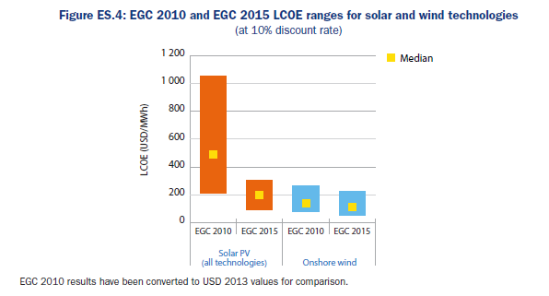
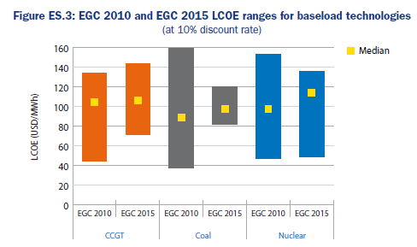
Dramatic recent drop in price of solar
Iea/NEA Projected costs of generating electricity (2015)
https://www.iea.org/publications/freepublications/publication/projected-costs-of-generating-electricity-2015-edition.html
20₵/kWh
$160/MWh=16₵/kWh
0
CCGT coal Nuclear

Slide 24
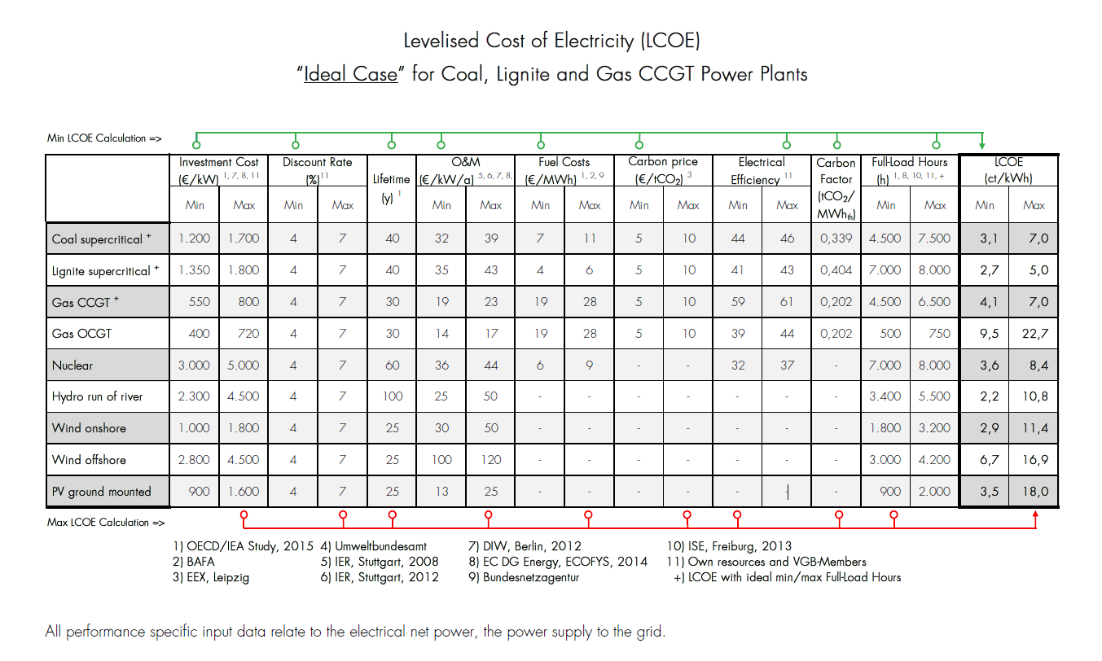
@ $1.3/€, $1170, $2080 per kW_{e}
Euro ~$1.1 today, $1.4 in 2015
https://www.vgb.org/en/lcoe2015.html?dfid=74042

Slide 25
$4000 in 2005
CCGT=Combined cycle gas turbine
OCGT=open cycle gas turbine
CSP=concentrated solar power
CHP=combined heat and power
https://www.iea.org/media/presentations/150831_ProjectedCostsOfGeneratingElectricity_Presentation.pdf

Slide 26
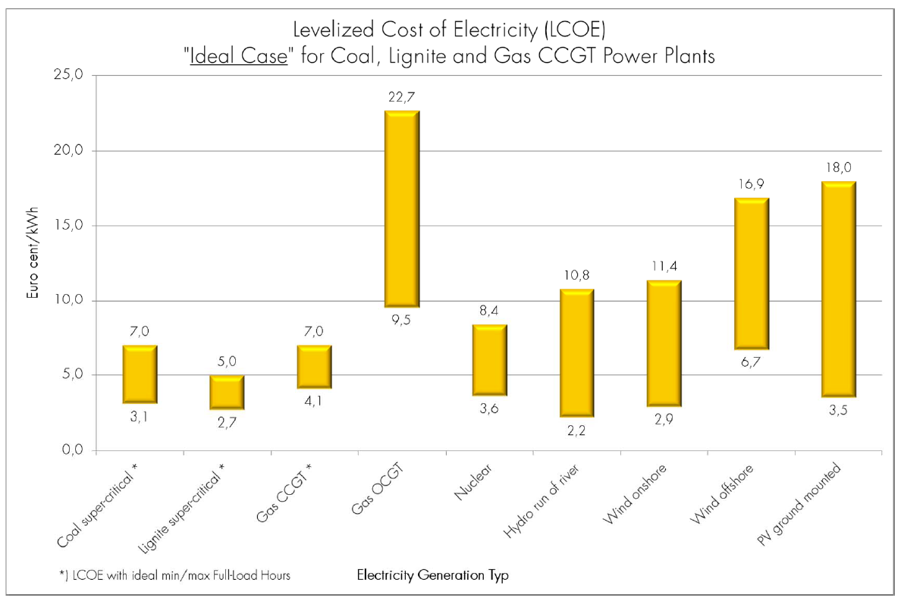
https://www.vgb.org/en/lcoe2015.html?dfid=74042

Slide 27
PS2: Economic analysis problem set
Using methods similar to those in the NPV-simple and mine examples excel spreadsheet:
Calculate the net present value of your education at Cornell 10 years after graduation assuming $40,000 cost per year followed by what you expect to earn upon graduation.
Compare this to what you would expect to earn over 14 years if you entered the workforce instead of Cornell. (Hint, you can modify the simple examples part of the spreadsheet on blackboard to carry out these two calculations).
Using the NPV-simple and mine examples excel spreadsheet:
Calculate the change in the NPV for the base case mine (8% discount, 1 million/year exploration tax incentive) if the government gave an exploration tax credit of $1.5 million per year instead of $1 million per year. (Hint, appropriately adjust the tax discount multiplier.)
What is the change in IRR?
Plot the NPV vs time when the discount rate equals the internal rate of return. (Hint: Use the spreadsheet and the plot will appear on the associated excel sheet.)
Explain why the shape of the curve is expected.
Tabulate the NPV of 350 MWe power plants in the “Electrical Costs unitized” spreadsheet on Blackboard assuming a discount rate of 8%, a tax rate of 30%, and an electricity sales price of 8₵/kWh. Use the base capacity factors, construction, and fuel costs in that spreadsheet (from the 2005 OECD Electrical Generation Costs Projections pdf ), and assume a 40 year plant life. Comment on what your results tells you.
In 2005 solar electricity generation was much more expensive than the other alternatives because of its capacity factor and high cost of construction, but from the discussion in lecture the cost of solar has dropped dramatically because of a strong decrease in construction cost, an increase in capacity factor, and a decrease in operations and maintenance. How much could the capacity factor be increased above that assumed in the spreadsheet? (Search in the OECD pdf, look at what MacKay has to say, and look at the web).
From the lecture material (see links) construction costs for Solar Photovolaics may have dropped from $4000/kW_{e} to $1500/kW_{e}, and O&M may be ~0.2₵/kWh rather than 0.48 ₵/kWh. Make a table showing the levelized cost of the base case of ($4000/kW_{e}, O&M=0.48 ₵/kWh, capacity=20%, discount=10%, life=40y) and sequential changes in the base case: (a) increase capacity factor to 24%, (b) decrease O&M to 0.2 ₵/kWh, (c) decrease the discount rate to 7%, and (d) then to 4%, (e) decrease the construction costs to $1500/kW_{e} , and (f) then to $1170, and then the impact of increasing the discount rate for this case to 7 and then 10%. You will find the lowest levelized cost is 3.95 ₵/kWh. From this analysis how certain are you that this is a good estimate.
What are the costs left out of your analysis in (5)?

Slide 28
References
Anonymous, 2006, Net Present Value and Internal Rate of Return: Accounting for Time, Chap. 15 in Managers Toolkit, Harvard Business School Press, Boston, 15p. (available for $3 on Amazon.com).
Snow, G. G., and Mackenzie B. W., 1981,The environment of Exploration: Economic, organizational and social constraints, Economic Geology, 75th Anniversary Volume, p. 871-896
NEA, IEA and OECD, 2005, Projected costs of generating electricity, 2005 update. http://www.iea.org/publications/free_new_Desc.asp?PUBS_ID=1472

