Slide 1
Can Subsurface Permeability be Imaged?
Presentation to
Earth Source Heat Project Team
11:00 AM June 27, 2019
L. M. Cathles
Acknowledgement:
Conversations with ARM and Peter Malin helped enormously in the preparation of this presentation

Slide 2
Outline
The concept
The history
The importance
The method
The evidence
The People
Conclusions/Recommendations

Slide 3
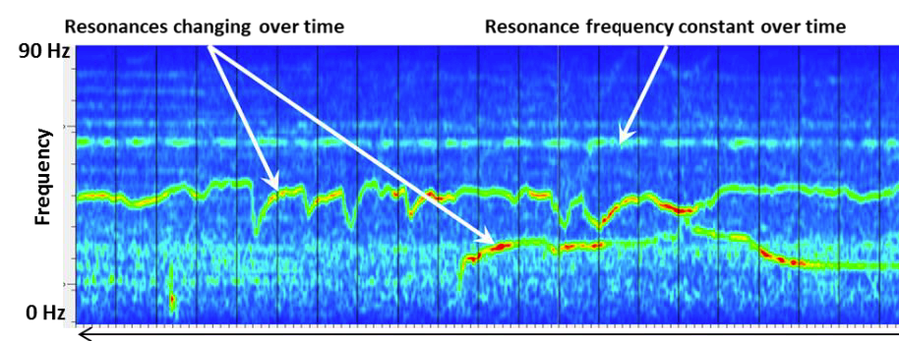
The Concept
Permeability is imaged by the weak background seismic signals (resonances) observed in all sediment and hard rock settings
Resonances lack sharp rise times and separated p and s signals that are characteristic of micro-earthquakes
Last seconds to minutes
Have narrow frequency range
Two main types:
Variable in frequency and time (dispersive)
→ dynamically connecting permeability
Steady in frequency and time (non-dispersive)
→ existing permeable pathways
Occur naturally but can also be induced (stronger)
Sonic spectra from Finland ESH project
Sicking et al., submitted JGR 2019
2 minutes
Audio curtesy of Peter Malin:

Slide 4
The History
Das and Zoback (2011), Pettitt et al. (2009)
Resonances discovered in quest to understand fracking energy flow
Energy input to fracking >> flow dissipation + microseismics
Tensile fracturing, aseismic deformation additional energy sinks
“Unconventional events” seen in time-frequency representation of continuous passive records
LPLD (long period long duration events) seen in frequency domain
Resonant signals observed between fracking stages
Resonant signal source can be located and seen to migrate
Ferrick et al. (1982)
Resonances similar to volcanic tremors associated with magma flow
Tary, et al. (2014a,b, JGR)
Resonances thought to be related to fluid-filled fractures that support flow. This could allow permeability to be mapped seismically.
Ambient Reservoir Monitoring, Inc.

Slide 5
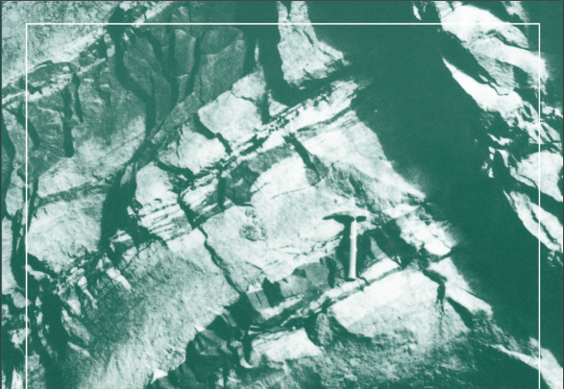
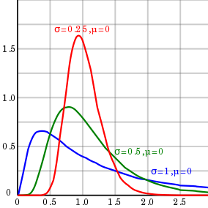
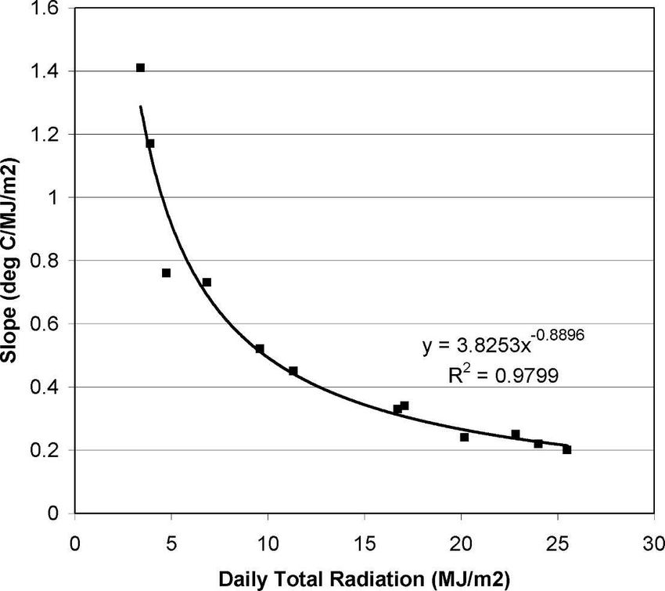
The Importance
Allows a geologically-established permeability distribution to be tied to the realities of a specific site
Only Power Law distributions are scale invariant
Log normal distribution
Power law distribution
a=3.82
d=-0.88
R²=0.98
Distributions modified from web

Slide 6
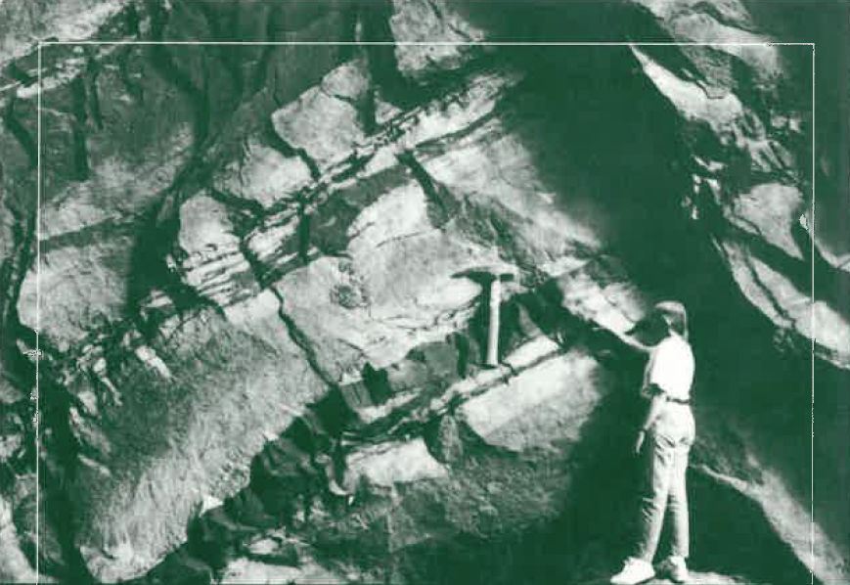
The Importance
Allows a geologically-established permeability distribution to be tied to the realities of a specific site
Only Power Law distributions are scale invariant
Log normal distribution
Power law distribution
Geology is scale invariant
a=3.82
d=-0.88
R²=0.98
Barton and La Pointe, Fractals in the Earth Sciences, 1995

Slide 7
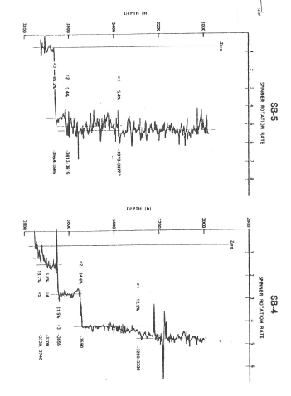
The Importance
Allows a geologically-justified permeability distribution to be tied to the realities of a specific site
Spinner survey shows where fluid leaves a well
???
No idea where fluid goes
12%
TFI images flow paths
Shows connections
35%
82% fluid loss
35%

Slide 8
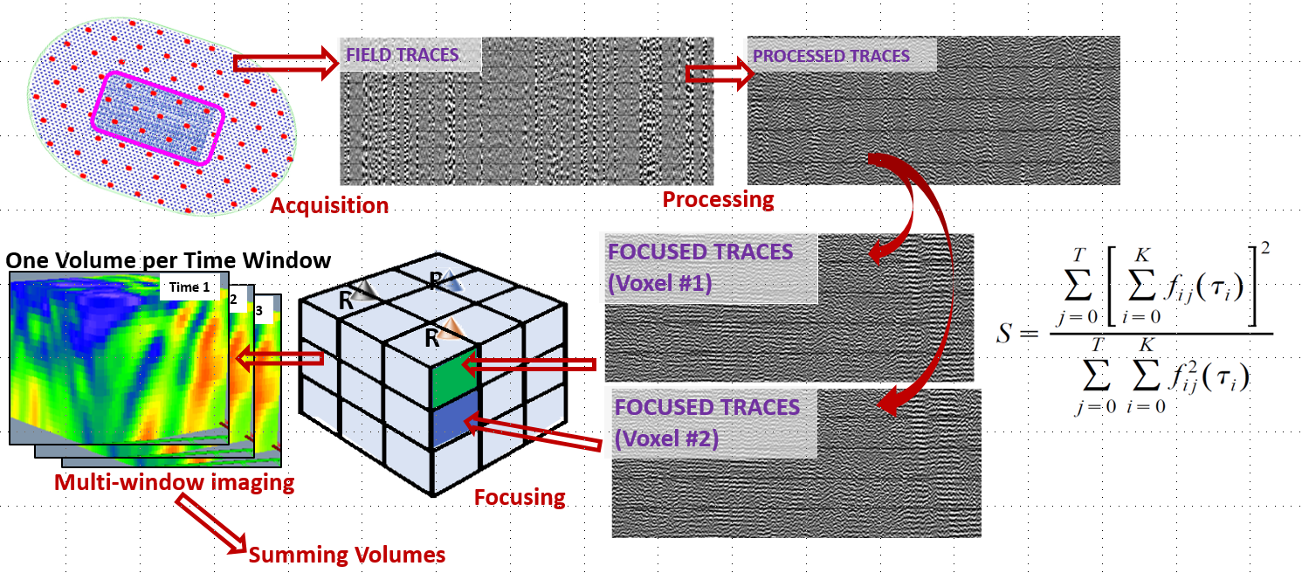
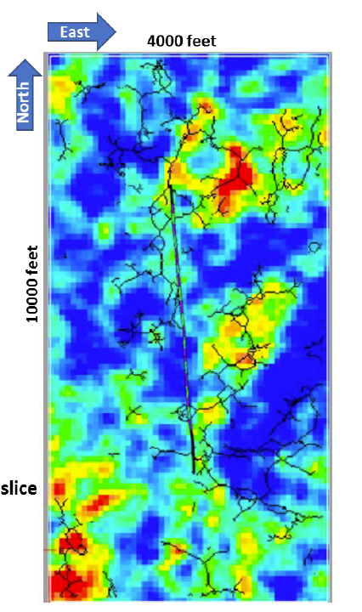
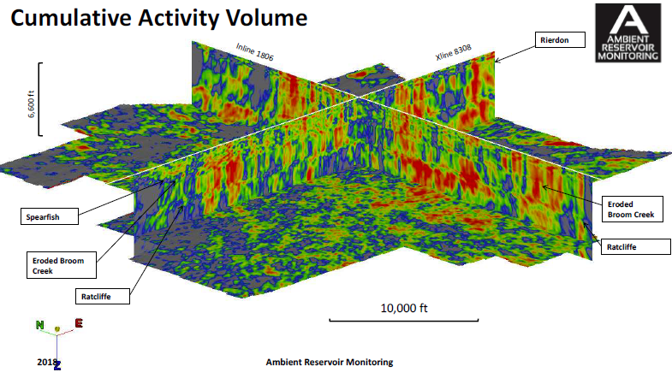
The Method
Depth slice
produces two products:
1.
2.
CAV shows water-filled fractures
fx network extracted from CAV
find local activity max keep connected pixels

Slide 9
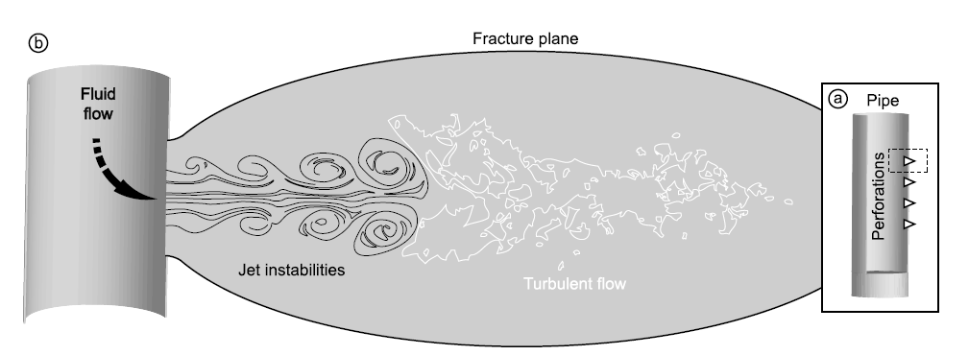
The Theory
Turbulent resonances are produced near injection perfs during hydrofracturing
Ambient resonances are seismic Krauklis waves trapped on sides of fluid-filled fractures
h
l
= shear modulus solid
harmonics
, k= 1, 2, 3,…
NOTE:
Krauklis resonances do not indicate fluid movement but depend on h which controls permeability
~ 15m for resonances to be in seismic range
= v_{s}/v_{p} in solid
= fluid density
l
Tary et al, JGR, 2014a

Slide 10
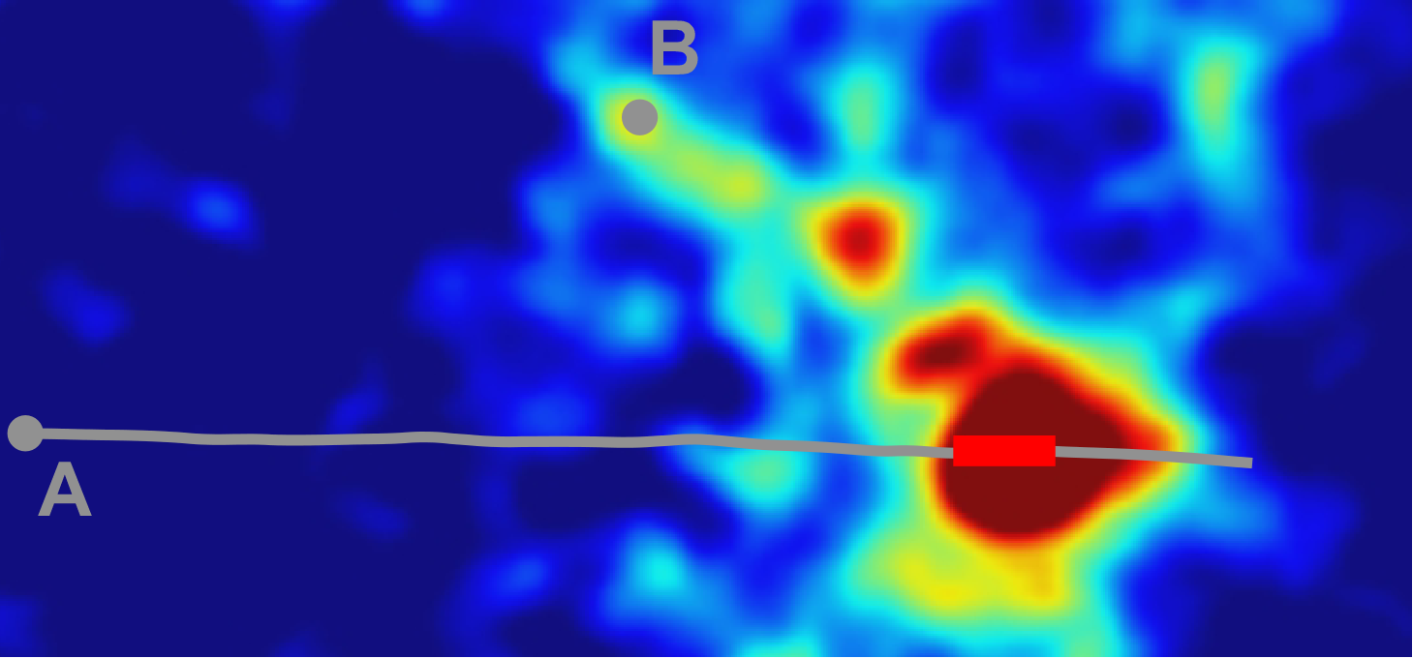
The Testing
Depth slice
CAV map prepared by TFI processing of seismic array data
Flow fracture presentation of CAV
Example from Lacazette et al. (2013)
Connection confirmed by tracer connection between vertical well B and horizontal (perforated and hydrofracked) well A. Distance from B to connection with A ~ 2000 ft.
From Sicking et al. (submitted JGR)

Slide 11
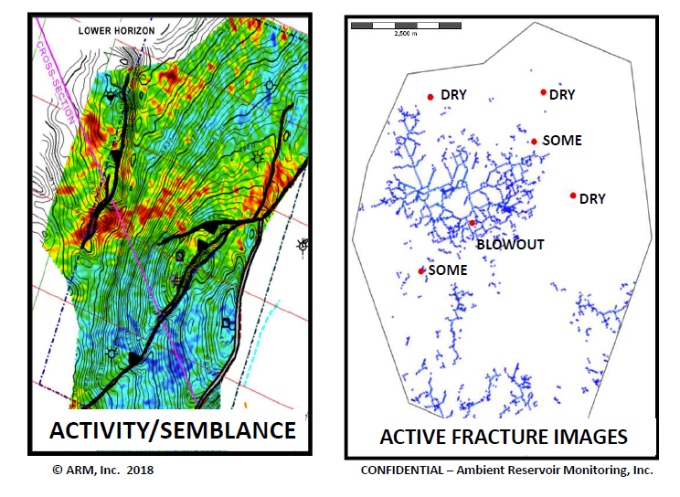
The Testing
Colombia, South America
Cumulative Activity Volume, Colombia
Permeability confirmed by production
Not all faults are active (permeable)
Well data from 1950’s
Fracture mapping confirmed old production results

Slide 12
The Testing
New Albany shale
Lost circulation predicted by
CAV and fx map
Intersections are to fracture network
All lost circulation occurred where well intersected fx

Slide 13
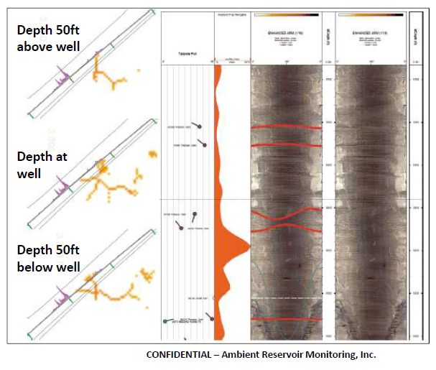
The Testing
West Virginia gas well
Radioactive tracer log
Gas production predicted by active fracture TFI images
Gas contains radon and is radioactive

Slide 14
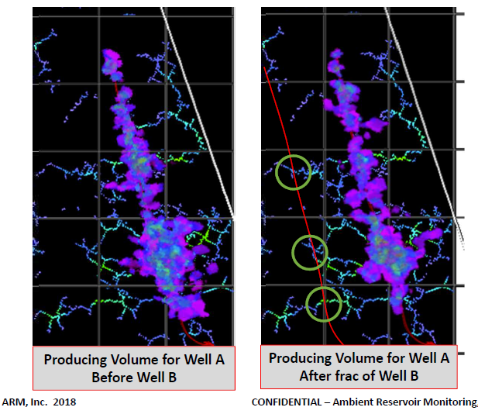
The Testing
Marcellus shale
Well A
Change in CAV images before and after Drilling well B
Well B
Decline in well A production (30%) occurs where TFI fx map suggests it should
ARM predicted the three fracking stages which interfere with production in Well A

Slide 15
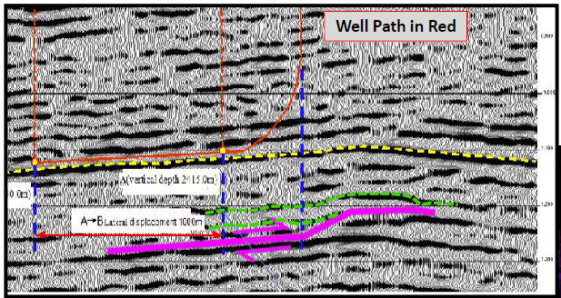
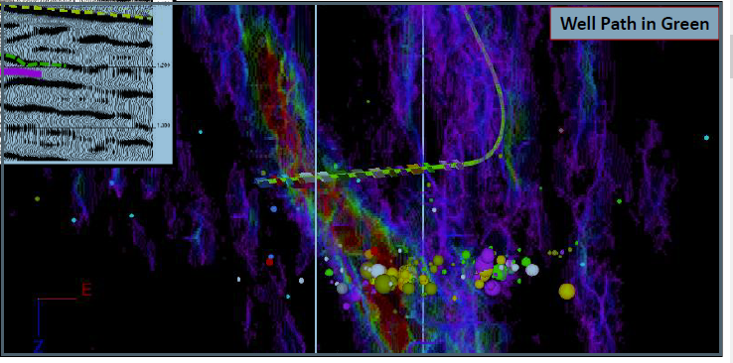
The Testing
China 3D seismic and microseismic survey
CAV predicts flow connection down tear fault which triggered micro EQ activity on ramp fold 300 m below
MEQ

Slide 16
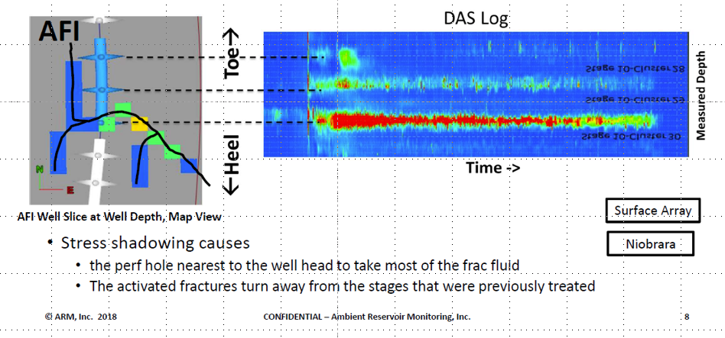
The Testing
Seismic signals from fiber optic cable in well show fluid exits well where flow pathway imaged by TFI intersects well
25ft square TFI pixels show flow is enhanced where well bends and is into activated fractures

Slide 17
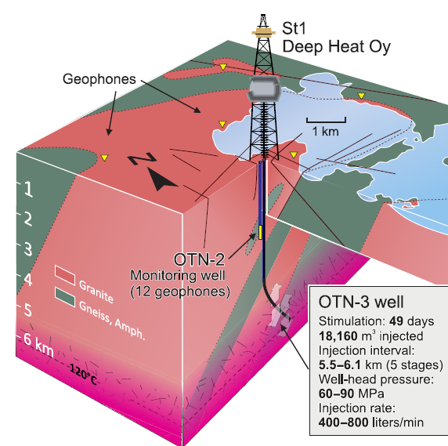
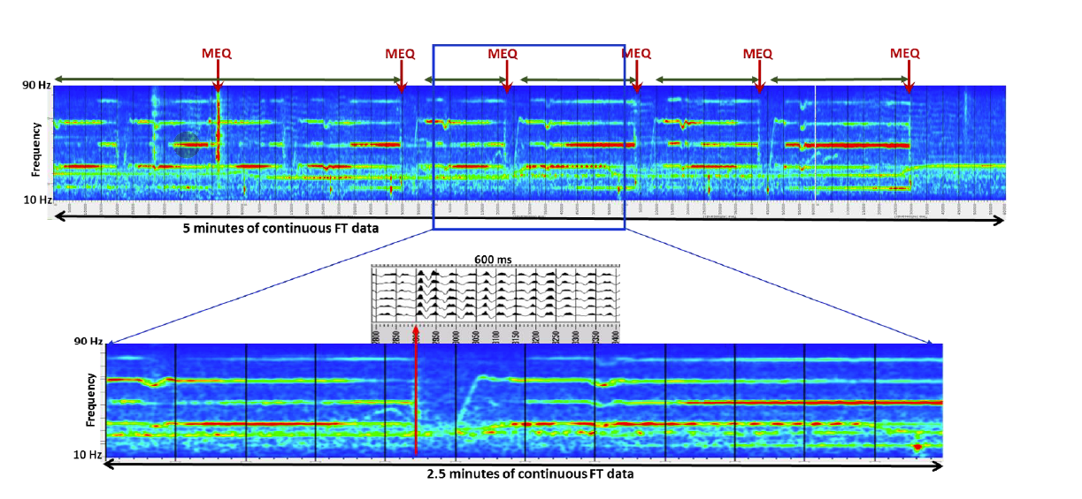
The Testing
Resonances measured in OTN2 during stimulation terminate abruptly when micro-EQ occurred, and then re-established themselves
Suggests MEQ lower P in fx and shut down resonance
Resonance monitoring useful in MEQ control
Array could locate TFI pathways shut down by MEQ
Aalto University ESH Project Finland
Kwiatek et al, Sci. Adv. (2019)
From Sicking et al. (submitted JGR)

Slide 18
The People
Corporate History
Important Background
Peter Geiser patented method in 2002
Sold IP to Global Geophysical in 2011
Global Geophysical bankrupted in 2016
Reconstituted as ARM (Ambient Reservoir Monitoring) 2017
Al Lacazette 1991 PSU thesis with Engelder
Pettitt et al. (2009)
Das and Zoback (2011)
Peter Malin – self-organized criticality
Ambient Reservoir Monitoring, Inc
Tom Fleure CEO
Ross Peebles COO
Charles Sicking Chief Technical Officer
Jan Vermilye Senior Geoscientist
Bill McLain Processing Manager
Tim Schield Development Manager
Al Lacazette Senior Geologic Consultant
Peter Malin has partner instrument company
Peter Geiser is shareholder
Companies doing similar work exist in Russia
China is trying to emulate
… but at moment TFI imaging is a small connected group

Slide 19
Conclusions/Recommendations
TFI can image flow pathways in subsurface
A TFI survey should be an initial part of Cornell’s ESH project
A TFI survey would be important contribution in its own right
imaging (potential) flow pathways has many applications
Cornell could be in on ground floor and seen as “break the rules” innovator
A serious proposal for a TFI survey is on the table
How do we proceed?

Slide 20
Questions and Discussion
Acknowledgements: Conversations with ARM and Peter Malin helped immensely in preparation of this presentation

Slide 21
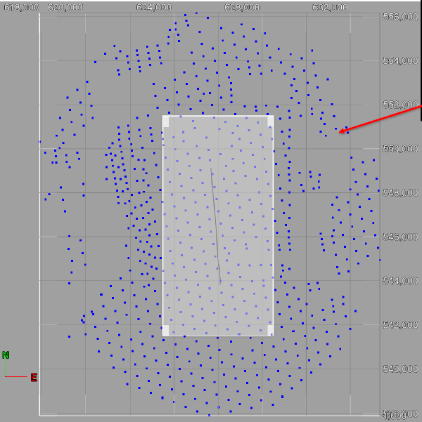
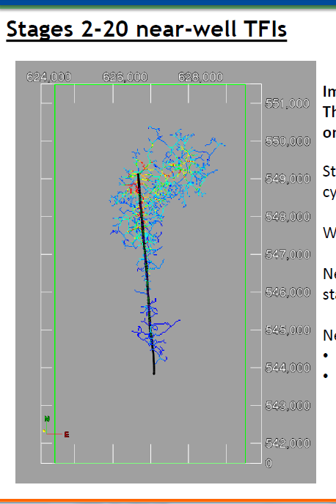
Gaps in array coverage will not impact results
Surface Array to image subsurface target area
Fractures activated during stimulation (20 stages)
Gaps in acquisition
Coverage

Slide 22
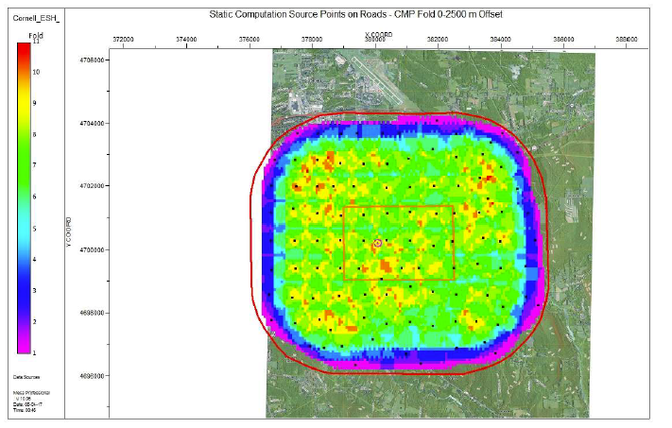
70 km² receiver area
8 km² target
2787 receivers
170m separation

Slide 23
References
Barton, C., and La Pointe,eds ,(1995), Fractals in the Earth Sciences, Plenum Press, New York, 265p.
Das I., and M.D. Zoback, 2011, Long-period, long-duration seismic events during hydraulic fracture stimulation of a shale gas reservoir: The Leading Edge, July, p.778-786.
Ferrick, M. G., A. Qamar, and W. F. St. Lawrence (1982), Source mechanism of volcanic tremor, J. Geophys. Res., 87(B10), 8675–8683, doi:10.1029/JB087iB10p08675.
Kwiatek, G, et al., (2019), Controlling fluid-induced seismicity during a 6.1-km-deep geothermal stimulation in Finland, Science Advances, 5:eaav7244.
Pettitt, W., J. Reyes-montes, B. Hemmings, E. Hughes, and R. P. Young (2009), Using continuous microseismic records for hydrofracture diagnostics and mechanics, Paper presented at SEG 79th Annual International Meeting, Houston, Tex.
Sicking, C., J. Vermilye, P. Geiser, A. Lacazette, 2013, Permeability field imaging from microseismic: Geophysical Society of Houston Journal, v. 3, no. 7, p. 11 -14.
Sicking, C., (submitted), Connecting passive seismic fracture images to their signal source: Resonance in fluid filled fractures, Journal of Geophysical Research.
Lacazette, A.L. (1991), Natural hydraulic frac turing in the Bald Eagle sandstome in central Pennsyvania and the Ithaca siltstone at Watkins Glen, New York, Ph.D. Thesis, The Pennsylvania State University, 224p.
Lacazette, A., J. Vermilye, S. Fereja, and C. Sicking, (2013), Ambient Fracture Imaging: A New Passive Seismic Method, Unconventional Resources Technology Conference (URTeC) Denver, Colorado, USA, 12-14 August 2013
Tary, JB, M. Van der Baan, DW. Eaton, (2014a), Interpretation of resonance frequencies recorded during hydraulic fracturing treatments Journal of Geophysical Research: Solid Earth 119 (2), 1295-1315
Tary, J. B., M. Van der Baan, B. Sutherland, and D. W. Eaton (2014b), Characteristics of fluid induced resonances observed during microseismic monitoring, Journal of Geophysical Research, 119, 8207-8222 Timur, A. 1968. An investigation of permeability, porosity, and residual water saturation relationships: SPWLA, 9th Annual Logging Symposium.

Slide 24
