Slide 1
Introduction to Groundwater EAS/BEE 4710
March 8, 2018
Regional flow and Three Examples
Fetter Chapters 7,8,9

Slide 2
Outline
Some Background
Class discussion of reading and your “streams”
Some Examples
Highlights of Fetter
GAB in Australia
Old Boonslick
Ithaca area

Slide 3
The first step is permeability
toward understanding regional flow
Intrinsic permeability
Physical
equation
Dynamic or shear viscosity
pressure head
hydraulic head
Perforations of well casing
elevation head

Slide 4
What permeability means
Bucket test
If just undersaturated so
P=0
h_{p} = 0 = h-z
h=z
Hydraulic conductivity is the rate at which you can pore water into the ground

Slide 5
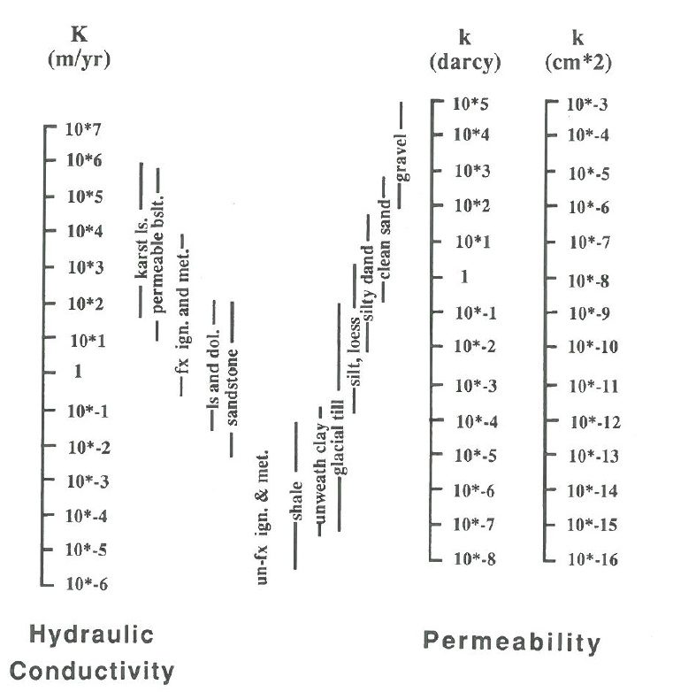
Range: 10,000 km/yr to 1μm/yr
Contrasting permeability makes juxtaposition of units (geology) very important
1 micron per year

Slide 6
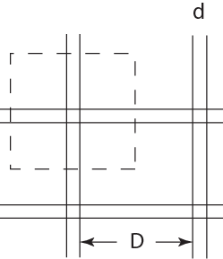
Can understand k’: Carmen-Kozeny
porosity
L
Carmen-Kozeny
Porous media
grain diameter
Pore throat ~d/3
Surface area per unit volume of pores
Surface area per unit volume of solid
Similarly for fractured media…
Fracture porosity
Note very strong dependence on porosity

Slide 7
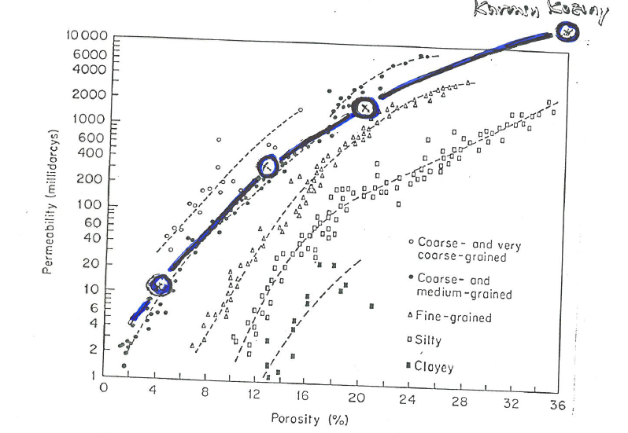
Verification of Carmen-Kozeny
grain size

Slide 8
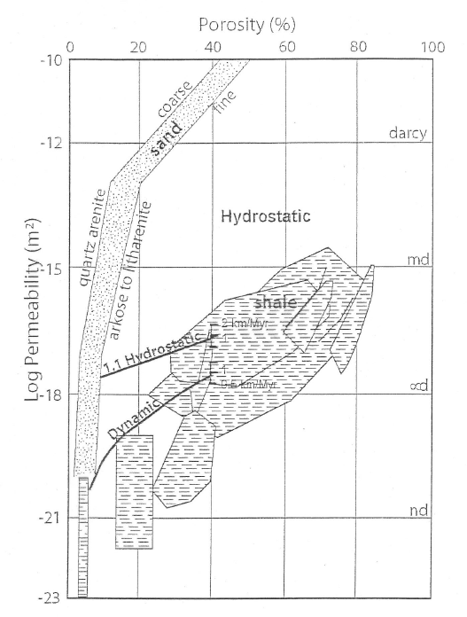
Permeability vs porosity
observational systematics

Slide 9
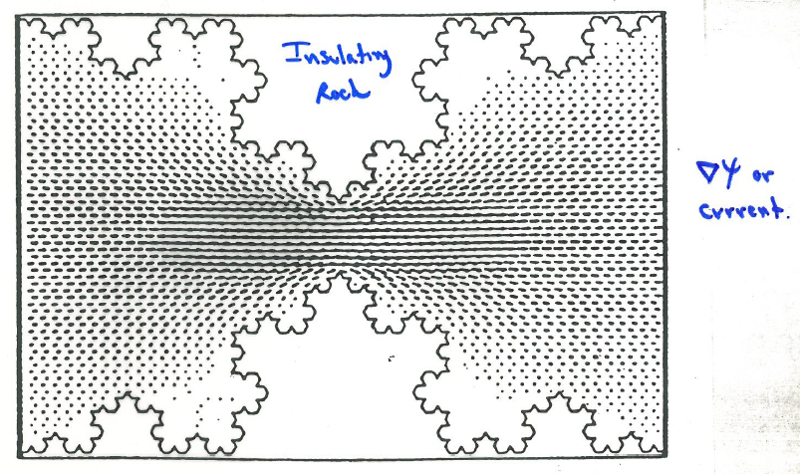
Electrical current probes constrictions
(future methods)

Slide 10
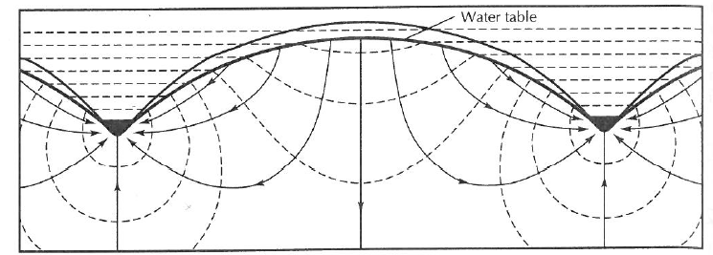
Permeability is just the start
A. Permeability
Δh
L
Darcy (1856)
B. Geometry
Flow lines
equipotentials
Toth (1962)
C. Geology
Freeze and Witherspoon (1967)

Slide 11
Simplest Toth Flow
hill
h
Ground water table
x
stream
L
Equations
Solution
Boundary conditions

Slide 12
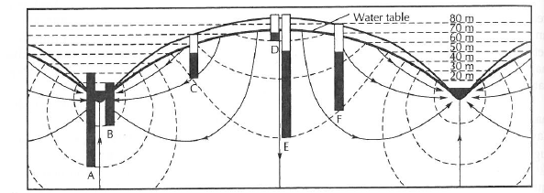
L/2
Base flow decays exponentially:
Example:
If L=20 km, τ=4 months, n=0.2
K=0.2/(0.33y)(6.28/20,000m) = 1930 m/y
K=~6 darcies
…suggests that system quite permeable

Slide 13
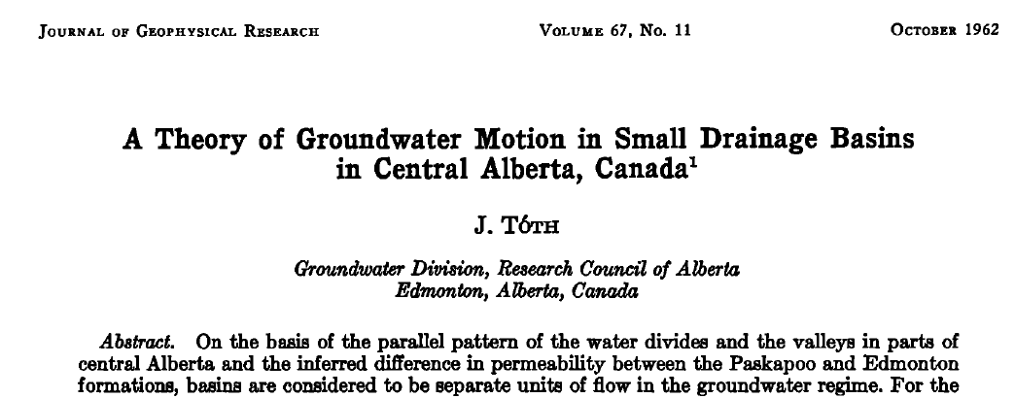
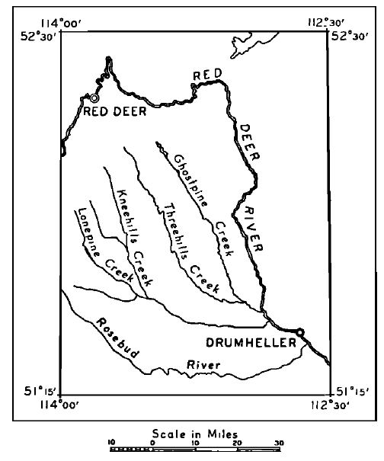
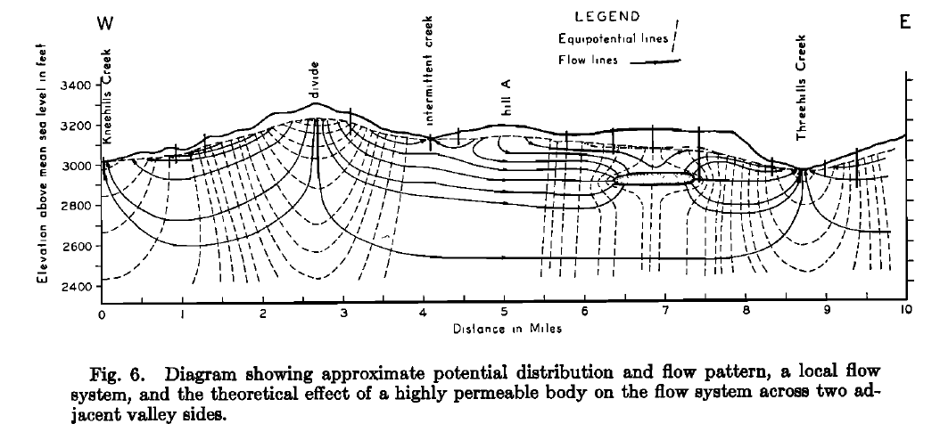

Slide 14
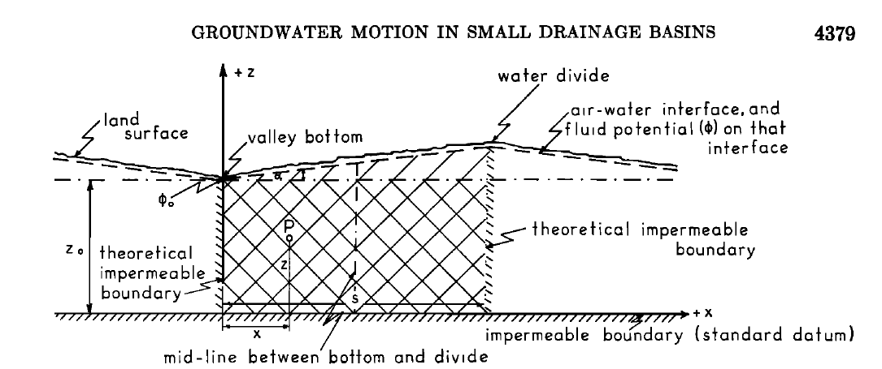
Linear slope and base to flow

Slide 15
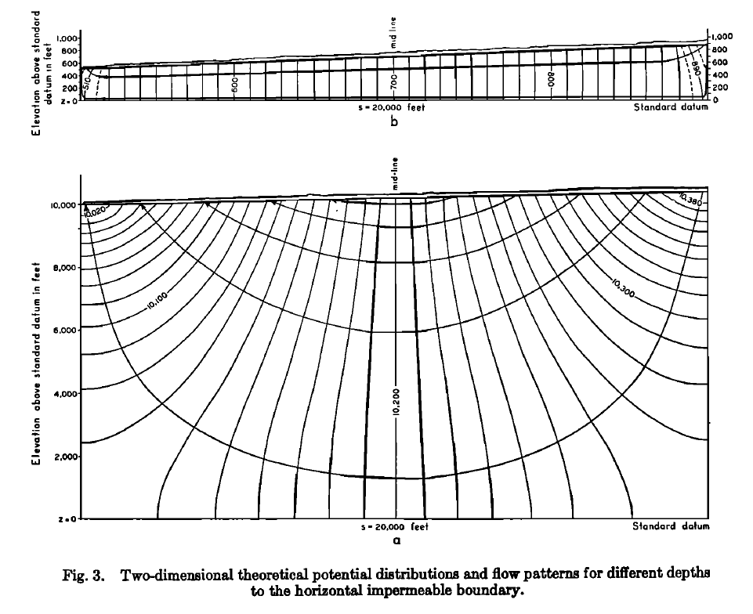

Slide 16
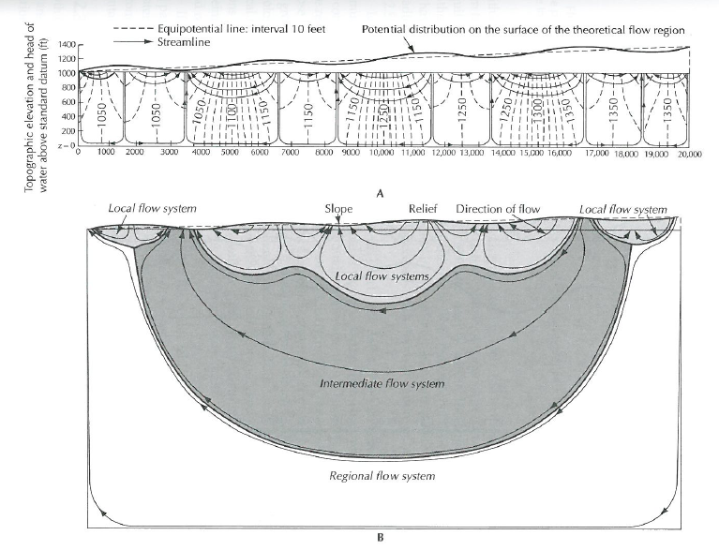

Slide 17
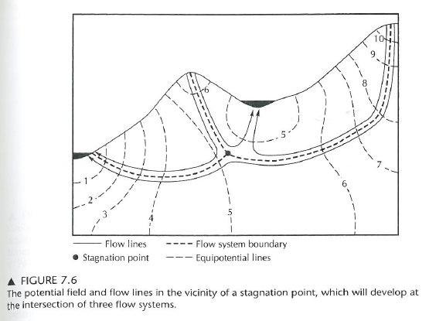
Some tricks

Slide 18
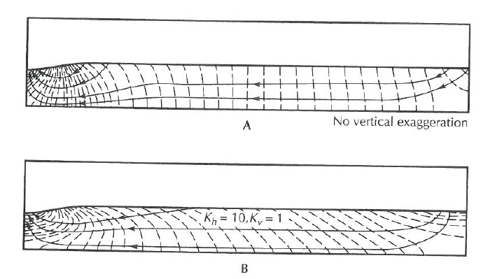
Anisotropy
Freeze and Witherspoon (1967)

Slide 19
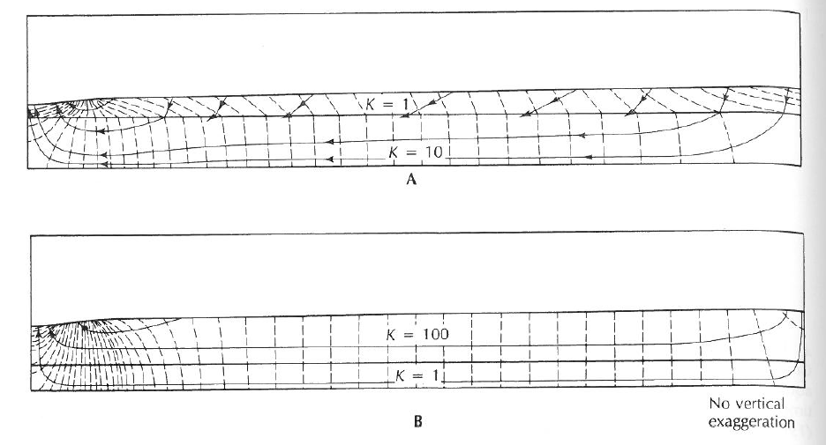
Layering
Freeze and Witherspoon (1967)

Slide 20
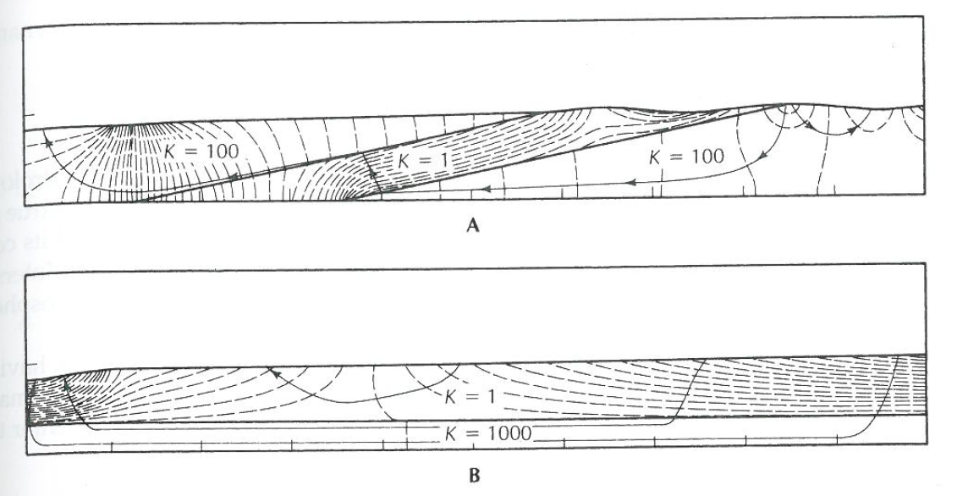
Refraction
streamline refraction
Freeze and Witherspoon (1967)

Slide 21
Three Examples
Great Artesian Basin in Australia

Slide 22
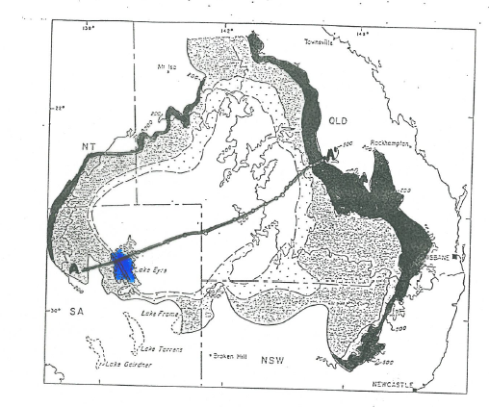
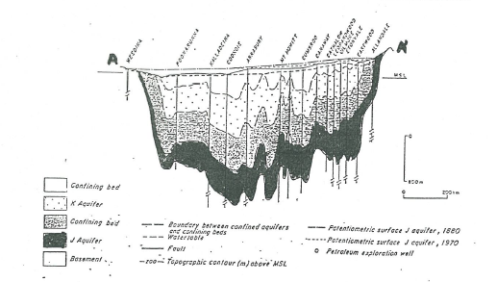

Slide 23
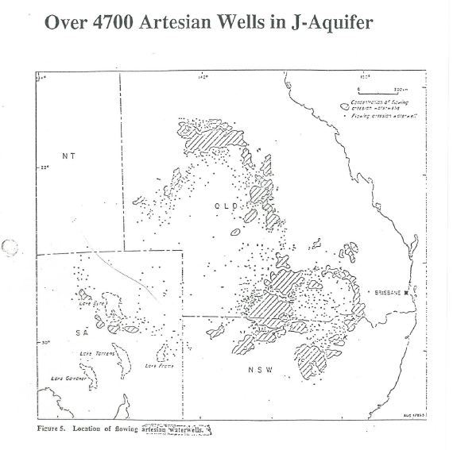

Slide 24
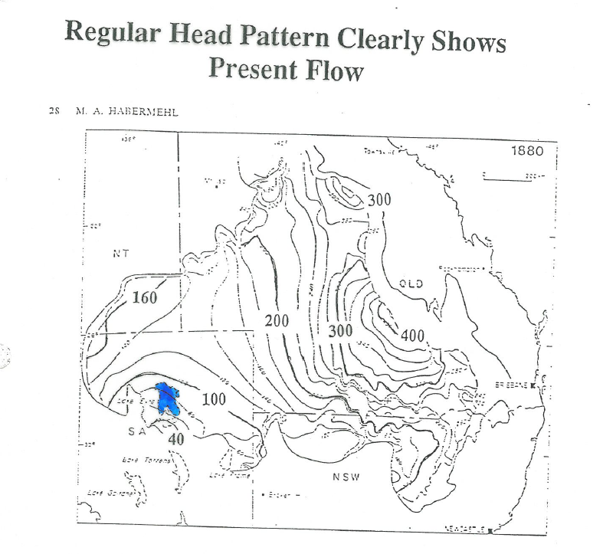

Slide 25
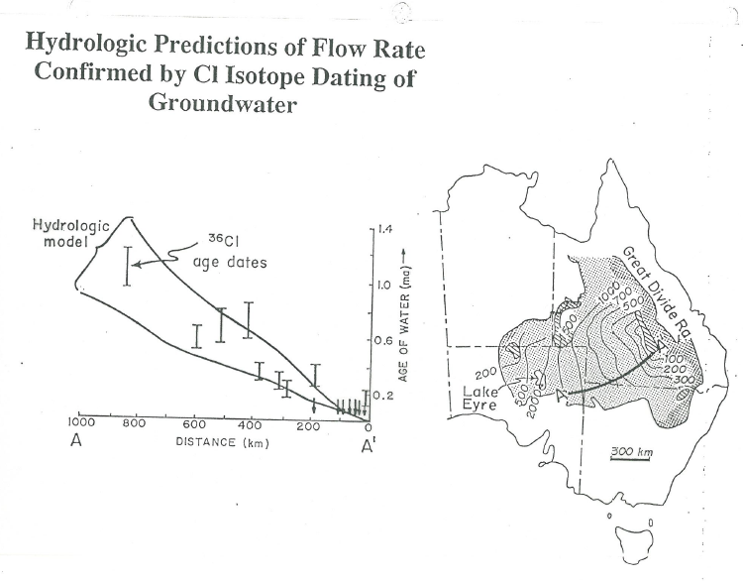

Slide 26
Example
Interior Plains Aquifer System

Slide 27
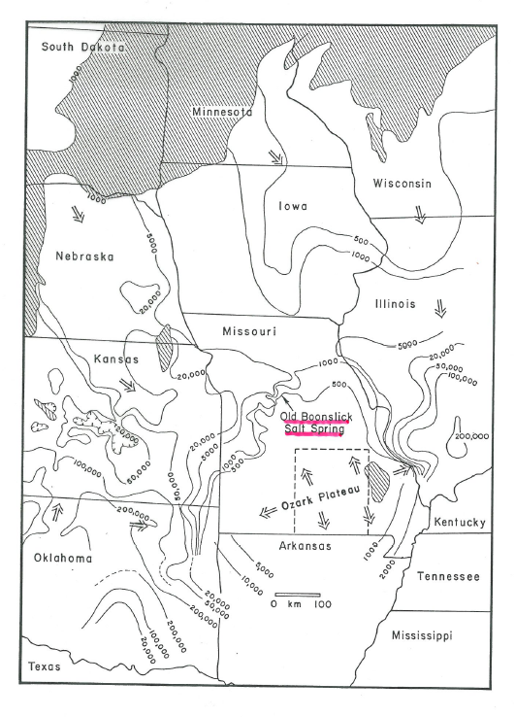
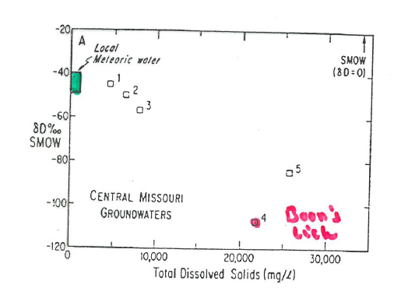

Slide 28
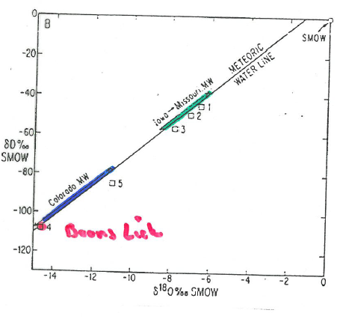
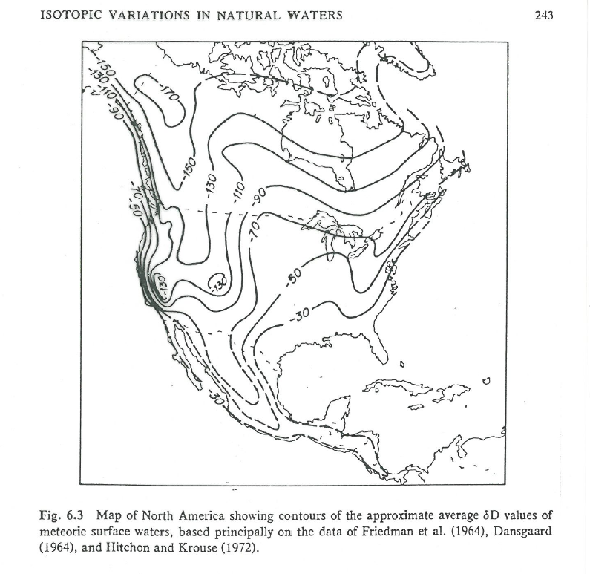

Slide 29
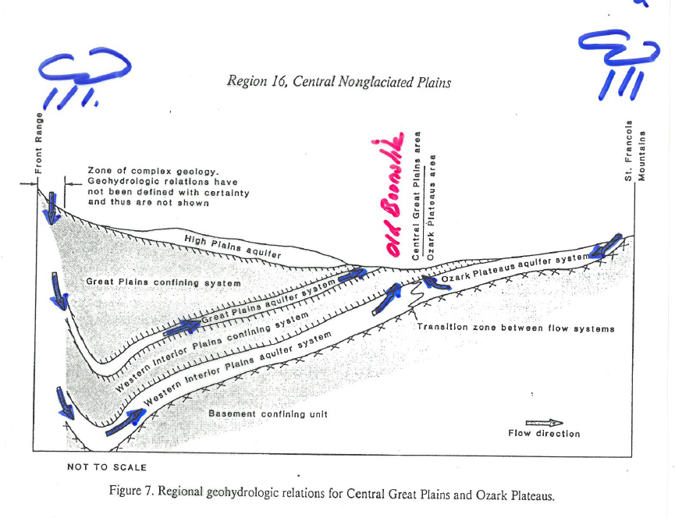
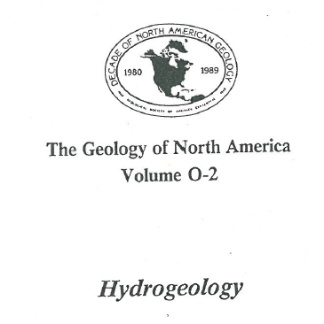
Picks up salt in Kansas

