Slide 1
Lecture 3: Multiphase
EAS 7970: Multiphase Subsurface Fluid Flow
L. M. Cathles
Tammo Steenhuis
Larry Brown
Spring 2017
3160 Snee Hall

Slide 2
Generalize to non-aqueous
Hydrology/water
Fluid phase α
Momentum Equation
Continuity Equation
Constitutive Relations
Diffusion Equation

Slide 3
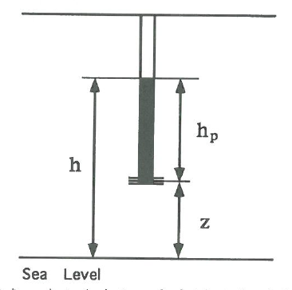
Relationship to Darcy’s Law
Note: Hydrologists specialize to water, planet earth and 20°C.
μ_{w}(0°C)=1.78x10⁻³ Pa s
K’[m²] = K[m s⁻¹] / 10⁷

Slide 4


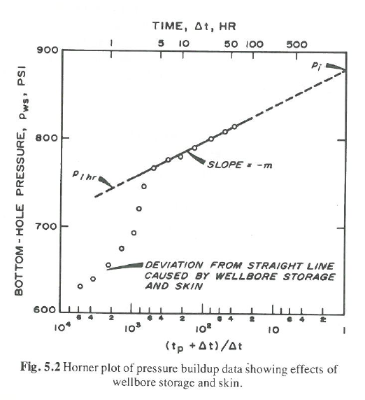
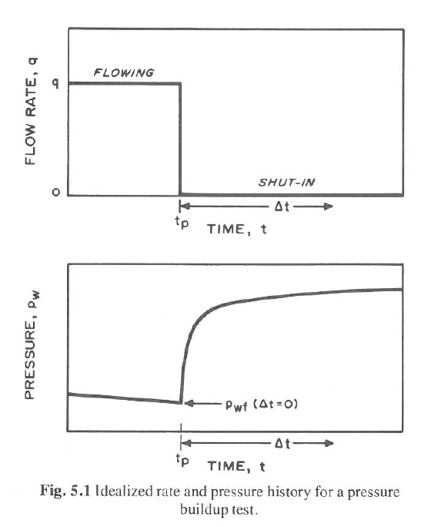
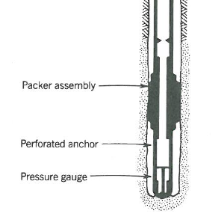
Horner plot analysis
Famous well analysis texts
From lecture 2 slide 11
Oil patch
Packed off interval
Measure pressure
Slope gives transmissivity

Slide 5
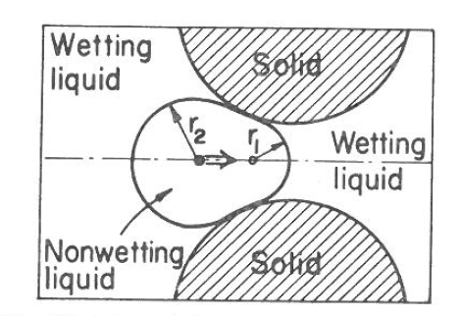
Multiphase- capillary pressure (the simple view)
oil
* or interfacial tension
Oil likes oil more than water
Interface behaves like a stretched rubber sheet
oil-water surface* tension, γ , molds oil into sphere like a balloon
Pressure inside oil is greater than in water by capillary pressure, p_{c}
Force balance gives the pressure
water
p_{c} greater for smaller oil bubbles
bubble size determined by pore size
Oil must be pushed into a finer strata
Water gets “sucked in” or imbibed
entry pressure
Note: water is assumed to “wet” the solid surface

Slide 6
Multiphase
Force driving petroleum same as that driving water
  + buoyancy term causing lighter petroleum to rise
  + capillary term pushing petroleum out of finer pores
Oil is buoyant
p_{c} pushes oil out of fine pores
up positive
points down
- points up
grad 1/r increases into pore
- grad 1/r pushes oil out

Slide 7
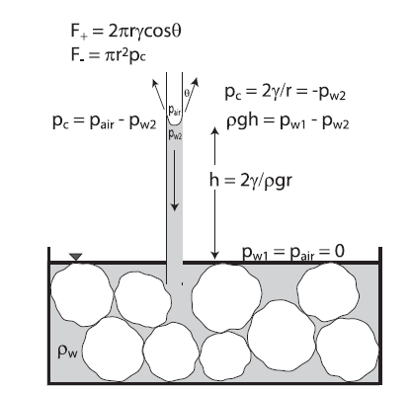
But water is also sucked into fine pores if surface is hydrophilic (water wet)
Capillary tube illustration
Tree rootlets do the (can “suck” at -40 bars)
Note: cos ϴ is wetting angle
Often assumed: cos ϴ ~ 1

Slide 8
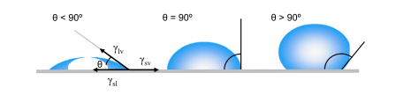
Contact angle indicates surface preference
Contact angle between liquid drop and surface (measured from the liquid-solid surface)
water
*
hydrophobic
Hydrophilic or water wet
Material can be both oil and water wet
* The force balance argument is tricky and probably requires a thermodynamic perspective which we will sidestep here

Slide 9
Liquid oil and water on Haynesville gas shale
Engelder et al.(2014)

Slide 10
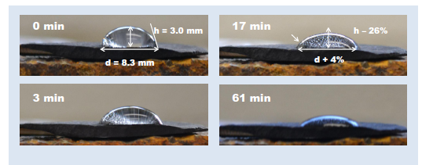
Imbibition of water into Marcellus Shale
Notice gas is expelled as water is imbibed
How can a sediment be both water and oil wet?
Engelder et al.(2014)

Slide 11
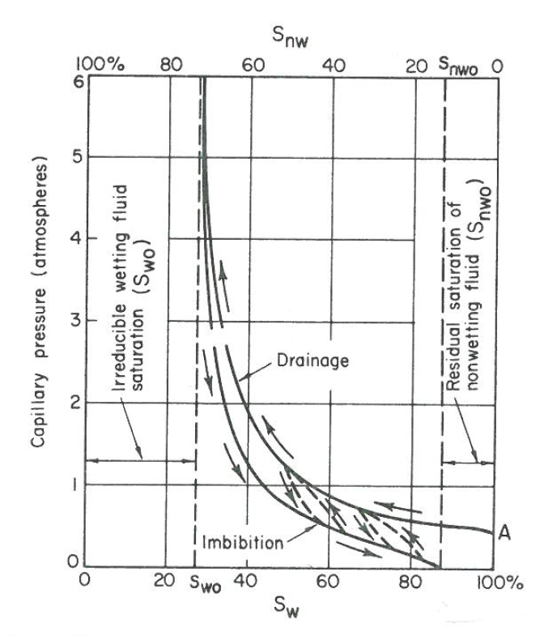
Imbibition and drainage (always relative to water)
Packed
column
porous plate
vacuum
p_{c}=p_{nw}-p_{w}
Imbibition not same as drainage curves
(because gas left behind)
Drainage (of water) , e.g. inject gas
Entry pressure of gas, p_{c}=p_{g}-p_{w},
p_{w}=0 at entry surface
Cannot push gas into 100% of pores
S_{iw}
S_{inw}
When imbibe water, not all gas can exit
…end effect in column tests

Slide 12
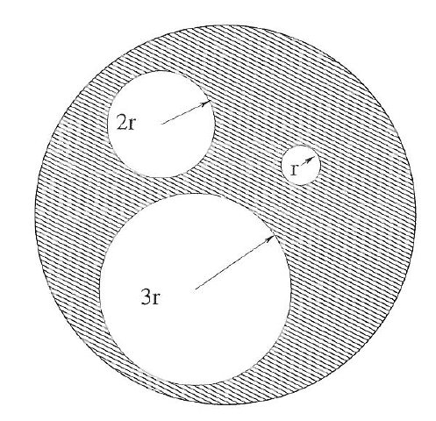
Example:
Steel plug L meters long with three holes

Slide 13
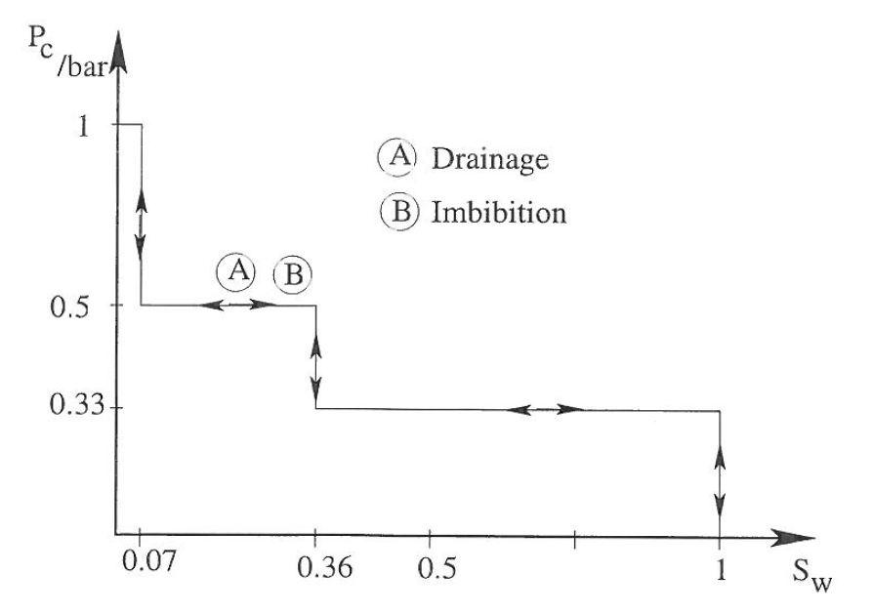
Thus, as we force oil into the steel plug by increasing p_{o}, we obtain a crude drainage curve
If we then lower the pressure on the oil the water will imbibe first in the small pore, then in the middle, and then in the large, producing an identical imbibition curve

Slide 14
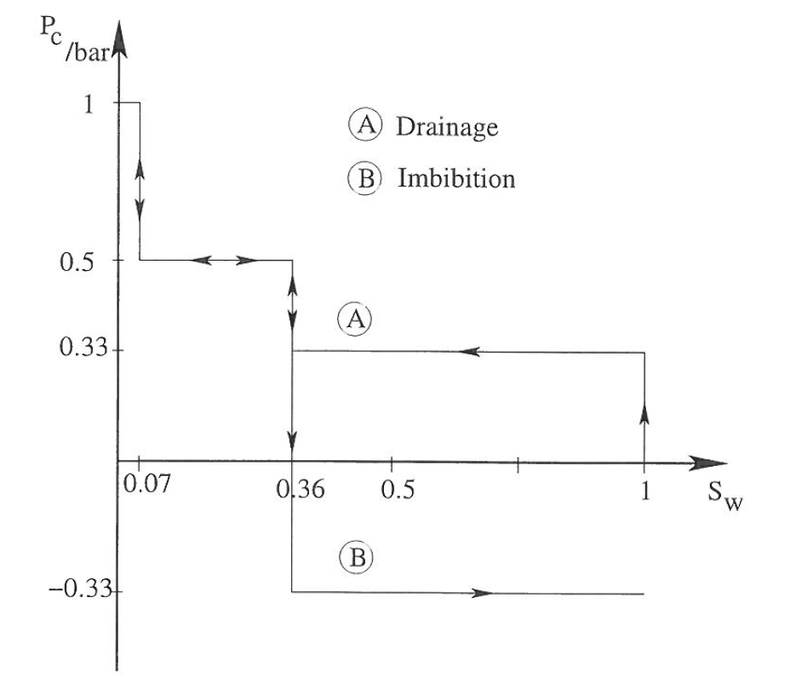
If the oil introduced into the large pore causes it to become fully oil wet (e.g., ϴ=180°), p_{o} must be negative to pull the oil out of this last pore.
Sometimes introducing oil will cause part of a core to become oil wet.

Slide 15
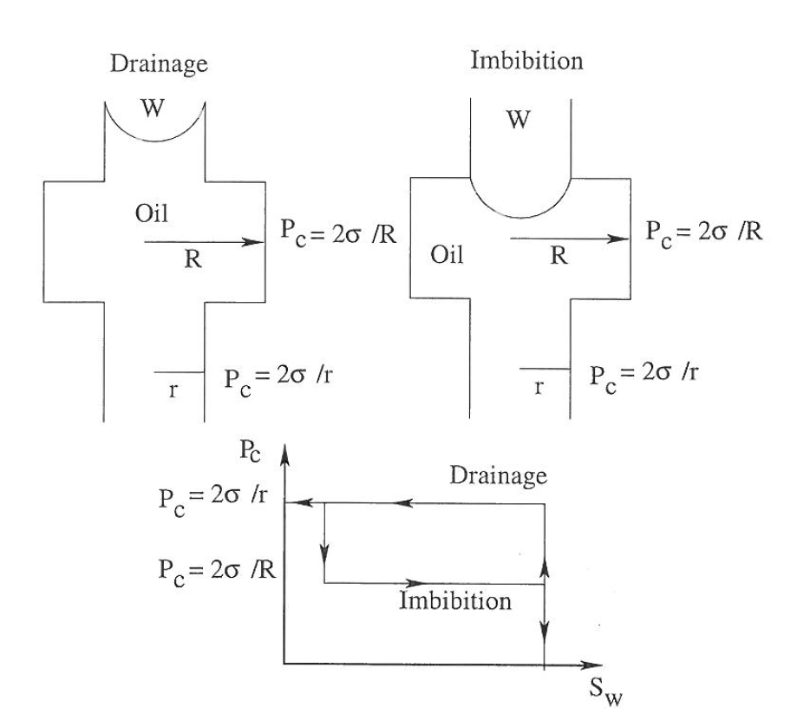
Hysteresis can occur even in one pore model.
When pressure is sufficient for oil to enter the narrow pore, oil will also fill all the wider parts of that pore.
But when po is reduced, water will not imbibe into wider parts until oil pressure is reduced below the oil entry pressure there.

Slide 16
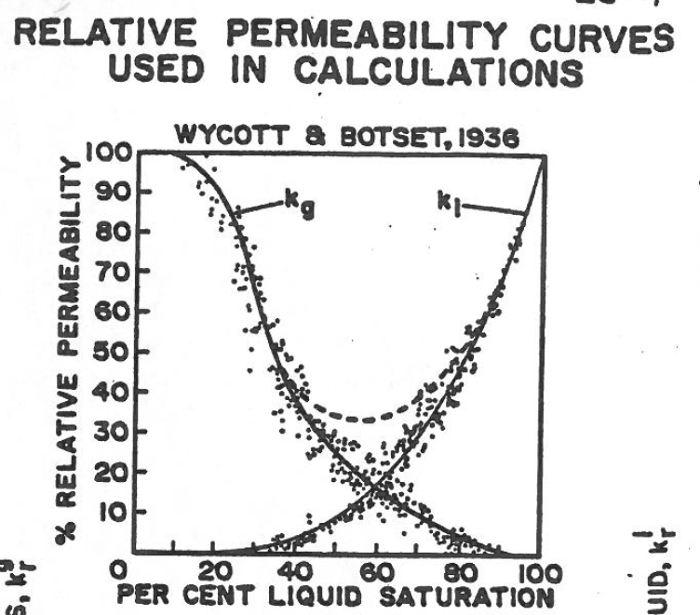
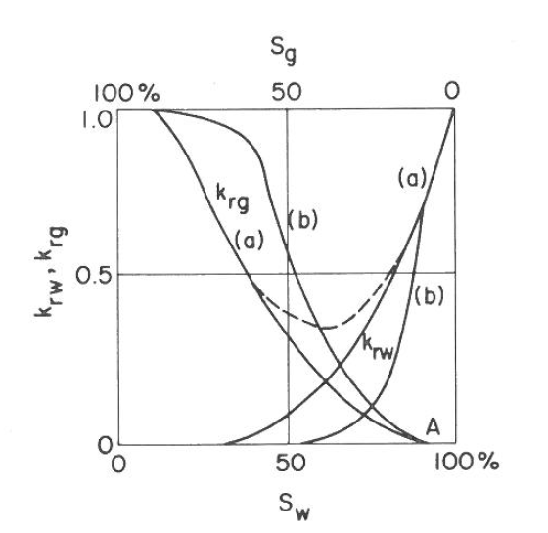
Relative permeability
For permeability of A, turn other phase into rock
Why not fall steeply?
Consolidated
sand
Why fall steeply?
Unconsolidated
sand
S_{iw}
S_{inw}

Slide 17
Fluid Properties
To calculate, we need fluid properties

Slide 18
Viscosity of water
At 20°C the dynamic viscosity is 1.0x10⁻³ Pa s. At 100°C it is 0.28x10⁻³ Pa s, less than 1/3rd the 20°C viscosity. To good approximation between 0 and 150°C:

Slide 19
Viscosity of oil = f(T,GOR,API)
Empirical relationships have been discovered that describe oil viscosity. For example, Beggs and Robinson (1974) showed that dead (m_{do}) and live (m_{o}) viscosity in centipoise (1 cp=10⁻³ Pa s) can be described as a function of temperature (T_{F}[°F]), GOR (gas oil ratio in scf /bbl ), and oil density in API:
API gravity (oil density) is a function of oil maturity (how thoroughly the oil has been cooked). Ultimately oil cooks to methane plus a residual, but on the way the oil progresses from heavy (e.g., high density) viscous oil, to light oil. API gravity was an early way to conveniently compare the density of oil and water.

Slide 20
GOR of Oil
Typically oil contains sufficient gas that as it migrates upward (it is less dense than water) it expels gas. When it reaches a reservoir it is therefore commonly gas saturated. The oil contains just the amount of gas such that it is at its bubble point—gas is just on the verge of “bubbling” out of the oil. In other words the reservoir pressure equal the bubble point of the oil. The bubble point of oil depends on T_{F}, GOR, and API:
Glasø(1980)
For p_{b}=p_{reservoir}, we can invert to obtain GOR

Slide 21
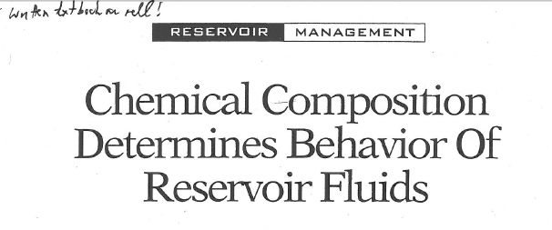
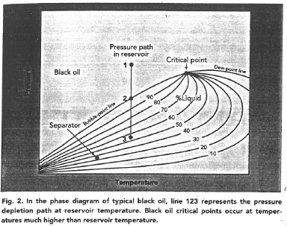
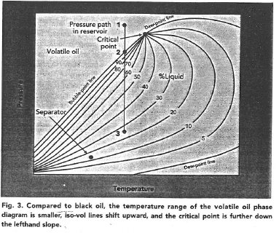
Phase Diagrams
On Blackboard to read

Slide 22
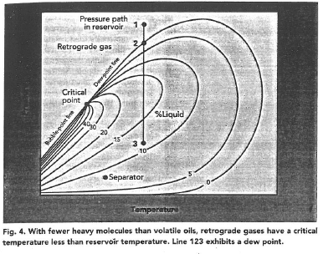
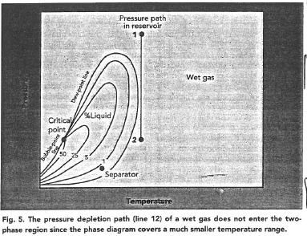

Slide 23
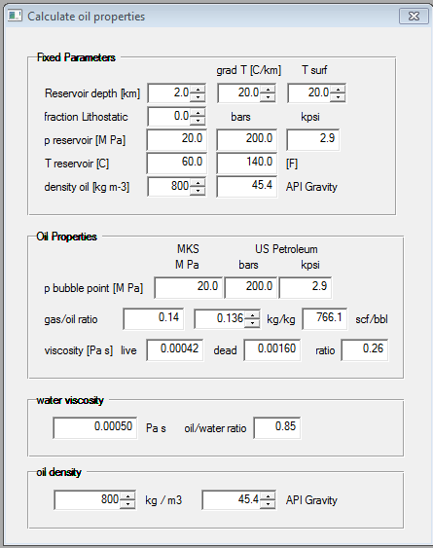
A calculator is on eas-cathles
Oil is at 2 km depth
Pressure is hydrostatic
T=60C, p=200 bars
Bubble point is 200 bars
GOR=766 scf/bbl
Live viscosity = 0.00042 Pa s
Note: some of these are for startup initial values. Numbers are slightly different when spin. For example after spin up and back, GOR=856.7 but live viscosity is still 4.2=10⁻⁴ Pa s.
Now let’s see how a carrier bed might operate for a reasonable oil generation rate.

Slide 24
Carrier bed calculation
Very thin layer of oil migrates along top of carrier sand!
Need:
Darcy sand, k’= 10⁻¹² m²
μ=4.2x10⁻⁴ Pa s
2°
G_{K}=0.02 maturable pet/kg sed
h=100 m source thickness
1500 m maturation interval
φ_{o} 0.55
φ_{s} 0.1
ρ_{sed} 2400 kg m⁻³
ρ_{pet} 800 kg m⁻³
h
Source rock of thickness h

Slide 25
In 1987 Dave Powley of Amoco raised issue of pressure compartmentation with GRI
Powley 1987 presentation to Gri

Slide 26
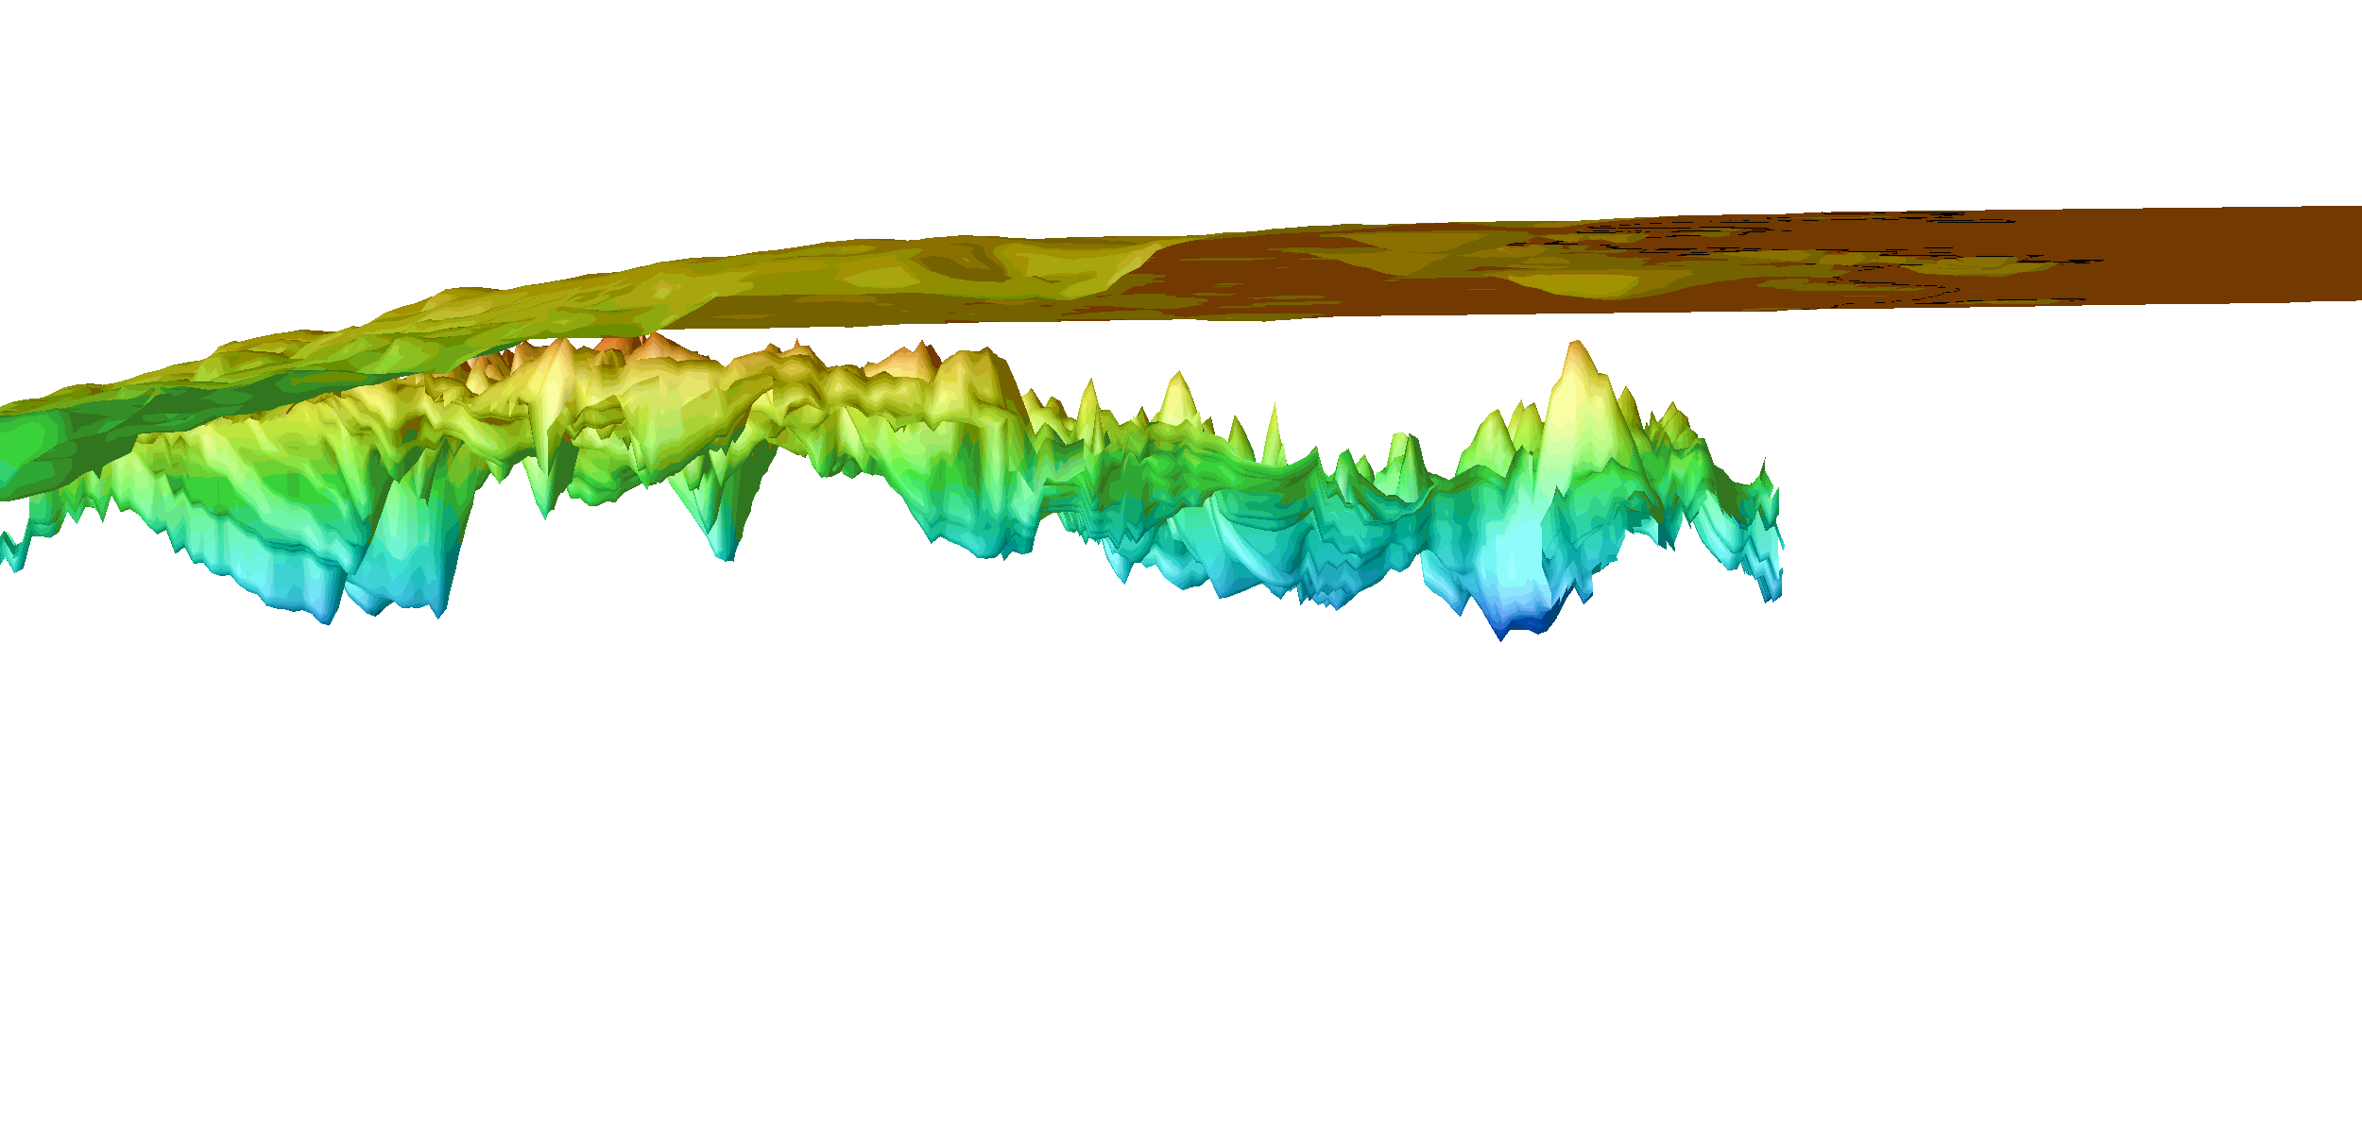
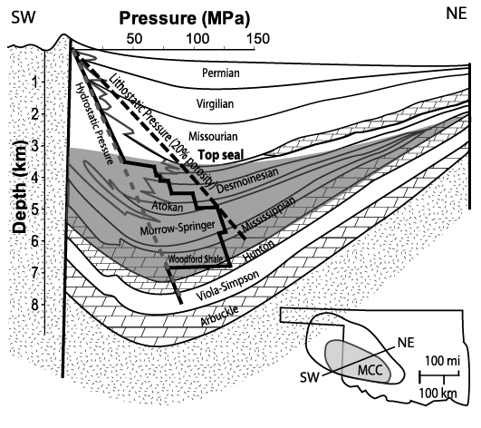
TOOP in GoM
Powley’s Buried
Beer Bottle
Model
Al Saieb, Anadarko Basin
Powley 1987 presentation to Gri

Slide 27
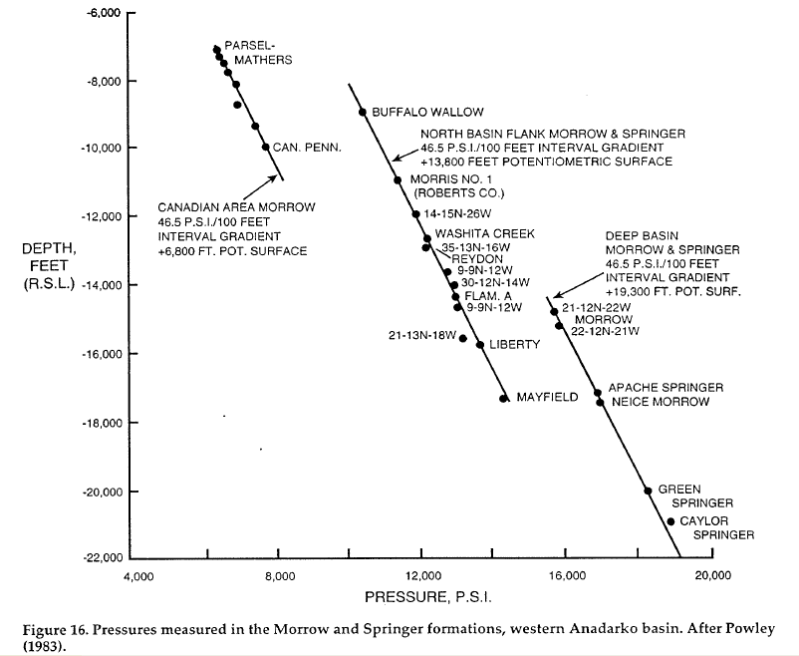
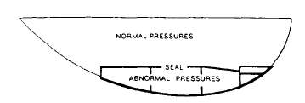
10 years of evidence
Powley (1990)
Bradley and Powley (1990)

Slide 28
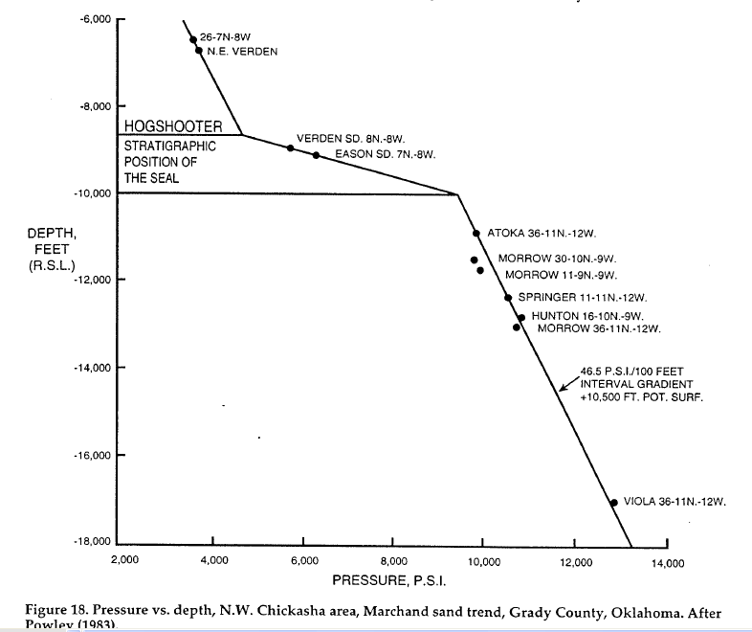
Bradley and Powley (1990)

Slide 29
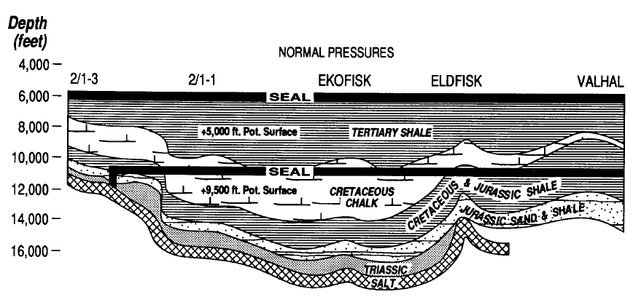
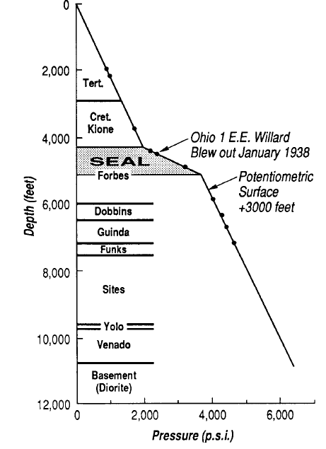
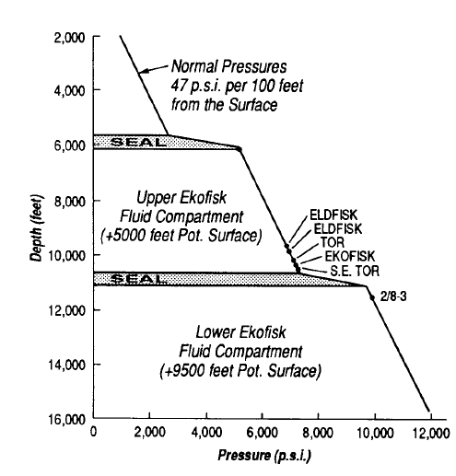
GRI Verification
North Sea
Sacramento Valley, Ca
Hunt (1990)

Slide 30

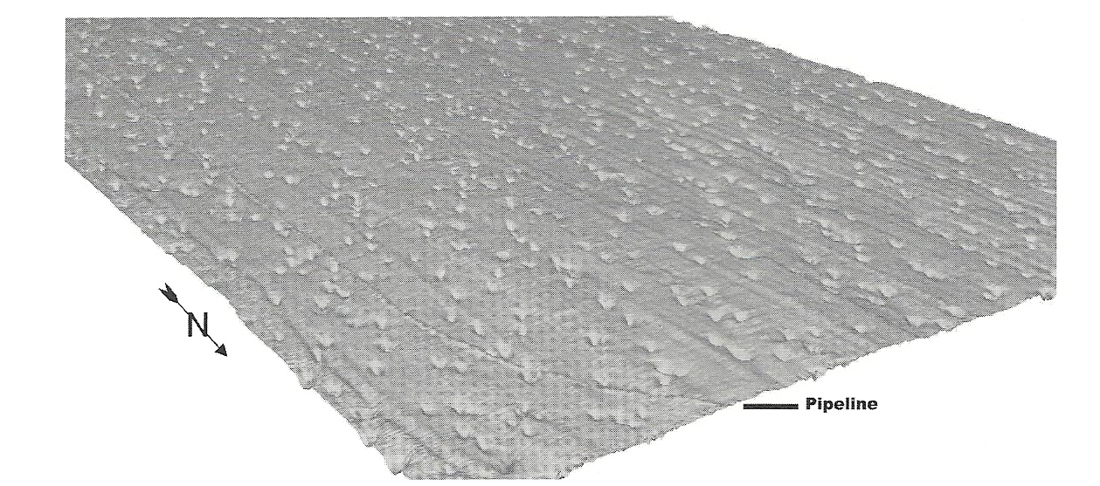
Pockmarks and seepages
Pockmarks produced by gas-driven water venting

Slide 31
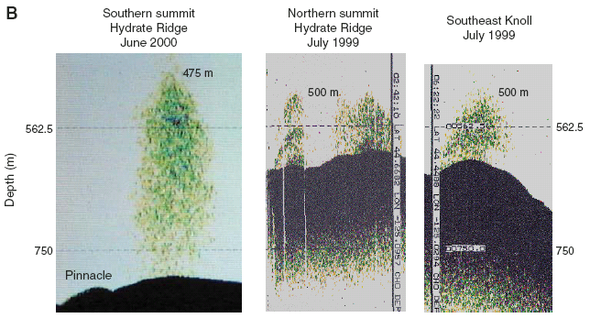
Echo Sounder Records of Gas Plumes in the Water Column of the Hydrate Ridge Region
Gas plumes are fairly common
Trehu A M et al ,2003

Slide 32
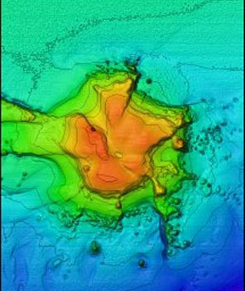
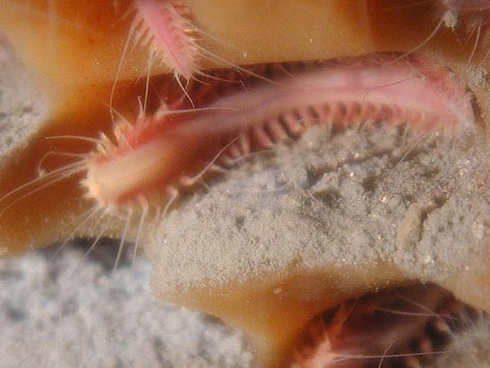
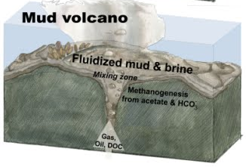
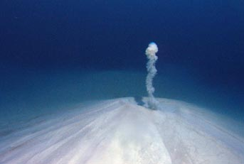
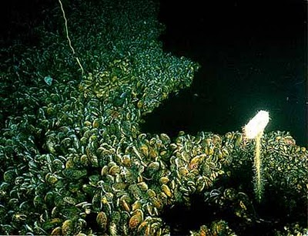
Ian MacDonald (TAMU)
Worms grazing on bacteria
growing on surface of methane ice
Salt dome
http://oceanlink.island.net/ONews/ONews7/images/mud%20vol%20-%20FBGNMS.jpg
Ian MacDonald (TAMU)
Ian MacDonald (TAMU)
gas
Brine pool
Mud Volcano
Methanotrophic mussels

Slide 33
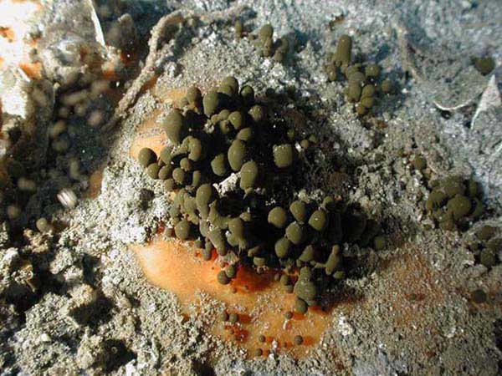
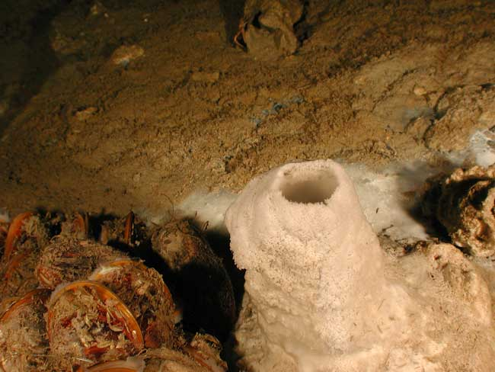
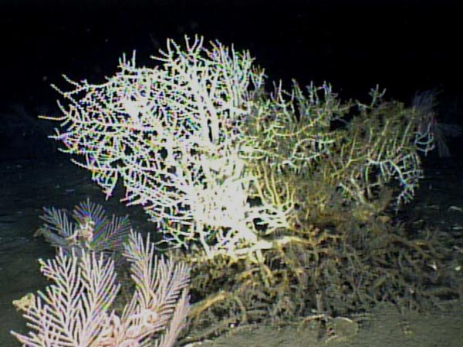
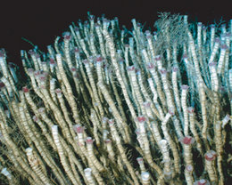
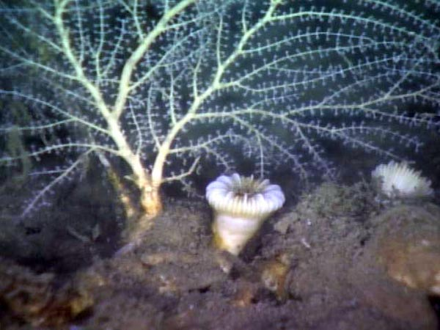
Ian MacDonald (TAMU)
Mineral chimney and microbe mats
http://i.livescience.com/images/090407-deep-vent-02.jpg
Small oil droplets
adhering to hydrate
Madrepora coral
Mississippi Canyon
Ian MacDonald (TAMU)
Oceanexplorer.noaa.gov
Callogoria coral; cup coral

Slide 34
Reservoir (capillary) seals
How would they work?

Slide 35
Assignment
Read p 14-20 of Cathles and Adams (2005) on blackboard
Experiment with calculator
Seek to understand how Petrel handles fluid and material properties

