Slide 1
Tracers- documentation of flow through rocks
Lecture 20
EAS/ChemE 6669 Earth Energy Science and Engineering
by
L. M. Cathles
November 20, 2015
2146 Snee Hall
Notes:
1

Slide 2
Outline
Subsurface flow is complicated
Why tracers

Slide 3
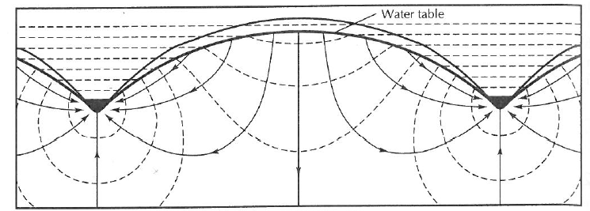
Permeability is just the start
A. Permeability
Δh
L
Darcy (1856)
B. Geometry
Flow lines
equipotentials
Toth (1962)
C. Geology
Freeze and Witherspoon (1967)

Slide 4
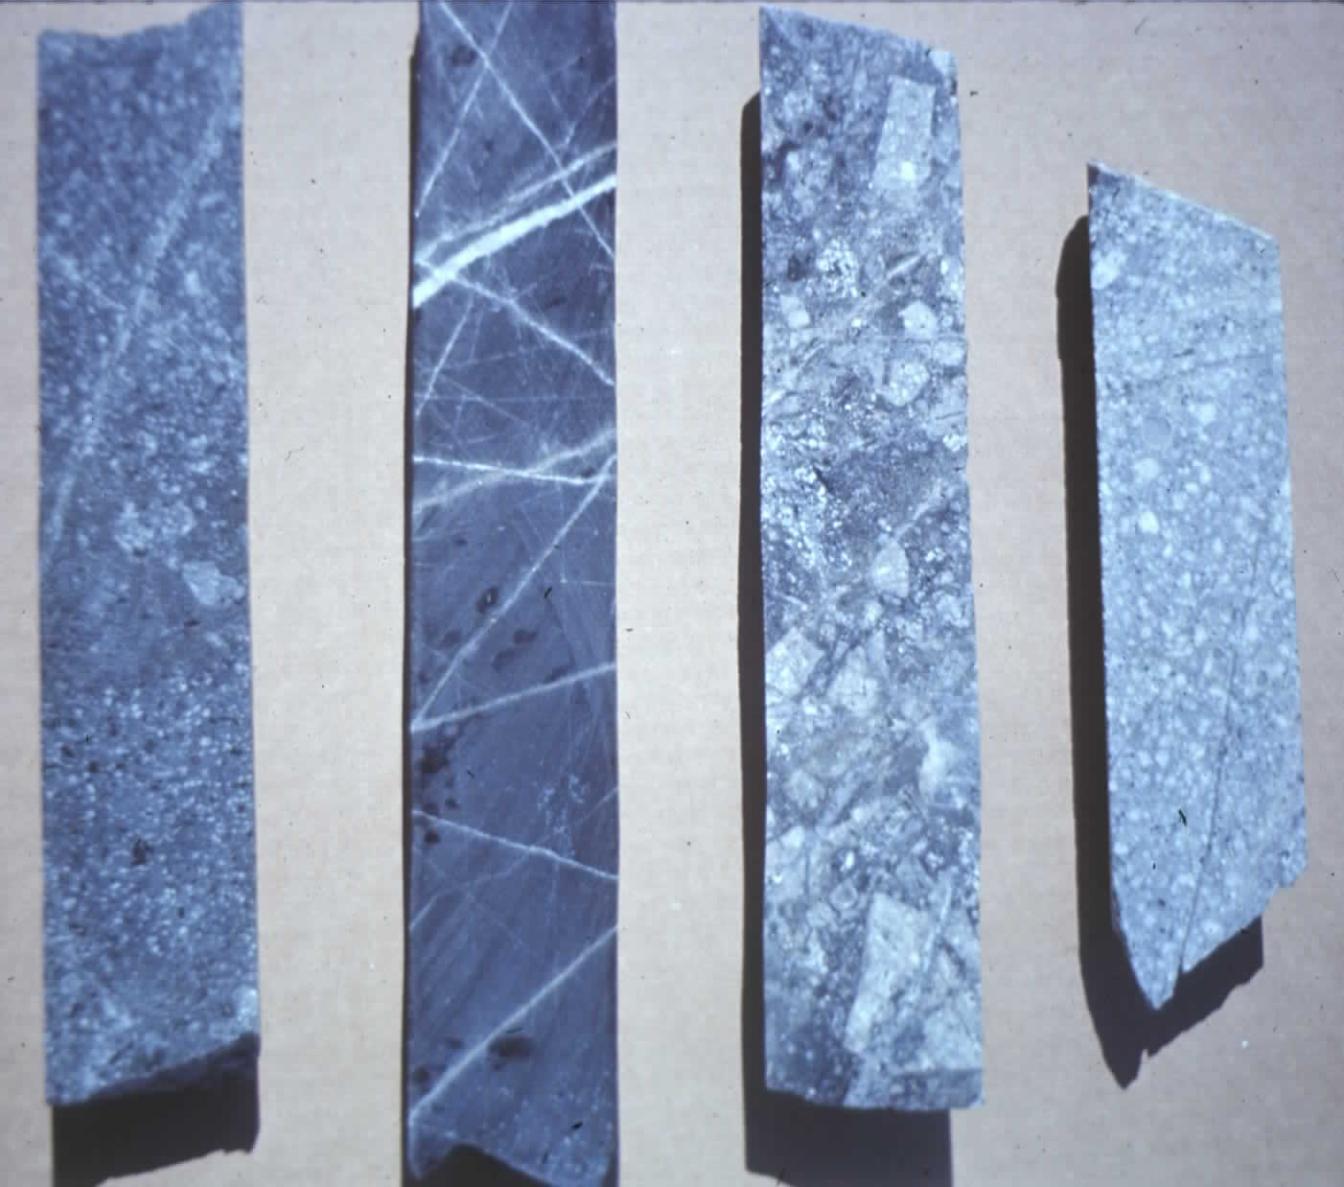
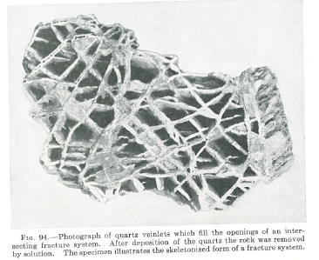
Veins are fractures cemented by fluid flow and mineral precipitation
A
B

Slide 5
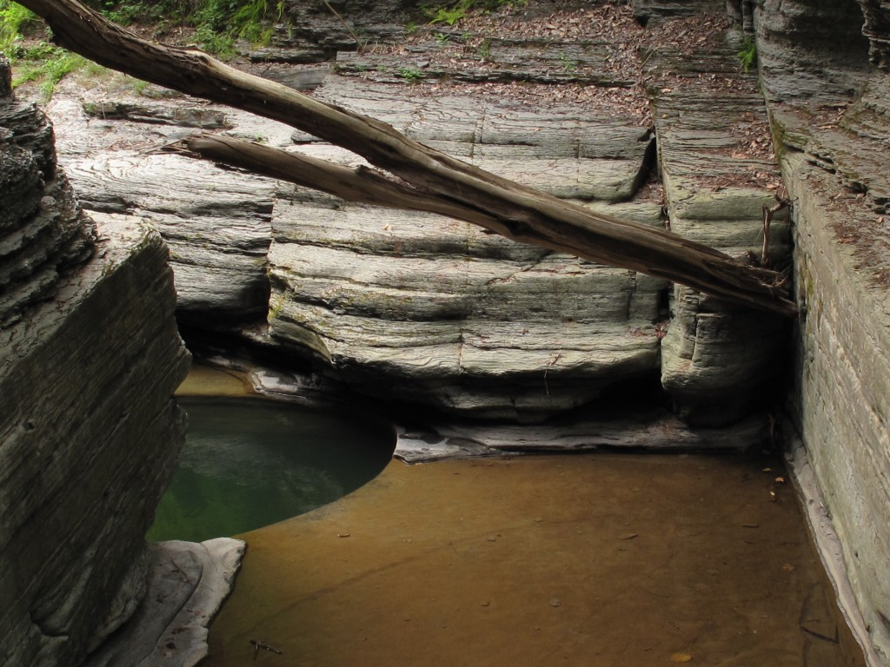
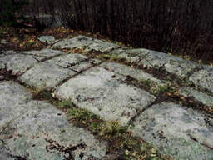
Spectacular examples of joint can be seen in our Ithaca gorges.

Slide 6
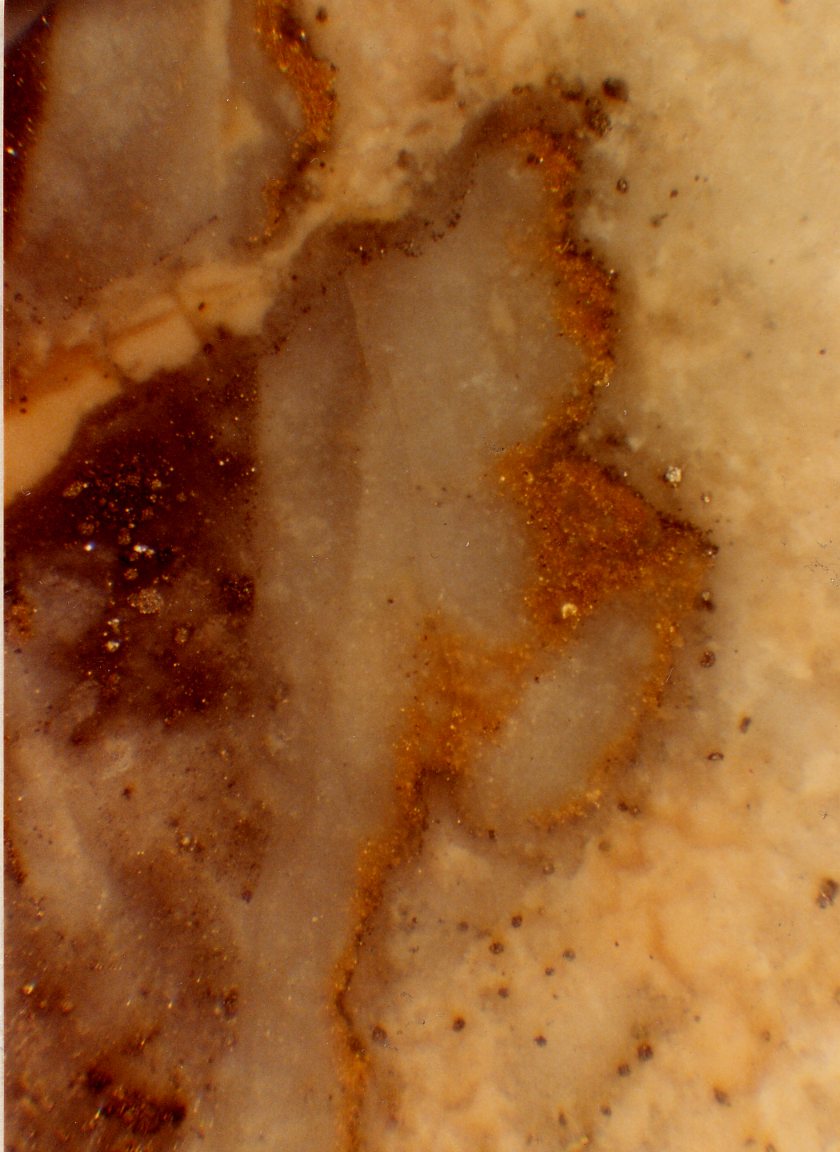
Gold
Few things motivate like Au
Gold has very low solubility and spectacular deposition such as shown requires very high volumes of fluid flow
El Indeo

Slide 7
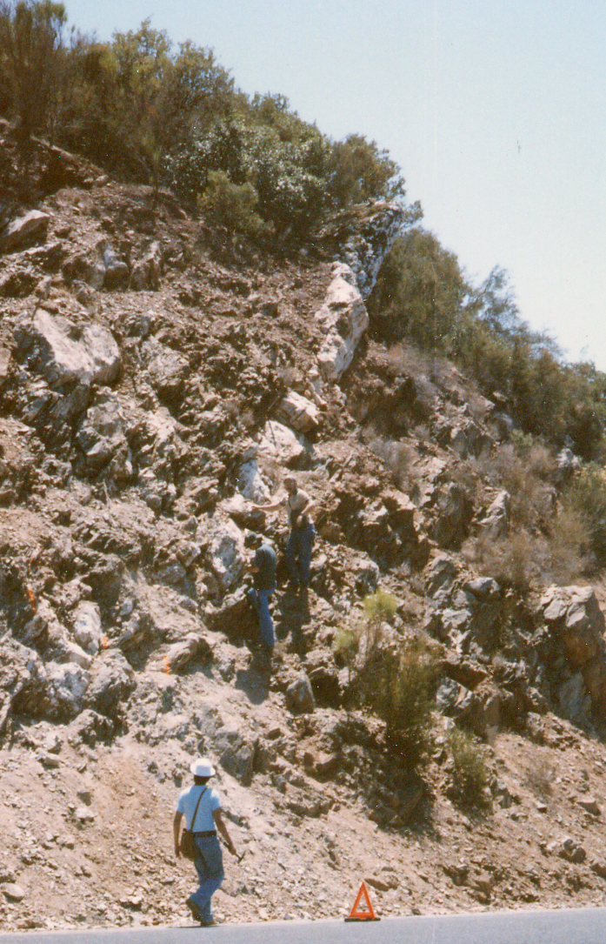
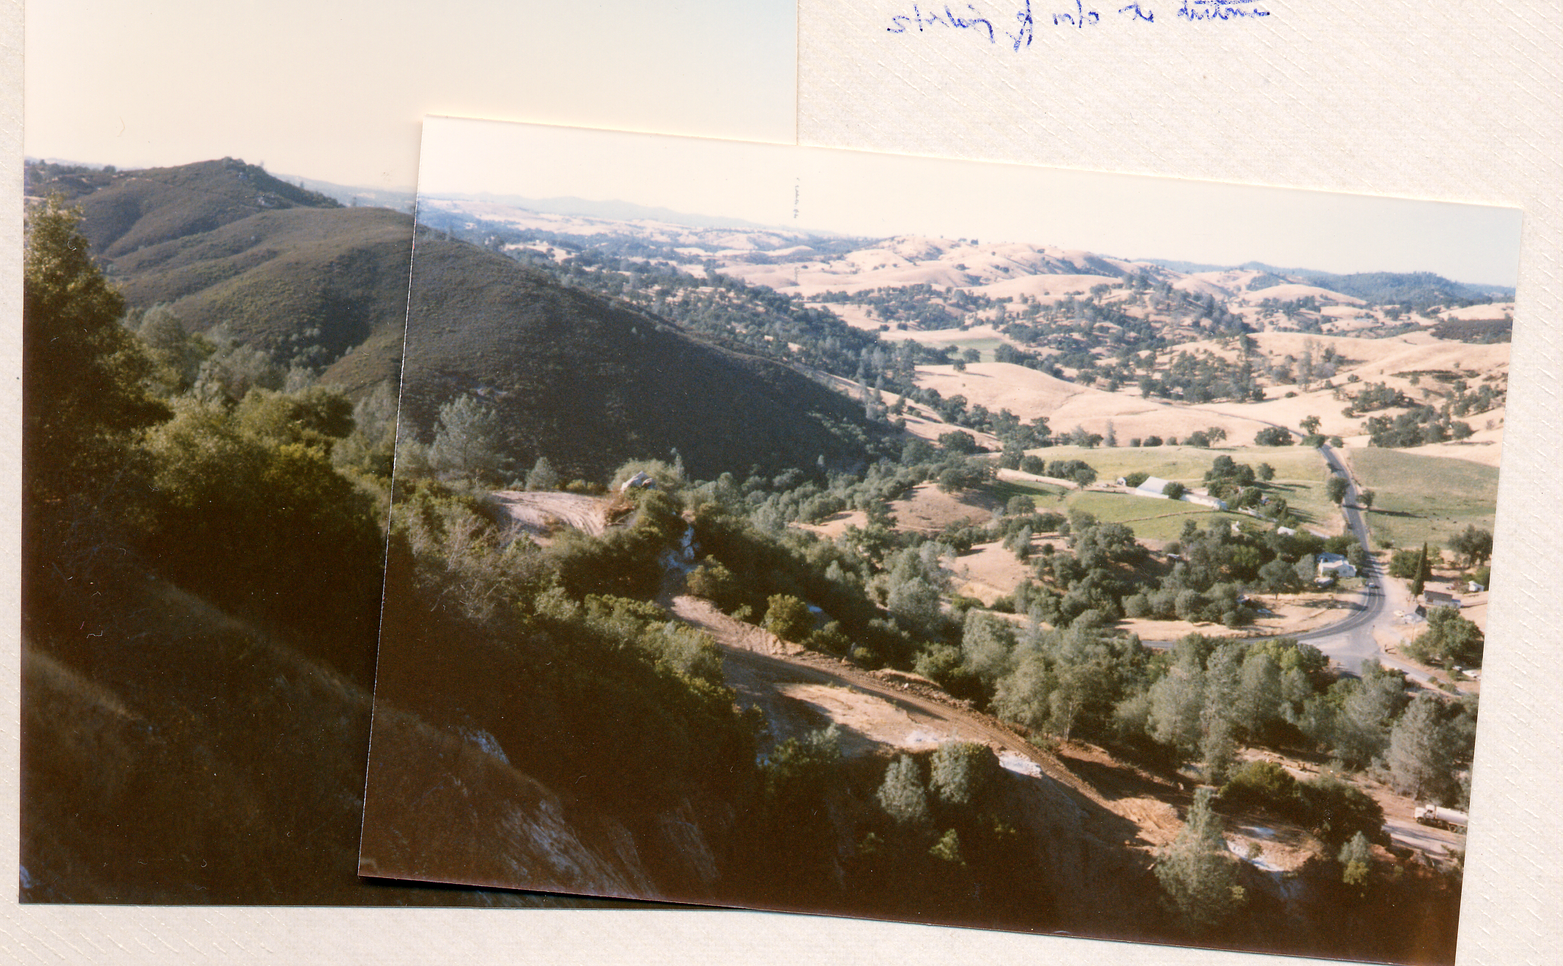
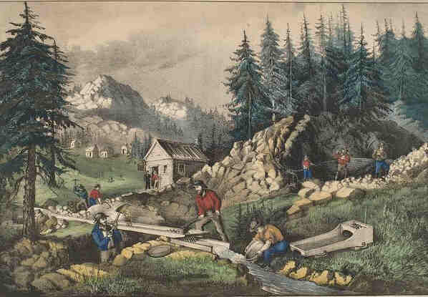
The Mother Lode, Ca
Regional fluid escape formed Mother Lode
m wide vein strikes across countryside formed by a different mechanism
Gold rush
1848-1855

Slide 8
Why Tracers?
Connectivity
Flow porosity
Diffusional accessibility

Slide 9
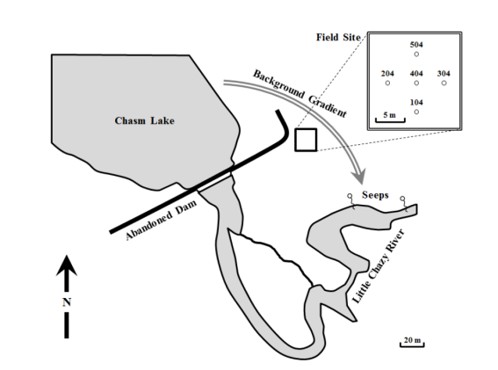
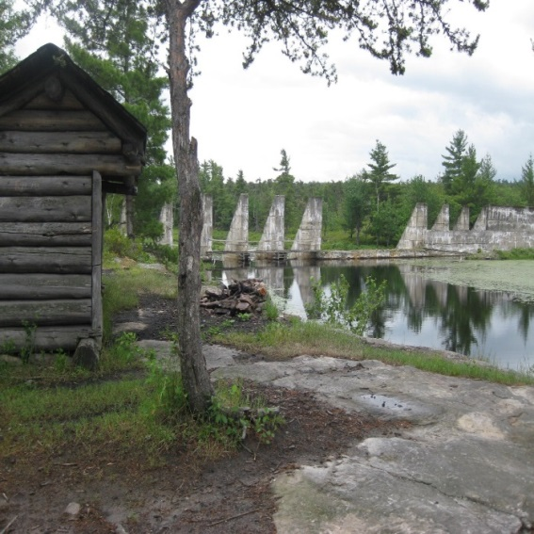
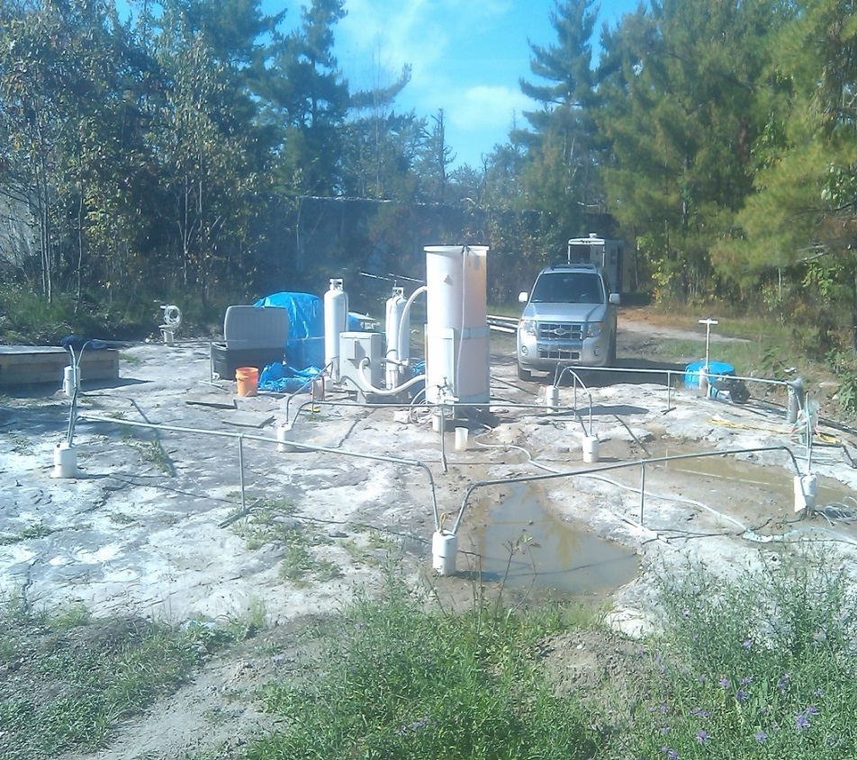
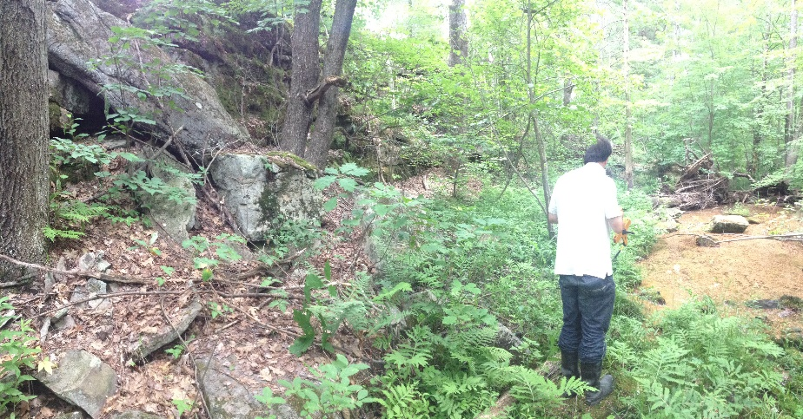
Altona, NY: connectivity in a single crack
Chasm Lake
Chasm Lake
204
404
304
7 m
104
1.9 mm
Horizontal crack at 8 m depth
Crack(s)
seeps
Cambrian sandstone
1% porosity

Slide 10
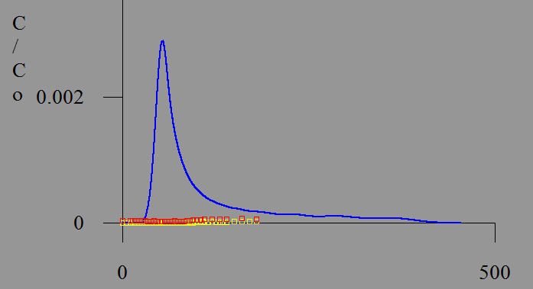
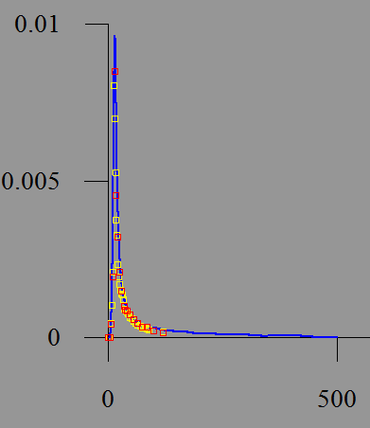
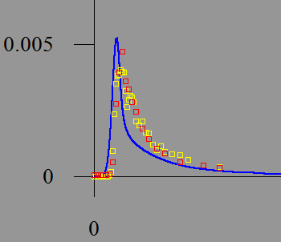
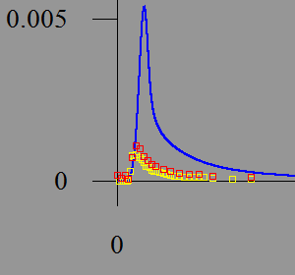
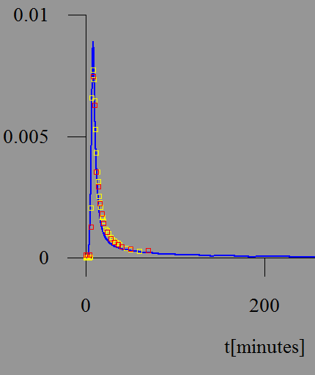
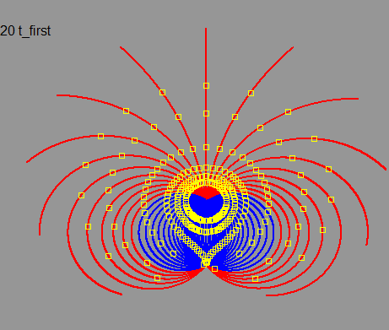
Single crack flow is complicated!
#6
(1%)
(4%)
(51%)
204
404
304
barrier
7 m
104
#7
504
204 404 304
104
(59%)
(51%)
(62%)
barrier
6
7
hi
#3
low
3
2
5
barrier
#5
(77%)
(75%)
(60%)
#2
(16%)
(18%)
(60%)
(63%)
(60%)
(58%)
#2
C-dots
I
barrier
Calibration
pair

Slide 11
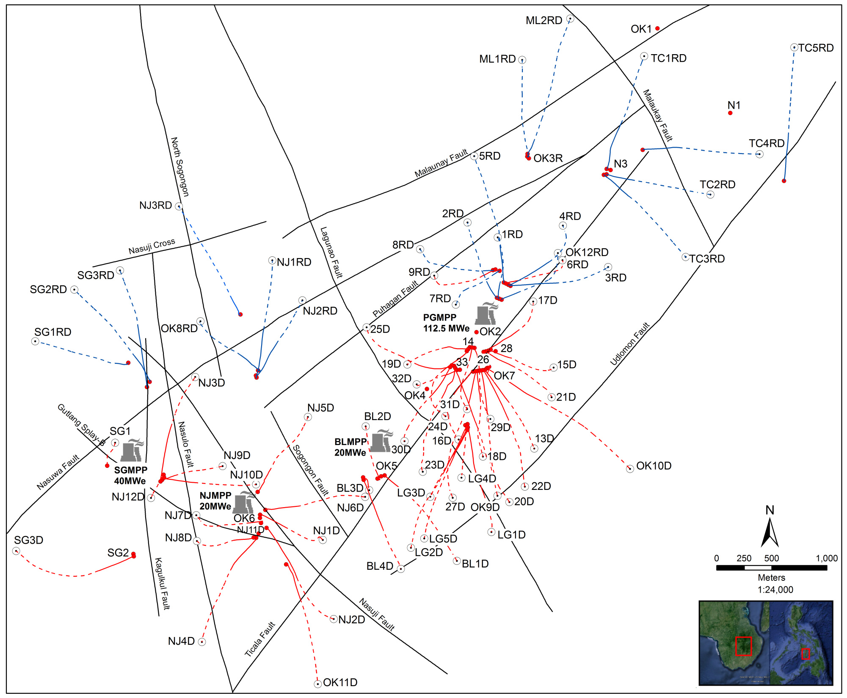
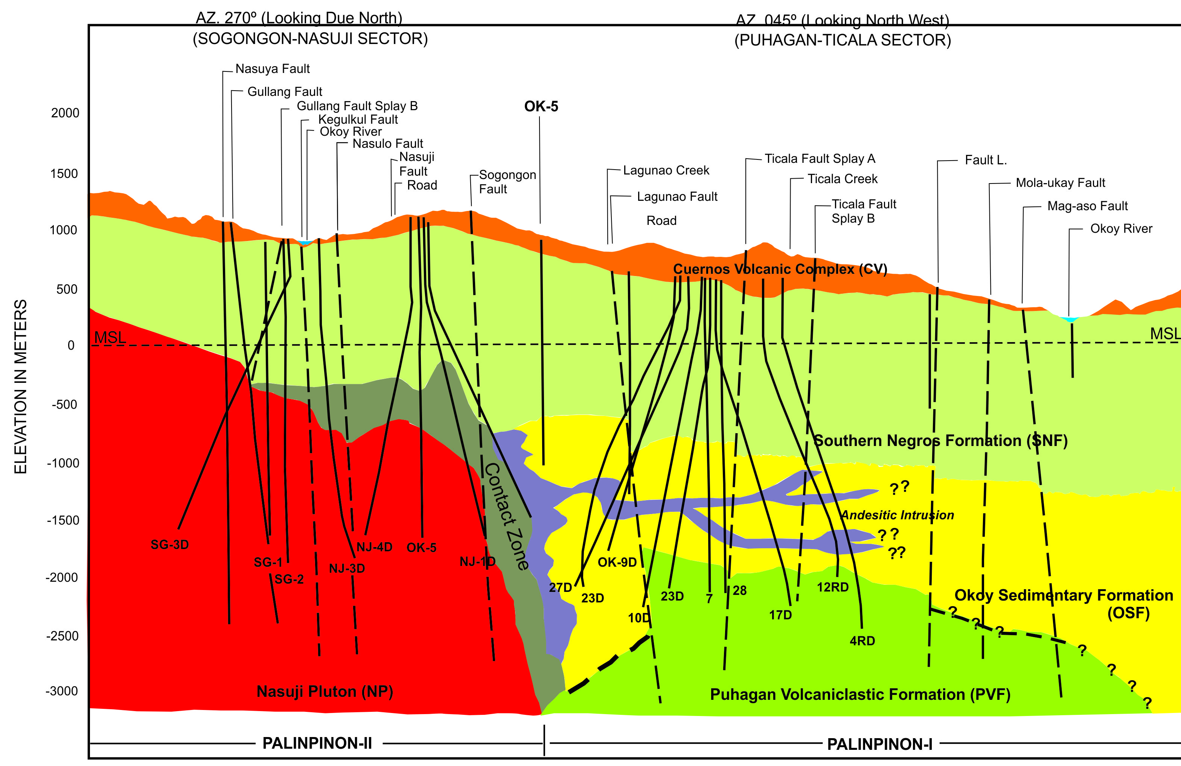
Palinpinon Geothermal Field, Philippines
Injection wells
Production Wells
Main production interval

Slide 12
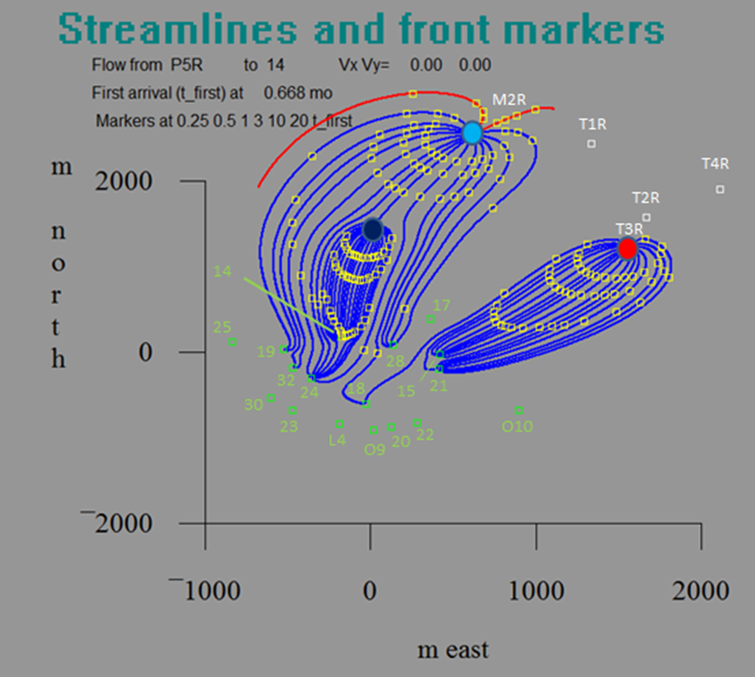
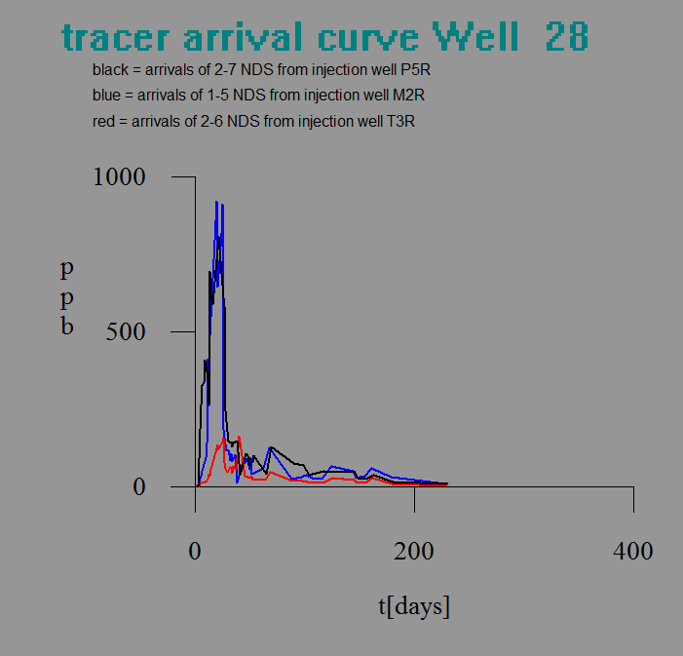

Slide 13
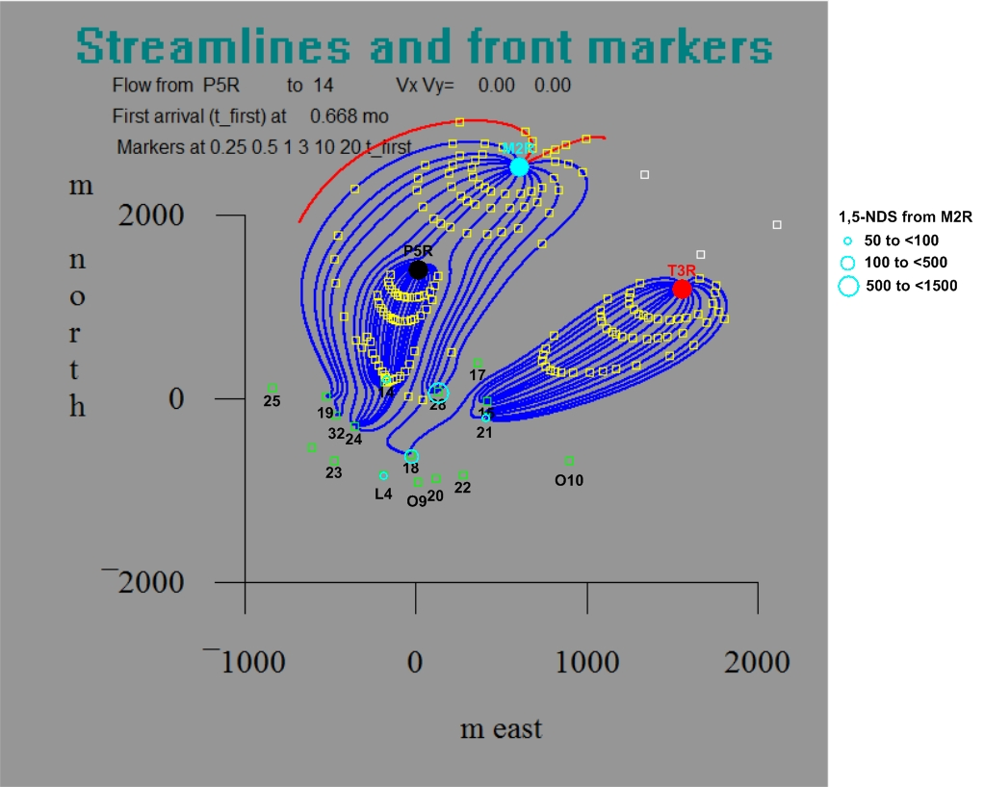
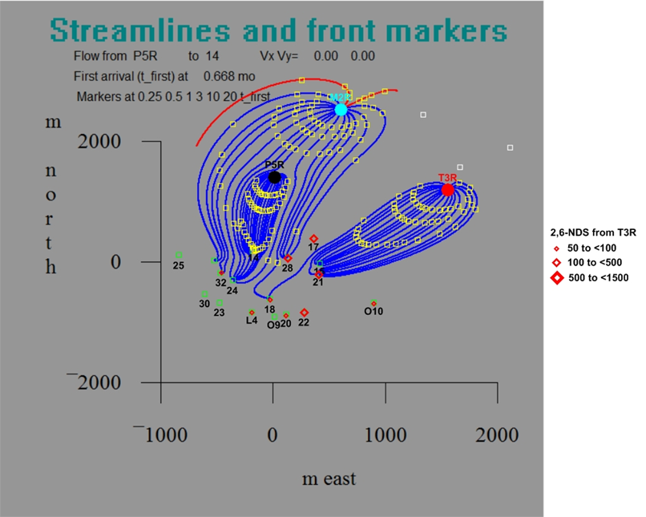

Slide 14
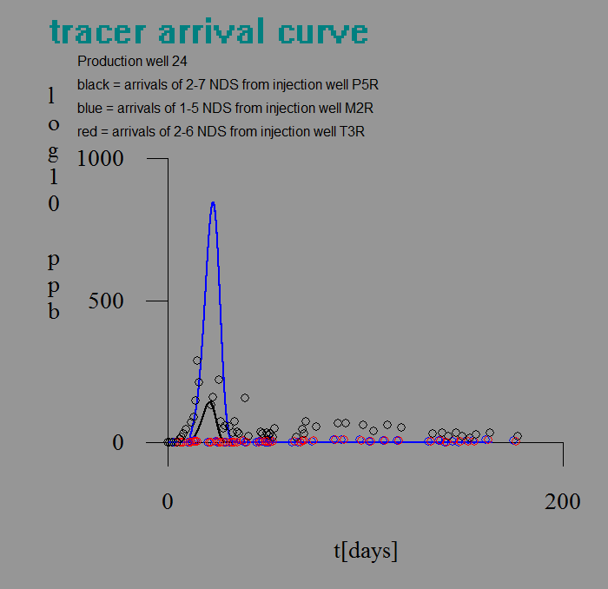
Only P5R (Black) arrives

Slide 15
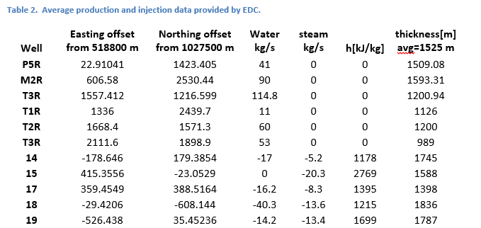
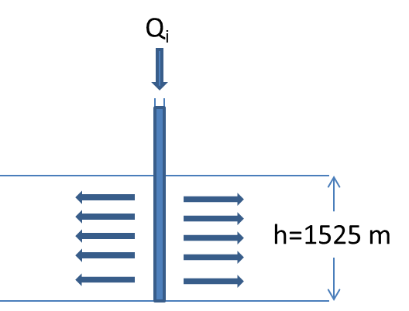
Model
Conclusions
Flow porosity ~0.01%
Flow remarkably homogeneous
(complications- recirculation of tracer)

Slide 16
Interpretation reasonable
Darcy’s Law
Intrinsic permeability
Fracture Porosity
D =0.1 m
d[μm] | k’[m²] | k’[md] | φ_{f}[%]
1 | 3.33x10⁻¹⁸ | 3.33x10⁻³ | 0.002
10 | 3.33x10⁻¹⁵ | 3.33 | 0.02
100 | 3.33x10⁻¹² | 3330 | 0.2
How could one test it?

Slide 17
Dual Tracer Concept
Injection
Chemical Tracer

Slide 18
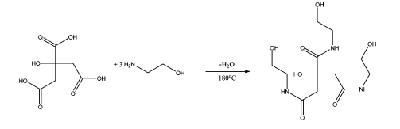
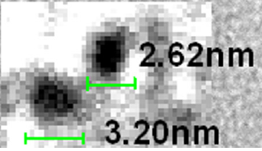
Inert nanoparticle synthesis
C-dot nanoparticles
Citric Acid
OH
Ethanolamine
HO
OH
mix at room temperature
Dry
Pyrolyze at 200°C for 8 hrs
Dialyze to remove ~3 nm particles
Detect by fluorescence to ~10 ppb
@20°C
TEM
@130°C
D_{C-dot}=1.2x10⁻⁶ cm² s⁻¹ = 0.1 cm² d⁻¹ = 0.01 cm² d⁻¹
D_{KBr} =2x10⁻⁵ cm² s⁻¹ = 1.7 cm² d⁻¹ = 0.17 cm² d⁻¹
diffuse 17 times more slowly

Slide 19
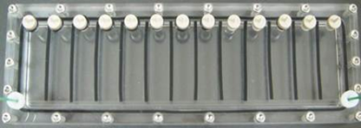
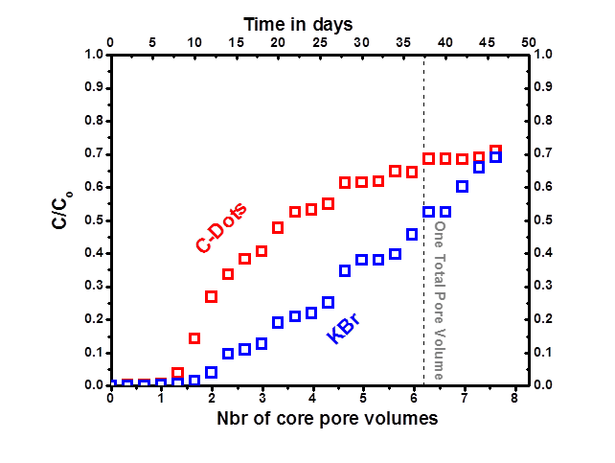
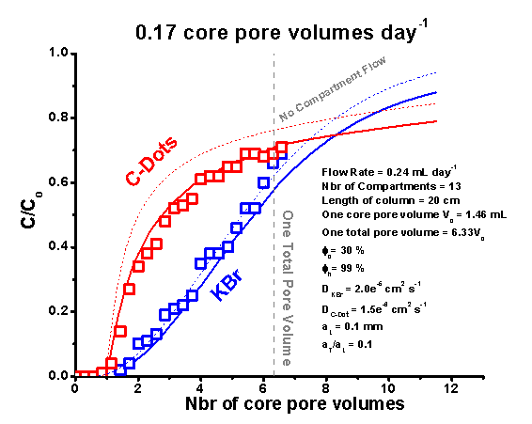
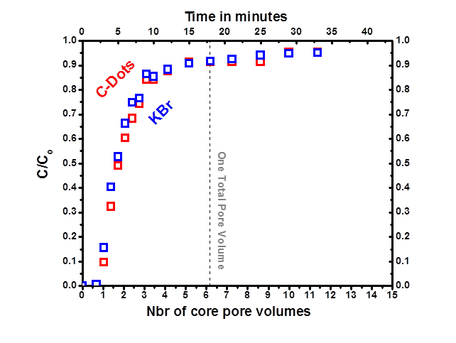
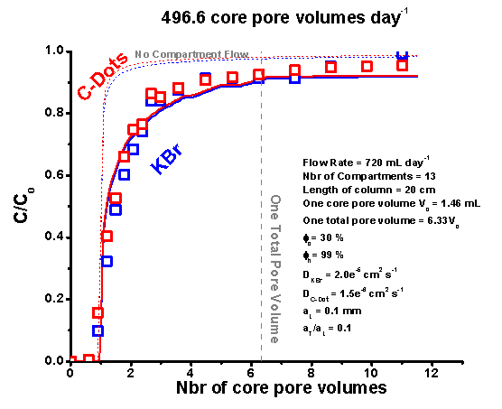
Methods tested in column experiments
L
l
Hele-Shaw Cell
And sand cells and columns
C_{effluent}(t)/Co
Model Analysis
O.17 core PV/d
∩
Design rule:
L
τ
=
l
l
497 core PV/d
∩
Subramanian et al (2013)

Slide 20
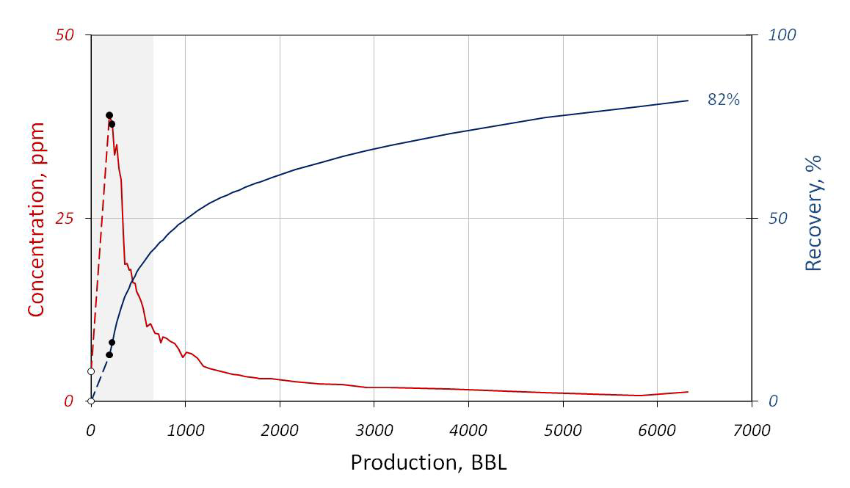
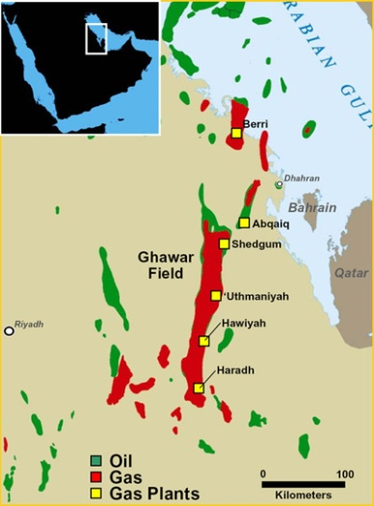
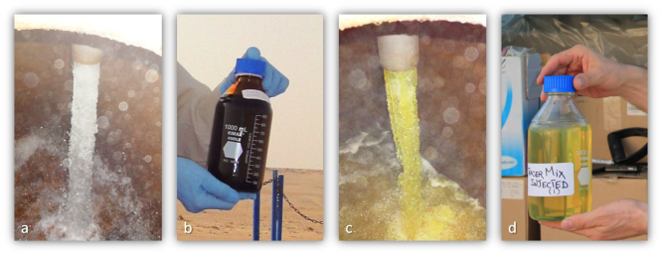
Successful test in Ghawar Reservoir
Field test 86% recovery
water 5 kg mix 130 ppm
255 bbl with 130 ppm C-Dot
injected at 7090 ft into 50 ft interval of
20% porosity carbonate reservoir at
~100°C and 120,000 TDS pore fluids.
Shut in 2 days.
Produced ~6000 bbl.
86% recovery.
Kanj, Rashid and Gianelis, 2011, SPE 142592-PP

Slide 21
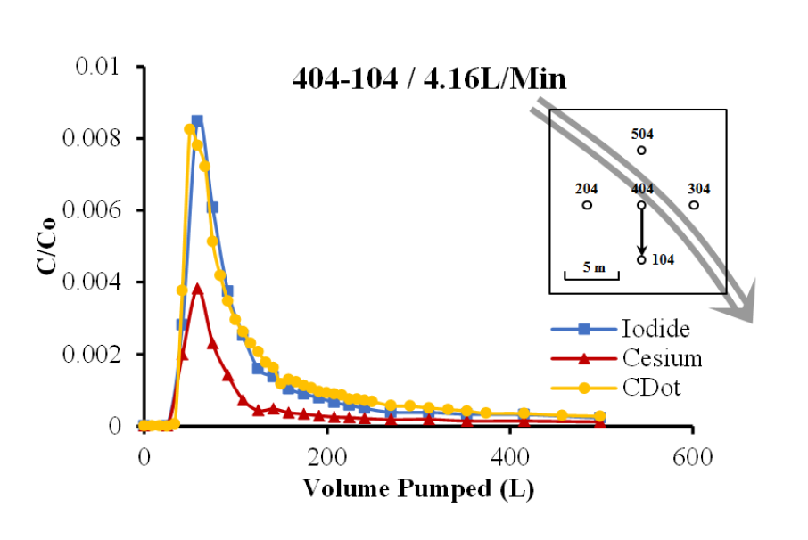
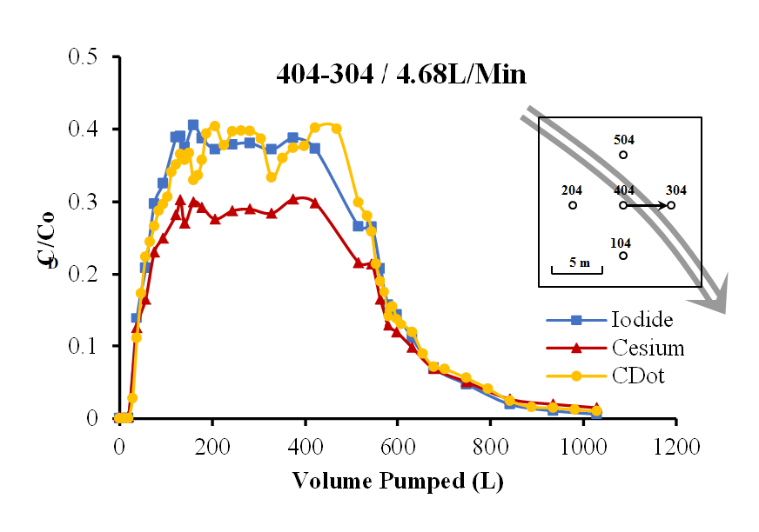
Successful test in quartzite, Altona NY
…C-dots behaved like Iodine
Iodide =
C-Dot
7 m
Horizontal crack at 8 m depth
EPA and DEC permissions obtained
Photo bleaching corrected
Laplace methods used in interpretation
Yushi Zhou, 2014 Cornell Ph.D Thesis

Slide 22
The Ely Witch Experiment
…testing the diffusional access of copper to in situ leaching
Cathles et al. (1974)

Slide 23
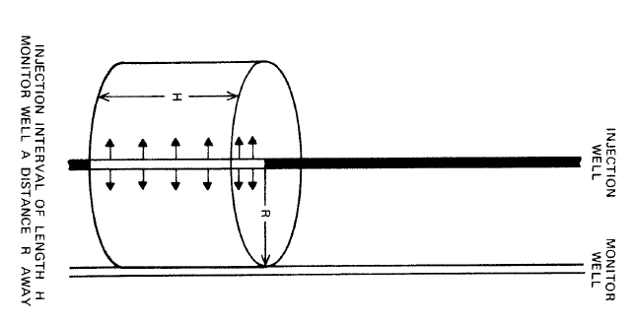
The Idea
Tracer arrives when it displaces the pore volume it interacts with once
Cathles et al. (1974)

Slide 24
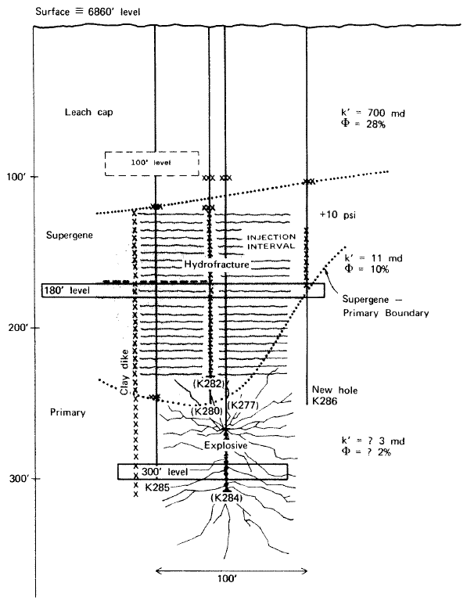
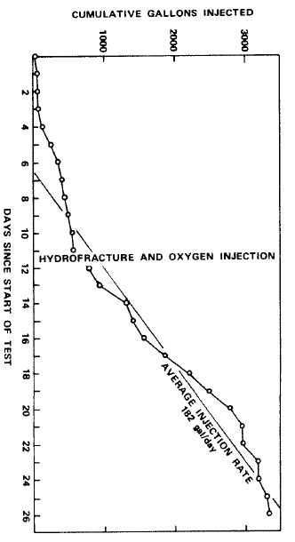
The site: Pit bench at Ray Mine, Ely Nevada
B’
B
other wells
bailed
Injection well
50 ft
3400 gal injected
Rate 182 gal/d
Over 50’ interval
41,000 ppm NaCl
0.5μm SiO₂ dust
26 d
Cathles et al. (1974)

Slide 25
Predictions
R=30 ft
Injection rate | 182 gal d⁻¹
Volume injected | 3400 gal
Fracture volume | 1057 gal (31%)
Halo volume | 105,760 gal (3100%)
D_{1/2} | 0.15 m
d_{1/2} | 75μm
D’_{NaCl} | 2x10⁻⁹ m² s⁻¹
D’_{particles} | 10⁻¹² m² s⁻¹
t_{D-NaCl}=τD_{1/2}²/D’_{NaCl} | 651 d
t_{D-particles}=τD_{1/2}²/D’_{particles} | 1.3x10⁶ d
t_{H}= vol. halo/inj. rate | 581 d
t_{f} = vol fx/inj. rate | 5.8 d
t | 30 d
Cathles et al. (1974)

Slide 26
fracture transit time
matrix porosity
tortuosity
half fracture spacing
effective diffusion constant = D_{o}φ_{m}/τ
Equation (5b)
NaCl tracer
valid to t~t_{D}
5x10⁻⁵
Cathles et al. (1974)

Slide 27
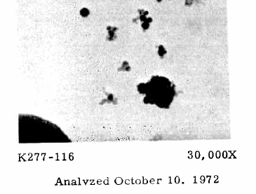
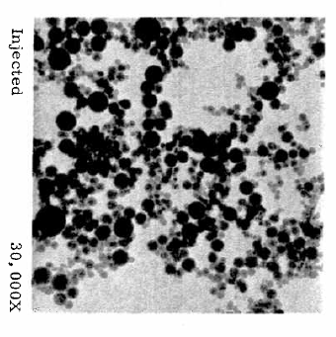
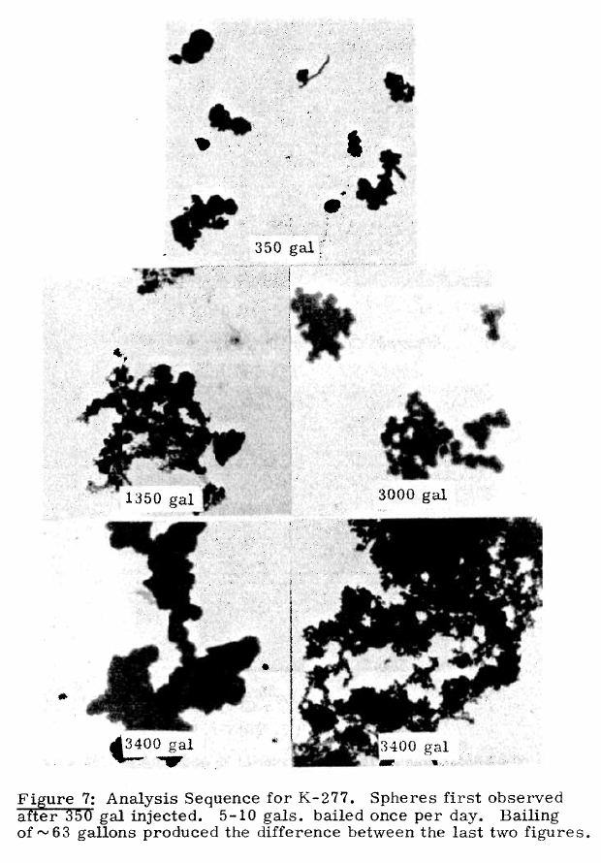
SiO₂ particles arrived
arrival K277
3400 gallons injected
over 30 days
later
analyzed
Gallons at particle arrival
Cathles et al. (1974)

Slide 28
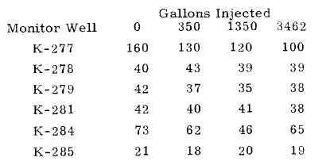
Salt never arrived
NaCl never arrived
injected 41,000 ppm NaCl
Cathles et al. (1974)

Slide 29
Example: Ekofisk Chalk
Ekofisk (N Sea chalk) permeability
Matrix 0.5-10 md
Effective up to 100 md
Fx spacing (5)-15-100 cm
intense in faults
conjugate, healed
induced
Anderson (1995, esp. Table 3.1)

Slide 30
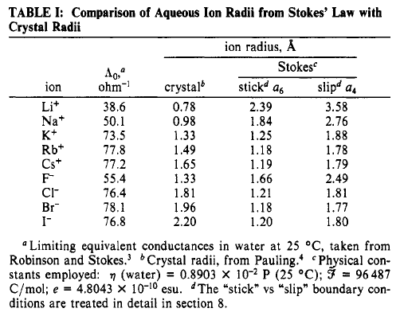
Diffusion in rock
Pau et al. (J. Phys. Chem., 1990,94, 2671)
Stokes-Einstein Equation
Boltzmann
constant
F-m
F/m²
Dynamic (shear)
viscosity of water
Particle
diameter
 | d_{slip}[nm] | D[cm² d⁻¹]_{20C} | D[cm² d⁻¹]_{20C} measured | x[cm]=2(D_{20C}t)^{0.5}
 |  |  |  | t=1d | t=10d
He
Cl⁻ | 0.181 | 2.04 | 1.53 | 2.9 | 9
Na+ | 0.276 | 1.34 | 1.00 | 2.3 | 7.3
np | 3 | 0.12 |  | 0.7 | 2.2
np | 30 | 0.012 |  | 0.2 | 0.7

Slide 31
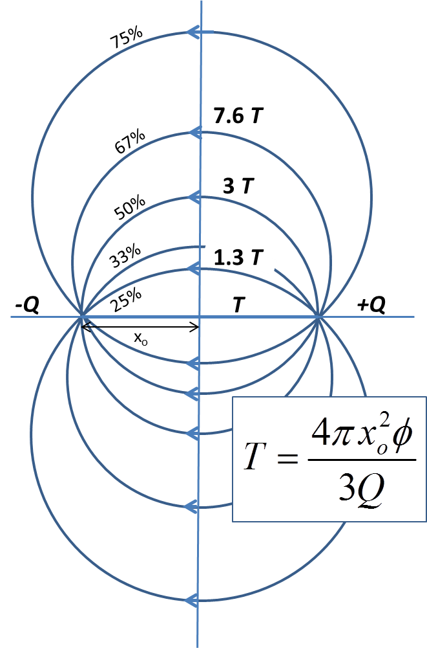
Transit time between wells
2x_{o} | T[d]
10 | 3
50 | 80
100 | 322

Slide 32
Diffusion fill time
Diffusional diffusion constant
 | 20C | 50C | 130C
D[cm/d] | 2 | 4.2 | 13.4
Diffusional matrix fill time (τ=3)
d | 20C | 50C | 130C
5 | 2.3 days | 1.1 | 0.35
10 | 9.3 | 4.5 | 1.4
50 | 234 | 111 | 35
100 | 937 | 446 | 140

Slide 33
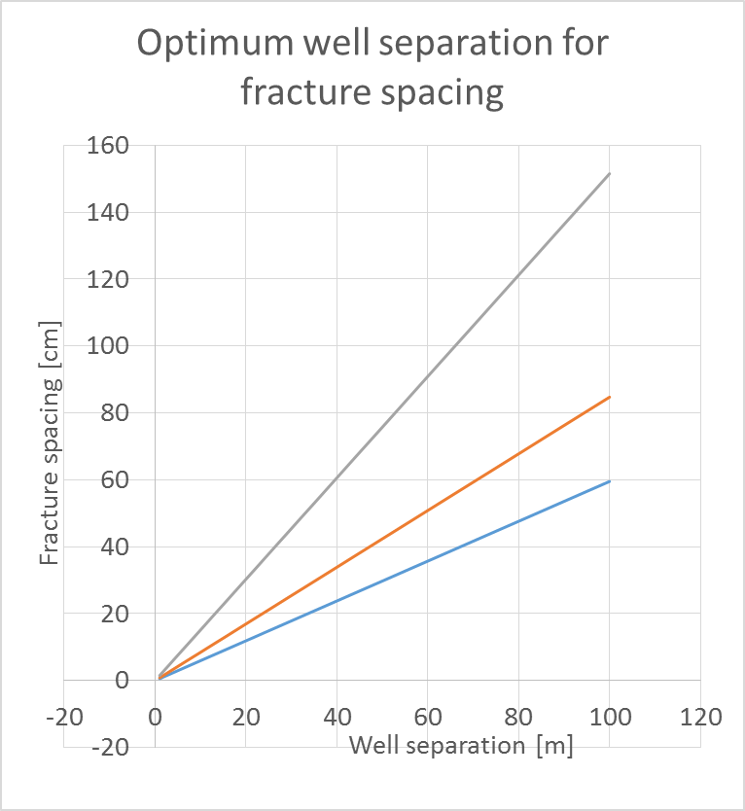
Design Criterion for Ekofisk
Design criterion
Lines show combination of well and fracture spacing that meet the design criterion . The criterion applies to the most rapidly diffusing of the pair of tracers. In the left diagram this is Cl-; in the right diagram is a 3 nm diameter C-dot nanoparticle. For example, the optimum well separation for detecting fractures with 15 cm separation with Cl- in a 50°C environment is ~18 m. For 3 nm nanoparticles the well separation would be ~100 m.
Cl-
130°C
3 nm nanoparticle
130°C
50°C
Range Ekofisk fracture spacing
50°C
Range Ekofisk fracture spacing
20°C
20°C
3 80 322d
3 80 322d
Calculations in “Optimized tracer test conditions.xls”

