Slide 1
Global GIA Modeling
A Presentation to
Kickoff Meeting
by
L. M. Cathles
Cornell University
August 18, 2011
Stavanger Norway

Slide 2
Outline
Background
  deep vs channel flow
Challenges
  Ice distribution
  Lithosphere
  Asthenosphere
  Predictions
Tasks
  Earth Models
  Ice Models
  Data
  Visualization

Slide 3
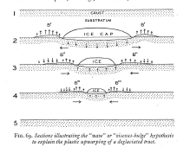
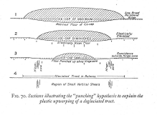
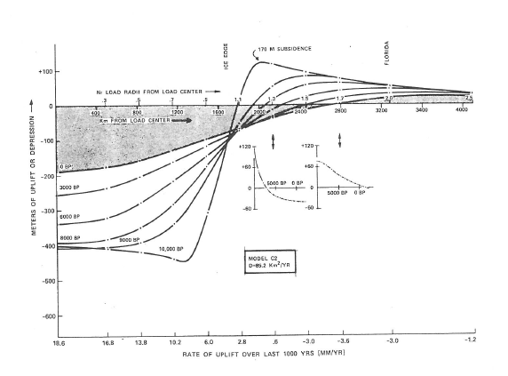
Daly’s 1934 Bulge Dilemma persists
Down – punching (thick lithosphere)
180 m
or
Deep flow
The Motion of a Viscous Fluid Under a Surface Load. Part II
N. A. Haskell, Massachussetts Institute of Technology
(Received October 14, 1935)

Slide 4
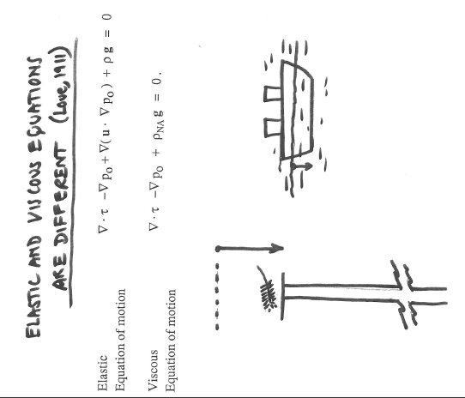
Reason for persistence: Methods of Solution
Carry pressure field with deformation
Love, 1911
1-equation Correspondence principle models
2-equation decoupled elastic and viscous models
Thick lithosphere to manage peripheral bulge ~Daly
Deep flow gets right bulge ~Haskel
… important at low order harmonics (sea level)
… lithophere “cure” impacts asthenosphere

Slide 5
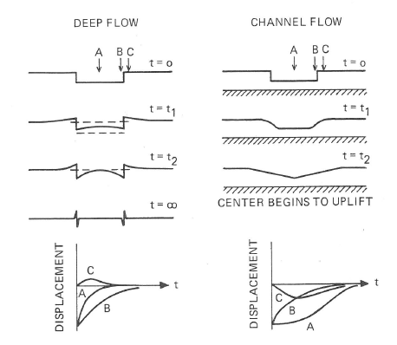
Differences inportant: Peripheral bulge is diagnostic
Cathles, 1975

Slide 6
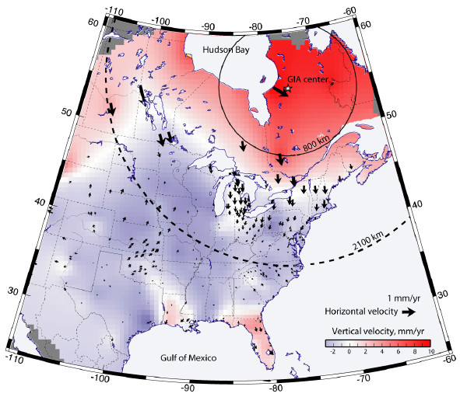
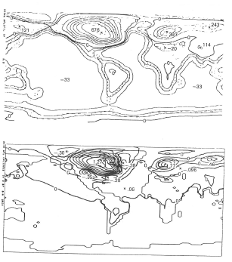
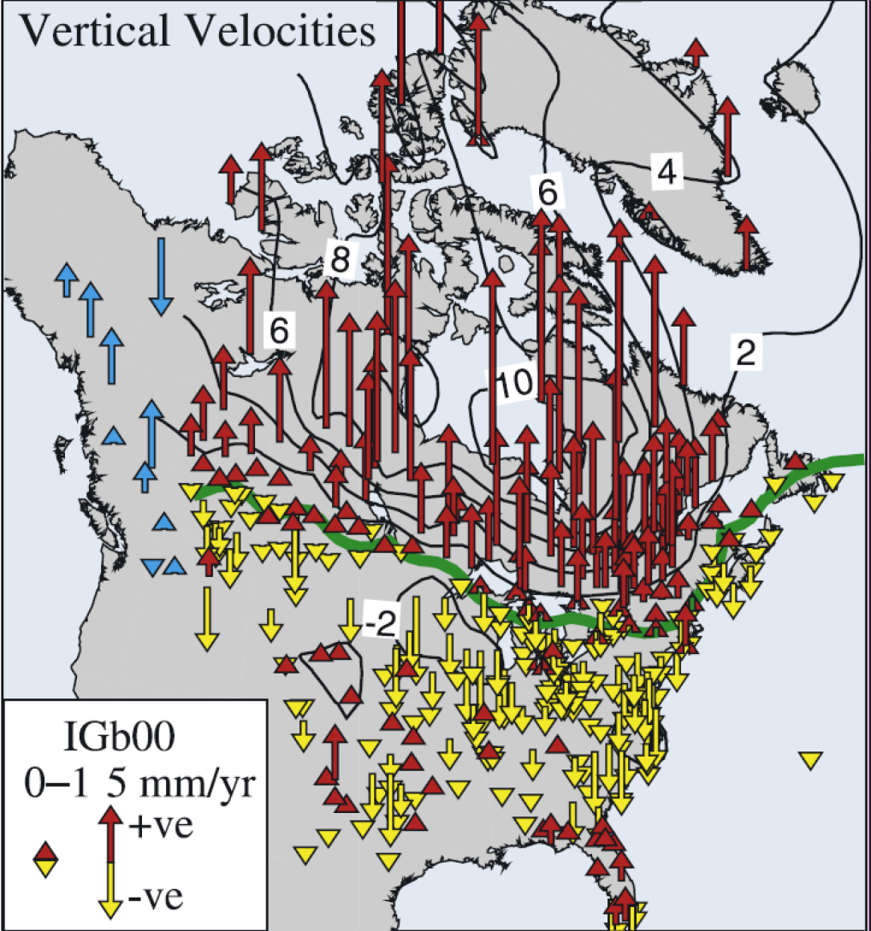
Key to my 1971 interpretation
10²¹ Pa S Uplift
Rate of Uplift
Sella et al., GRL,2007
Cathles, 1975

Slide 7
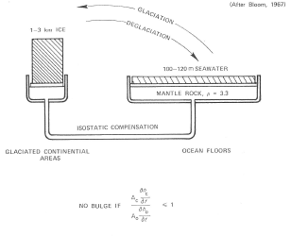
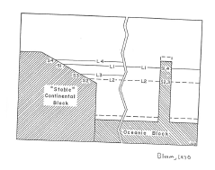
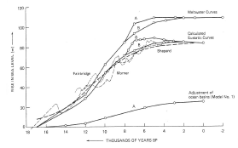
Sealevel impacted by longest load wavelenghts
Deep flow vital

Slide 8
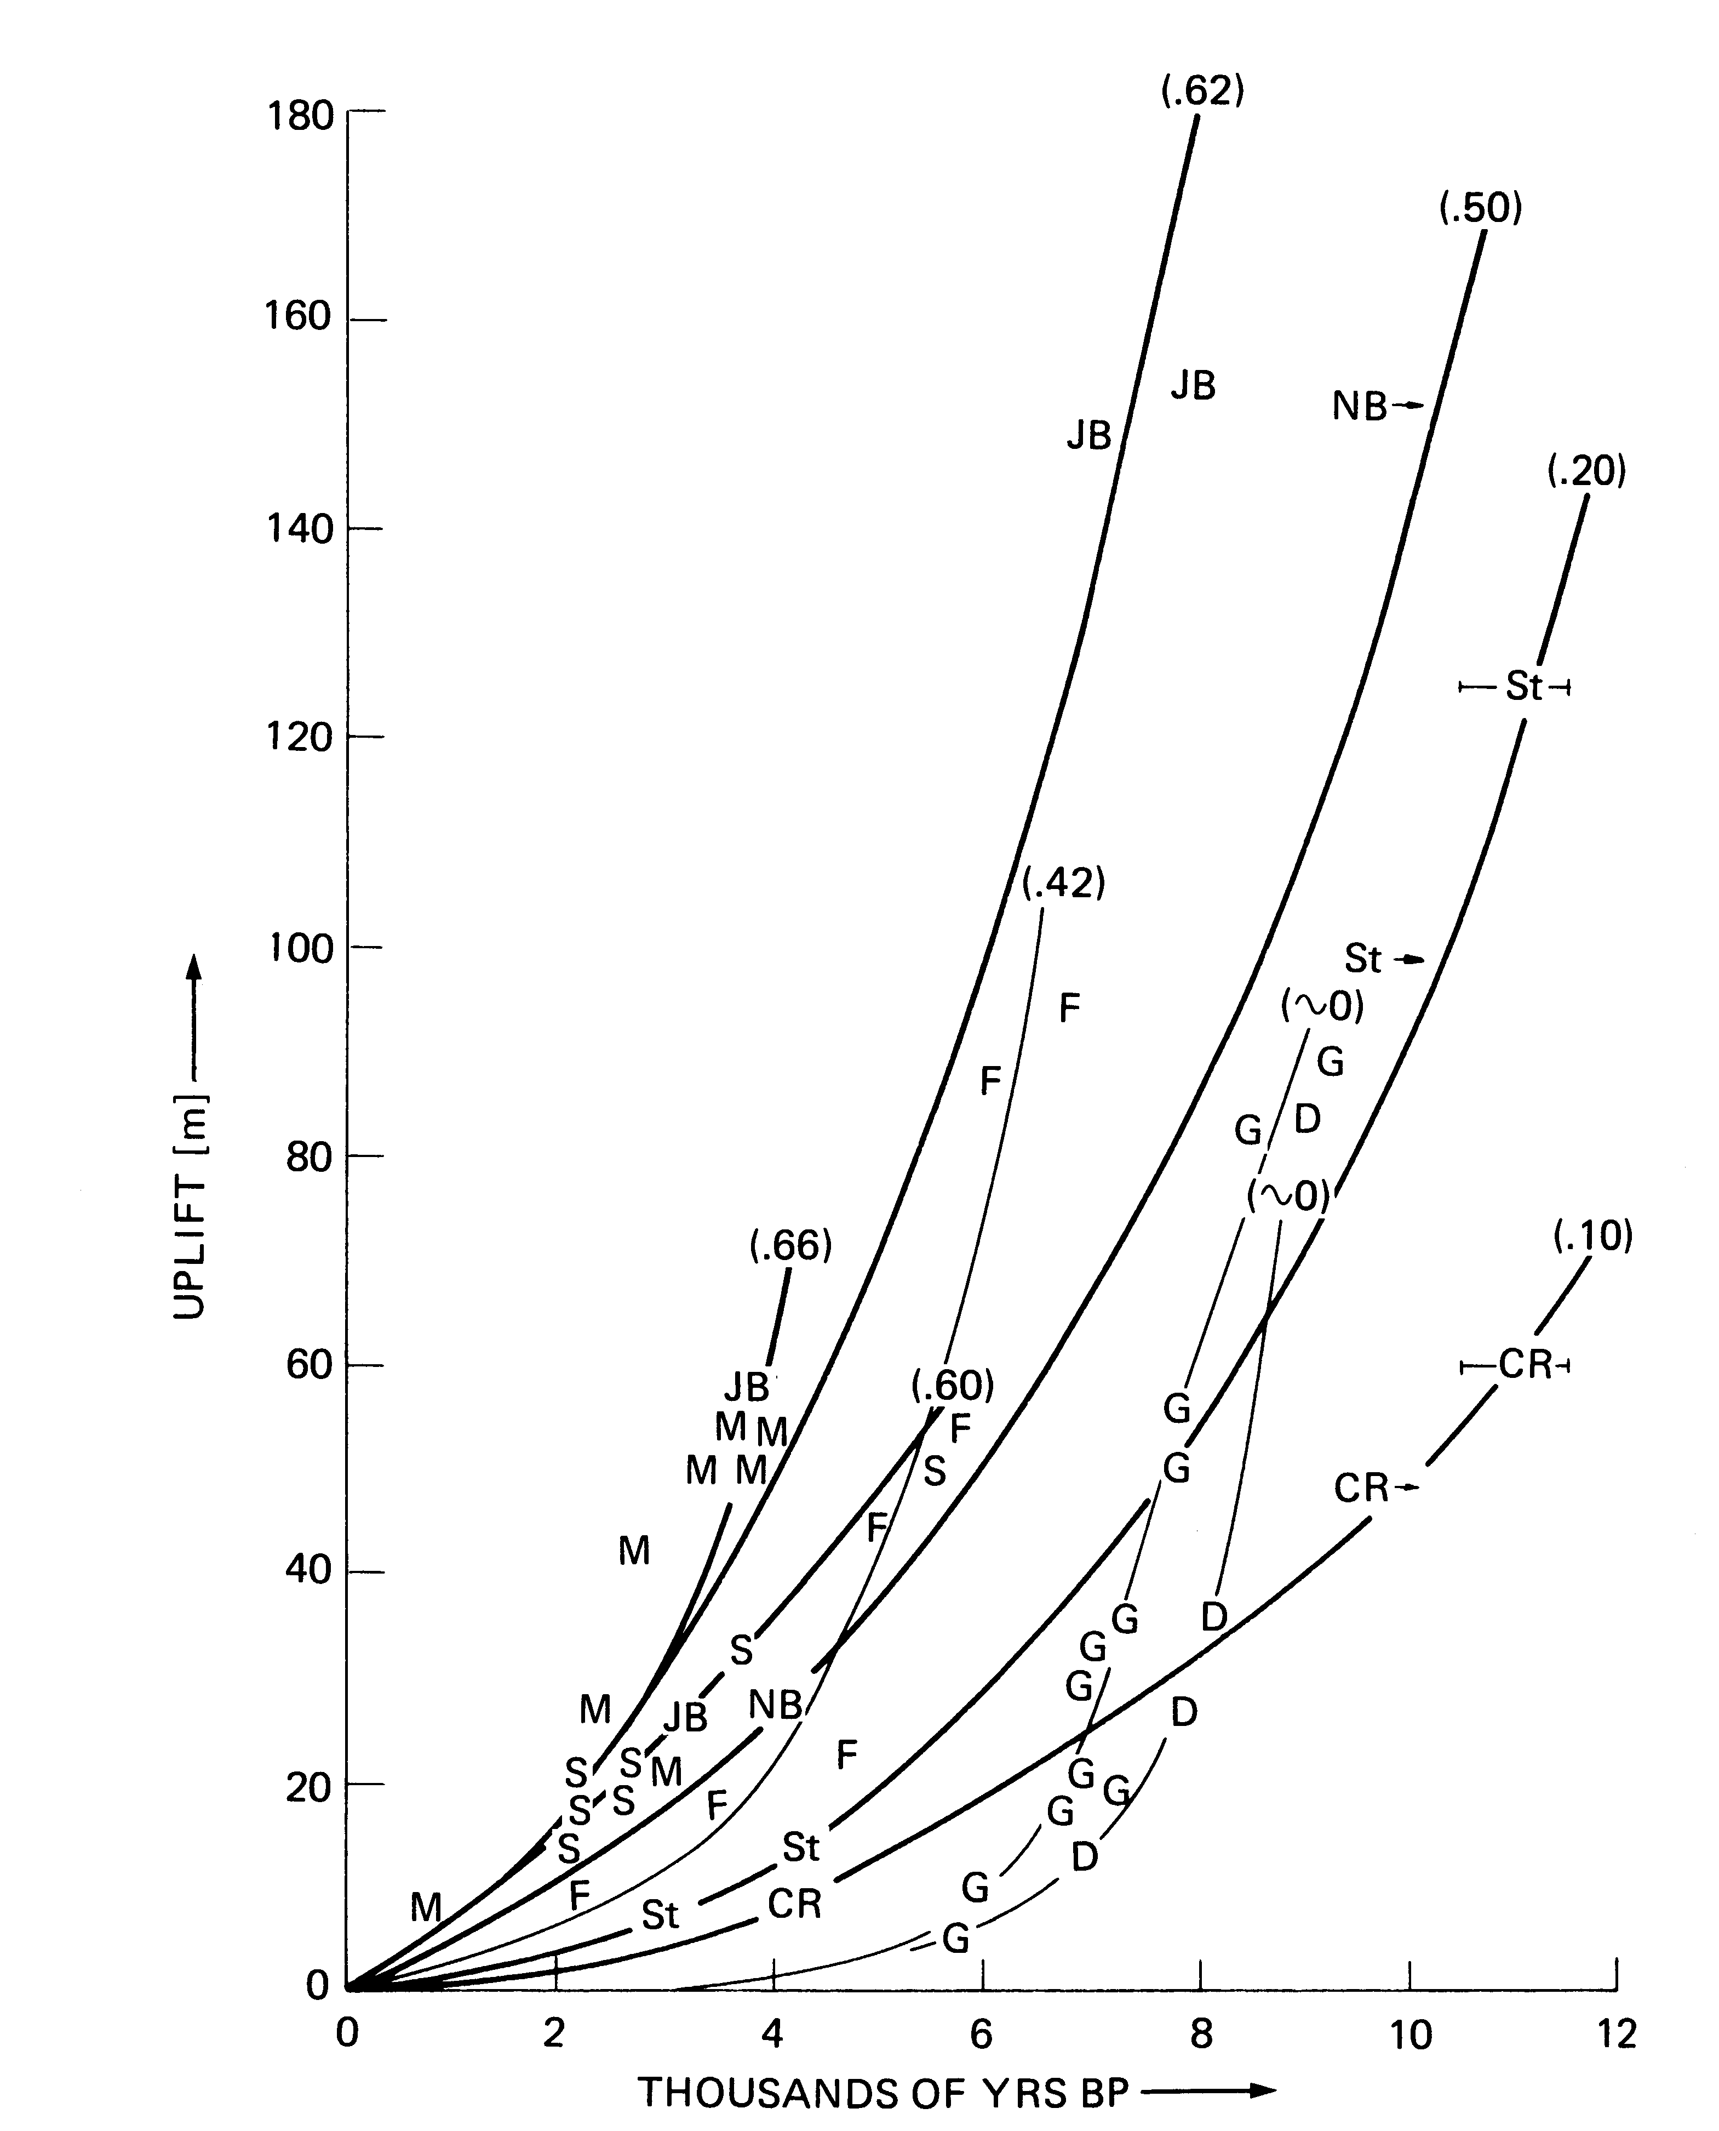
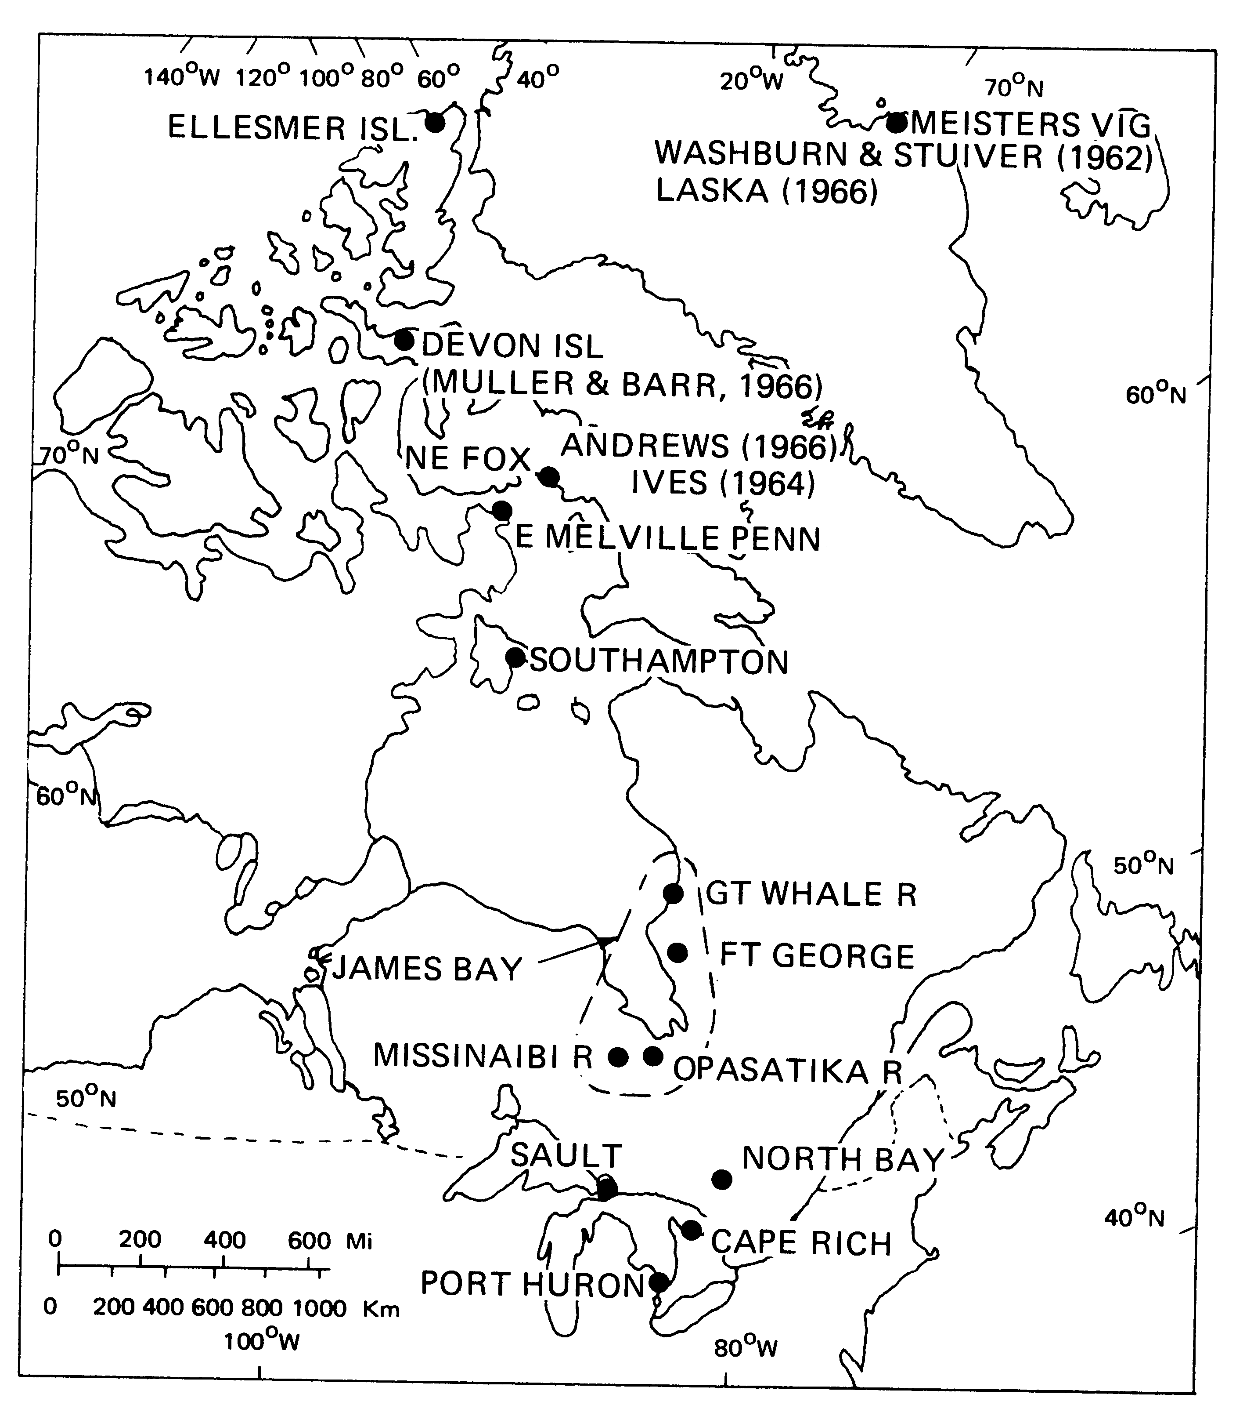
Asthenosphere impacted
Thick lithosphere precludes modeling it
widespread evidence (small loads with fast decay)
G
D
F
F
M
G
M
D
Cathles, 1975

Slide 9
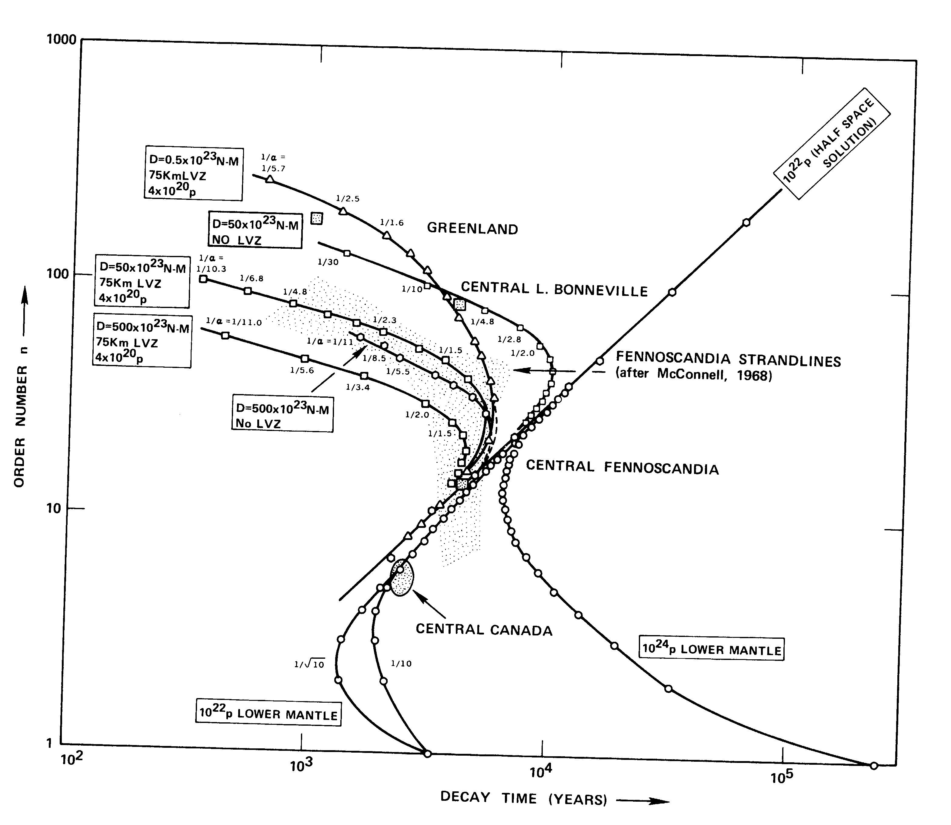
Asthenosphere in Fennoscandia
69 km
576
0.5x10²³ Nm, 19 km, asthen
D=50x10²³ Nm
88 km
no asthen
395 km
1 /30
1 /5
asthen 75 km, 4x10²⁰ p
D=50x10²³ Nm
188 km
1 /11
1/11
asth
no asth
McConnell’s 1968 FT shorline decay times
3800 km
26,600
km
Cathles, 1975

Slide 10
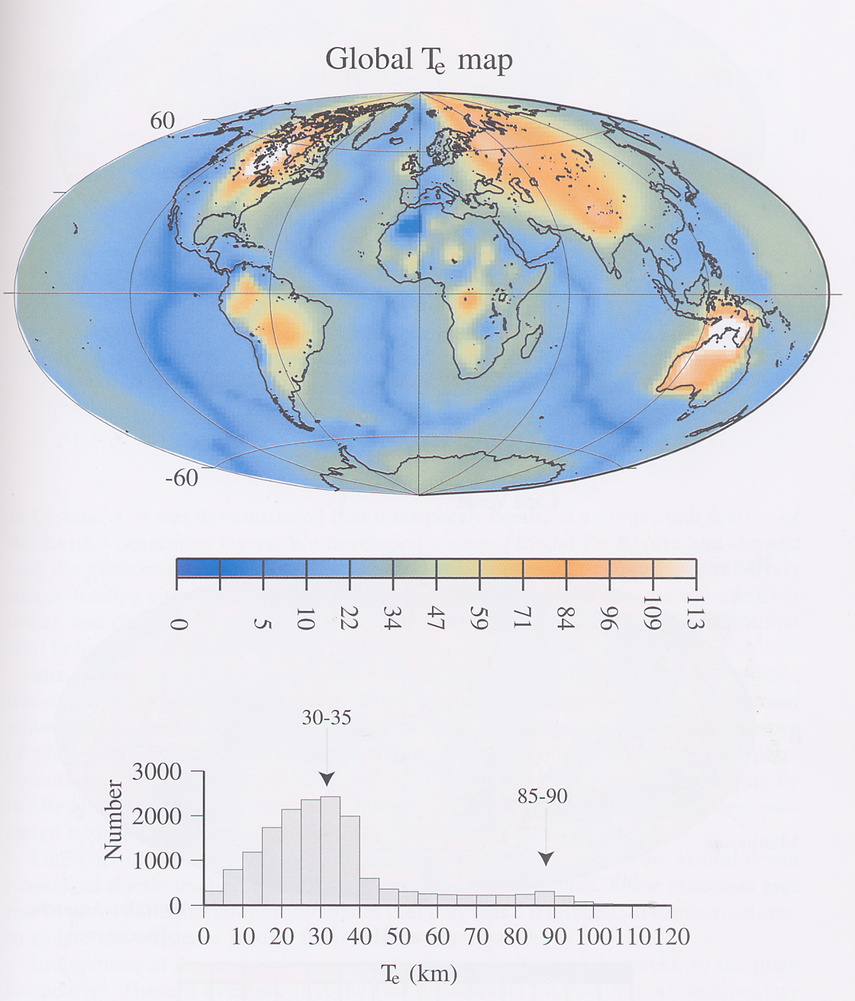
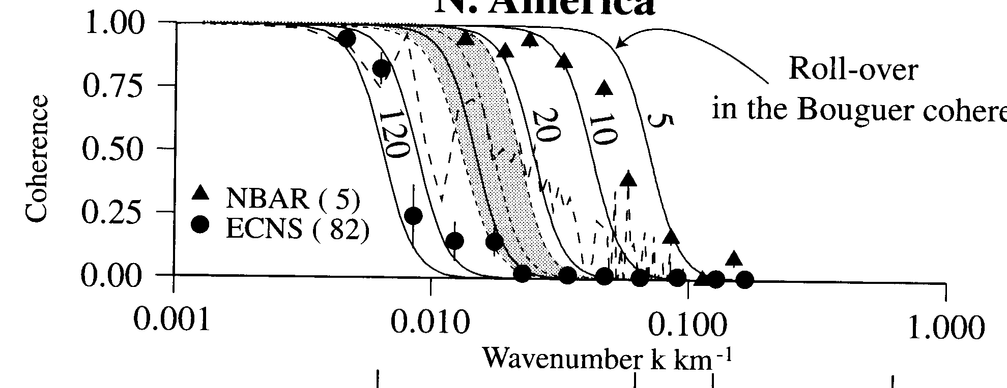
Flexural crustal thickness mostly 30-35 km based on Bouguer gravity coherence with topography
Watts (2001)
Coherent if load floats
US Basin and Range
1 km
1000 km
100 km
Eastern Canadian Shield

Slide 11
From start very different models (deep vs channel flow)
Important for sea level, asthenosphere, lithosphere
My objective: Test deep flow models at high resolution against modern data
Talk Objective
… give indication of approach and current status

Slide 12
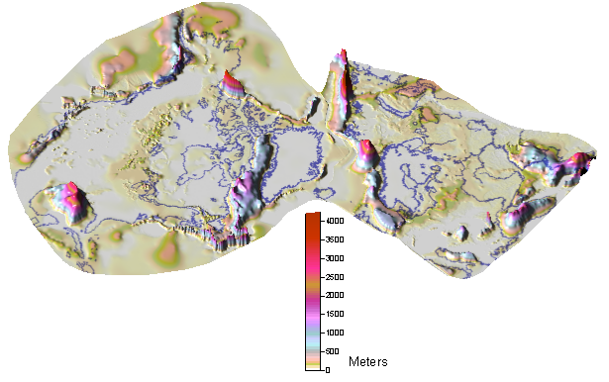
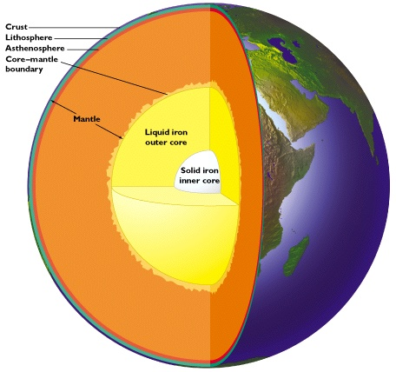
Model Design
Resolution
Load redistribution
For T_{e} = 5 km (0.02x10²³ Nm)
  Need: 1156 x 1156 grid
  Resolve: λ=69 km
  Need: decay to n=576
Ice-water
Sediments
Lakes
Evaluate against data
Earth Model
λ
h
Emergence
Sealevel change
GPS
Numerical integration
  n = 1 to 100
Add analytical asthensphere and lithosphere
  Meld n=75-100
  Changed quickly
Output: emergence, uplift
k=2π/λ
n= (k+0.5)/r
Base Prediction
asthenosphere
Lithosphere
fourier transform
relax and filter
add back up
Match present
Future changes

Slide 13
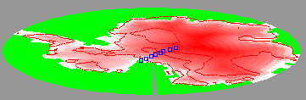
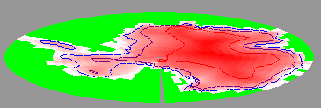
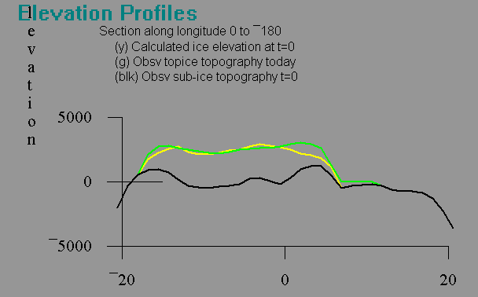
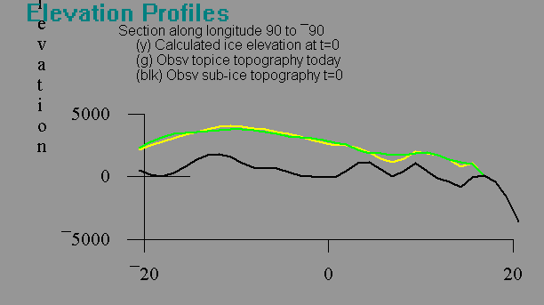
“Dupuit” 1D Ice Model converts ice edges to elevation
relative ice
accumulation rate
Method:
calculate profile from an ice node to all margin nodes
pick minimum elevation
h
τ_{b} basal
shear stress
D
slipperiness
shade=calculated
Antarctic today
A
contours=observed
A
calculate
B
B’
3000 m
A’
red shade=calculated
A’
typical mismatch
B’
observed
B

Slide 14
Waelbroek’s RSL curve used to map deglaciation ice stages across last glacial cycle
Calendar kabp
0
10
20
30
0
Barbados Meltwater Curve
40
Peltier and Fairbanks 2006
Diploria <40 m
RSL Adopted
80
(Acrpora palmata
<5 m from sealevel
P. asteroides <40 m
120
Montastrea annularis <20 m
m relative sea level
0
0
20
40
60
80
100
120
Pacific
-40
N. Atlantic
Ice Edges Same
-80
Initial RSL Curve
Waelbroek et al. (2002)
RSL from Δδ¹⁸O
-120
Waelbroeck et al 2002

Slide 15
Glacial Ice mass forced to match meltwater
160
120
Calculated (133.5)
“Observed” (130)
80
Meltwater (change sealevel, m)
Laurentide (63%)
E. Antarctic (23.5)
40
Calendar kabp
Europe (17.15)
W. Antarctic (15.5)
N. Am. Fringe (5.87)
0
Greenland (3.42)
Inutian (1.56)
0
5
10
15
20
25
-
Minor (0.19)
20
Iceland (0.16)
Convert to load by considering sub-ice topography, isostasy, water displaced, lakes
Add sediment redistribution
Iterate for geoid water redistribution∩

Slide 16
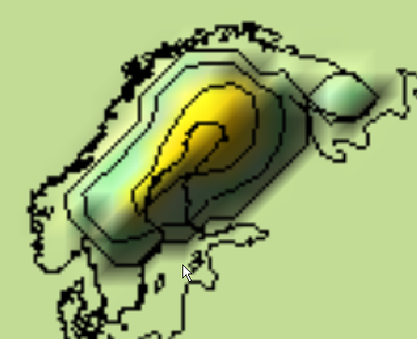
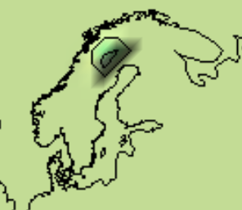
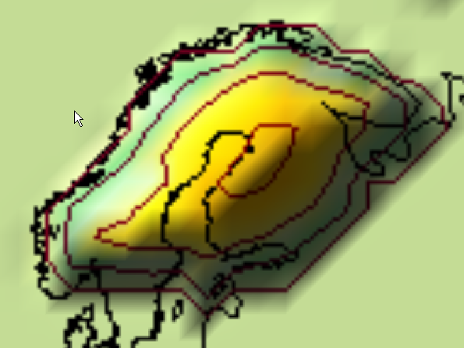
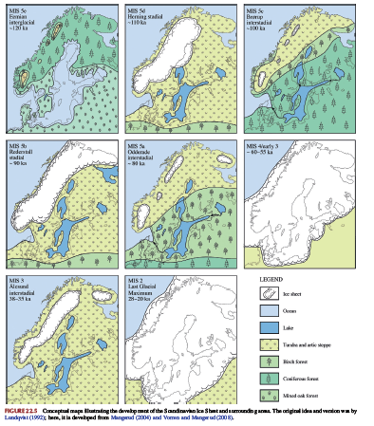
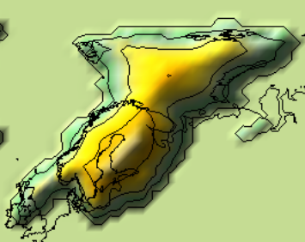
0
0
20
40
60
80
100
120
90
80
80
60
-40
90
-80
65
Initial RSL Curve
65
60
-120
Waelbroeck et al 2002
120
110
100
23.75
90
80
60-55
28-20
38-35
Mangerud et al 2011

Slide 17
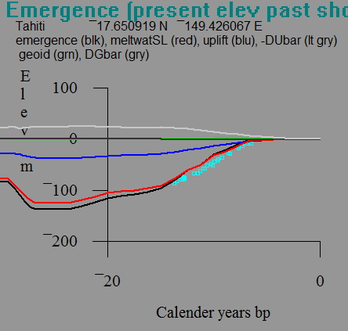
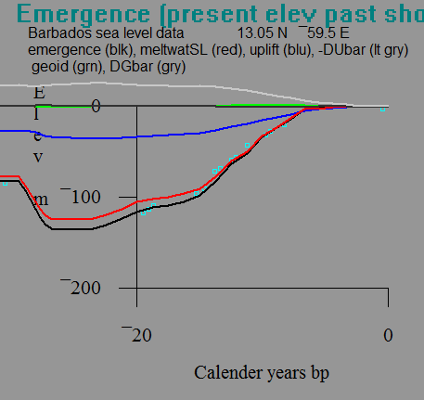
Eustasy Matches
All thickEU2 Model

Slide 18
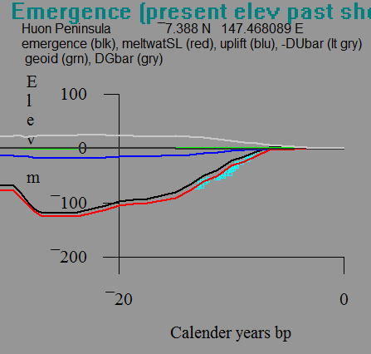
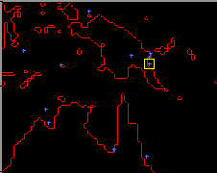
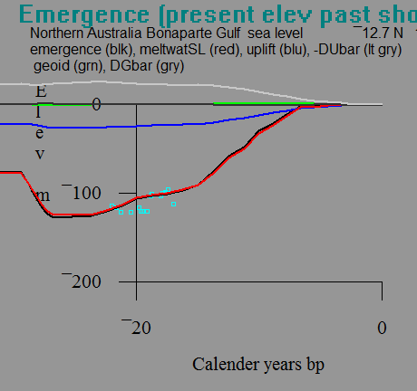
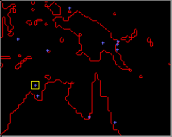

Slide 19
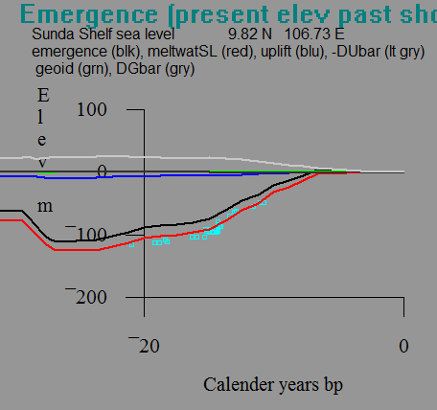
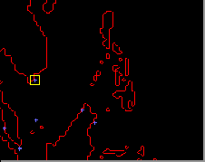
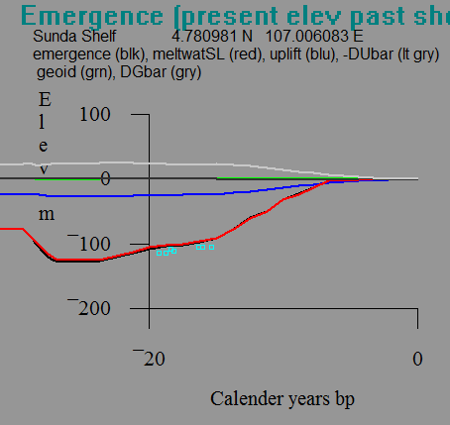
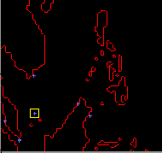

Slide 20
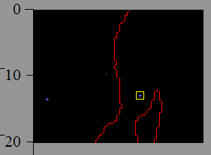
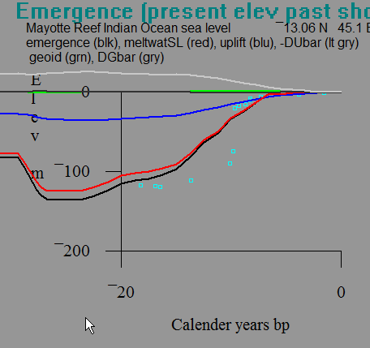
Next emergence England -> Sweden
Oceans show deep flow response
thick ice thin ice

Slide 21
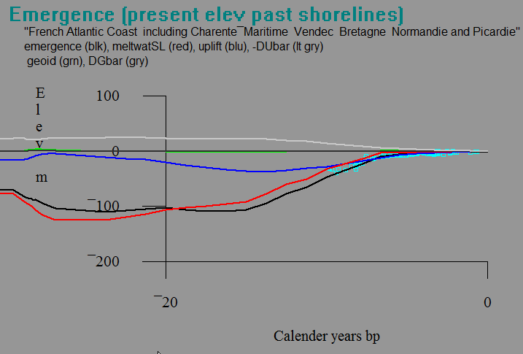
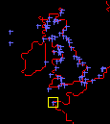
Thick Ice Model

Slide 22
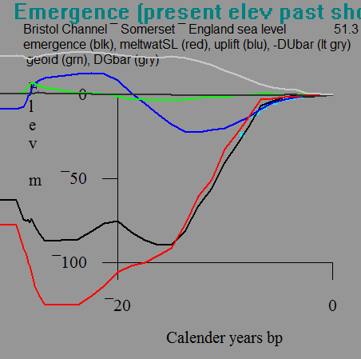
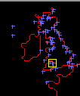
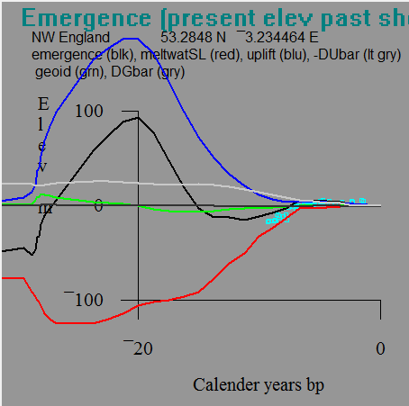
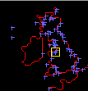
Thick Ice Model
Thick Ice Model

Slide 23
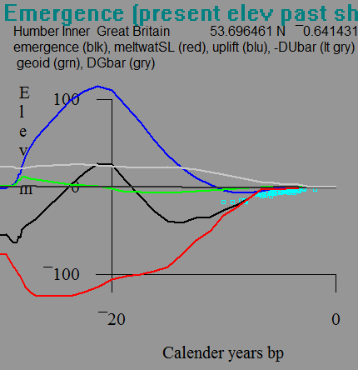
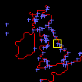
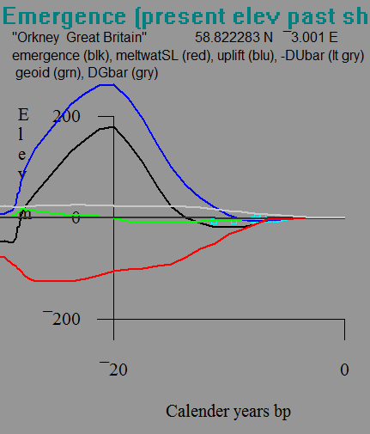
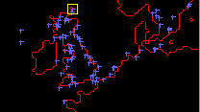
Thick Ice Model
Thick Ice Model

Slide 24
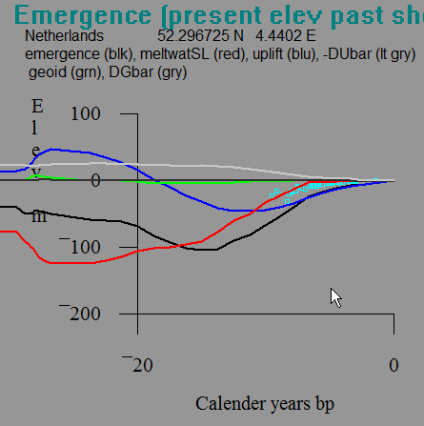



Thick Ice Model
Thick Ice Model

Slide 25



Thick Ice Model
Thin Ice Model
Thick ice model better to here

Slide 26



Thick Ice Model
Thin Ice Model
Thin ice model better to east

Slide 27



Thick Ice Model
Thin Ice Model

Slide 28



Thick Ice Model
Thin Ice Model

Slide 29




Thin Ice Model
Thin Ice Model
asthenosphere

Slide 30


Rate of uplift today
Thin EU Ice Model
Thick EU Ice Model

Slide 31

Basal τ for Thin Ice EU
Objectives
  Test deep flow model
  asthensophere, lithosphere (x)
  stitch HR2D to Global Models
  establish context for future predictions
Predictions:
  Use same basal τ
  Bracket future pptn and ΔT worldwide
  Calculate ice melt, GIA, sealevel change

Slide 32

Back of envelope look at future sea level
Barbados Meltwater Curve
0
10
20
30
Calendar kabp
0
40
Diploria <40 m
m relative sea level
80
P. asteroides <40 m
(Acrpora palmata
<5 m from sealevel
120
Montastrea annularis <20 m
120m in 6 ka
2 m/100y
20 mm/y
120m in 13 ka
0.92 m/100y
9.2 mm/y
120m in 16 ka
0.75 m/100y
7.5 mm/y
Peltier and Fairbanks 2006

Slide 33



Global RSL curves
IPCC 1 m/100 yrs
0.045 m/100 y
0.45 mm/y
3m @ 6.6ka
IPCC 0.1 m/100y
Projections
m/100y
1
0.5
0.1
Fleming et al., EPSL, 1998
~maximum over
last deglaciation

Slide 34
Predictions
Glacial Component Small:
40 m @ 2m/100y
80m @ 1 m/100y
x 1/10 to 1/20 = 0.05 to 0.2 m/100 y
 | Wisconsin | Future | Factor
DT | 6 | 3 | 1/2
DSL | 40 | 7 | 1/5
 | 80 | 7 | 1/10
Thermal Component Likely Dominant:
(3˚C ) (2x10⁻⁴ ˚C⁻¹)(1000m) = 0.6 m, if in 100 y = 0.6 m/100y
Question: what drives SL change over last 6.6 ka?

Slide 35




Central Fennoscandia: channel or deep

Slide 36



Slide 37
Global sediment redistribution
Amantov, 2007

Slide 38




Asthenosphere and Lithosphere
asthen
1 /4.8
1 /30
1 /11

Slide 39
Sella et al., GRL,2007
http://www.geology.um.maine.edu/geodynamics/AnalogWebsite/UndergradProjects2008/CalvinBeebeWebsite/sella.jpg

Slide 40
http://web.ics.purdue.edu/~ecalais/projects/noam/jgr06/noam.jpg∩
http://web.ics.purdue.edu/~ecalais/projects/noam/jgr06/noam.jpg∩

