Slide 1


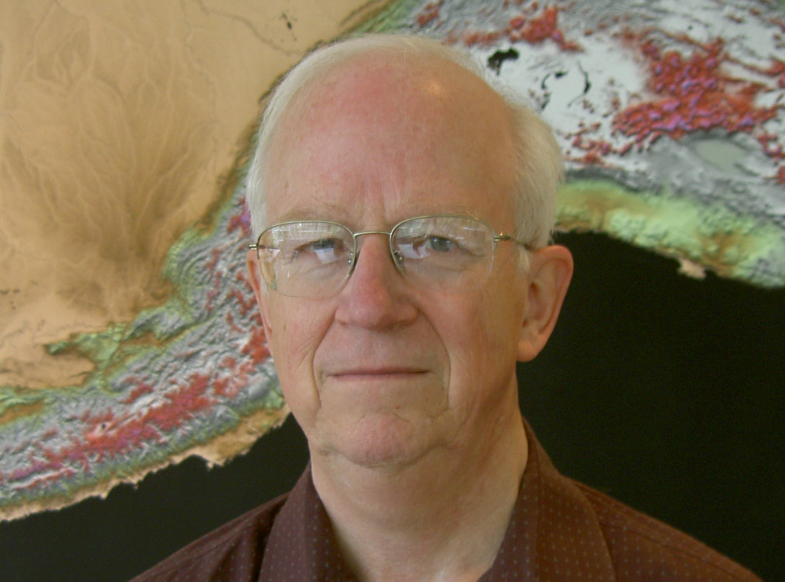
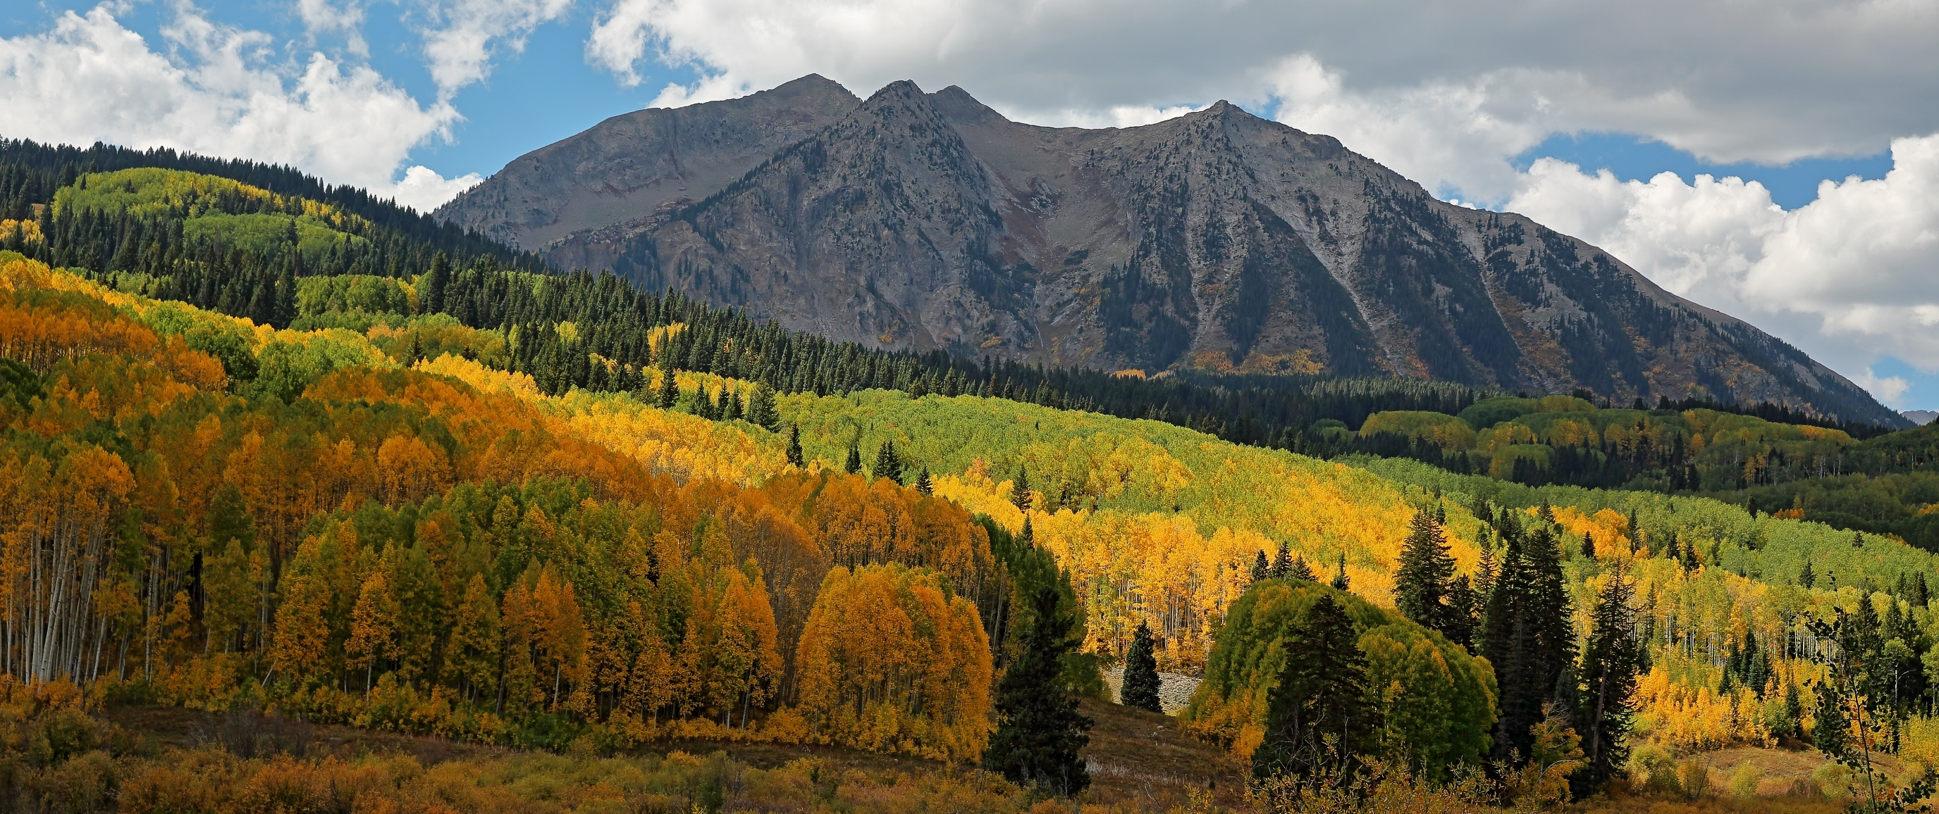
The surprising nature of fluid flow in sedimentary basins
Water, Climate & Environment Seminar
Friday, February 14, 2020
12:00 – 1:00 pm
JGB 3.222
Dr. Larry Cathles
Cornell University
Flow in sedimentary basins can be shockingly dynamic, non-linear, and channelized on a scale so large that is it is easy to overlook. We know this from resource observations. How observations lead to these conclusions, why the results might be expected, and the broad implications for future research are discussed.
photo credit: Dave Leary

Slide 2


Flow in basins
Large Scale
Dynamic
Non-linear
Fundamentals
Issue Editors: W. Fjeldskaar and L. Cathles
scale invariance and channeling
seismically imaging permeability
https://www.mdpi.com/journal/geosciences/special_issues/basin_modelling
personal education
A bit of a personal tour of discovery…
[ ref # ]

Slide 3
Large Scale
… so large you almost can’t see it.
Will return to this again, but briefly: two examples of 100 km flow in basins

Slide 4
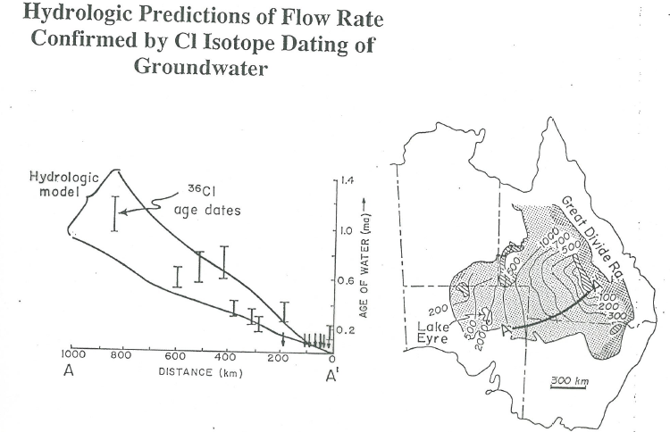
[1,2]

Slide 5
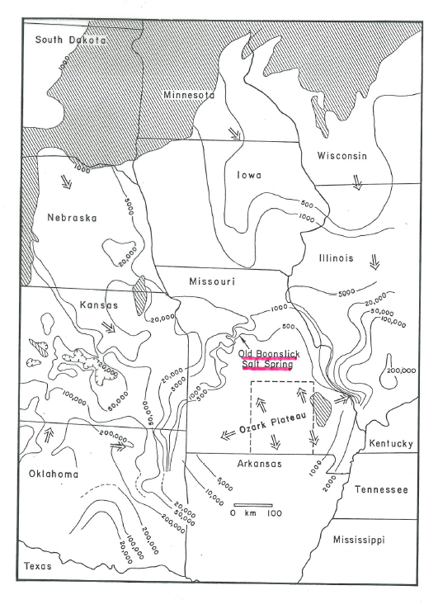
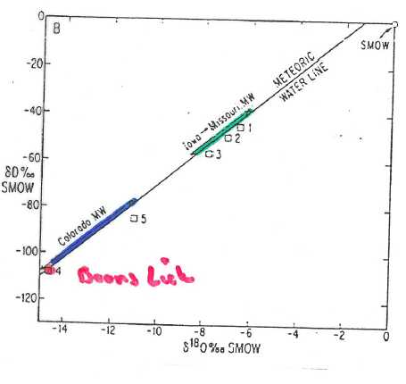
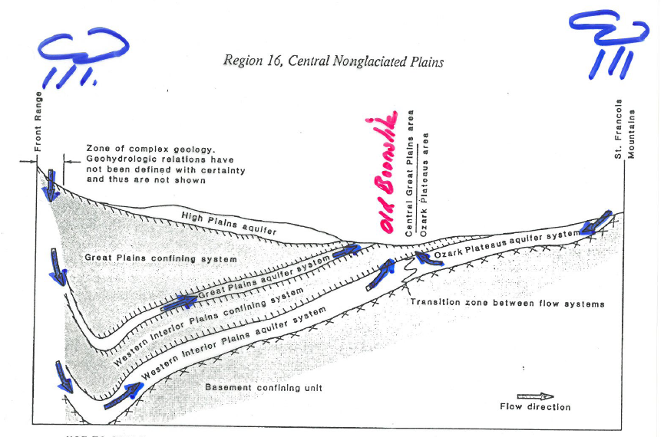
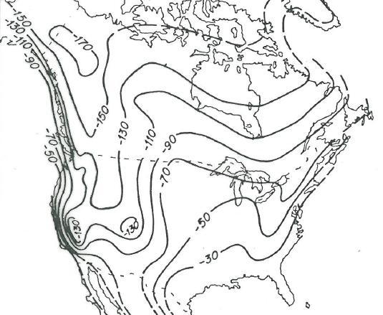
[3]

Slide 6
Dynamic
Non-linear

Slide 7
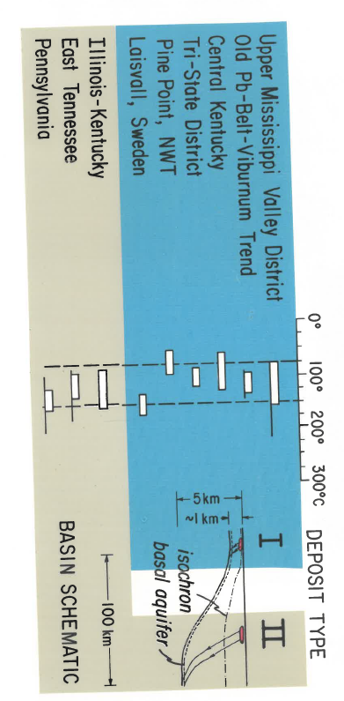
It began with a question:
Don Graff ~1981 “could you give a talk on flow in basins?”
MVT deposits: brines from basins
… modeling whether normal compaction would warm margins as observed
…dull, but adequate talk.
…so yes.
Noble 1963, Jackson and Beales 1966, Ohle 1980, Anderson and Macqueen 1982
Ray Coveny- “blindfolded me,
drop me from an airplane
I’ll go to the nearest outcrop and
find sph with FI with T_{homog}=80°C”
Ubiquitous
[4]

Slide 8
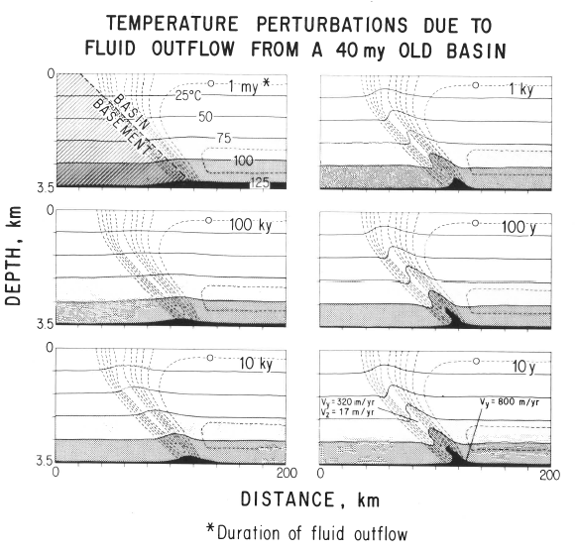
A value of modeling is that it can produce surprises:
Steady expulsion for 10⁶ y
Result: steady compactive expulsion cannot warm basin margins
same expulsion for shorter times
Cathles and Smith, 1983
[4]

Slide 9
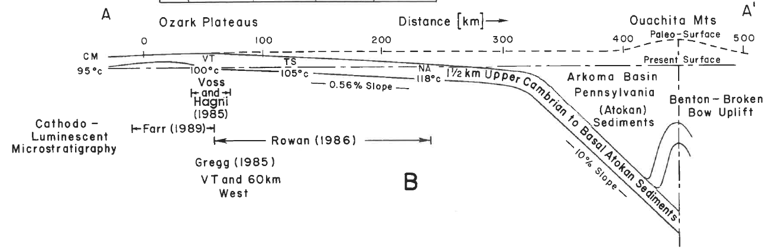
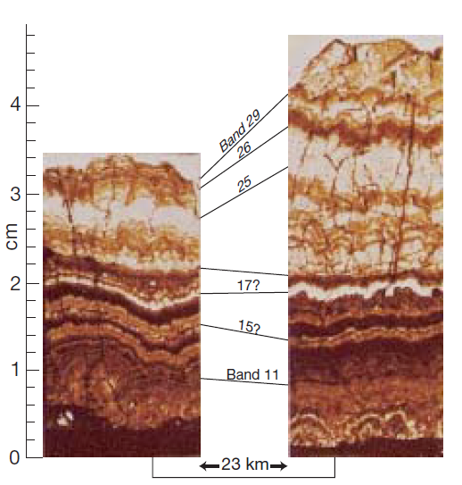
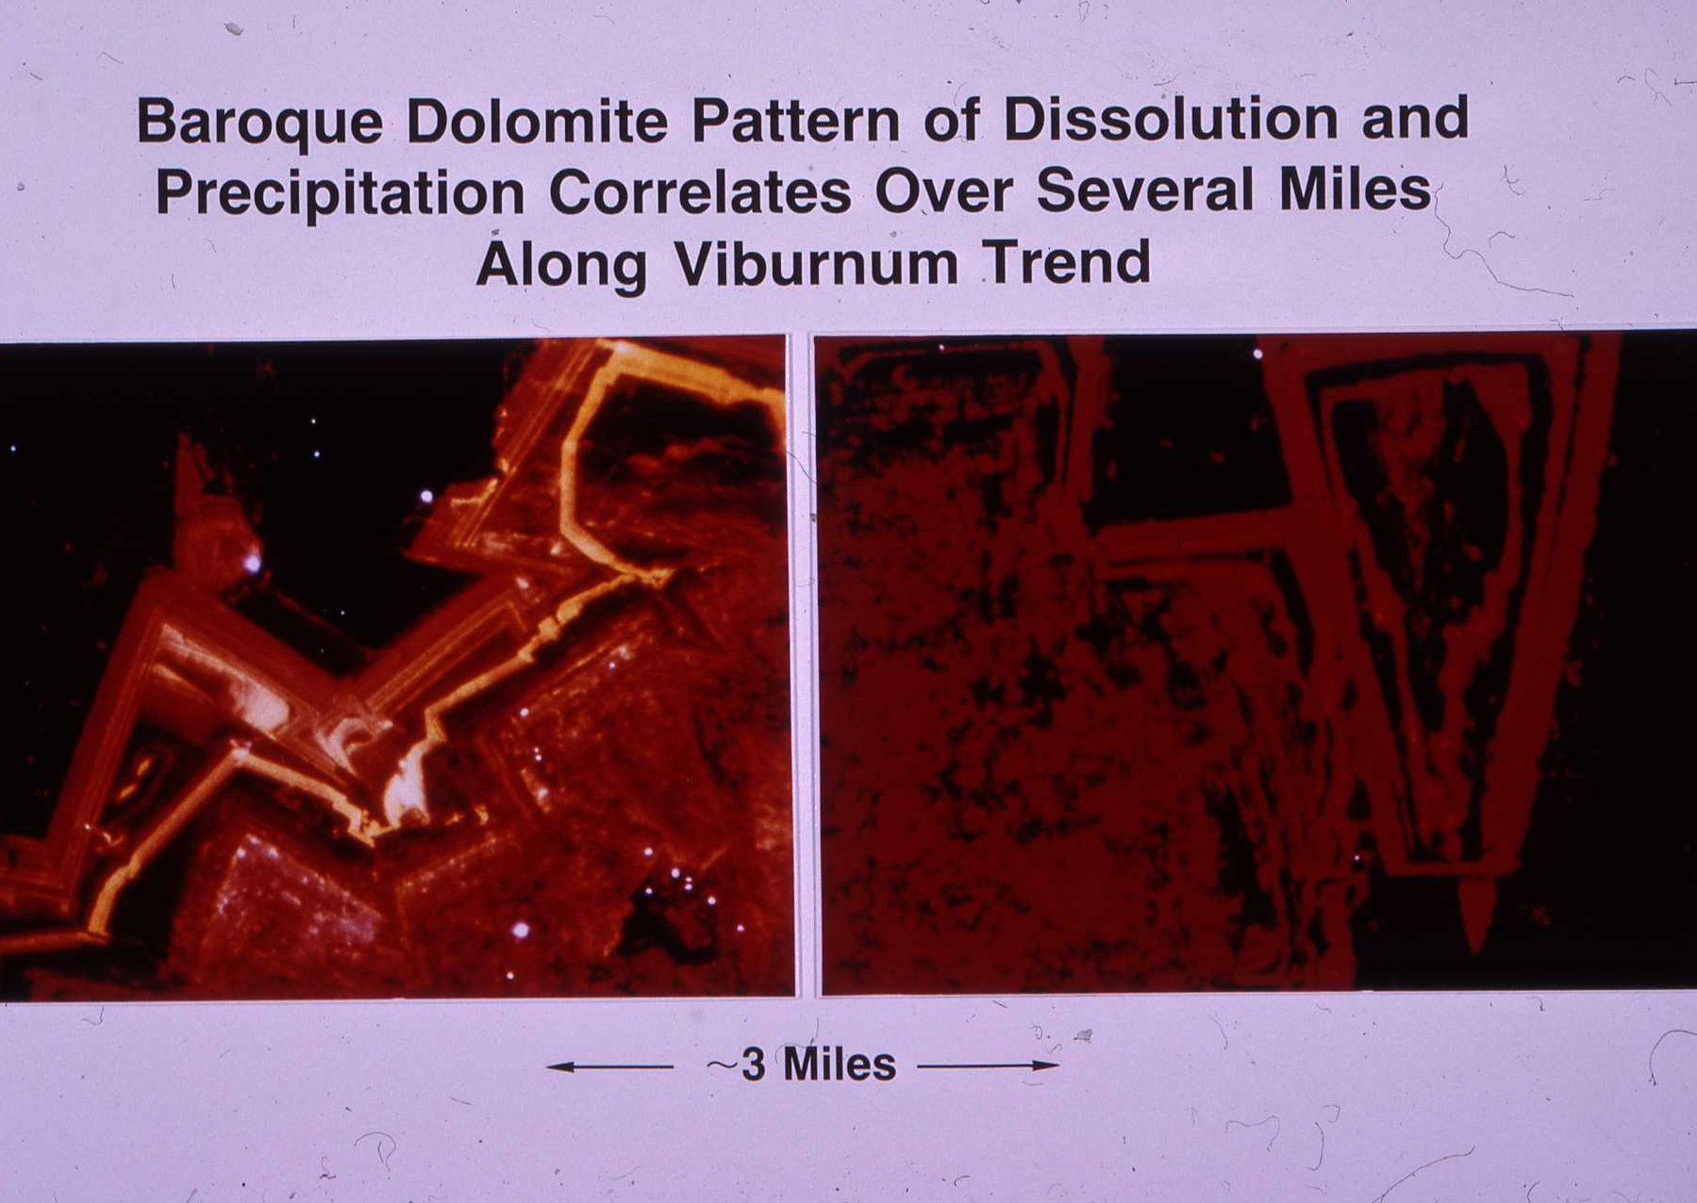
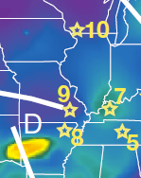
…yet lots of evidence of pulsed expulsion
Houseknecht: “completely dry”
UMV district
McLimons 1977
UMV
A
VT
Correlation of baroque dolomite pattern, Viburnum Trend
A’
Arkoma Basin
[5,6]

Slide 10
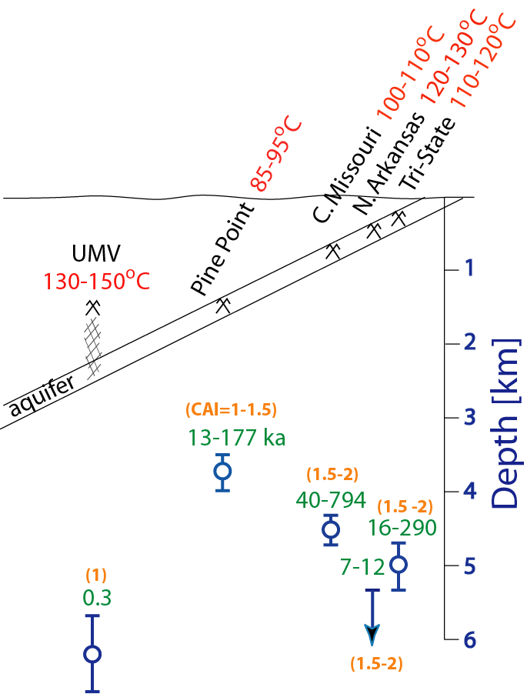
…and pulses must be of short duration
T_{homog}
Homogenization T of fluid inclusions in Sphalerite
Depth of deposits
Inferred assuming geotherm of 20°C/km
= (T_{homog}-15°C)/20°C km⁻¹
Conodont maturity cap on t-T
CAI caps ka at T_{homog}
ka max duration
Depth of fluids
depth
from
T_{homog}
[7]

Slide 11
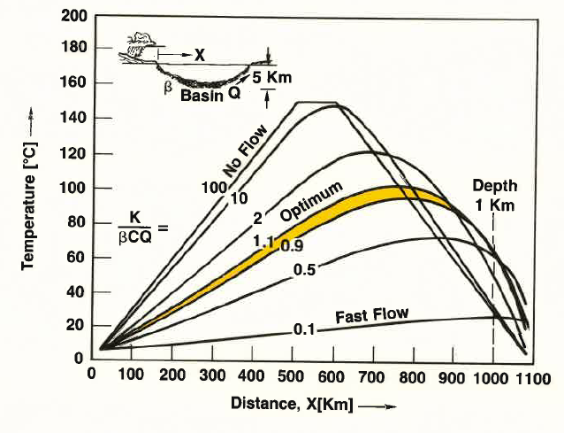
Cross-basin hydrologic flow is flawed hypothesis
Hydrologic flow
  cools basin
  Flushes salt
  Slowly changing
…so how do basins spit?
[8]

Slide 12

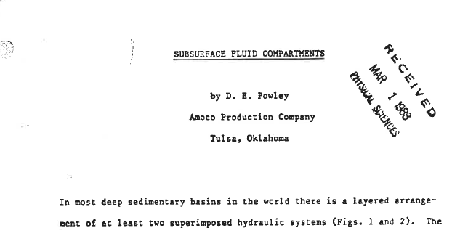
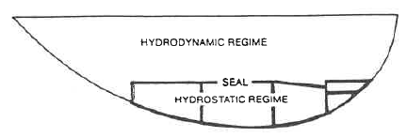
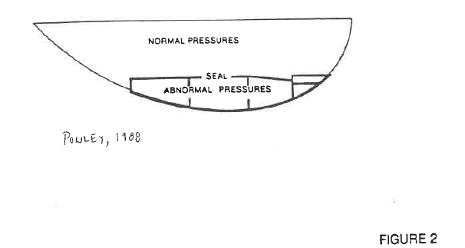

Second strand…
On July 30, 1987 a remarkable thing happened…
T~100°C
… would GRI investigate pressure compartments?

Slide 13
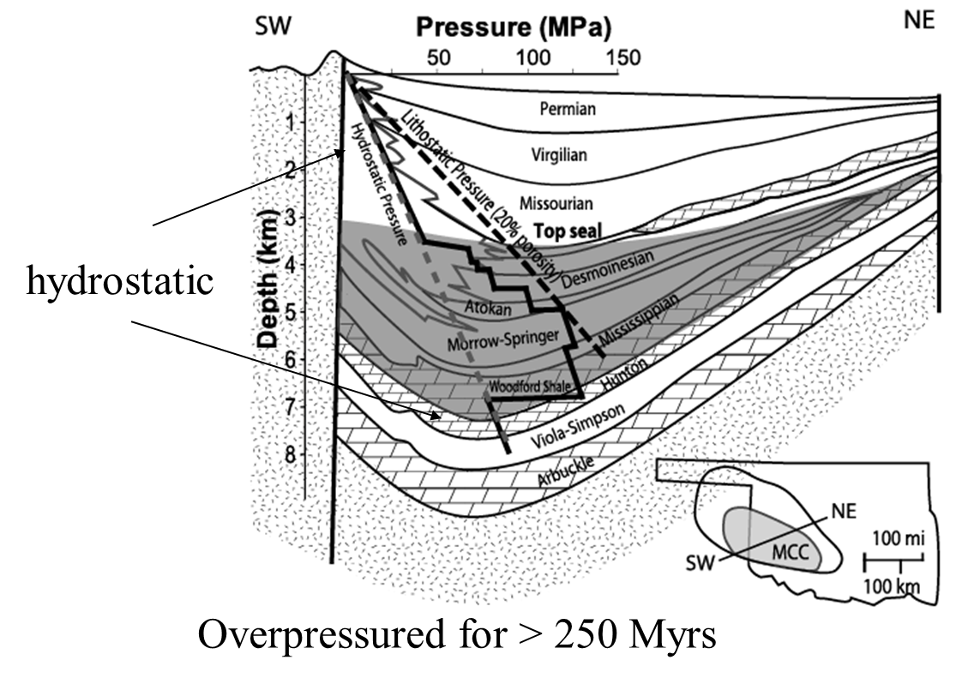
1st GRI phase late 80’s to 1992: are pressure compartments real?
Anadarko Basin
1994
Anadarko (Al-Shaib)
Gulf Coast (Engelder)
Michigan (Bahr)
Powder River (Surdam)
Zuhair Al-Shaib
[9,10]

Slide 14
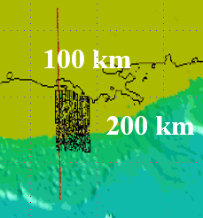
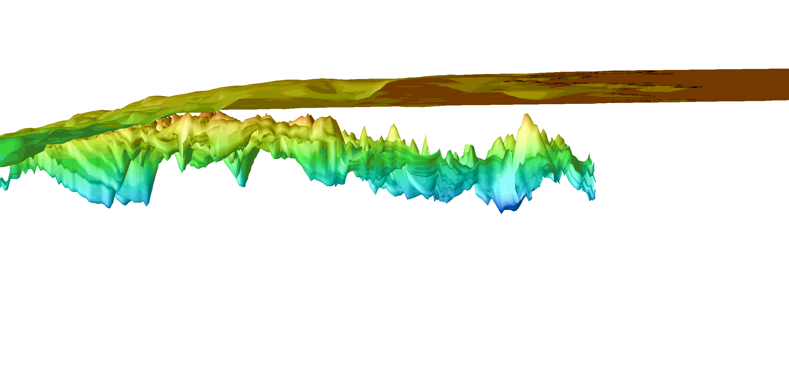
1st GRI phase late 80’s to 1992: are pressure compartments real?
Hydrocarbon fields associated with topographic highs in the top of overpressure
GRI Corridor
Top of overpressure in GoM
12 pound mudweight surface from 2131 wells in GRI corrdor
[11]

Slide 15
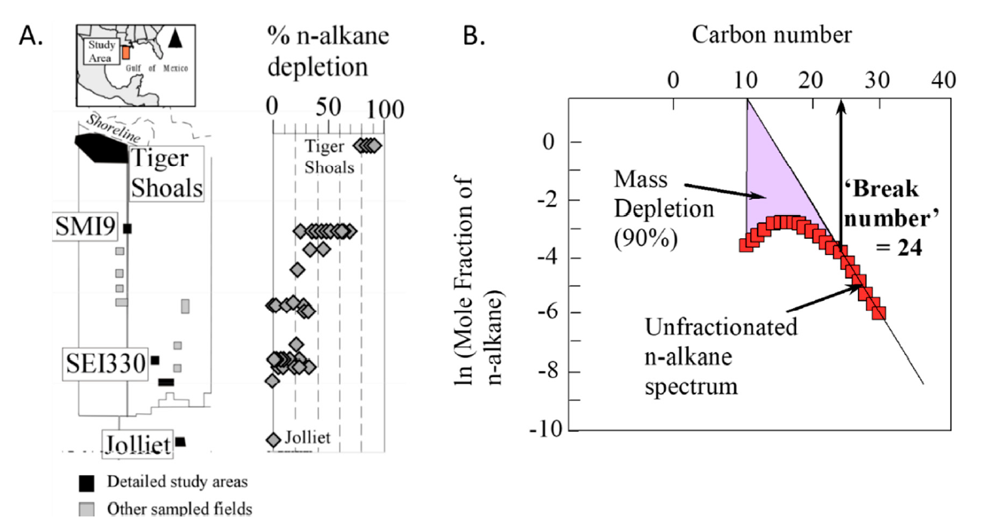
A digression to gas washing…
GRI Corridor
[12]

Slide 16
2nd GRI phase: Understanding compartments
1992-2002
The Dilemma:
Capillary Seal understood (Schowalter 1979)
shale
Sand
How can seals compartmentalize basin to hydrocarbons and water? How do vertical seals work?
Gas or oil trapped but water free to move
Bradly and Powley (1994) were careful to distinguished “pressure seals” that block flow of both brine and hydrocarbons between compartments from “capillary seals” which block just hydrocarbons
in [10]

Slide 17

The “Shosa pressure Seal”
Darcy Flow
Gas bubbles block flow
There is a critical mix of water and hydrocarbons that is completely impermeable to both phases
Darcy Flow
Capillary Seal
[15]

Slide 18
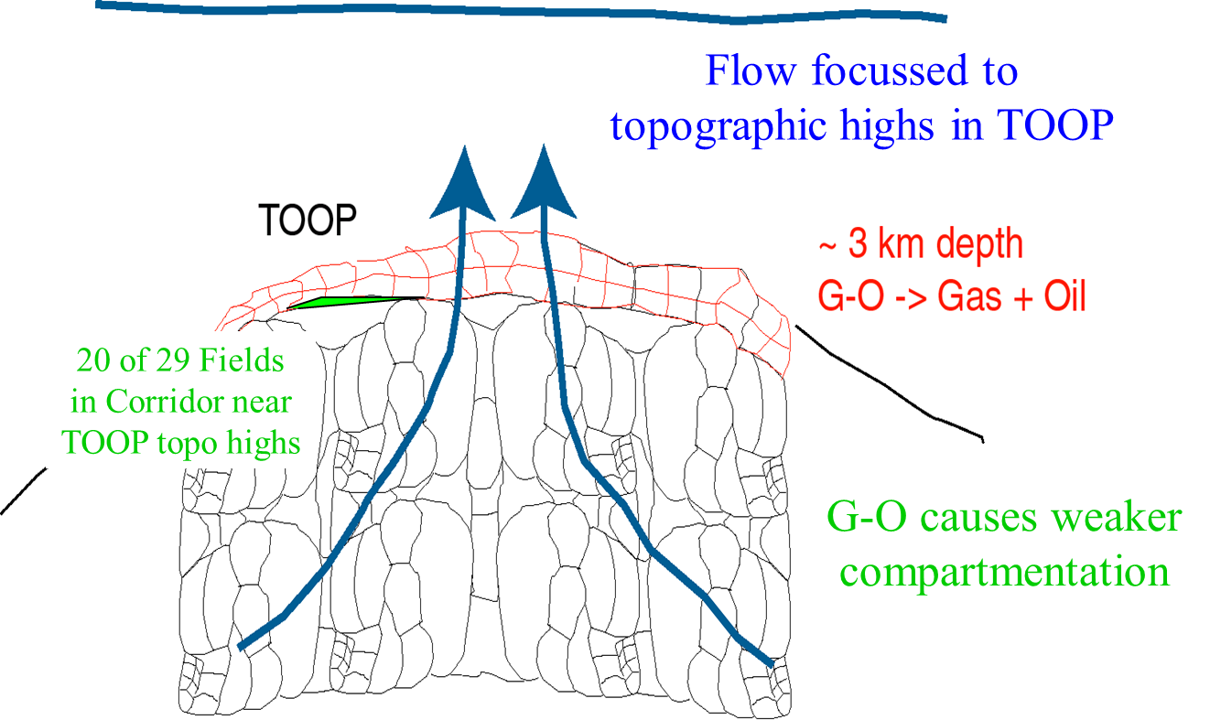
The first of many Shosa Seal implications…
The orange model:
Water and hydrocarbons migrate together through seal ruptures
Toop (orange peal) alteration records cumulative brine throughput
[16]

Slide 19
Shosa Seal implications…
Gas can be trapped for 100s of millions of years (Anadarko and Marcellus)
400 Ma
Water + organic matter
oil
330 Ma
Interior can be bone dry
Water + oil (20%) + organic matter
Wet gas
brine can’t get in
Brine
Gas + water + organic matter
Shosa seals
Critical mix of brine + gas
Dry gas
JUST GAS
250 Ma
Gas + residual organics
Shosa seals
Critical mix of brine + gas
Brine
[17]

Slide 20
Shosa Seal implications…
Seals can migrate
Porosity records history of migration
Hydrostatic, normal compaction
Fixed seal began to leak at 1430 mbsf
Continued leakage formed migrating seal
Sealed when strata was 550 mbsf
Paleo-hydrostatic compaction
Revil and Cathles 2001
[18]

Slide 21
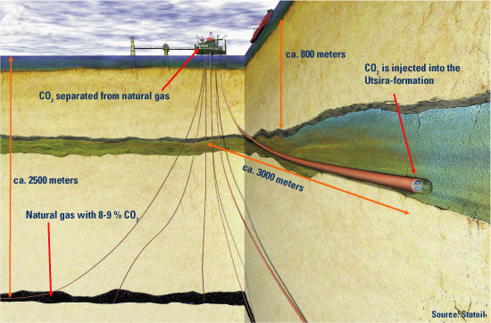
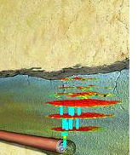

Shosa Seal implications…
Shape of gas chimneys and vertical distribution of CO₂ at Sleipner

Slide 22
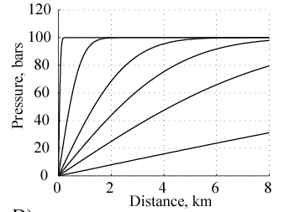
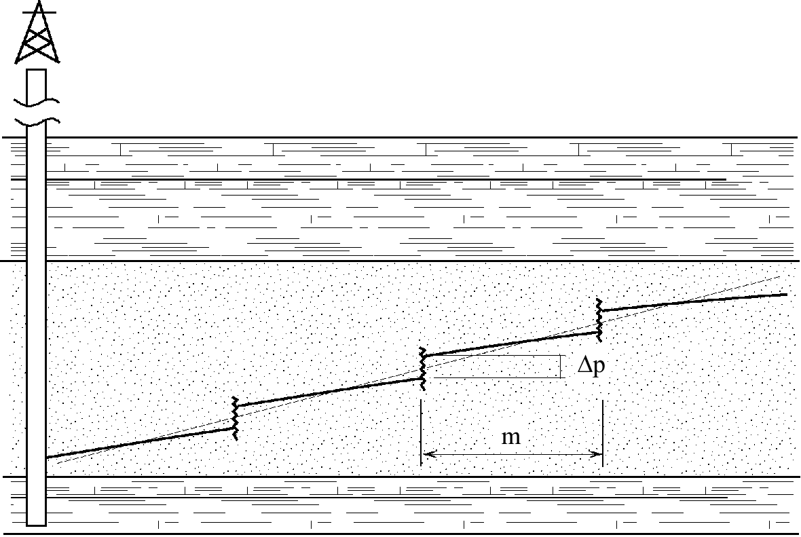
Shosa Seal implications…
If gas exsolution forms Shosa Seals production is impaired
Greatest lost production is in most productive wells
[19]

Slide 23
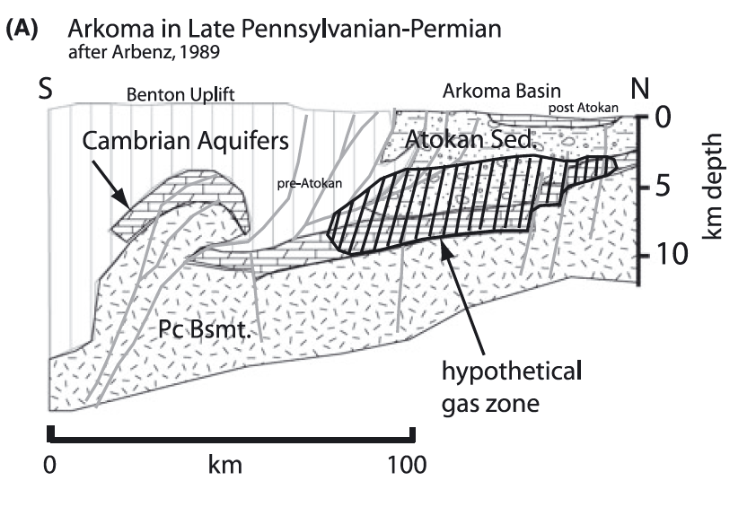
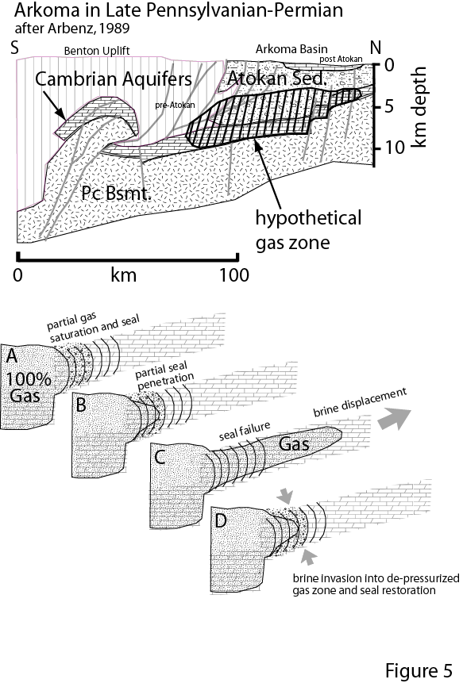
Shosa Seal implications…
Shosa Seals are very dynamic: Gas pulsars
MVT geological context…
seal requires 2 phases
seal disappears if just 1
[6,7]

Slide 24
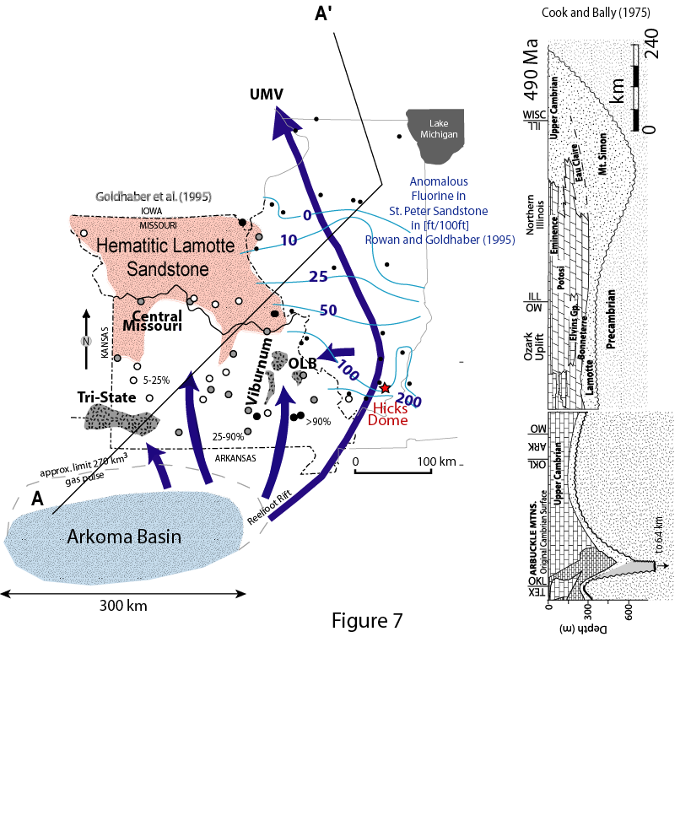
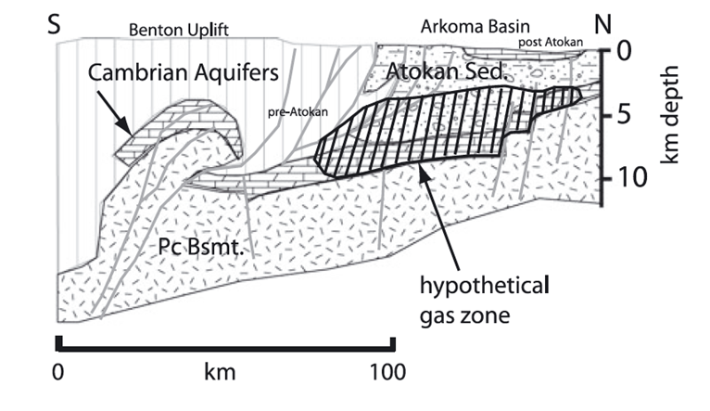
Shosa Seal implications…
[6,7]

Slide 25
Shosa Seal implications…
MVT deposits formed from repeated failure of Shosa Seals containing Arkoma Basin gas
270 km³ gas pulse displaced brines which
Escaped to surface through all passageways
Reduced hematitic Lamotte SS
Produced F zoning
Re-magnetized mid-continent
[7]

Slide 26
Fundamentals
… do fluids control fundamental properties of the crust
…understanding channeling
…seismically imaging premeability

Slide 27
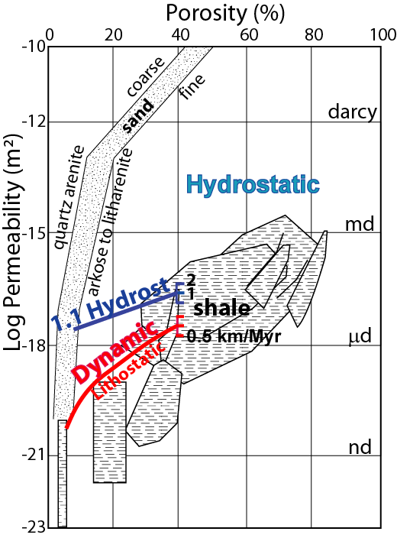
Dynamic permeability
Subsidence and compaction set the permeability of fine-grained sediments
[6]

Slide 28
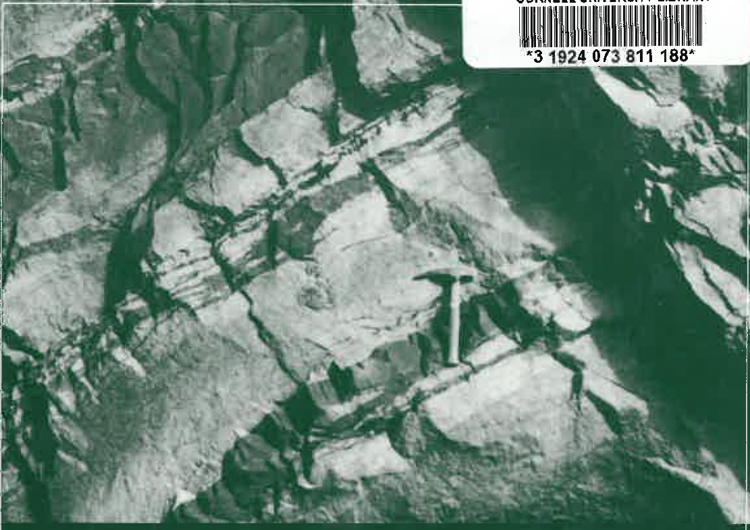
Scale Invariance of geology
Front cover “Fractals in the Earth Sciences” Barton and La Pointe Eds
[20]

Slide 29
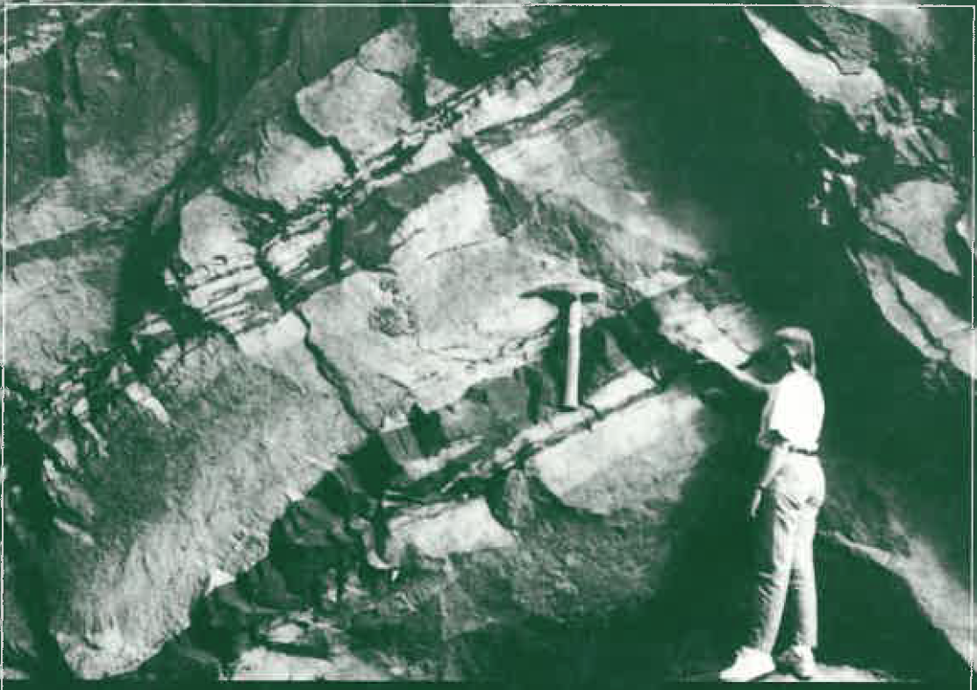
Scale Invariance of geology
[20]

Slide 30
The critical crust
Short-circuiting requires wide spread and pink distribution of k
Spread of k about its mean
= α
permeability
porosity
Spatial distribution of k
β=0 white noise
β=1 pink noise
β=2 red noise
Scale invariant
Critical point of crust
Like opalescence at critical point of CO₂
Could fluids cause scale invariace?
Could fluids make the k suitable for their escape?
Malin, Leary et al., 2020
[21]

Slide 31
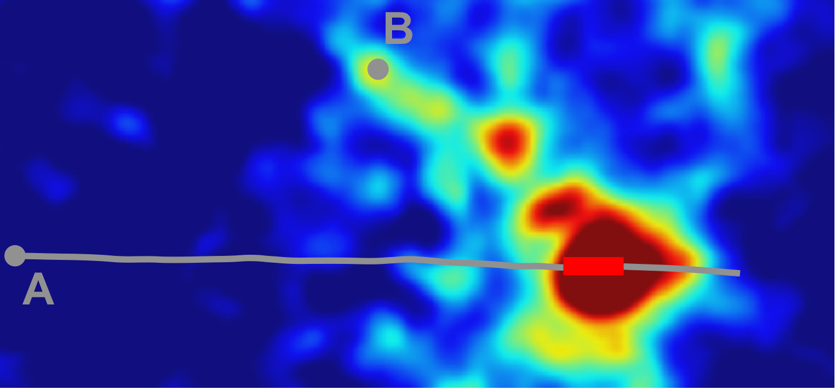
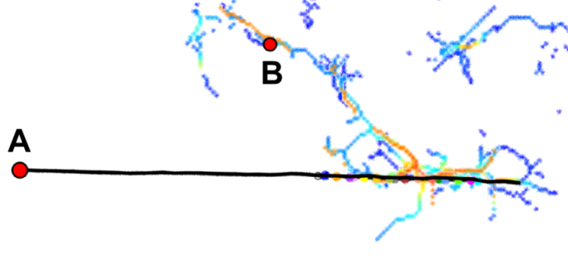
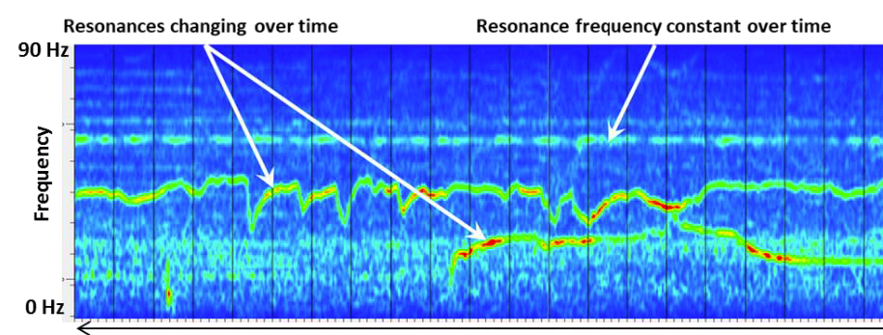
Fracture seismic imaging of permeability
mostly?
Ambient resonances are seismic Krauklis waves trapped on sides of fluid-filled fractures
Fracture Seismic emissions intensity
h
l
= shear modulus solid
= harmonic
harmonics
, k= 1, 2, 3,…
FS Backbone
= v_{s}/v_{p} in solid
= fluid density
From Lacazette et al. (2013)
2000 ft well A to well B flow path confirmed by pressure and tracer communication
2 minutes
[22-25]
Tary et al, JGR, 2014a,b
Sicking et al., 2019

Slide 32
Conclusions
Large Scale
Dynamic
Non-linear
Channelized
Shosa Seals
Lots of data
Lots of clues
Lots new
Lots to figure out
Interesting and important (resources)
Possibly fundamental
What is there not to like about sedimentary basins?

Slide 33
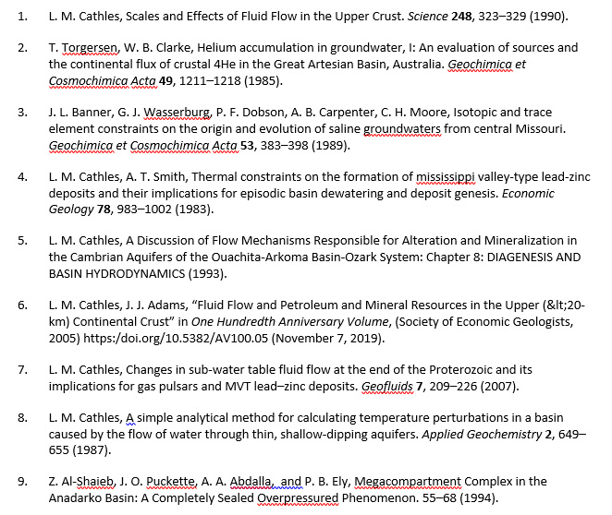
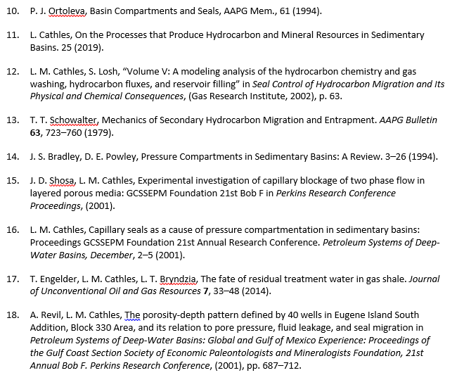
References

Slide 34
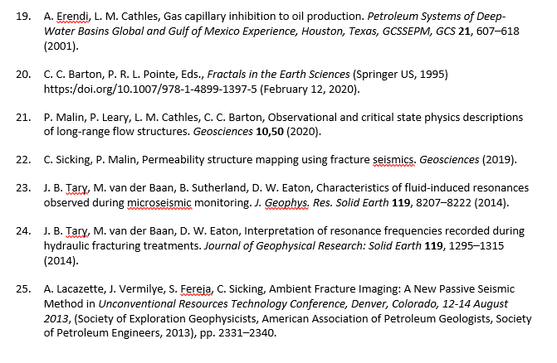
References Continued

