Slide 1
What IOCG deposits tell us about crustal intrusion and alteration
L. M. Cathles & Maria Rodriguez-Mustafa
Presentation to T006: Dynamic interactions between structure, fluids and geochemistry
Annual meeting of the American Geophysical Union
December 14, 2016
San Francisco

Slide 2
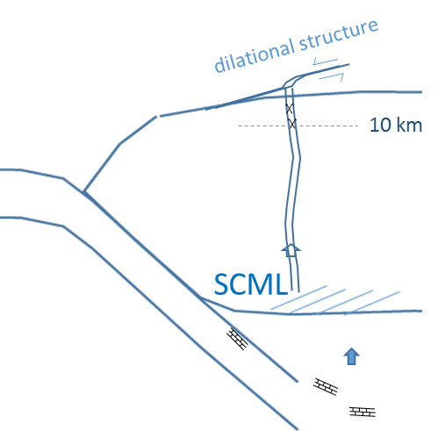
IOCG deposits tell of flow from SCML
Sub-continental mantle lithosphere
Story of CO₂ cycling
Gas prepares path for later magmas
Phase separation alters and deposits metals
Are volatiles magma pathfinders?
Giant deposit Cu, Au, U, Ba, F, LREE
Form surface to >10 km
100s km² Na alt. requiring 500 km³ brine
All ages (Archean to present)
Sourced from SCLM fertilized by subduction
Stru. control (bdry cratons) and bx
Metals from UB to B magmas and crust
In active intrusive province (not assoc w/ intr)
Don’t have to be near current subduction
(100-200 ma post supercontinent assembly)
Can form wherever SCLM not delaminated
bx
Na alt.
Phase separation
Na alteration
Au, Cu deposition
basalt
>80 km
H₂O-CO₂
sc fluid
Carbonate rich
silicic melt

Slide 3
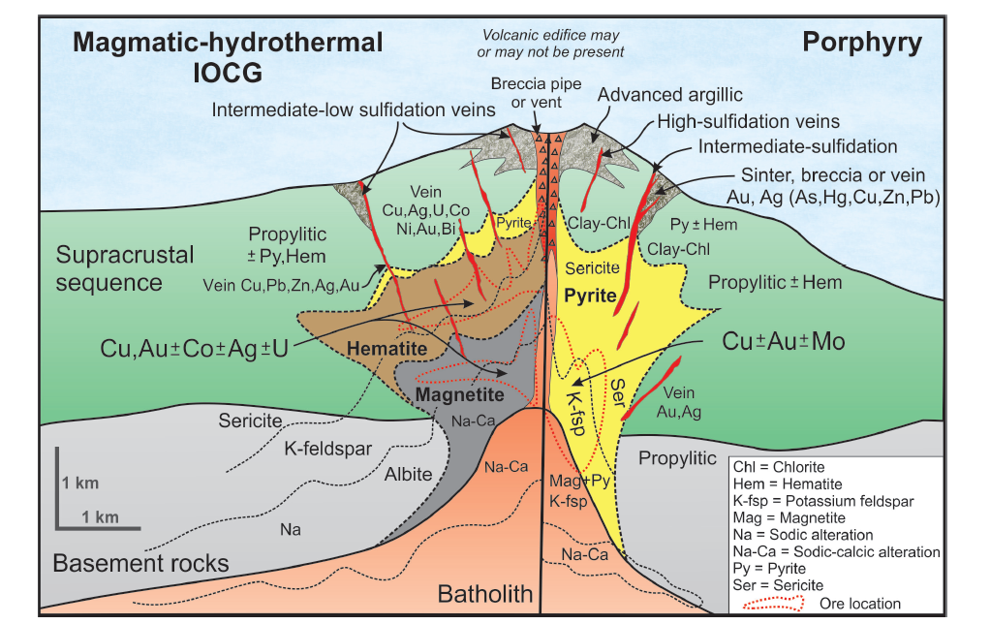
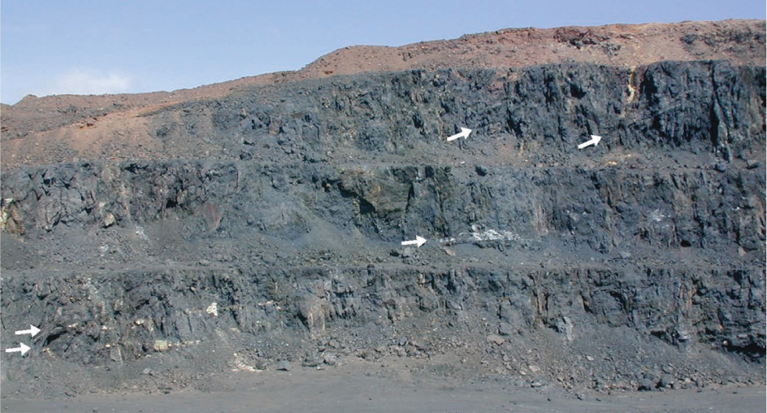
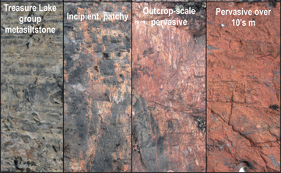
IOCG deposits
Magnetite “flows”, El Laco, Atacama
Iron Oxide Copper Gold
Maria Rodrigues Mustafa
Irene del Real
Chris Siron
John Thompson
Like porphyry copper deposits, but different
Pink stones
0-10 km depth
~5km depth
Pseudomorphic replacement
Sodic alteration transforming the Treasure Lake Group metasiltstone into a rhyolite-looking albitite in the Southern Breccia system (southern GBmz).
Richards and Mumin (2013)
600°C
Extensive sodic alteration
Iron oxide copper-gold (IOCG) systems are characterized by a wide range of hydrothermal alteration types that can indiscriminately and intensively replace their host rocks over areas of > 100 km²
Montreuil et al. (2016)
link

Slide 4
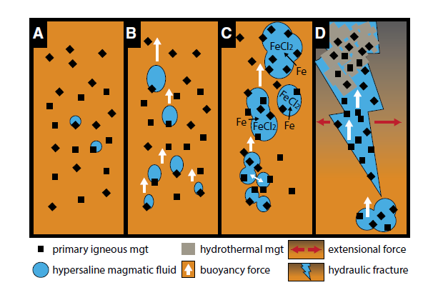
Deep phase chemistry
Carbonate -> mantle produced carbonate melt.
Heating or unroofing releases SC H₂0-CO₂ fluid,
which can migrate through crust if structures allow.
dilational structure
3. phase separate
10 km
H₂O + CO₂
U, W
2. CO₂-rich fluid
SCML
2-2.4 GPa
88 km
Lowenstein (2001)
LREE
1. Carbonate-rich melt
First liquidus phase
Magnetite floated by H₂O-CO₂
Knipping et al. (2015)
Frezzotti and Touret (2014)
Granitoids and granulites

Slide 5
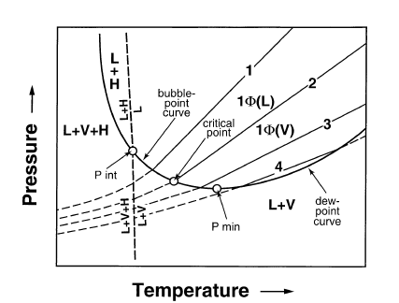
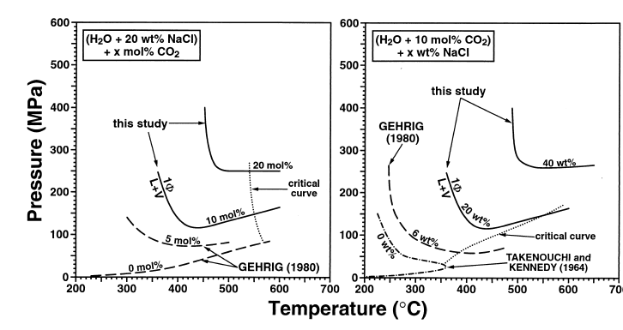
Phase separation, Na alteration, metal deposition at ~10 km
General phase diagram
10 km
Critical point diagram
One phase
Critical curve
Gas-like
Liquid-like
Decreasing CO₂
Decr. Salin.
3 km
20 wt% NaCl
10 mol% CO₂
20 mol% CO₂
20 wt% NaCl
10 mol% CO₂
40 wt% NaCl
Salt, CO₂ drive 1 phase region to higher P, T
Phase separation wide range depths
Ligands -> vapor phase, brine precipitates Au, Cu
Phase separation produces Na alt
(Na/(Na+K) 0.96 SC → 0.79 brine)
250 MPa
9.4 km lith.
Decr. Salin.
Decr. CO₂
Schmidt and Bodnar (2000)
600°C
Pollard (2001)

Slide 6
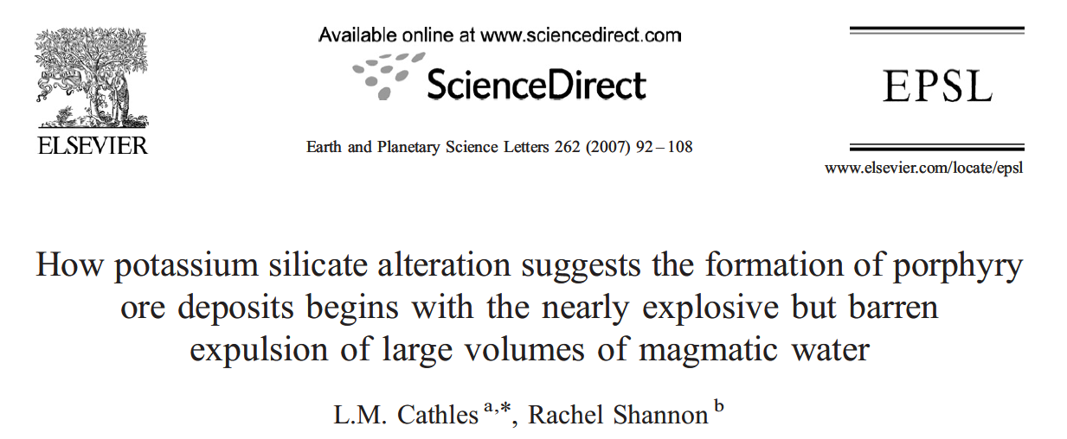
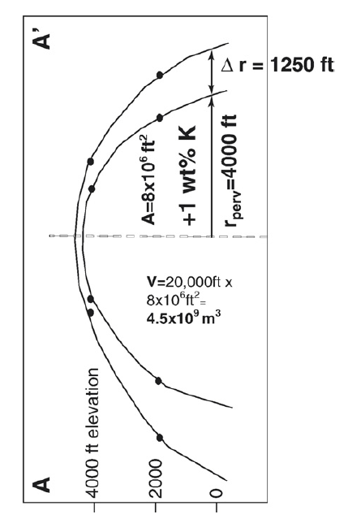
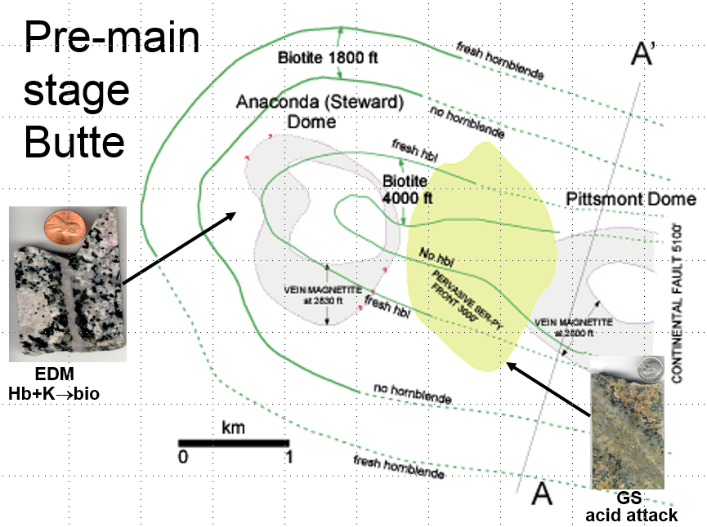
Large fluid volumes released
Mt Isa Cloncurry system
180 km³ altered rock
2.7 m³ _{fluid} /m³_{alt rk}
486 km³ brine
Butte, Montana
4.5 km³ altered rock
22 m³ _{fluid} /m³_{alt rk}
100 km³ magmatic water
Pollard (2001)
Cathles and Shannon (2007)
~ 1 yr flow of Mississippi
barely contained explosion
Candelaria, Chile
12.7 km³ altered rock
2.7 m³ _{fluid} /m³_{alt rk}
35 km³ brine
~600°C early potassic alteration

Slide 7
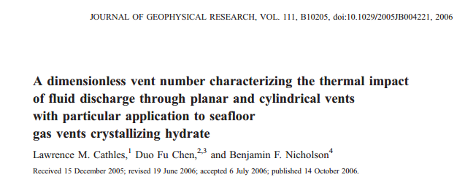
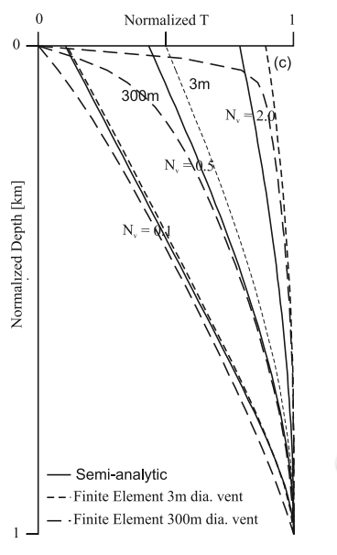
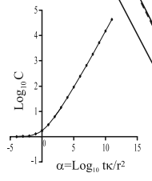
Volatiles overcome freezing problem
Vertical conduction
T
isothermal
d
T
isothermal
q_{z}
N_{v} approx.
Numerical confirmation
α= Log₁₀ tκ/r², log₁₀ C = 0.2734+0.2068α+0.0316α²-0.0013α³
Cathles et al. (2006)

Slide 8
Easy to carry down carbonate and keep cold
7 cm/y @ 45°
q_{z} =(0.035 m y⁻¹)(2700 kg m⁻³)
= 95 kg m⁻² y⁻¹
t=100,000m/0.035m y⁻¹ = 2.9 my
κ=~10⁻⁶ m² s⁻¹
c_{f} = 837 J kg⁻¹ K⁻¹
K = 2 W m⁻¹ K⁻¹
d= 100 km
W= 30 km
K = 2 W m⁻¹ K⁻¹

Slide 9
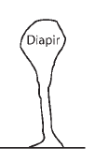
Challenging to intrude entire crust
2 km
t = transit time
cylindrical correction
Ascent[m y⁻¹] | t[y] | C | N_{v}
10 | 3,000 | 1.24 | 2.6
1 | 30,000 | 1.85 | 0.56
0.1 | 300,000 | 3.19 | 0.10
d=30 km
Only fastest ascent rates suffice
Easier if:
Intrusion very fast
Dike-like
intrude short distance
Intrusions wider
~0.01 to 10 m y⁻¹ ascent rates
Zellmer and Allen (2008)

Slide 10
Challenging to intrude long dikes
t = transit time
 | D=30 km |  |  | d=1 km
v[m d⁻¹] | t=d/v | N_{v} (W=1m) | Nv (W=0.1m) | t[d]=d/v | Nv (W=0.1m)
10⁴ | 6 days | 2.3 | 0.23 | 0.1 days | 1.25
10³ | 60 days | 0.72 | 0.072 | 1 days | 0.40
10² | 600 days | 0.23 | 0.023 | 10 days | 0.125
d= 30 km
or
1 km
Only fastest ascent rates suffice
transit time = d/v
Easier if:
Velocity very fast
dikes wide (1 m)
Intrude short distance
v = ~0.01 to 10⁴ m days⁻¹ magma transfer rates
Zellmer and Allen (2008)

Slide 11
Volatiles could be magma pathfinders because not constrained by freezing
IOCG deposits support this idea:
Vent whenever fault movement.
This warms channel.
Facilitates magma utilization.
Repeated pulses produce complex geology.
Lithosphere-scale process.
Phase separation
basalt
But raise many questions:
H₂O-CO₂ fluid
How can rapidly release of 600°C fluids
..in pulses?
Do magmas proceed in order of fluidity?
Capillary effects?
Exploration implications?
Carbonate rich silicic melt

Slide 12
References
Cathles, L, and R Shannon. 2007. “How Potassium Silicate Alteration Suggests the Formation of Porphyry Ore Deposits Begins with the Nearly Explosive but Barren Expulsion of Large Volumes of Magmatic Water.” Earth and Planetary Science Letters 262 (1–2): 92–108. doi:10.1016/j.epsl.2007.07.029.
Cathles, Lawrence M., Duo Fu Chen, and Benjamin F. Nicholson. 2006. “A Dimensionless Vent Number Characterizing the Thermal Impact of Fluid Discharge through Planar and Cylindrical Vents with Particular Application to Seafloor Gas Vents Crystallizing Hydrate.” Journal of Geophysical Research: Solid Earth 111 (B10): B10205. doi:10.1029/2005JB004221.
Frezzotti, Maria-Luce, and Jacques L.R. Touret. 2014. “CO2, Carbonate-Rich Melts, and Brines in the Mantle.” Geoscience Frontiers 5 (5): 697–710. doi:10.1016/j.gsf.2014.03.014.
Groves, David I., Frank P. Bierlein, Lawrence D. Meinert, and Murray W. Hitzman. 2010. “Iron Oxide Copper-Gold (IOCG) Deposits through Earth History: Implications for Origin, Lithospheric Setting, and Distinction from Other Epigenetic Iron Oxide Deposits.” Economic Geology 105 (3): 641–654.
Knipping, J. L., L. D. Bilenker, A. C. Simon, M. Reich, F. Barra, A. P. Deditius, C. Lundstrom, I. Bindeman, and R. Munizaga. 2015. “Giant Kiruna-Type Deposits Form by Efficient Flotation of Magmatic Magnetite Suspensions.” Geology 43 (7): 591–94. doi:10.1130/G36650.1.
Lowenstern, Jacob. 2001. “Carbon Dioxide in Magmas and Implications for Hydrothermal Systems.” Mineralium Deposita 36 (6): 490–502. doi:10.1007/s001260100185.
Montreuil, J.-F., L. Corriveau, and E. C. Grunsky. 2013. “Compositional Data Analysis of Hydrothermal Alteration in IOCG Systems, Great Bear Magmatic Zone, Canada: To Each Alteration Type Its Own Geochemical Signature.” Geochemistry: Exploration, Environment, Analysis 13 (4): 229–47. doi:10.1144/geochem2011-101.
Pollard, Peter J. 2001. “Sodic (–calcic) Alteration in Fe-oxide–Cu–Au Districts: An Origin via Unmixing of Magmatic H2O–CO2–NaCl$\pm$CaCl2–KCl Fluids.” Mineralium Deposita 36 (1): 93–100.
Richards, Jeremy P., and A. Hamid Mumin. 2013. “Magmatic-Hydrothermal Processes within an Evolving Earth: Iron Oxide-Copper-Gold and Porphyry Cu ± Mo ± Au Deposits.” Geology 41 (7): 767–70. doi:10.1130/G34275.1.
Schmidt, C, and R. J Bodnar. 2000. “Synthetic Fluid Inclusions: XVI. PVTX Properties in the System H2O-NaCl-CO2 at Elevated Temperatures, Pressures, and Salinities.” Geochimica et Cosmochimica Acta 64 (22): 3853–69. doi:10.1016/S0016-7037(00)00471-3.
Smith, M.P., S.A. Gleeson, and B.W.D. Yardley. 2013. “Hydrothermal Fluid Evolution and Metal Transport in the Kiruna District, Sweden: Contrasting Metal Behaviour in Aqueous and Aqueous–carbonic Brines.” Geochimica et Cosmochimica Acta 102 (February): 89–112. doi:10.1016/j.gca.2012.10.015.
Zellmer, Georg F., and Catherine Annen. 2008. “An Introduction to Magma Dynamics.” Geological Society, London, Special Publications 304 (1): 1–13. doi:10.1144/SP304.1.

